Slide 1
The impact of digital transformations across industries and global value chains
Margherita Russo
margherita.russo@unimore.it
EU-China Social Protection Reform Project | C1-Training in Italy
Effects and Tendency of Income Redistribution Policy

Slide 2
Outline
Research questions
What do we mean by “digital transformation”?
How do digital transformations emerge?
How do they percolate in /enhance/change the working of the economy and society?
→ Focus on cross sector interrelations
  Interrelations matter because they mark the pace of changes within the many subsystems (energy, transport, industry, public administration, …) in the sociotechnical & economic systems
Case studies to frame the concepts on digital transformation and on its impact
  Big data in Japan
  Industry 4.0 in Italy
  Automotive supply chain in China, Germany, Italy
Summing up and discussion

Slide 3
What do we mean by “digital transformation”? digital transformation_the internet economy
  "the full range of our economic, social and cultural activities
  supported by the internet and related information and communication technologies (ICT)"
  OCSE 2008

Slide 4
Digital transformation
the transformation of the economy and society brought about by the use of information technologies
  they affect practically all sectors of the economy
the digital economy has become a common term used in both the political and academic spheres, but there is no universally accepted definition
The Internet economy is often used as a synonym for the digital economy, although its scope is narrower.

Slide 5
Industry 4.0
Implementation of digital technologies in industrial production systems and increasing automation and connectivity in production.
The term was first used by the German government in 2012 and refers to a strategy aimed at digitizing the German manufacturing sector (BMBF, 2015).
The "four" in industry 4.0 refer to the "fourth industrial revolution" or the "next production revolution".
The three previous industrial revolutions refer to the changes brought about by hydropower and steam power, electricity and automation respectively (Davies, 2015; Schwab, 2016)

Slide 6
Industry 4.0
  "Industry 4.0" has been adopted by governments and industry to refer to
  the development of "smart factories"
  greater flexibility
  large-scale customization
  speed and autonomy in production collection of large amounts of data
  significant reduction in costs by increasing efficiency
  reducing the duration of innovation cycles

Slide 7
Industry 4.0: the main technology drivers i)
DIGITAL TECHNOLOGIES
enable communication between machines, products and people in cyber and physical systems (CPS)
exchanges of matter, energy, information
incorporate data flows and calculations into physical environments and processes (e.g. manufacturing processes).
How?
via radio frequency identification (RFID): a chip devices (size of a grain of rice)
RFID technology
is related to the products
is able to transfer data through cloud systems to data centers
→ that evaluate information and communicate with machines,
other products and people.
a new level of synchronization of production processes
monitoring of product data in real time

Slide 8
Industry 4.0: the main technology drivers ii)
ARTIFICIAL INTELLIGENCE
allows production systems to go further:
by automatically optimizing them
predicting machine failures
and simulating new production and product innovations

Slide 9
Effects of the Fourth Industrial Revolution
"the "next production revolution"
involves a range of technologies
digital technologies (e.g. 3D printing, Internet of Things, advanced robotics)
new materials (e.g. bio or nanotechnology)
new processes (e.g. data-based production, artificial intelligence, synthetic biology)
has an impact on the production and distribution of goods and services in virtually all sectors
is expected to have far-reaching consequences on
productivity
capabilities
income distribution
wealth
environment.

Slide 10
State-of-play of digital transformation developments and devices embedded in Industry 4.0
Internet of Things connecting devices
Artificial intelligence Machine Learning, Simulation, Augmented reality
Robotics in production and logistics
Additive manufacturing solutions 3D printers, flexibility: prototypes, small batches
Human-machine integration
Mobile services and technologies integration in the working environment
RFID data transfer without physical contact
All-time localization through sensors and data transfer
Big Data → Smart Data: analytics converting big data in smart data
Cloud computing services providing platform for worldwide access

Slide 11
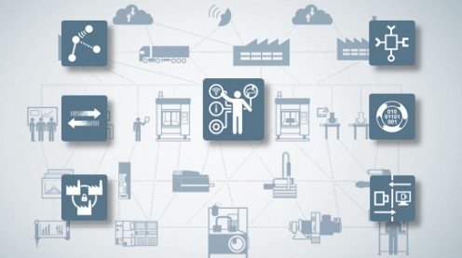
Smart manufacturing in Industry 4.0
https://www.boschrexroth.com/en/xc/trends-and-topics/industry-4-0/internet-of-things/internet-of-things-1?gclid=CjwKCAjw85zdBRB6EiwAov3RioYZ1V7rN4KhUYu5eOu7gTld-E2neh5YsZVTi7WBWFaBI_fpW8RIhBoChykQAvD_BwE

Slide 12
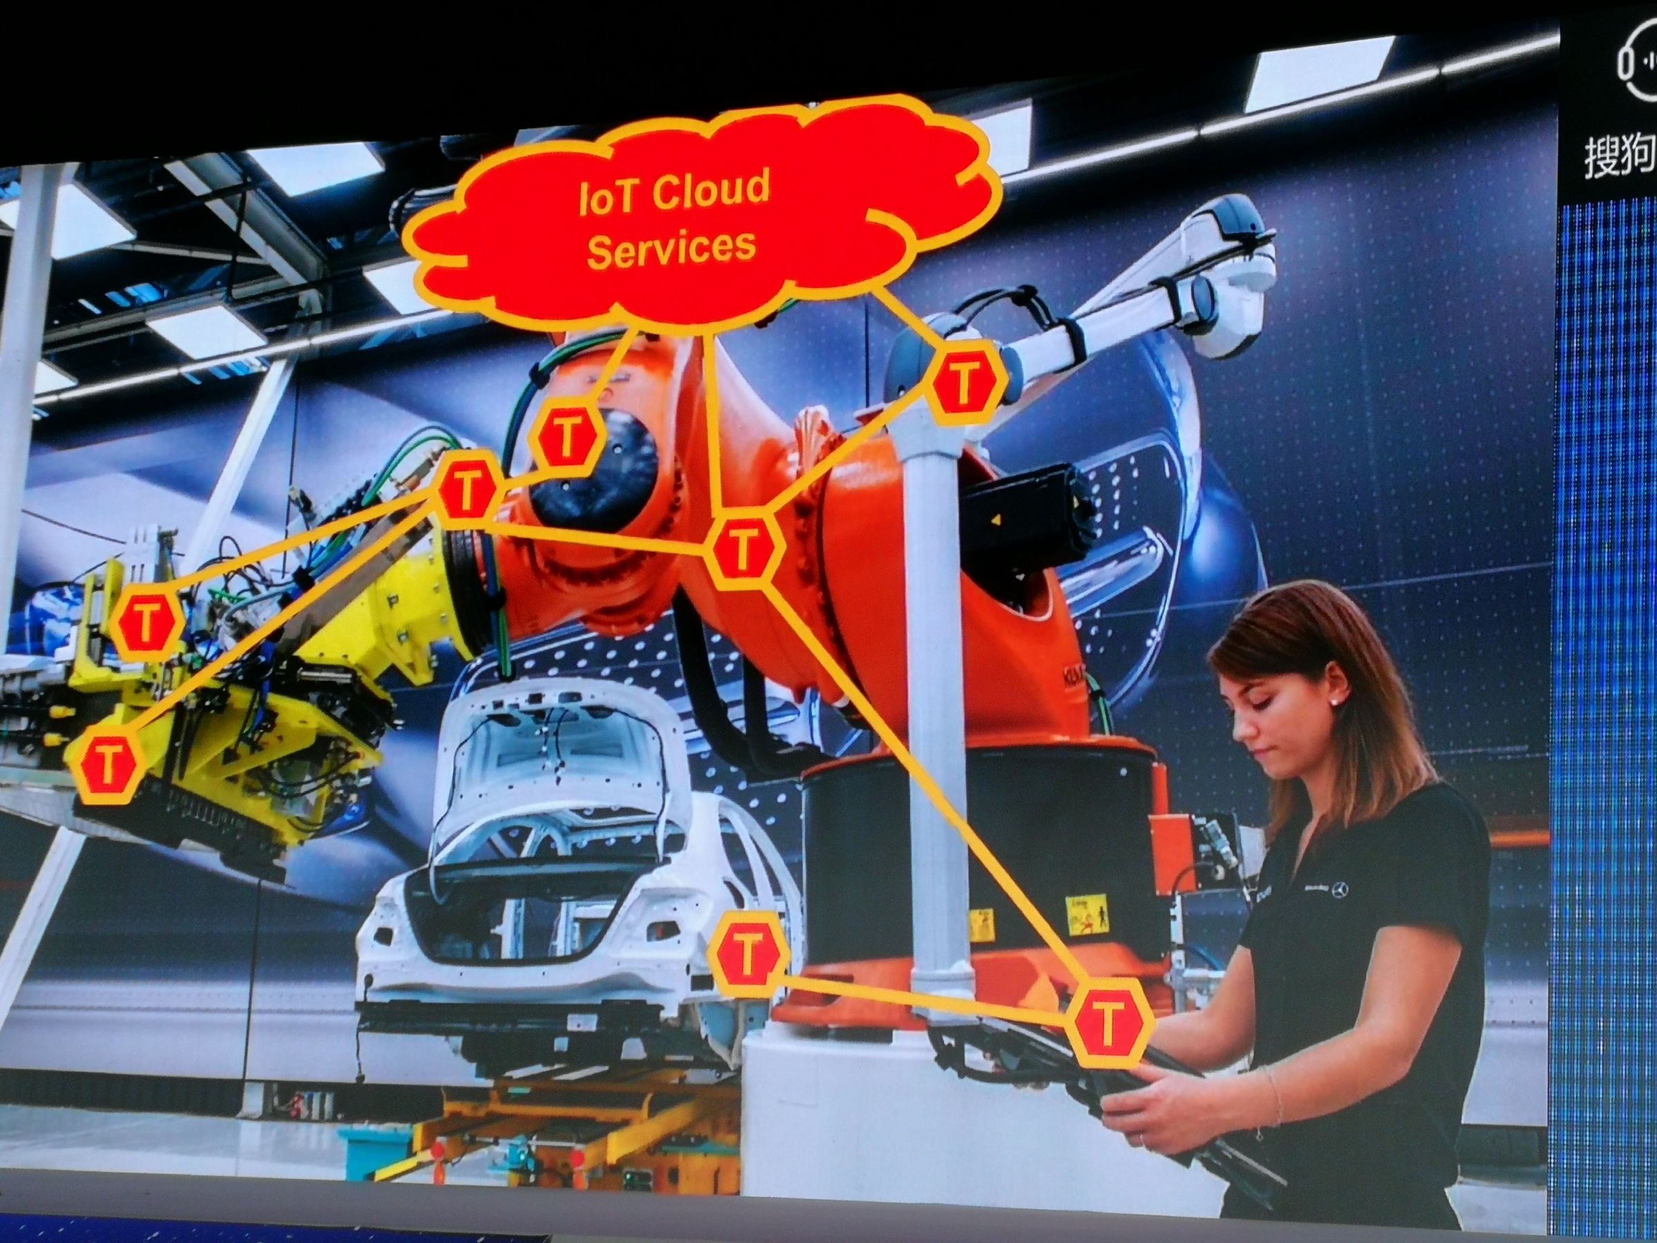
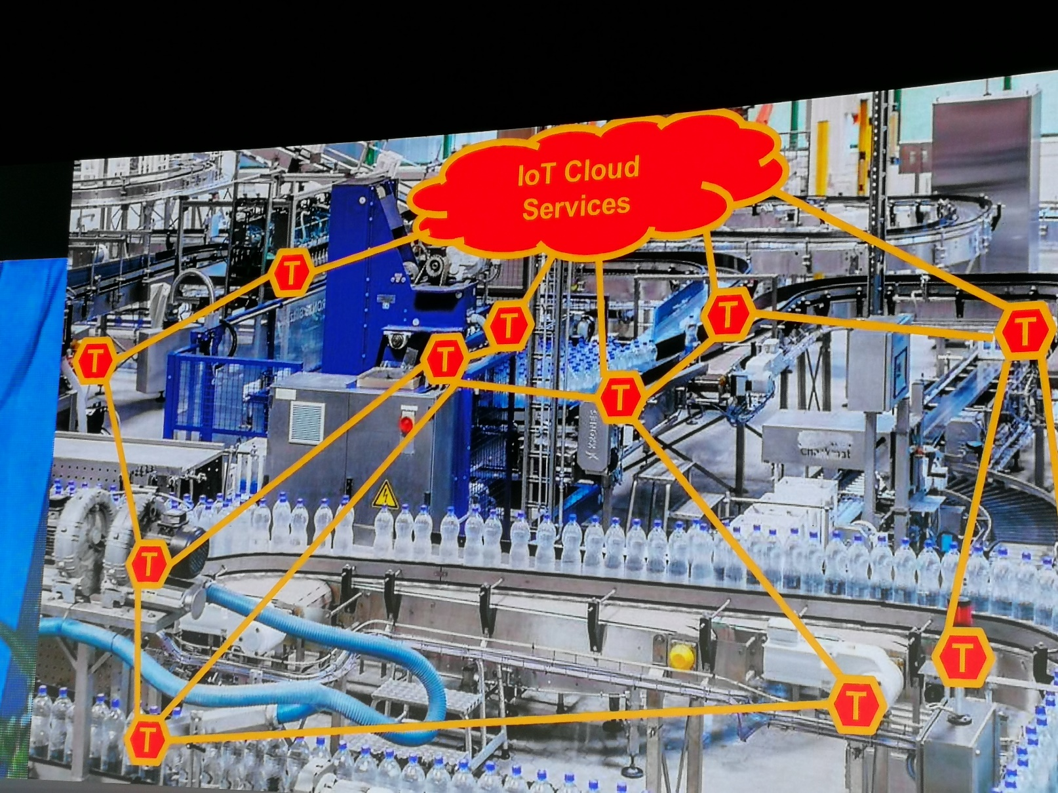

Slide 13
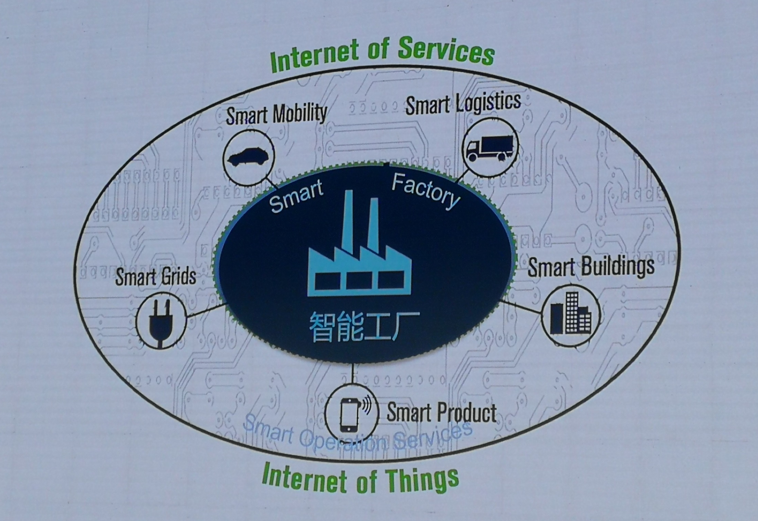
Smart manufacturing in Industry 4.0
Smart Factory
Source: Uszkoreit on I4.0, GAITC 2018, Beijing

Slide 14
Smart manufacturing in Industry 4.0
Cyberphiscal systems: sensors, actuators, processors connected by IoT
Digital Twin: digital model of product (or part) with hostory/memory
Flexible product-driven configuration of production
Intelligent automation: robots collaborating woth robots and people
AI-based optimisation of processes: predictive resources utilisation
Source: author elaboration on Uszkoreit on I4.0, GAITC 2018, Beijing

Slide 15
Smart manufacturing in Industry 4.0 multilayers actors, technologies, devices
customers
service partners
media
suppliers
Smart Operation Services
Smart Factory
investors
regulators
competitors
technology providers
Source: author elaboration on Uszkoreit on I4.0, GAITC 2018, Beijing

Slide 16
Smart manufacturing in Industry 4.0 multilayers actors, technologies, devices
customers
service partners
Smart Manufacturing Support Services
media
suppliers
Smart Operation Services
Smart Factory
investors
regulators
competitors
technology providers
Source: author elaboration on Uszkoreit on I4.0, GAITC 2018, Beijing

Slide 17
Smart manufacturing in Industry 4.0 multilayers actors, technologies, devices
customers
PM Project management
service partners
CRM Customer Relationship Management
market research
Smart Manufacturing Support Services
media
suppliers
Smart Operation Services
IRM Information rights management
SCM Supply Chain Management
Smart Factory
investors
regulators
technology scouting
competitors
technology providers
Source: author elaboration on Uszkoreit on I4.0, GAITC 2018, Beijing
Notes:
NB https://searchcontentmanagement.techtarget.com/definition/information-rights-management-IRM
Information rights management (IRM) is a discipline that involves managing, controlling and securing content from unwanted access.
IRM is a subset of digital rights management (DRM), which protects multimedia content, including video and music. While DRM focuses on protecting intellectual property from patent infringement and piracy, IRM focuses on protecting sensitive data, especially data that is exchanged with parties outside an organization (suppliers and partners, for example).

Slide 18
digital transformation_ digital start-ups multilayers actors, technologies, devices
  place on the market
  a new product
  an additional product
  a digital service
  transform existing commercial activities into digital ones
  for example,
  the adoption of digital technologies to increase the efficiency
  or convenience of a product or service
  or to allow the introduction of new functionalities

Slide 19
digital transformation_ digital platforms multilayers actors, technologies, devices
  The case of Vodafone
  use of technological infrastructure (internet connections)
  to supply a new service: data analytics

Slide 20
How do they percolate in/enhance/change the working of the economy?
Case studies
Big data in Japan
Industry 4.0 in Italy
Automotive supply chain: Germany, China and Italy

Slide 21
Big data in Japan: survey
Research Institute of Economy, Trade and Industry | Motohashi 2017
539 interviews
topics
organization in the use of big data by enterprises
collection and use by enterprises of big data, by type of data
use of data outside enterprises
production process: three macro-activities
design and development
manufacturing
after-sales services

Slide 22
Big data in Japan: types of data & sw applications
Research Institute of Economy, Trade and Industry | Motohashi 2017
Computer Aided Design/Manufacturing; computer aided engineering, simulazione, Product life cycle management
Customer Relationship Management
Manufacturing Extension System
Supply Chain Management
Enterprise Resources Planning
Types of data (data generated in the commercial activity with customers and suppliers; data generated within the company)
Name of the sw application
Internal/external to the company

Slide 23
Big data in Japan: highlights
Research Institute of Economy, Trade and Industry | Motohashi 2017
Highlights on:
generation and use of data in each process
use of data between activities (e.g. development uses data collected from production)
collaboration with other companies in the use of data (suppliers and customers)
management structure for the use of data
the presence or absence of a specialised department to promote the use of big data
human resources needed for the use of data in the departments barriers to the use of data
their effect on the performance of companies

Slide 24
Big data in Japan: main results
Research Institute of Economy, Trade and Industry | Motohashi 2017
are widely used in all activities
companies with a big data function are more likely to use them in various departments, which improves their performance.
BUT
great disparity in terms of style of use depending on the size of the company
more than half of small and medium-sized enterprises responded that they had heard of the Internet of Things, but do not know how they could use this technology
  Policy implications
  promoting the dissemination of the use of large data, in particular for SMEs
  support for the development of human capital for the use of big data
  strategic standardisation activities for the Internet of Things

Slide 25
Industry 4.0_Italy_results of a national survey
Brancati and Maresca 2018 on MISE
Significant diffusion:
  greater in larger companies, but with a very high presence also in SMEs
Involved more than 20% of companies from 10 employees upwards, almost 50% of large companies
Very high expected diffusion among SMEs in the next two years
(also in the South)
Different technologies, and different objectives
  - Large companies: efficiency (even at the expense of employment)
  - SMEs: new business models and quality improvements
4.0 companies are of excellence, but the median values have small size (7 employees), critical feature: quality of the managerial factor
(strong incidence of training and external relations).
Close link with innovative strategies and research.

Slide 26
Industry 4.0_Italy_current and future diffusion, by firms’ size
Brancati and Maresca 2018 on MISE, fig.1.4 and fig 1.7
Current diffusion of technologies 4.0
by size of employees
Total, top axis, by size class, bottom axis
Interventions in the next three years
by size of employees
Total, top axis, by size class, bottom axis
% 0,0 0.5 1.0 1.5 2.0 2.5 3.0 3.5 4.0 4.5
% 0,0 0.5 1.0 1.5 2.0 2.5 3.0 3.5 4.0 4.5
Cyber security
Horizontal integration of information
Vertical integration of information
Cloud computing
Big data/analyitcs
IoT
Collaborative robots
3D printers
Simulation
Smart material
Augmented reality
0% 5% 10% 15% 20% 25% 30% 35%
0% 2% 4% 6% 8% 10% 12% 14% 16%
Total
Classes of employees
and over
Source:MISE & MET at http://www.sviluppoeconomico.gov.it/images/stories/documenti/Rapporto-MiSE-MetI40.pdf

Slide 27
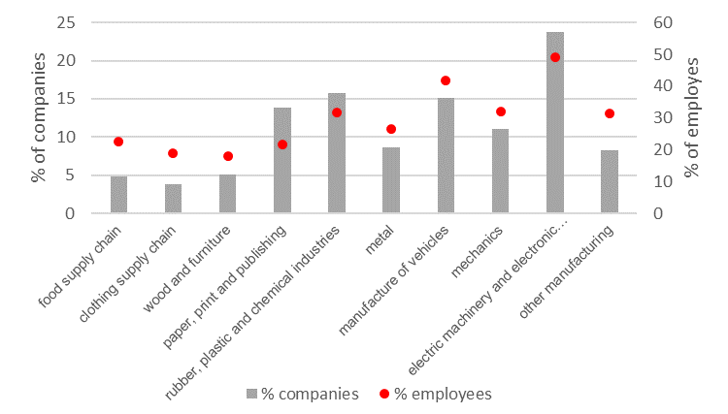
Industry 4.0_Italy_current diffusion of technologies, by industry
Brancati and Maresca 2018 on MISE, fig. 2.2
% of companies, left axis, % of employees, right axis
do paces of change across industries matter?
Source:MISE & MET at http://www.sviluppoeconomico.gov.it/images/stories/documenti/Rapporto-MiSE-MetI40.pdf

Slide 28
State-of-play of digital transformation in the automotive supply chain: Germany, China and Italy
Which are the paces of change in the SCs?
Sources:
Automotive Observatory 2018
Bosh Chair of Global Supply Chain Management, 2018

Slide 29
State-of-play of digital transformation in the automotive supply chain: Germany, China and Italy
Cloud computing services providing platform for worldwide access
Mobile services and technologies integration in the working environment
RFID data transfer without physical contact
Big Data → Smart Data: analytics converting big data in smart data
All-time localization through sensors and data transfer
Robotics in production and logistics
Internet of Things connecting devices
Additive manufacturing solutions 3D printers, flexibility: prototypes, small batches
Augmented reality
Simulation

Slide 30
Key facts on digital transformation: policies
Germany has key players in the OEM in Europe and at word level (BMW, Volkswagen, )
Industry 4.0: from Automation and Robotics to Cyber Physical Systems
China has a huge and expanding domestic market
National policy: “Made in China 2025” guideline, tasks, target industries)
Many Chinese companies are still on the way of Industry 3.0
Lagging behind (in some fields) and stepping forward (in other domains): Chinese suppliers are important for the European car makers
Italy has a long tradition as supplier of European and US carmakers
National policy on Industry 4.0, incentives to support investment in physical assets for I-4.0 and to competences
SMEs
Different opportunities and level of upgrade in the SC

Slide 31
Should we care of what is going on in China?
Yes, for at least three reasons

Slide 32
1_scalability of experiments in many alternative technologies i)
The size of Chinese domestic market (if not the ones of the African countries) opens to scalability of experiments in many alternative technologies
Which experiments?
The one on alternative techniques to produce energy.
China plans to focus mainly on
  batteries and
  on energy produced in nuclear plants (other renewable energy sources)
This matters because: technologies improve their performance
  in a cumulative way
  within socio-technical systems of complementary technologies
  by patterns of user-producer interactions

Slide 33
1_scalability of experiments in many alternative technologies ii)
lock-in conditions affect path-dependence and hence what results to be the most efficient technology could have been crowded out by other technologies, if their implementation would have been exploited enough
policy makers should leave many doors open for the emergence of complementary technologies or improvements derived by learning and scalability
but China has already closed many doors
the combined conditions of very large scale of production and domestic adoption might reduce the possibility of more effective alternatives, such as hydrogen fuel cells, and the decentralized small scale production of hydrogen (among the ones now on the stage)

Slide 34
2_quality of digitalization
The quality of digitalization in the automotive supply chain in China will impact on EU vehicles:
  critical issue of standards and effective control

Slide 35
3_China-Italy-France: a network of competence with remote control→learning i)
The case of an Italian company
who leads in the segment of modular and redundant Uninterruptible Power Supplies (more than 600 employees)
European leader in the production of telematics system for remote control of vehicles (great impact on insurance)
acquired by the Chinese company, Deren Electronics, aiming at become world leader in connectivity, extending to multiple product lines in automotive platforms
  Increased employment in Italy
  Long term project of growth
a new plant in Chongqing Industrial Park (OEM: Porsche, BMW, Volkswagen, PSA)
  investment project: Deren
  long term contract: PSA
  designed and controlled, in remote, by the Italian subsidiary

Slide 36
3_China-Italy-France: a network of competence with remote control→learning ii)
Feedback on local competences in Italy
from design and remote control of such a plant
Impact on local competences in China
with regard to the strong link within that network of competences
Feedback on competence network in the three countries and in related business activities

Slide 37
Summing and discussion
→ The many interrelated dimensions of the ongoing digital transformation
The new emerging actors
The new competences and skills
The new opportunities for mutual learning

Slide 38
Sources of data
Brancati, Raffaele, and Andrea Maresca. 2018. ‘Rapporto-MiSE-Met-I40_Slide.Pdf’. Accessed 12 September 2018. http://www.sviluppoeconomico.gov.it/images/stories/documenti/Rapporto-MiSE-Met-I40_Slide.pdf.
Cabigiosu, Anna. 2018. ‘Industria 4.0: Diffusione, Applicazioni e Rischi Nel Settore Auto’. 2018. In Osservatorio Componentistica Auto 2018, edited by Anna Moretti and Francesco Zirpoli, Ca’ Foscari. Venezia.
Bosh Chair of Global Supply Chain Management, 2018, reserved communication
Liao, Yongxin, Fernando Deschamps, Eduardo de Freitas Rocha Loures, and Luiz Felipe Pierin Ramos. 2017. ‘Past, Present and Future of Industry 4.0 - a Systematic Literature Review and Research Agenda Proposal’. International Journal of Production Research 55 (12): 3609–29. https://doi.org/10.1080/00207543.2017.1308576.​
Ministero dello sviluppo economico. 2018. ‘La diffusione delle imprese 4.0 e le politiche: evidenze 2017’. http://www.sviluppoeconomico.gov.it/images/stories/documenti/Rapporto-MiSE-MetI40.pdf.
Motohashi, Kazuyuki. 2017. ‘Survey of Big Data Use and Innovation in Japanese Manufacturing Firms’. RIETI Policy Discussion Paper Series, XX-P-00X. http://www.rieti.go.jp/en/publications/summary/17080010.html.
Yin, Yong, Kathryn E. Stecke, and Dongni Li. 2018. ‘The Evolution of Production Systems from Industry 2.0 through Industry 4.0’. International Journal of Production Research 56 (1–2): 848–61. https://doi.org/10.1080/00207543.2017.1403664.
Wang, Shiyong, Jiafu Wan, Daqiang Zhang, Di Li, and Chunhua Zhang. 2016. ‘Towards Smart Factory for Industry 4.0: A Self-Organized Multi-Agent System with Big Data Based Feedback and Coordination’. Computer Networks 101 (June): 158–68. https://doi.org/10.1016/j.comnet.2015.12.017.

