Slide 1
Training Programme
Effects and Tendency of Income Redistribution Policy
EU-China Social Protection Reform Project
INCOME-RELATED GROUPS AND INCOME GAP IN EUROPE: DEFINITIONS AND SOCIOLOGICAL ISSUES
Prof. Nereo Zamaro
Luiss University, Rome – Methods of social research
Political Science Department

Slide 2
Topics
Assumptions
Poverty Vs Inequality
Definitions, measurement designs, and new data sources
Some data, new insights and sociological issues

Slide 3
I was invided here today as a methodologist and a sociologist.
Therefore, before going into the details of my presentation, I would like to recall two quite old but – I think -- still key quotations.

Slide 4
The first by Lester Ward (1906) Applied Sociology (Boston, Ginn & Company: 4):
“Reform may be defined as the desirable alteration of social structures. Any attempt to do this must be based on a full knowledge of the nature of such structures, otherwise its failure is certain.”
The second from Paul F. Lazarsfeld (1962) The Sociology of Empirical Social Research (ASR, 27, 6: 757):
You all know the old saying: those who can, do; those who cannot, teach; and those who have nothing to teach, become methodologists. I always felt that this is an unfair misunderstanding of methodology (…)”.

Slide 5
The training programme includes a list of substantive contributions analysing (mostly secondary) data on topics like
the income re-distribution patterns, within the European area, and
the influence of technological changes on labour markets, focusing on the OECD countries,
the anti-poverty policy programmes in Italy and in Europe,
the labor economic policies, both «active» and «passive» focusing on the Italian institutional setting,
Trends on income inequality in Italy.

Slide 6
This presentation will focus on a few methodological issues, using data only to show some new data sources and preliminary insights about poverty and social inequality and (some of) the consequences one can observe comparing our societies on the two topics.
The aim is defining a set of basic definitions, classifications and methodologic issues that will offer an overall frame of reference, making the pictures that will be presented by the following experts rooted in a common backgroud.

Slide 7
By tradition definitions, classifications (metadata), and measures (indicators) on poverty and inequality are set by international institutions like the World Bank, the International Monetary Fund, the OECD, and Eurostat (and the national statistical authorities within the EU statistical system).
Most students rely on these definitions, classifications, and measures.
However, several private and public research institutions, and universities, think tanks, in different countries and for different research and/or policy related purposes are more and more producing their own data sets, sometimes working on a different set of definitions, classifications and measures.
Therefore, our starting points need to be set clearly.

Slide 8
Poverty Vs Inequality
Sometimes these two words
are mixed-up.
Let’s set the methodological problem:
what are we going to observe?

Slide 9
On poverty (concepts)
Social researchers favour two different approaches to poverty: absolute poverty and relative poverty.
The concept of absolute (or extreme) poverty is grounded in the idea of subsistence – the basic conditions that must be met in order to sustain a physically healthy existence. People who lack these fundamental requirements for human existence - such as sufficient food, shelter and clothing – are said to live in poverty.
The concept of absolute (or extreme) poverty is seen as universally applicable. It is held that standards for human subsistence are more or less the same for all people of an equivalent age and physique, regardless of where they live. Any individual, anywhere in the world, can be said to live in poverty if he or she falls below this universal standard.

Slide 10
The poverty line used by the World Bank.
One common technique used in attempts to measure absolute poverty is to determine a poverty line*, based on the price of the basic goods needed for human survival in a particular society.
Individuals (or households) whose income falls below the poverty line are said to live in poverty.
Yet using a single criterion of poverty can be problematic, because such definitions fail to take into account variations in human needs within and between societies.
Notes:
*Global Monitoring Report 2015/2016 unveils poverty data based on a new $1.90 international poverty line, using 2011 purchasing power parity (PPP). To be comparable,
the global poverty estimates are based on a common poverty line across all countries. As with the previous line of $1.25 a day, in 2005 prices, the new line is calculated by averaging the national poverty lines of the 15 poorest developing countries. It represents a very low threshold standard of living which is believed to correspond to the minimum costs of basic needs. Changes in this value over time thus reflect the increasing cost of obtaining these basic needs.
(WB (2017), p.5; underlines ours)

Slide 11
WB (2017), Global monitoring report 2015-2016.

Slide 12
Poverty [WB, 2017 b)]
Besides the poverty line approach, researchers may consider four different points of departure to study poverty:
subjective views (“asking people”),
basic needs,
capabilities, and
minimum rights.
Different approaches can lead to a different views either about the assessment of individual/household status or about the poverty standard to be applied, or about both.

Slide 13
Subjective approah
Starting point. The discourse about poverty has been dominated by the perspectives and expertise of those who are not poor.
Recent research has demonstrated the potential of this approach (= participatory approach), for instance in selecting those countries that are comparable ( = people share the same ideas on what is necessary in life, allowing for meaningful comparisons).
Meantime, there are limits to what can be learned from “asking people,” and not all views are equally valid (i.e. local cultural frames).
Notes:
“local cultural frames” = in qualche contesto si nega anche l’evidenza della povertà, assumendo un punto di vista inficiato da considerazioni religiose, culturali, … distorte.

Slide 14
Looking for all the dimensions of poverty
Studies suggest that poverty consists of many interlocking dimensions, where lack of food, poor health, and illness; lack of access to public goods; and powerlessness were judged to be more important than monetary poverty.
Nonmonetary poverty domains: The participatory approach may help in identifying these dimensions (= self assessment; individual necessary minimum consumption* to set an individual standard; distance from the individual standard; general minimum consumption level to set a population-wide standard, or poverty line).
Approach which is crucial to collect information from sub-populations which are under represented in household surveys (i.e. children; young people; other vulnerable groups).
Notes:
Consumption not income!

Slide 15
Basic needs approach
Long story, different in different countries
Minimum food (and minimum cost diets), and non food requirement for an adequate intake (= food input) for a household. It is implied
determination of nutritional requirements
conversion of these requirements into a food budget
allowance for non food items
Issues on measurement: calories and other nutritional requirements, variability among countries, (sub-) groups by gendre, age, working condition…, the use of equivalence scales, updating data in time and direction of changes*.
Notes:
Problemi di misurazione – alta variabilità tra le misure e discrezionalità nei giudizi espressi per valutare la corrispondenza tra standard e abitudini alimentari e non alimentari dei rispondenti.
Esempio.
* “Adjustments to the basic needs standard may be expected to be upward in the case of nonfood items, as in the example just cited, but the reverse may be true for the food component.
The fact that energy requirements are greater for those undertaking heavy work means that the food requirements should vary with the level of activity. A country where most workers are
sitting looking at screens should have a lower nutrition requirement than one in which many people are pulling rickshaws. Allen (2013, table 2) shows a time budget for a laborer in mid eighteenth
century London, whose activities required 2.16 times the intake of the basic (sleeping) requirement. If the worker had instead been seated at a desk, the requirement would have fallen to 1.41.” (p.133)

Slide 16
Not everyone accepts that it is possible to identify such a universal standard of absolute poverty however.
It is more appropriate, some argue, to use the concept of relative poverty, which relates poverty to the overall standard of living that prevails in a particular society. Advocates of the concept of relative poverty hold that poverty is culturally defined and should not be measured according to some universal standard of deprivation.
The concept of relative poverty presents its own complexities, however. One of the main ones is the fact that, as societies develop, so understandings of relative poverty must also change. As societies become more affluent, standards for relative poverty are gradually adjusted upwards.

Slide 17
Capabilities
This approach dates from recent decades (Amartya Sen): well-being should be judged in terms of the functionings and capabilities open to a person.
Functionings are the activities and states that are valued by a person, and capabilities are the various combinations of functionings that he/she can achieve.
Focusing on poverty this should be seen as the deprivation of capabilities, where that deprivation limits the freedom of a person to pursue their goals in life: identifying a minimal combination of basic capabilities can be a good way of setting up the problem of diagnosing and measuring poverty.

Slide 18
A different perspective…
First, capabilities are essentially multidimensional, and require the construction of multidimensional indicators. We find here a theoretical frame to think of the nonmonetary poverty domains spelled out before.
The second feature is that capabilities are individual based, whereas the WB - International poverty line and the needs-based indicator are centered on the household.
The third feature is that the capability approach, like standard of living measures in general, or basic needs–based measures, is concerned with the diversified (=variability of) characteristics of individuals (i.e. uderrepresented groups here are explicitly taken into account).

Slide 19
Fourth, often poverty measures treat each household on its own, as if it were living in isolation, with no neighbors or fellow citizens.
With the capability approach there enters an essential interdependence. The capability to function depends on the society in which the person lives: “in a country that is generally rich, more income may be needed to buy enough commodities to achieve the same social functioning, such as ‘appearing in public without shame.’”
The same applies to the capability of ‘taking part in the life of the community’”. The last sentence brings out the relation with the concept of social exclusion.

Slide 20
Minimum rights
Universal Declaration of Human Rights (1948). 3 Contributions:
Rights are individual (families and/or households are not considered => much a western perspective; in fact, in some contexts the right to live harmoniously might be recognized…).
Rights are universal (= neutral), if not explicitly stated differently.
The third contribution is that a list of key rights/ dimensions that are relevant when considering a multidimensional approach is presented: education, food, clothing, housing, medical care, and necessary social security.

Slide 21
Poverty, relatively speaking (1)
The capability to function (3rd) depends on the society in which the household lives; the minimum rights (4th) only have meaning when studying poverty in a societal context.
Therefore the absolute concepts of poverty (functionings) are translated into relative concepts of resources (capabilities) you may use or that you are deprived from.

Slide 22
Poverty, relatively speaking (2)
The EU definition of poverty is a multidimensional, dynamic and relative definition which was largely inspired by Peter Townsend’s research and described in short as follows:
“Poverty can be defined objectively and applied consistently only in terms of the concept of relative deprivation. […] Individuals, families and groups in the population can be said to be in poverty when they lack the resources to obtain the type of diet, participate in the activities and have the living conditions and amenities which are customary, or at least widely encouraged or approved, in the societies to which they belong. Their resources are so seriously below those commanded by the average individual or family that they are, in effect, excluded from ordinary living patterns, customs or activities.” (Townsend, 1979, p 31).

Slide 23
Theory of relative deprivation
For Townsend, deprivation is a relative phenomenon which encompasses both a lack of material goods and social activities:
“Deprivation takes many different forms in every known society. People can be said to be deprived if they lack the types of diet, clothing, housing, household facilities and fuel and environmental, educational, working and social conditions, activities and facilities which are customary, or at least widely encouraged and approved, in the societies to which they belong.” (1987: p.126)

Slide 24
Poverty considered from the EU point of view:
In 1975, the EU Council of Ministers agreed that the poor are “the persons whose resources are so small as to exclude them from the minimum acceptable way of life in the Member State in which they live”, with “resources” being defined as ‘goods, cash income plus services from public and private sources’ (Council of the European Union, 1975).
This definition includes both input elements (“...due to a lack of resources”) and outcome elements (“the exclusion from the minimum acceptable way of life”).

Slide 25
In 1985, the Council amended this definition and enlarged the concept of “resources” in order to take into account material, cultural and social aspects:
“the persons whose resources (material, cultural and social) are so limited as to exclude them from the minimum acceptable way of life in the Member State to which they belong” (Council of the European Union, 1985).

Slide 26
In 2010, the EU adopted the target for the year 2020 of
lowering by at least 20 million the number of people at risk of poverty or social exclusion in the EU.
The target indicator of “Risk of poverty or social exclusion” in fact combines three elements:
risk of income poverty,
(quasi-)joblessness, and
severe material deprivation.

Slide 27
Indicators on poverty by Eurostat
(SDGs # 1 – No poverty)

Slide 29
Inequality (or inequalities?)
A.Giddens, a well known British student, as other sociologists before him, stressed once that
“Social inequality is one of the issues on which the discipline of sociology was founded, though the focus of the classical sociologists was on inequalities of class, status and power within the industrial societies. This generally meant studying the internal processes which produced inequality, disadvantage and exclusion.” (2009, pp.526)
pointed out also that
“Just as we can speak of the rich and poor, high and low status or powerful and powerless within a single country, so we can talk about these inequalities and their causes within the global system as a whole” (Ibid., p.527).

Slide 30
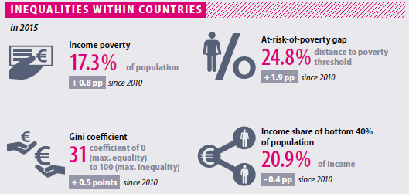
Indicators on inequality by Eurostat
(SDGs # 10 – Reduced inequalities)
Notes:
Income share of bottom 40% of the population.
SOURCE:
From the speech of World Bank President Robert S. McNamara to the Annual Meeting in 1972:
“The first step should be to establish specific targets, within the development plans of individual countries, for income growth among the
poorest 40 percent of the population. I suggest that our goal should be to increase the income of the poorest sections of society in the short
run—in five years—at least as fast as the national average. In the longer run—ten years—the goal should be to increase this growth significantly
faster than the national average.” (World Bank Group 2016, 47).
Indeed, McNamara, in his speech, confounded two related, but distinct, goals (disposable income, average income). They have different implications.

Slide 31
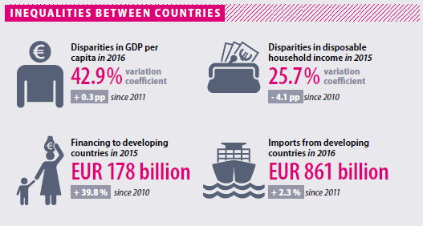
Notes:
Household disposable income is the total amount of money households have available for spending and saving after subtracting income taxes and pension contributions.

Slide 32
The extension of the indicators from a national (or EU) to a global plane is “too big a stretch.” The domains may be the same, but the implementation should possibly be quite different.
Three narratives about:
nation-based inequality of type 1: here the population sizes are not taken into account (unweighted). The country is the unit of analysis and the weight of each country is 1 (China = Luxembourg). The calculation takes into account not actual incomes of individuals, but country averages.
nation-based inequality of type 2, here the population sizes are taken into account (weighted). The country is the unit of analysis and the contribution of its population to the world population is weighted (China =/= Luxembourg). The calculation takes into account not actual incomes of individuals, but country averages.
as individual-based or global inequality: here each individual person, regardless of her country, enters in the calculation with her actual income. Here access to household surveys with data on individual incomes or consumption is needed.

Slide 33
What about comparing inequalities in developed and developing countries?
Recall that
«Clearly, material conditions of life in the developed countries are very different from those in developing countries. However, in terms of inequalities within individual countries, the share of national revenue which goes to the bottom fifth is often not so starkly different. Chronic inequality still exists within the developed countries, in spite of their elimination of extreme poverty.» (Giddens, 2009, p.481)
Notes:
Sebbene le condizioni materiali di vita siano nettamente diverse nei paesi sviluppati rispetto a quelli in via di sviluppo, la parte che va al quintile più povero del paese non è così diversa nei due contesti. Inoltre sacche di povertà cronica sono ancora presenti anche nei paesi più sviluppati economicamente, a dispetto della eliminazione della povertà estrema.

Slide 34
Inequality globally speaking!
Not yet a consolidated area of studies.
One of the leading scholars into this field, B. Milanovic, in a recent book (2016) on global income inequality suggested that
“It is time to look at income inequality not only as a national phenomenon only, but as a global one”.

Slide 35
Milanovic-Roemer (2016): overall picture
Global inequality, defined as income inequality among all citizens of the world, where incomes are adjusted to reflect differences in price levels between the countries,
- has been broadly stable between 1980s and early 2000s, and
has decreased from 69 Gini points in 1988 to 67 Gini points in 2011.
afterwards, a further decrease, down to about 64 Gini points, has been estimated.
This is indeed a remarkable decline that has occurred over a relatively short time period. It was driven by very high rates of income growth in China and India in particular, but also of other populous and relatively poor countries such as Vietnam, Thailand, Indonesia, and others.
Notes:
PPP Purchase power parities
Un tasso di cambio che è applicato tra monete diverse in modo da capire quale può essere il valore in denaro che una persona deve spendere per pagare lo stesso bene o lo stesso servizio ad esempio sia in Italia, sia in Cina.

Slide 36
Following this line of analysis Milanovic contributed to shed some light on a few emerging consequences of income inequality seen on its the global scale.
Out of many, let’s consider two suggestions:
First the emerging role of middle classes at the global level (Milanovic, 2012):

Slide 37
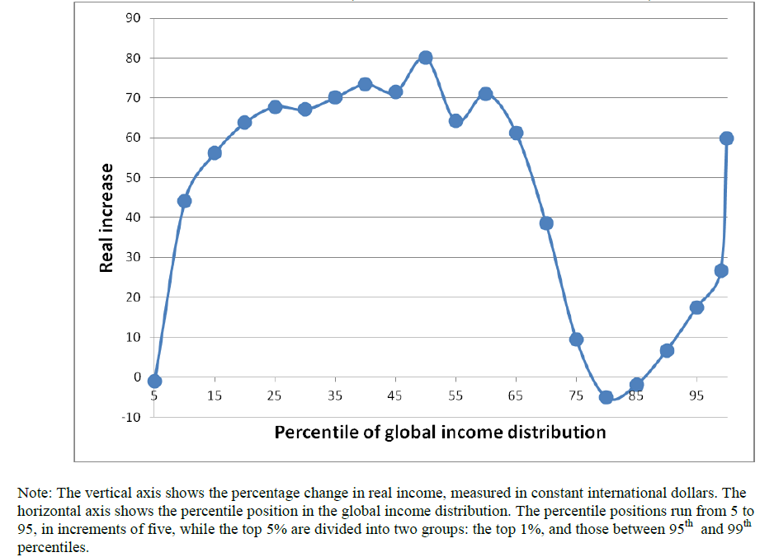

Slide 38
The most significant increases in per capita income are observed
among the very top of the global income distribution that. The top 1% has seen its real income rise by more than 60% over those two decades;
among the “emerging global middle class”, which includes more than a third of world population. The largest increases however were registered around the median: 80% real increase at the median itself and some 70% around it;
those at the bottom third of the global income distribution have also made significant gains, with real incomes rising between more than 40% and almost 70%;
the only exception is the poorest 5% of the population whose real incomes have remained the same;
but the biggest losers (other than the very poorest 5%), or at least the “non-winners,” of globalization were those between the 75th and 90th percentiles of the global income distribution whose real income gains were essentially nil.

Slide 39
It is remarkable that this historic decrease in global income inequality, explained mostly by the reduction in gaps between countries’ mean incomes, has coincided with rising income inequality in most individual countries, whether advanced, middle-income or poor.
(For the developed countries see: OECD, 2015)

Slide 40
Second, the introduction of the idea of citizenship rent to explain much of income differences at the global level, with some sociological consequences:
“Our world today is still a world in which the place where we were born or where we live matters enormously, determining perhaps as much as two-thirds of our lifetime income” (2016, p.5).
In detail, connecting GDP data and place of residence, data show that: (…)

Slide 41
To what extent two variables, GDP and income income inequality in the country of residence, predict income variability at personal level?
First, while everybody (the poor, middle class, and the rich) benefits from higher mean income, that benefit is proportionately greater for the rich classes.
Second, distributional change matters to the poor and to the rich (in the opposite directions, of course), while it is of little importance to the middle class.
Third: what seems to matter to the income of the middle class is whether the county is getting richer or poorer, not whether it is becoming more or less equal.

Slide 42
4 Comments:
First: more than half of the variability in personal percentile incomes around the world are accounted for by the GDP per capita and the income inequality in the country of residence. Place of residence is therefore a lower bound to global inequality of opportunity.
Second: given the income class of a person (her country and income ventile), knowing the country where that person lives is sufficient to explain about 90% of the variability of incomes globally.

Slide 43
Third: there is a trade-off between the GDP per capita of the country and its income distribution. A person who is in a low income class might prefer to live in a more egalitarian country, even if that country’s GDP per capita is less. The opposite, of course, holds for a person in a high-income class. This for the extreme income classes.
Forth: for the middle classes, national distribution is relatively unimportant because income shares of the middle ventiles do not vary much across nations, whether the nations are equal or not. For the middle classes, therefore, the mean income of the country where they live will be the key factor in determining their own income level.

Slide 44
Sociological issues. A very provisional sketch
Globalization may impact in rather different ways in different countries, and strain different areas of activity, concerning several and diversified groups of people, with hopes, interests and/or expectations not overlapping.
Furthermore, people’s reactions to globalization may follow rather different patterns and timing in different countries.
Some sociologists look at the connections that may emerge between the range of economic inequalities, estimated country by country worldwide, and political or civic participation:

Slide 45
Economy space
STRAIN
Inequalities
STRAIN
STRAIN
Political space
Civic space

Slide 46
What is income inequality undermining, and where?
For instance, in a paper just published Prof. Wade Cole (2018), after working on a world wide data set on income inequality, signals that income inequality is inimical to both political and civil equality, pointing out that
“Income inequality is detrimental to political and civil equality. As income inequality increases, rich people enjoy greater political power and respect for civil liberties than poor people do.”
And furthermore
“respect for even the most basic of liberties – access to justice, freedom of movement, freedom from forced labor – diminishes as income inequality increases.”
Suggesting that
“Resurgent populisms on both sides of the ideological spectrum may be one consequence of these processes. The findings hold for developed as well as developing countries and for democratic as well as nondemocratic countries.” (pp.21-22)

Slide 47
Other sociologists, trying to go beyond statistical correlations, look at more general explanations.
They suggest that globalization processes (extension of markets, media, and migration) are producing
new forms of social inequality and exclusion (from access to citizenships’ rights),
community (space of mutual recognition) erosion , and
personal humiliation (self-esteem, or -respect),
prompting polarization among those who can have access to resources allowing for distance communication and mobility, and those deprived of such resources.
And this is the kind of situational background that may bring about social frustration, which may turn to some form of social (politics or economy related) protest.

Slide 48
Thank you!
nzamaro@luiss.it

Slide 49
Annexes

Slide 50
References
Wade M. Cole, (2018). Poor and powerless: Economic and political inequality in cross-national perspective, 1981–2011, International Sociology, ﻿1–29.
Eurostat ,(2017). Sustainable Development in the European Union, Luxembourg.
- (2017). Overview of progress towards the SDGs in an EU context, , Luxembourg.
A. Giddens, (2009). Sociology.
A-C Guio, D. Gordon, H. Najera, M. Pomati (2017). Revising the EU material deprivation variables, Eurostat, Statistical working papers, European Union.
B. Milanovic, (2016). Global inequality: A new approach for the age of globalization. Harvard University Press.
- (2015). Gobal inequality of opportunity: how much of our income is determined by where we live? The Review of Economics and Statistics, 97(2): 452–460,
- (2012). Global Income Inequality by the Numbers: in History and Now . An Overview, The World Bank, Policy Research Working Paper, n. 6259
Organization for Economic Cooperation and Development, (2015). In it together, Paris: OECD.
P. Townsend , (1979). Poverty in the United Kingdom, Harmondsworth: Penguin Books.
- (1987). Deprivation, Journal of Social Policy, Vol. 16, No 2, pp. 125-146.
World Bank, (2017). Global Monitoring report 2015-2016.
- (2017). Monitoring Global Poverty. Report of the Commission on Global Poverty.

Slide 51
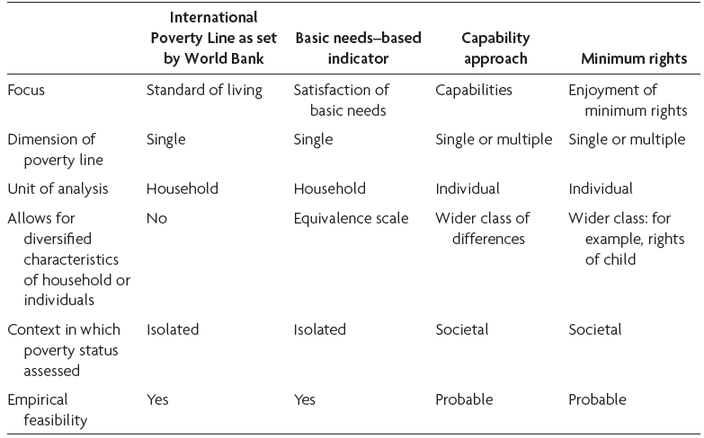
Characteristics of Different Approaches to Poverty Measurement
  Source: WB (2017), Monitoring Global Poverty. Report of the Commission on Global Poverty, p. 112.

Slide 52
“What can we say about the level of global inequality?
What does the Gini of about 70, which is the value of global inequality, mean?
One way to look at it is to take the whole income of the world and divide it into two halves: the richest 8% will take one-half and the other 92% of the population will take another half. So, it is a 92-8 world.
Applying the same type of division to the US income, the numbers are 78 and 22. Or using Germany, the numbers are 71 and 29.
Another way to look at it is to compare what percentage of world population, ranked from the poorest to the richest, is needed to get to the cumulative one-fifths of global income. Three-quarters of (the poorer) world population are needed to get to the first 1/5th of total income, but only 1.7% of those at the top suffice to get to the last one-fifth.
Global inequality is much greater than inequality within any individual country. Global inequality is substantially greater than inequality in Brazil as an exemplar of excessive inequality. And it is almost twice as great as inequality in the United States.” (Milanovic, 2012)

