Slide 1

“应对人口老龄化”赴西班牙培训
“Training on Adaptation to the ageing Population”in Spain
2016年6月19-7月3日·西班牙
June19-July3,2016 Spain

Slide 2
中国人口现状与人口政策
Population Status and Population Policy in China
景朝阳
Jing Chaoyang
国家发展和改革委员会国际合作中心
International Cooperation Center of
National Development and Reform Commission
jcylaw@126.com

Slide 3

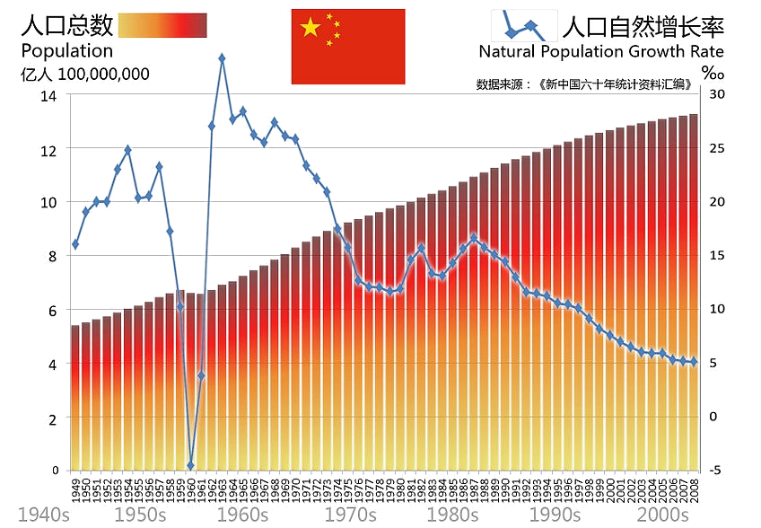
中国人口现状与人口政策 —— 中国人口现状
Population Status And Population Policy in China —— Population Status in China
1,373,490,000
中国人口概述
An overview of China's population

Slide 4
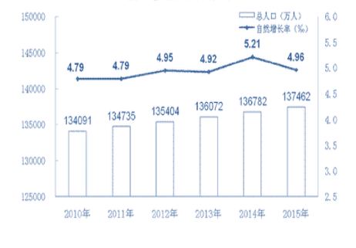
中国人口现状与人口政策 —— 中国人口现状
Population Status And Population Policy in China —— Population Status in China
中国人口现状特点
The characteristics of Chinese population
人口数量大，但增速放缓
人口素质低，结构不合理
人口老龄化问题突出，出生人口性别比失调
流动迁移人口规模大
人口与资源、环境和经济发展的矛盾日益突出
Large population with low growth rate
Low quality with improper structure
Prominent aging trend the old and gender imbalance for the newborn
Large scale of migration
Increasing conflicts among population, resources, environment and economic development.
2010-2015年中国总人口和自然增长率
China’s population and natural population growth rate in 2010-2015

Slide 5
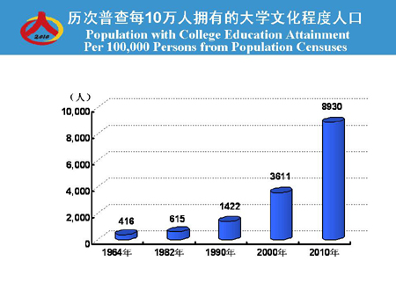
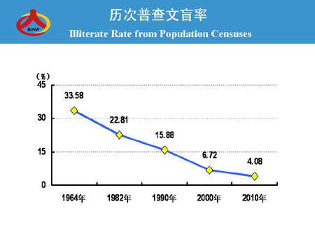
中国人口现状与人口政策 —— 中国人口现状
Population Status And Population Policy in China —— Population Status in China
Large population with low growth rate
Low quality with improper structure
Prominent aging trend the old and gender imbalance for the newborn
Large scale of migration
Increasing conflicts among population, resources, environment and economic development.
中国人口现状特点
The characteristics of Chinese population
人口数量大，但增速放缓
人口素质低，结构不合理
人口老龄化问题突出，出生人口性别比失调
流动迁移人口规模大
人口与资源、环境和经济发展的矛盾日益突出

Slide 6
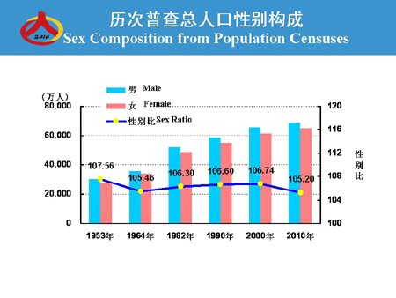
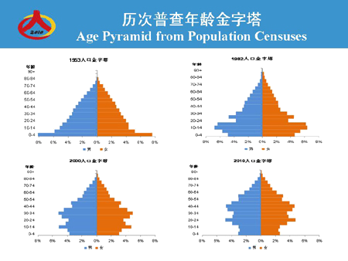
中国人口现状与人口政策 —— 中国人口现状
Population Status And Population Policy in China —— Population Status in China
Large population with low growth rate
Low quality with improper structure
Prominent aging trend the old and gender imbalance for the newborn
Large scale of migration
Increasing conflicts among population, resources, environment and economic development.
中国人口现状特点
The characteristics of Chinese population
人口数量大，但增速放缓
人口素质低，结构不合理
人口老龄化问题突出，人口性别比失调
流动迁移人口规模大
人口与资源、环境和经济发展的矛盾日益突出

Slide 7
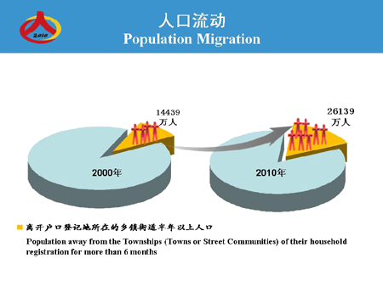
中国人口现状与人口政策 —— 中国人口现状
Population Status And Population Policy in China —— Population Status in China
Large population with low growth rate
Low quality with improper structure
Prominent aging trend the old and gender imbalance for the newborn
Large scale of migration
Increasing conflicts among population, resources, environment and economic development.
中国人口现状特点
The characteristics of Chinese population
人口数量大，但增速放缓
人口素质低，结构不合理
人口老龄化问题突出，出生人口性别比失调
流动迁移人口规模大
人口与资源、环境和经济发展的矛盾日益突出

Slide 8
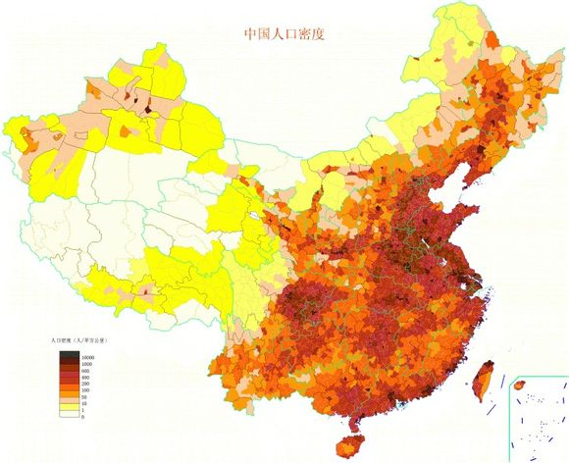
中国人口现状与人口政策 —— 中国人口现状
Population Status And Population Policy in China —— Population Status in China
中国人口现状特点
The characteristics of Chinese population
人口数量大，但增速放缓
人口素质低，结构不合理
人口老龄化问题突出，出生人口性别比失调
流动迁移人口规模大
人口与资源、环境和经济发展的矛盾日益突出
Large population with low growth rate
Low quality with improper structure
Prominent aging trend the old and gender imbalance for the newborn
Large scale of migration
Increasing conflicts among population, resources, environment and economic development.
中国人口密度图
Populationg density of China in 2015

Slide 9
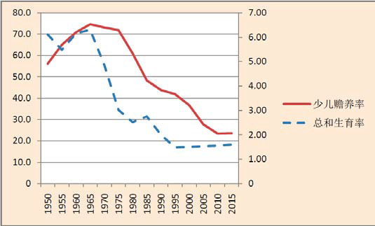
中国人口现状与人口政策 —— 中国人口现状
Population Status And Population Policy in China —— Population Status in China
习近平总书记在五中全会做的“关于《中共中央关于制定国民经济和社会发展第十三个五年规划的建议》”指出，我国人口结构呈现明显的“高龄少子特征”。
President Xi Jinping pointed that Chinese population structure has taken on the characteristics of Aging Population with Too Few Children, in the Fifth Plenary Session of the Central Committee of the Communist Party of China about 13th Five-year plan To formulate National economy And Social Development.
1950-2015年中国“总和生育率”和“少儿抚养比”变化
The “total fertility rate” and “child-age dependency rate” of China in 1950-2015

Slide 10
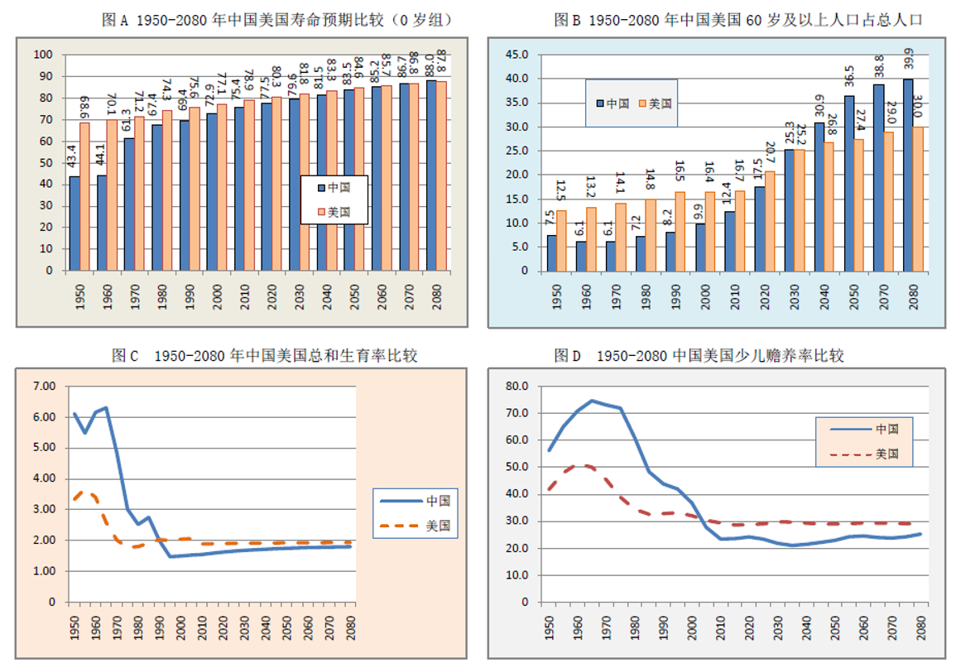
中国人口现状与人口政策 —— 中国人口现状
Population Status And Population Policy in China —— Population Status in China
中国”高龄少子”原因及预测
The reason and forecast about “Aging population and low fertility” of China
计划生育等政策导致少子化严重
人口面临长寿风险加剧老龄化
The one-child policy led to low birthrate severity
Longevity risk & aging faster
1950-2080年中国人口“高龄少子”比美国更为严峻
“Aging population and low fertility” of China is more serious than the United States in1950-2080

Slide 11
中国人口现状与人口政策 —— 总结
Population Status And Population Policy in China —— Summary
高龄少子特征为中国养老制度带来严峻挑战
Aging population and low fertility have been bringing great challenge to China's pension system.

Slide 12
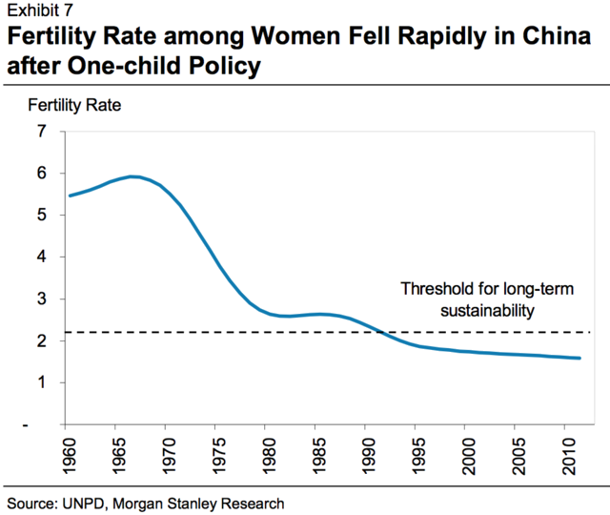
中国人口现状与人口政策 —— 中国人口政策
Population Status And Population Policy in China —— Population Policy in China
计划生育政策
One-child policy in China
中国的生育率在1970年代达到最高5.5，随着计划生育政策的实施开始迅速下降，到了2012年为1.6，以经低于2.1的可持续发展水平。

Slide 13
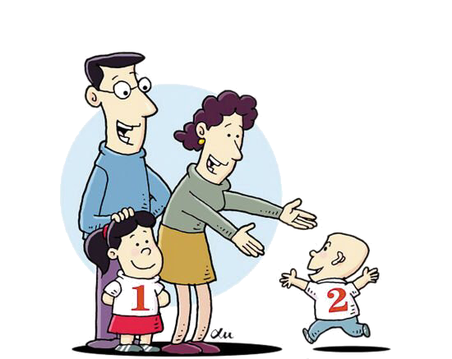
中国人口现状与人口政策 —— 中国人口政策
Population Status And Population Policy in China —— Population Policy in China
“单独二孩”政策
The two-child policy for only-child parents
（two-child fertility policy for couples where either the husband or the wife is from a single-child family）

Slide 14
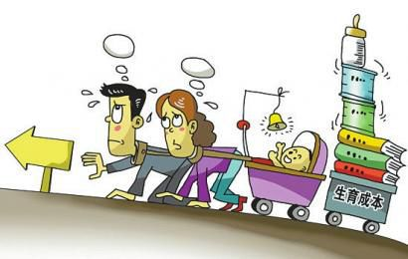
中国人口现状与人口政策 —— 中国人口政策
Population Status And Population Policy in China —— Population Policy in China
“单独二孩”政策
The two-child policy for only-child parents
政策效果不如预期的原因：
The reason of policy effect not as excepted
年轻人生育观念明显变化
养育成本明显增加
社会保障水平提高，少生优生观念
Childbearing concept changed obviously in youth view
Child-rearing costs increased apparently
Social security level improved & Fewer and better birth improved
The fertility cost is one of the key factors that have impacts upon family birth inclinations.

Slide 15

中国人口现状与人口政策 —— 中国人口政策
Population Status And Population Policy in China —— Population Policy in China
“全面二孩”政策
The universal two-child policy

Slide 16
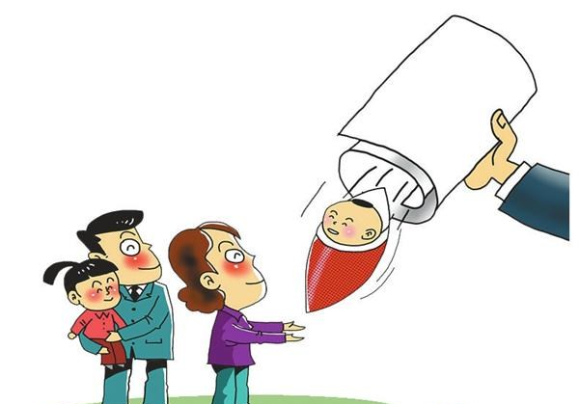
中国人口现状与人口政策 —— 中国人口政策
Population Status And Population Policy in China —— Population Policy in China
“全面二孩”政策
The universal two-child policy
“全面二孩”政策目的：
The purpose of universal two-child policy
进一步释放生育潜力
减缓人口老龄化压力
增加劳动力供给
促进人口均衡发展
To release fertility potential
To slow down the aging population
To increase labor supply
To promote balance population growth
待翻译

Slide 17

中国人口现状与人口政策 —— 中国人口政策
Population Status And Population Policy in China —— Population Policy in China
“全面二孩”政策
The universal two-child policy
“全面二孩”政策意义：
The significance of the universal two-child policy
国家民族长治久安的举措
增加劳动力供给
拉动经济增长
稳定社会和促进社会发展
The method of national long-term stability
Increasing labor supply
Stimulating economic growth
Maintaining social stability and promoting social development

Slide 18
中国人口现状与人口政策 —— 总结
Population Status And Population Policy in China —— Summary
One-child policy in China
The universal two-child policy
计划生育
单独二孩
全面二孩
The two-child policy for only-child parents
“全面二孩政策”将有效应对中国的人口老龄化趋势
Maybe China's aging trend would be actively addressed by the universal two-child policy.

Slide 19
中国人口现状与人口政策
Population Status And Population Policy in China
THANK YOU
By Jing Chaoyang

