Slide 1
Management of benefits in the Spanish Social Security System 西班牙 社会保障体系中的 福利管理

Slide 2
Management model管理模式
The Management Entity responsible for responding to cases of need through recognition of contributory benefits and the right to healthcare, except for
管理机构负责通过确认缴费福利和医疗权响应需求，除了
Non-contributory retirement and invalidity benefits
Benefits under the Special Sea Workers' Scheme
Unemployment benefits
非缴费型退休金和病残救济金
特殊海上工人计划中的福利
失业补助金

Slide 3
Management model 管理模式
Secretariat of State of the Social Security system
社会保障体系国务秘书处
INSS国家社保局
DGOSS
GISS社保信息部
TGSS
社保基金总库
ISM海事保障署
IGSS

Slide 4
Management model 管理模式
Principles that
guide the
management of
the benefits
福利管理原则
EFFICIENCY 效率
EFFICACY 效益
TRANSPARENCY 透明
DECENTRALISATION 分权
UNIFORM AND EQUAL TREATMENT
统一方式、平等待遇

Slide 5
Management model 管理模式
Our model includes:
  Management centres (52) and active contact centres – CAISS (434) to deal with a population of around 47 million residents
我们的模式包括：
  管理中心(52) 和活跃的联络中心– CAISS (434) 为大约4700万人口提供服务
  GUIDING PRINCIPLE:
  CLOSENESS TO PEOPLE
  指导原则:
  亲近服务群众

Slide 6

Management model 管理模式
Values 价值
Technologically modern
技术现代化
Examined by an independent body
独立机构核查
Controlled by
Parliament
国会监管
Discussed in
social dialogue
通过社会对话方式导论

Slide 7

Management model 管理模式
Customer service and information
Recognition of the right to benefits
Control and monitoring of benefits
客户服务和信息
福利权的确认
福利的控制和监控
Areas of action
工作范围

Slide 8

Recognition of the right to benefits 福利权益确认
Simplification of paperwork.
简化纸面工作
Automated procedures.
自动化程序
Reduced processing times
缩短处理时间
Average resolution period for RETIREMENT: 6.84 days
退休金事务平均处理时限为6.84天
Average resolution period for PERMANENT INCAPACITY: 42.14 days
永久丧失工作能力事务平均处理期限为42.14天
Average resolution period for DEATH AND SURVIVORS 6.58 days
逝者和遗属事务平均处理期限为6.58天

Slide 9
Recognition of the right to benefits 福利权益确认
Benefit application
福利申请
In person 本人到场
Online 在线
Opening of case file 打开个案申请文件
Processing of case file 处理个案申请文件
Supervision of the benefit 福利监管
Recognition of the benefit 待遇确认
Notification to the General Treasury of the Social Security. Processing of payment 通知社保基金总库处理待遇给付
Granting of pension 发放福利

Slide 10






Recognition of the right to benefits 福利权益确认
Benefit application 福利申请
Electronic and online services 电子和在线服务
TESOL (Electronic processing of applications): offers the possibility of presenting the benefit applications via the Internet.
TESOL (申请的电子化处理): 为通过网络提交福利申请提供可能性
Following validation, if the user registers the request the information will be sent to the corresponding management system随后的批准，如果用户注册了申请，信息会发送到相应的管理系统
TESOL
Corporate Systems
集合系统
Registration receipt 注册凭据
When the process is complete, the applicant obtains a receipt of the registration signed digitally, with all the information necessary:
程序完成后，申请人获得一份有电子签名的注册凭据，包含必要信息：
:: Copy of application 申请副本
:: Associated file numbers 相关文件编号
:: Registration number 注册号码
:: List of documents to be presented
提交文件清单
:: Registration date and time 注册日期和实践

Slide 11
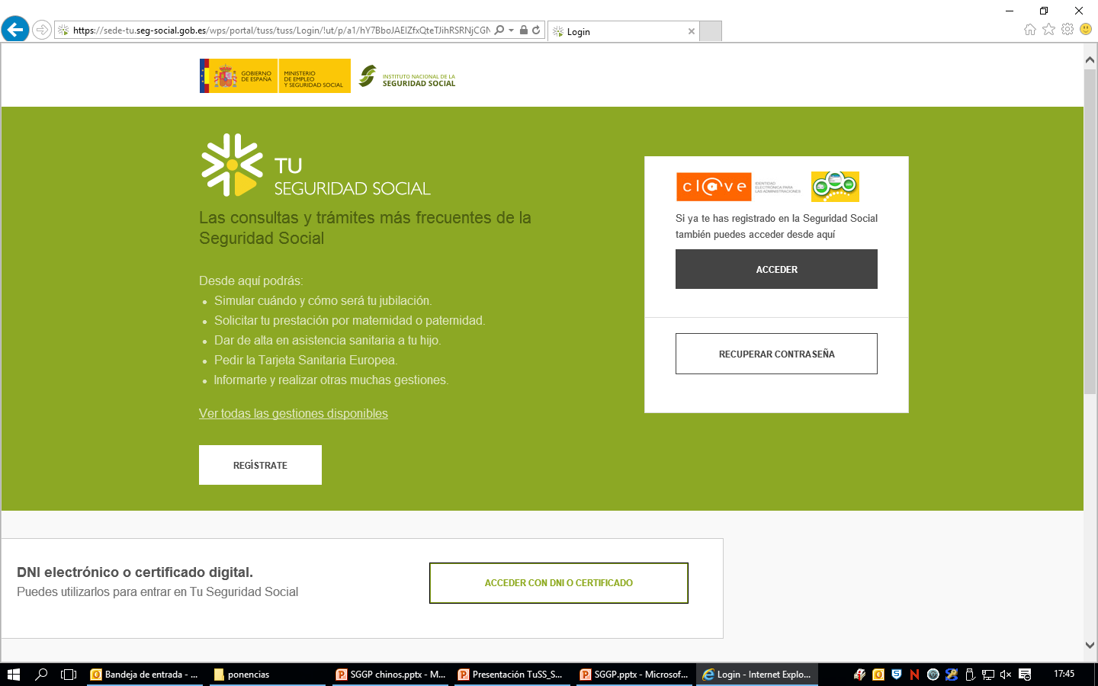
Recognition of the right to benefits 福利权益确认
Benefit application 福利申请
“YOUR SOCIAL SECURITY”website
“大家社保”网页

Slide 12
Recognition of the right to benefits 福利权益确认
Benefit application 福利申请
“YOUR SOCIAL SECURITY” website
“大家社保”网站
    EMPLOYMENT AREA
    Personalised information on contributions made for calculating benefits
    Information on the days left for access to ordinary retirement
    就业区
    有助于计算福利的个人缴费信息
    普通退休的剩余时间信息
    PENSIONS AREA
    Information on current pensions
    Online access to the necessary certificates for pensioners.
    养老金区
    现有养老金的信息
    在线访问领取养老金人员的必要证书

Slide 13
Recognition of the right to benefits 福利权益确认
Benefit application
福利申请
In person 本人到场
Online 在线
Processing of file 处理申请文件
        Automated internal processes
        内部自动化程序
        Computer applications:
        计算机应用程序
Recognition of benefit 福利待遇确认
Authenticity 真实
Confidentiality 保密
Integrity 完整
Availability 有效
Continuance 持续
Pension award 发放养老金

Slide 14
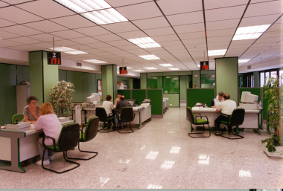


Recognition of the right to benefits 福利权益确认
Pension application
养老金申请
In person 本人到场
Online 在线
CAISS
GISS
GISS
DDPP
SILSSP
Pension amount 养老金额
Resolution of case files 申请结果
First payment
首次给付
Pension award 养老金发放

Slide 15

Recognition of the right to benefits 福利权益确认
Benefit application
福利申请
In person 本人到场
Online 在线
Interoperability of the Social Security System databases. Online connection
社保体系数据的互通性、在线链接
General Membership File 全体会员文件
Public pension database 公共养老金数据
General Contribution Database file 全体缴费数据库
General Collection File 总体采集文件
Pension award 养老金发放

Slide 16
Recognition of the right to benefits 福利权益确认
1. Recognition of the benefit by INSS Provincial Directorates 全国社保署省厅福利确认 | 5.23
2. Examination of the payment and communication to the TGSS 社保基金总库福利发放审核与通知 | 8.66
3. Procedures in the TGSS to obtain payment 社保基金总库福利获取程序 | 4.61
4. Procedures in banks 银行程序 | 1.38

Slide 17
Supervision of benefits 福利监管
Supervision of recognition of the right to benefit福利待遇确认的监管
Supervision of receipt of benefit
福利领取的监管
So that only the person with the right to the benefit can receive it and only while eligible to do so
只有符合资格、拥有福利权益的人才可以享受福利待遇

Slide 18
Supervision of benefits 福利监管
Supervision of eligibility to the benefit
福利待遇资格监管
Check of compliance with requirements
审核是否符合条件
Retirement 退休
Permanent incapacity 永久丧失工作能力
Death and Survivors 亡故和遗属
Incompatibilities 不符合

Slide 19
Supervision of benefits 福利监管
Supervision of eligibility to benefit
福利待遇资格监管
Verification of compliance with requirements
审核是否符合条件
Retirement 退休
  Membership and registration 成员身份与注册
  Age 年龄
  Contribution 缴费
Incompatibility 不符合

Slide 20
Supervision of benefits 福利监管
Supervision of recognition of the right to benefit
对福利待遇资格确认的监管
Check of compliance with requirements
审核是否符合条件
Permanent incapacity 永久丧失工作能力
  Membership and registration
  成员身份与注册
  Serious functional and anatomical limitations
  重度功能和身体残障
  Contributions
  缴费
Incompatibilities
不符合

Slide 21
Supervision of benefits 福利监管
Supervision of recognition of the right to the benefit
对福利待遇资格确认的监管
Check of compliance with requirements
审核是否符合条件
Death and Survivors 亡故和遗属
  Requirements for the deceased
  亡故人员条件
  Accreditation of kinship
  亲属关系确认
Incompatibilities 不符合

Slide 22
Supervision of benefits 福利监管
2. Supervision of receipt of benefit
福利收取监管
Monitoring of deaths
亡故人员监控
Monitoring of top-ups to minimum pensions
补充最低养老金监控
Monitoring of fraudulent registrations
注册欺诈监控
Automation of cancellations due to death
因亡故自动取消福利发放
Automation of expiries
自动到期
Automation of those condemned for offences
因裁定有罪而自动终止

Slide 23
We process all the files that enter the entity without ever allowing any to accumulate
我们处理机构收到的所有文件，不允许有任何积压
We guarantee the principle of non-interruption of income
我们保证收入不间断原则
We process the files with as little paperwork as possible and the least possible trouble for people
我们以尽可能少的纸面工作处理申请，并尽可能不给群众造成麻烦
We provide quick and professional attention for the users of our services, in personal, by phone and online
我们为用户提供快捷专业的服务，可以本人到现场、通过电话或在线找到我们

Slide 24
THANK YOU VERY MUCH
谢谢聆听！

