Slide 1
BEST PRACTICES EXCHANGE IN PENSION SYSTEMS.
SUSTAINABILITY FACTORS.
养老金体系最佳实践交流. 可持续性因素
Ms. María Teresa Quílez Félez
Deputy Director General of Planning and Financial Analysis of Social Security
Member of the Social Protection Commitee EU
María Teresa Quílez Félez女士
社会保障计划和财政分析副总干事
欧盟社会保障委员会成员
Location, Day Month Year 地点，日月年

Slide 2
Europe 2020 Priorities 欧盟2020年优先事项
Smart, sustainable and inclusive growth 智慧、可持续、包容性增长
    Smart Growth 智慧增长
    Developing an economy based on knowledge and innovation 发展知识经济和创新经济
    Sustainable Growth 可持续增长
    Promoting a more resource efficient, greener and more competitive economy 发展资源节约型、环保型和竞争力更强的经济
    Inclusive Growth 包容性增长
    Fostering a high employment economy delivering economic, social and territorial cohesion. 发展高就业型经济，实现经济、社会、领土凝聚力

Slide 3
Focus areas of EU co-operation in social field & supported by Europe 2020 Strategy 专注 欧盟社会领域合作的方面&得到欧洲2020战略支持
  Social inclusion (combating poverty & social exclusion; child poverty & wellbeing; homelessness & housing exclusion)
  社会融合（解决贫困&社会排斥；儿童贫困&幸福；无家可归&没有房屋）
  Social protection (pensions, healthcare, long-term care)
  社会保障（养老金，医疗，长期看护）
  Each includes: shared objectives, agreed indicators, monitoring, mutual learning, peer review
  每个包括：共同目标，一致接受的指标，监测，互相学习，同行互查

Slide 4
Major challenges to EU social protection systems
欧盟社会保障体制面临的主要挑战
Short-term challenge: The economic crisis and its aftermaths
短期挑战：经济危机及其余波
  Financial, economic and public budget crises aggravate the situation for social protection schemes. It has had an impact on the resources of citizens and also in employment.
  因为金融、经济和公共预算危机，社会保障体系状况恶化。影响公民的资源和就业。
  In Spain, since 2013, creating jobs at high rates.
  2013年以来，西班牙就业高速度增长
Medium and Long-term challenge: Demographic ageing
中期和长期挑战：人口老龄化
  Ageing of the 'baby-boomers' generation
  “婴儿潮”一代变老
  Increasing longevity amid persistently low birth rates
  人口寿命增加，同时持续低出生率
  Shrinking EU working age population
  欧盟工作年龄人口下降
  Future generations: strengthening intergenerational solidarity
  未来数代人：加强代际团结

Slide 5
Mayor Risk Factor. Pyramid Population
主要风险因素-人口金字塔
MEN男性
WOMEN女性
2050
2040
2030
2020
2010
50
40
30
20
10
0
10
20
30
40
50

Slide 6
Old-age dependency ratio (population 65 + vs population 20-64), in 2013 and 2053
2013年-2053年老年人抚养比例（65岁以上人口数量和20-64岁人口数量的比例）
Source: Eurostat, code proj_13npms. Note: Member States sorted by increase in dependency 2013-2053
来源：欧洲统计局， code proj_13npms 。注：根据2013-2053年老年人抚养比例增加情况排列成员国

Slide 7







Regarding the future 关于未来
Explanatory variables of the pensions expenditure 养老金支出的解释性变量
Sustainability
可持续性
Mayor risk factor
主要风险因素
Adequate Pensions
充足的养老金
 | Dependency Ratio 老年人抚养比例 | Coverage Ratio 覆盖比例 | Labour market Ratio 劳动力市场比例 | Benefit Ratio 收益比例 | Residual Ratio 剩余比例
ѱ | = δ | *α | *λ | *β | *ϕ
Adequate Pensions 充足的养老金
Keep a standard of living similar to active life. (Replacement rates)
保证积极的生活水平（替代率）
Keeping older out of poverty
让老年人摆脱贫困
There is also a residual interaction effect between explanatory variables
解释性变量之间存在残留的互动效应。

Slide 8
Council Recommendation EU
欧盟委员会建议
Ensure that the retirement age is rising in line with life expectancy when regulating the sustainability factor foreseen in the recent pension reform and underpin the Global Employment Strategy for Older Workers with concrete measures to develop lifelong learning further, improve working conditions for older workers and foster the reincorporation of this group in the job market
当调控最近养老金改革所预见的可持续性因素时，保证退休年龄和预期人口寿命同步增长，为进一步推动终身学习采取实际措施支持“全球老年工作者就业战略”，改善老年工作者工作条件，让该群体人士再次融入就业市场。

Slide 9
Statutory retiremet ages in the long-term, 2040
长远角度的法定退休年龄，2040年
Source: The 2015 Ageing Report. Note: Belgium: as of end 2014, reforms adopted thereafter are not reflected
来源：《2015年老龄化报告》。注：比利时：截至2014年底，没有反应此后所进行的改革。

Slide 10
Duration of working life, 2013, EU-28
工作生涯持续时间，2013年，欧盟28国
Data source: Eurostat
数据来源：欧洲统计局

Slide 11
Life expectancy at age 65 in 2013 and 2053
2013年和2053年65岁时的预期人口寿命
Source: Eurostat, codes demo_mlexpec, proj_13nalexp and proj_13nalexphlv. Note: ranked and grouped by 2013 value
来源：欧洲统计局，codes demo_mlexpec, proj_13nalexp and proj_13nalexphl。注：根据2013年数值排名和分组。

Slide 12
Gross Mortality Rates
总死亡率
Fallecidos
de
existentes
en
1
.
1
.
06
Fallecidos
de
altas
en
2006
Fallecidos
de
altas
en
2007
6
4
4
7
4
4
4
8
6
4
4
7
4
4
4
4
4
8
6
4
7
4
8
1
(
D
06
/
e
06
+
D
07
/
e
06
)
+
1
(
D
06
/
a
06
+
D
07
/
a
06
)
+
1
(
D
07
/
a
07
)
ˆ
x
x
x
x
x
q
06
/
07
=
2
4
4
x
P
07
+
1
06
/
e
06
+
1
06
/
a
06
+
1
B
06
/
e
06
+
1
B
06
/
a
07
−
1
A
06
{
x
D
x
D
x
x
x
x
2
4
2
4
2
Existentes
en
1
.
1
.
07
1
4
4
4
2
4
4
4
3
1
4
4
4
2
4
4
4
3
{
Fallecidos
anteriores
a
1
.
1
.
07
Otras
bajas
anteriores
a
1
.
1
.
07
Altas
anteriores
a
1
.
1
.
07
Being: 其中
= Gross mortality rate of the population at age X 某年龄段人口总死亡率
D_{x}^{06/e06} = Died in 2006 existing population in 1-1-2006 截至2006年1月1日2006年总人口中死亡人数
D_{x}^{07/e06} = Died in 2007 existing population in 1-1-2006 截至2006年1月1日2007年总人口中死亡人数
D_{x}^{06/a06} = Died in 2006 new population in 1-1-2006 截至2006年1月1日2006年新增人口中死亡人数
D_{x}^{07/a06} = Died in 2007 new population in 1-1-2006 截至2006年1月1日2007年新增人口中死亡人数
D_{x}^{07/a07} = Died in 2007 new population in 1-1-2007 截至2007年1月1日2007年新增人口中死亡人数
P_{x}⁰⁷ = Population in 1-1-2007 截至2007年1月1日总人口数
B_{x}^{06/e06} = Other causes law final in 2006 existing population in 1-1-2006 截至2006年1月1日2006年总人口的其他原因
B_{x}^{06/a06} = Other causes law final in 2006 existing population in 1-1-2006 截至2006年1月1日2006年总人口的其他原因
A_{x}⁰⁶ = New population in 2006 2016年新增人口

Slide 13
Heligman-Pollard Method
Mortality tables .Penalized Least Squares Regression Methods
死亡率表格-补偿最小二乘回归方法

Slide 14
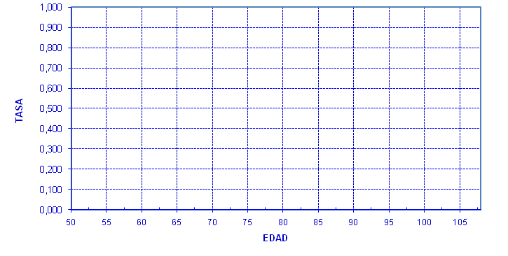
Mortality tables . Probabilities of death HP , others methods
死亡率表格-死亡HP概率，其他方法
(From 93 years a quadratic function is applied)（93岁起使用二次函数）

Slide 15
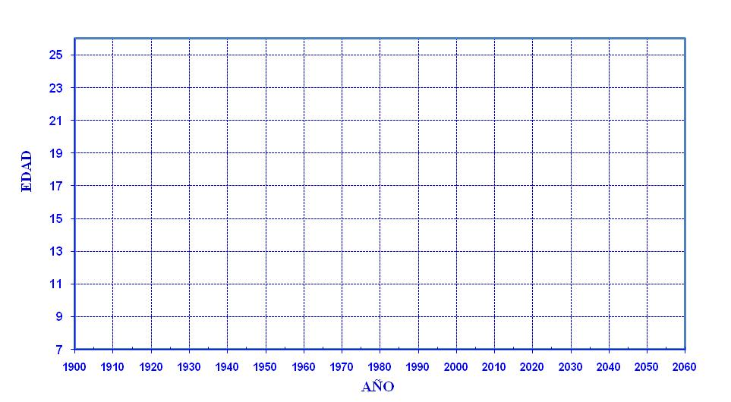
Logistic function of life expectancy at age 65
65岁时预期人口寿命的逻辑函数
= 8 + (23,83 - 8/ 1+
)

Slide 16
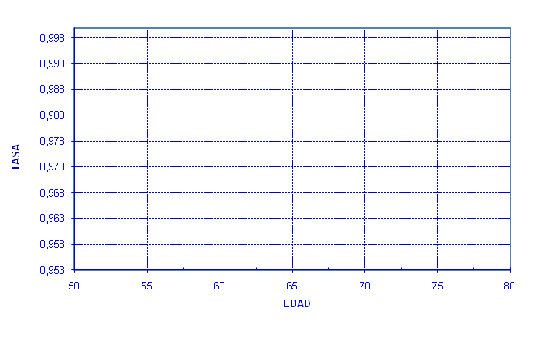
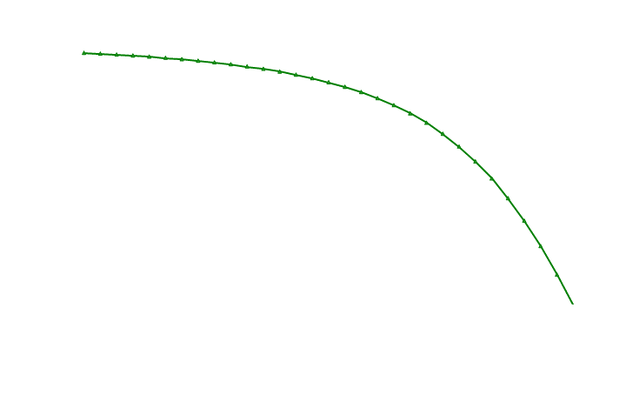
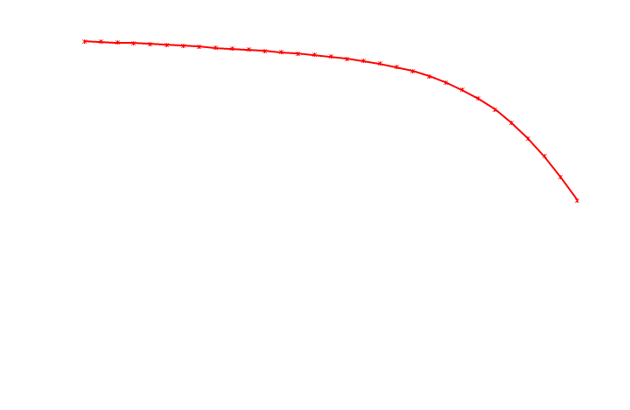
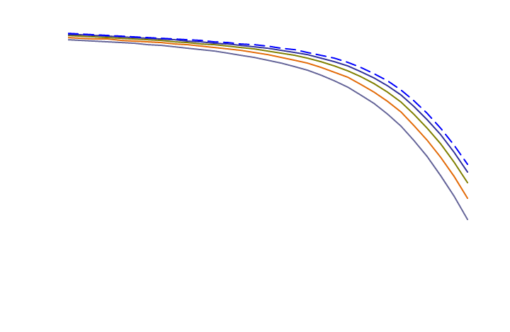

Mortality tables with life expectancy according to logistic function
死亡率表格-逻辑函数下的预期人口寿命

Slide 17
Life Expectancy at age 65 and 80 (2007-2060)
65岁和80岁时的预期人口寿命（2007-2060年）
YEAR | LE 65 | LE 80 | YEAR | LE 65 | LE 80 | YEAR | LE 65 | LE 80
2007 | 19,91 | 8,85 | 2025 | 21,52 | 9,71 | 2043 | 22,54 | 10,25
2008 | 20,01 | 8,91 | 2026 | 21,59 | 9,75 | 2044 | 22,59 | 10,27
2009 | 20,12 | 8,97 | 2027 | 21,66 | 9,78 | 2045 | 22,63 | 10,29
2010 | 20,22 | 9,02 | 2028 | 21,73 | 9,82 | 2046 | 22,67 | 10,32
2011 | 20,32 | 9,07 | 2029 | 21,80 | 9,86 | 2047 | 22,71 | 10,34
2012 | 20,42 | 9,13 | 2030 | 21,86 | 9,89 | 2048 | 22,74 | 10,36
2013 | 20,52 | 9,18 | 2031 | 21,92 | 9,92 | 2049 | 22,78 | 10,38
2014 | 20,61 | 9,23 | 2032 | 21,98 | 9,95 | 2050 | 22,82 | 10,39
2015 | 20,70 | 9,28 | 2033 | 22,04 | 9,98 | 2051 | 22,85 | 10,41
2016 | 20,79 | 9,33 | 2034 | 22,10 | 10,02 | 2052 | 22,88 | 10,43
2017 | 20,88 | 9,37 | 2035 | 22,15 | 10,04 | 2053 | 22,92 | 10,45
2018 | 20,97 | 9,42 | 2036 | 22,21 | 10,07 | 2054 | 22,95 | 10,46
2019 | 21,05 | 9,46 | 2037 | 22,26 | 10,10 | 2055 | 22,98 | 10,48
2020 | 21,14 | 9,51 | 2038 | 22,31 | 10,13 | 2056 | 23,01 | 10,49
2021 | 21,22 | 9,55 | 2039 | 22,36 | 10,15 | 2057 | 23,03 | 10,51
2022 | 21,30 | 9,59 | 2040 | 22,41 | 10,18 | 2058 | 23,06 | 10,52
2023 | 21,37 | 9,63 | 2041 | 22,46 | 10,20 | 2059 | 23,09 | 10,54
2024 | 21,45 | 9,67 | 2042 | 22,50 | 10,23 | 2060 | 23,11 | 10,55

Slide 18
Sustainability Factor 可持续性因素
The majority of EU countries have introduced some sustainability factor in their systems.
  The factor acts on:
  The retirement legal age
  The retirement real age
  The pension amount
大部分欧盟成员国已经将部分可持续性因素纳入体系。
因素影响：
法定退休年龄
实际退休年龄
养老金数量
Monthly Pension Amount 每月养老金金额 | = | Number of pension points accumulated during working life 工作期间累积的养老金点数 | X | Indexed point value (Workers / Pensioners and economics values) 指数化的每点价值（工人/退休人士和经济价值）
Germany德国

Slide 19
Sustainability Factor 可持续性因素
Annual Pension Amount 每年养老金金额 | = | ∑ update quotes according to variation of GDP (Geometric Average 5 years) ∑根据GDP变化设定的最新价格（5年的几何平均数） | X | Conversion coefficient according to age 根据年龄设定的换算系数
Italy意大利

Slide 20
Sustainability Factor
Annual Pension Amount 每年养老金金额 | = | Average annual salary of the 25 best years updated with IPC 根据CPI调整后，最佳25年的平均年薪 | X | Proration Factor Min (1,D/T) T (Theoretical number of quarter of a full working life. If increase as a function of life expectancy at 60 age) D (Real worked quarter) 最小分摊因数（1，D/T） T（完整工作生涯1/4时间的理论值） D（完整工作生涯1/4时间的实际值） | X | Pension Rate % generally. There is a benefit for the higher contributions T made from 60 years and a penalty to retirement before age 65 养老金比例 总体比例
France
法国

Slide 21
Sustainability Factor 可持续性因素
Pension Amount 养老金金额 | = | 1/Conversion Factor 1/换算系数 | X | Notional accounts ∑ Contribution updated (16% contribution rate) 名义账户 ∑最新缴费（缴费率为16%） | + | Funded system (2,5% contribution rate) 资金系统（缴费率为2.5%）
Sweden瑞典

Slide 22
Sustainability Factor可持续性因素
Pension Amount 养老金金额 | = | Annual earnings with more than 120 years, updated with CPI (40 best years) 根据物价指数调整后的120年年收入（最佳40年） |  | X | % Contribution years 缴费年数比例 | X | Sustainability Factor 可持续性因素
% Contribution years 缴费年数比例 | = | Per year up to 20 years with a minimum of 15. Over 20 years of contribution from 2% to 2.3% according level of salary 最多20年，最少15年的比例。 缴费超过20年，比例根据工资水平不同在2%到2.3%之间浮动
Portugal
葡萄牙
Sustainability Factor 可持续性因素 | = | LE 2006/ LE year I-1 预期寿命 2006/ 预期寿命I-1 | LE 2006 = life expectancy at age 65 in 2006 LE year I-1 = life expectancy at age 65 calculated in the year before the beginning of the pension 预期寿命2006=2006年65岁时预期人口寿命 预期寿命I-1 =开始领取养老金前一年65岁时预期人口寿命

Slide 23
Sustainability Factor Spain 西班牙可持续性因素
The Sustainability Factor (FS) is an automatic link between the amount of retirement pension benefits and developments in life expentancy of pensioners. The mathematical formulation of the Sustainability Factor:
可持续性因素（FS）反映的是退休养老金收益金额和退休人士预期寿命变化之间的自动关系 。可持续性因素的数学计算方法如下：
Pension = Regulatory Base *% years contribution * FS ≤ Maximum Pension
养老金=监管基数*缴费年限比例*FS≤最大养老金
Being:其中
t = The year of the factor, taking values from the year 2019 onwards. 因素的年份，从2009年开始取值
Is the annual change in a five year period life expectancy at age 67, according to the mortality tables of the population covered by Social Security, calculated using the following formula 67岁时五年预期人口寿命的年变化，根据社保覆盖人口的死亡率表格使用如下公式计算得出
Fixed value applicable for the calculation of FS in the years 2019 to 2023 = 0.9953
为固定值0.9953，适用于计算2019年至2023年的FS
Fixed value applicable for the calculation of FS in the years 2024 to 2028 = 0.9960
为固定值0.9960，适用于计算2024年至2028年的FS
2012
Link benefits to life expectancy
收益和预期人口寿命挂钩
2017

Slide 24
Key aims 主要目标
Highlight the importance of adequacy and examine what makes up an adequate income in old-age强调养老金充足的重要性， 确定老年充足收入的组成部分。
Adoption of policies to deliver longer working lives and higher pension ages could potential provide win-win scenario in terms of enhancing adequacy and sustainability 采纳能够实现更长工作年数的政策，从提高充足性和可持续性而言推迟领取养老金年龄可能是双赢。
Public pension systems should contain minimum income provision mechanisms and redistributive features in order to protect people who were unable to build adequate entitlements 公共养老金体系应该具有最低收入机制和再分配功能，从而保护那些无法获得充足津贴的人。
Assess the risks to future adequacy, bearing in mind that financial sustainability and adequacy must always be analyzed together 评估未来充足性的风险，谨记必须同时分析财政可持续性和充足性。
Need for safer and more transparent schemes 需要更加可靠和透明的计划。

Slide 25
Policy mix needed to deliver longer working lives
延长工作年数所必须的组合政策
REWARDING WORK
Pension reform to out implicit tax on working longer
Close Other early retirement pathways
Give better options for phased retirement
有回报的工作
进行养老金改革，消除延长工作年数的隐性税目；
关闭其他提前退休的通道；
为阶段性退休提供更好的选择
Government
Employers
Unions
Civil society
IMPROVING EMPLOYABILITY
- Provide suitable training opportunities for all ages
- Give better help for older jobseekers
- Improve the work environment
政府
雇主
工会
民间社会
提高就业能力
-为各年龄段人士创造合适的培训机会
-更好地帮助老年求职者
-改善工作环境
CHANGING EMPLOYER PRACTICES
- Legislation and information campaigns to promote age diversity
- Align labour costs with productivity
- Help protect employment opportunities not jobs
改变雇主行为
-开展立法和宣传活动，促进年龄多样性
-根据生产力调整劳动成本
-保护就业机会，而不是工作岗位
Source: According to the OECD, Older workers reviews (2014, 2015).
来源：OECD，《老年工作者评论》（2014年，2015年）

Slide 26

THANK YOU
谢谢
More information can be found at:
更多信息请见：
www.meyss.es
www.seg-social.es

