Slide 1
PRACTICAL EXAMPLE
Recognition of retirement pensions under the
Special Maritime Workers' Scheme.
特殊海上工作人员计划中的退休金待遇确认实例
Madrid, 23 June 2016 马德里，2016年6月23日

Slide 2
SOCIAL SECURITY SYSTEM 社保体系
Composition of the system:
The System is composed of the General Scheme and the Special Schemes
The following are included within the General Scheme:
    Special Agricultural Scheme
    Special Domestic Workers' Scheme
Currently the Special Schemes are:
Special Self-Employed Workers' Scheme
Special Coal Mining Scheme
Special Maritime Workers' Scheme
体系构成:
该体系由普通计划和专项计划构成
普通计划包括:
    农业专项计划
    居家工作人员专项计划
当前专项计划为:
自雇工作人员专项计划
煤矿业专项计划
海上工作人员专项计划

Slide 3
SOCIAL SECURITY SYSTEM 社保体系
MANAGEMENT ORGANISATION OF THE SOCIAL SECURITY SYSTEM
社保体系管理组织架构
Ministry of Employment and Social Security
就业和社会保障部
State Secretariat for
Social Security
社保国务秘书
Management Bodies and Common Services
管理部门和公共服务机构
Managing Entities
管理部门
General Treasury of the Social Security System
社保基金总库
IT Department of the Social Security System
社保体系信息技术司
National Social Security Institute
全国社保署
Social Marine Institute
(ISM)
海事社保署

Slide 4
MANAGEMENT BODY
Social Marine Institute :
    Body responsible for the protection and solution of problems for maritime workers.
    The managing entity of the Special Social Security Scheme for Maritime Workers.
Reason for existence:
    Special circumstances of work at sea.
    Need for comprehensive and specific protection.
管理机关
海事社保署：
    海上工作人员保障和问题解决负责机关
    海上工作人员专项社保计划关机机关
存在理由:
    海上工作情况特殊
    需要综合而特别的保障

Slide 5
SOCIAL SECURITY SYSTEM 社保体系
STRUCTURE OF THE ISM
CENTRAL DEPARTMENT
PROVINCIAL DEPARTMENTS (25)
LOCAL DEPARTMENTS (96)
CENTRES ABROAD:
Care centre in Dakar (Senegal)
Care centre in Nouadhibou (Mauritania)
Care centre in the Seychelles and Walvis Bay (Namibia)
海事社保署架构
中央部门
省区部门(25)
地方部门(96)
海外中心:
达喀尔救护中心 (塞内加尔)
努瓦迪布救护中心 (毛里塔尼亚)
塞舌尔和鲸湾港救护中心(纳米比亚)

Slide 6
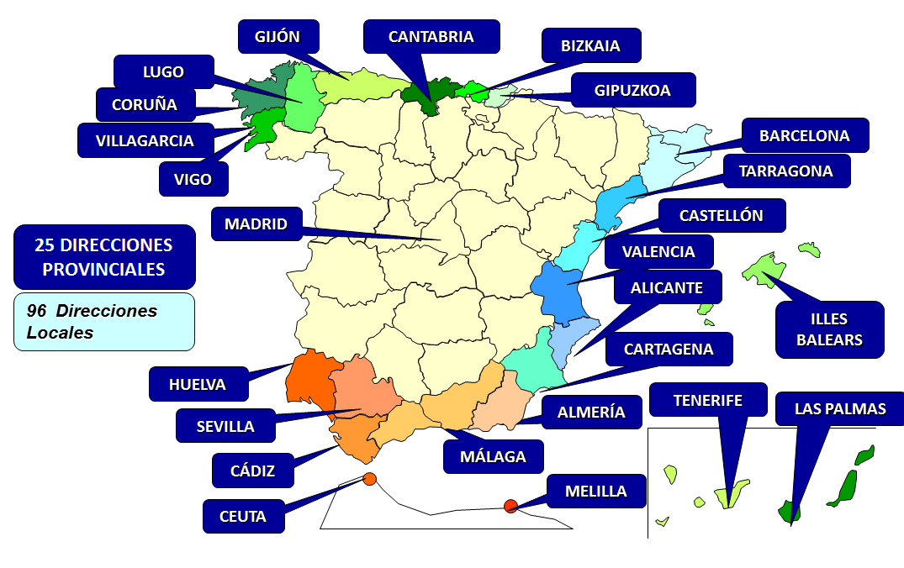
PROVINCIAL DEPARTMENTS 省区部门
25个省区部门
96个地方部门

Slide 7
SCOPE OF PROTECTION 保障范围
In general, the protection offered by the Social Marine Institute consists of three main blocks:
Management, administration and recognition of the benefits of the Special Social Security Scheme for Maritime Workers.
Management of healthcare for seafarers: The hospital ships Esperanza del Mar and Juan de la Cosa.
Management of various social programmes that aim to improve the living and working conditions on board ships.
Marine and healthcare vocational training
PRINCIPLE OF INTER-TERRITORIALITY
Exception to the principle of territoriality (Article 7 of the General Social Security Act): Article 11.4 of ¡Regulation EC 883/2004 and 11 of Regulation EC 987/2009 (1 May 2010) allow these workers to be subject to the law of their country of residence, even though they are active in ships under the flag of another member state.
总体而言，海保署所提供的保障主要包含三大板块:
海上工作人员专项社保计划之管理、经办和福利确认.
海上救护中心管理：海上希望号和胡安德拉柯飒号.
管理旨在推进海船生活工作条件的社保项目.
海上健康救护职业培训
境内原则
境内原则的例外情况（《普通社保法》第7条）：欧盟第883/2004号法规第11条第4款、欧盟第987/2009号法规第11条（2010年5月1日生效）允许海上工作人员依照其居住国的法律处理问题，即使其在使用其他成员国旗帜的船只工作。

Slide 8

SCOPE OF APPLICATION 适用范围
EMPLOYED WORKERS 受雇人员
SELF-EMPLOYED WORKERS 自雇人员
Workers aged over 16 who are employees in one of the following activities： 年满16岁并受雇于下列工作者
Merchant Marine. 海上商业 Marine fishing in any of its forms. 任何形式海上渔业 Extraction of marine products. Aquaculture. 海产捕捞；海产养殖 Internal traffic in ports and sports and recreational vessels. 进出口运输、娱乐船只 Fixed platforms for the exploitation of marine resources.海洋资源开采平台 Administrative, technical and other employees of the companies mentioned.上述类型公司之行政、技术和其他雇员 Port workers. 港口工作者 Divers. 潜水员 Service personnel for associations of fishermen, their federations and marine cooperatives.渔业人员协会、海上合作机构和联合工会服务人员 Any other marine fishing activity included by the Ministry of Labour. 劳动部所定其他海上渔业工作
Workers aged over 18 who work in any of the following activities that constitute their normal, personal and direct means of earning a living : 年满18岁并参加下属工作，以之作为长期、独自、直接的谋生渠道
Extraction of marine products. 海产捕捞 Netters. 撒网渔业人员 Shipowners who provide on-board service .提供穿上服务的船主 Divers. 潜水员

Slide 9
RETIREMENT 退休
LAW 27/2011 OF 1 AUGUST ON THE UPDATE, ADAPTATION AND MODERNISATION OF THE SOCIAL SECURITY SYSTEM
Change in the legal age of retirement (from 65 to 67).
The increase in the age is being phased in gradually, first by one additional month per year from 2013 to 2018.
The increase will be 2 months per year starting in 2019 until 2027, when the retirement age will be 67.
However, the retirement age will remain at 65 years if more than 38.5 years of contributions are accredited in 2027.
Early retirement is possible, but it involves a penalty that consists of applying a percentage reduction to the regulatory base for each year that contributions total less than 38.5 years.
For 2016 the retirement age is:
65 years and 4 months with fewer than 36 years of contributions
65 years with 36 or more years of contributions
《关于社会保障体系更新、调适、现代化之2001年8月1日第27号法》
变更法定退休年龄（从65岁改到67岁）.
所延长的年龄逐渐实现，从2013年到2018年每年增加1月.
从2019年到2027年每年增加2个月，届时退休年龄打67岁.
但是，到2027年时缴费年限累计满28.5年，退休年龄仍可保留为65岁。
可以提前退休，但须有惩治措施，在其缴费累计少于38.5年的情况下，每年按规定降低一定比例之养老金.
年退休年龄为:
缴费不足36年者为65岁零4个月
缴费满36年及以上者可65岁

Slide 10

RETIREMENT 退休
General requirements for retirement:
退休总体要求：
  In general: REGISTERED MEMBER
  须为社保登记参保人员
  Age requirement
  年龄要求
  Minimum total contribution period of 15 years, with 2 within the last 15 years
  最低缴费年限为15年，且在退休前15年中有2年缴费
  There has to be a termination of employment or application
  须结束就业或须有退休申请

Slide 11
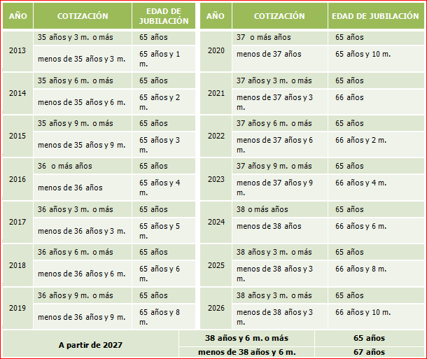
RETIREMENT – AGE 退休：年龄
RETIREMENT AGE ACCORDING TO THE ACCREDITED CONTRIBUTION PERIODS 根据累计缴费年限确定退休年龄
西班牙语注：
Año: 年
Cotización: 缴费年限
Edad de Jubilación ：退休年龄
Más : 多于
Menos de: 少于
M: 月
Y: 和

Slide 12

RETIREMENT - REGULATORY BASE
退休：法定计算基础
Another modification included in the law is the increase in years taken into consideration when calculating the regulatory base.
Currently the last 19 years are used. With the pension reform, this figure will be increased to 25 years of contributions to calculate the regulatory base for retirement pensions.
This increase began to be phased in starting in 2013 and will be complete in 2022, using 25 years for the regulatory base
法律另外一项修改是养老金计算基础的缴费年限增加.
目前，计算是使用的是最近19年缴费。在养老金改革之后，增加为25年缴费，作为退休金法定计算基础.
缴费年限从2013年开始逐渐增加，并在2022年完成，最终以25年为养老金计算基础。

Slide 13
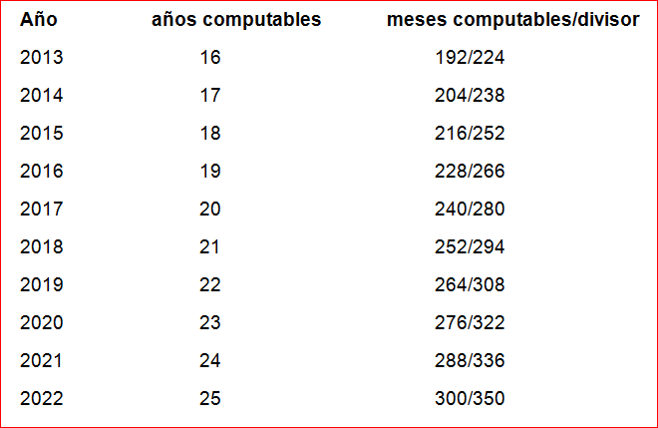
RETIREMENT - REGULATORY BASE
退休：法定计算基础
REGULATORY BASE 法定计算基础
The period taken into account to calculate the Regulatory Base is being increased from 15 to 25 years on a step-by-step basis, increasing by 1 year every year from 2013 to 2022. 计算养老金的基础缴费年限从15年增长到了25年，逐步实现，从2013年到2022年间，每年增加1年。
计算年数
计算月数/除数

Slide 14
RETIREMENT 退休
The amount of the pension is calculated by applying to the regulatory base the corresponding percentages in accordance with a transitional period. The minimum for eligibility for 100% of the regulatory base is increasing from 35 to 37 years.
The application is being phased in from 2013 to 2027.
In 2016 the 100% figure was reached with 35 years and 6 months.
养老金计算方法为计算基础，并加上按比例的转轨年数。100%养老金法定计算基础（最低缴费年限）已从35岁增加到37岁。
增加过程从2013年开始到2027年结束。
2016年，100%养老金最低缴费年限为35年龄6个月。
Period 时期 | 15 years 15年 | percentage by additional months 增加约束比例 |  | 100% 全额养老金
2013-2019 | 50% | 0.21 from month 1 to 163 第1月至第163月为0.21 | 0.19 from month 164 to 246 第164月至第246月为0.19 | 100% at 35 years and 6 months 35年零6个月可获全额
2020-2022 | 50% | 0.21 from month 1 to 106 第1月至第106月为0.21 | 0.19 from month 107 to 252 第107月至第252月为0.19 | 100% at 36 years 36年可获全额
2023-2026 | 50% | 0.21 from month 1 to 49 第1月至第49月为0.21 | 0.19 from month 50 to 258 第50月至第258月为0.19 | 100% at 36 years and 6 months 36年零6个月可获全额
2027 | 50% | 0.19 from month 1 to 248 第1月至第248月为0.19 | 0.18 from month 249 to 264 第249月至第264月为0.18 | 100% at 37 years 37年可获全额

Slide 15

RETIREMENT – COE 退休- 年龄降低系数
COEFFICIENTS REDUCING THE LEGAL AGE (COEs)
PERIODS AND ACTIVITIES ELIGIBLE
  Effective work
  Illness and accident
  Legally paid leave and time off
EVIDENCE FOR PROFESSIONAL SERVICES
  Membership documents; registration, cancellation and contributions
  Navigation histories of qualified personnel
  Maritime registration books, registration certificates
  Certificates from the competent maritime authority
  Permit from autonomous region (shellfish producers, barnacle gatherers and seaweed collectors)
  * The calculation of the COE was automated in 2011 using our IT applications.
  * A new mobile COE consultation service is now available for both Android and iOS devices.
法定年龄降低系数（COE）
合格时期与工作
  有效工作
  疾病与事故
  合法工作时段的假期或中断
获得专业服务证明
  参保文件；参保、退保和缴费状况；
  符合资质人员航行历史
  海上工作登记书、登记证明
  具有职权的海事机关所开具的证明
  自治区许可（贝类生产人员、附着甲克动物采集人员与海藻收集人员）
  * 降低系数计算在2011年由信息技术应用程序自动进行
  * 新的降低系数计算服务目前可在安卓设iOS系统设备上实现

Slide 16
RETIREMENT 退休
COEs ON FOREIGN SHIPS
The time of service on foreign vessels under flags of countries with which there is an international instrument will be taken into account if it is duly accredited and the pension is calculated by aggregation.
If the pension is recognised by internal legislation, the time of service on foreign ships accredited in the other country will only be taken into account for the COE if during this time contributions to the Spanish Social Security system were maintained through a special agreement.
The time of service on foreign ships under flags of countries with which there is no international instrument will only be taken into account if there was a special agreement during those years.
外国船只法定年龄降低系数
如果海上工作者按时缴费，其所在在外国船只所属国家有国际合作协议，则其服役时长将被考虑，其养老金将以总计额进行计算。
如果其养老金受国际法承认，其在外国船只上的服役时长运用“降低系数”的条件为其缴费通过特殊协议保留在西班牙社保体系中。
如果其所服务的外国船只所属国无国际协议，只有在其服务时段内有相关特殊协议，方可考虑其服务时长。

Slide 17
COE MERCHANT MARINE 海上商业年龄降低系数 |  |  |  |  |  |  | COE FISHING
 | OIL TANKERS GAS TANKERS CHEMICAL SHIPS SUPPLY VESSELS ISM VESSELS |  | FREIGHT VESSELS OCEAN-GOING TUGS OIL AND GAS PLATFORMS OCEANOGRAPHIC AND FISHERY RESEARCH SHIPS SALVAGE AND ANTI-POLLUTION VESSELS OR SHIPS |  |  |  | FREEZER VESSELS COD FISHING VESSELS PAIR COD FISHING VESSELS WHALING SHIPS |  |  |  | TRAWLERS OF MORE THAN 250 GRT
 |  |  |  |  |  |  | FISHING VESSELS OVER 150 GRT NOT INCLUDED IN THE PREVIOUS GROUPS |  |  |  | FISHING VESSELS OF MORE THAN 10 - 150 GRT NOT INCLUDED IN THE ABOVE GROUPS
 | MIXED FREIGHT AND PASSENGER SHIPS |  | PASSENGER SHIPS OF MORE THAN 1,500 GT VESSELS FOR INTERNAL PORT TRAFFIC (except for small passenger vessels for internal port traffic)
 |  |  |  |  |  |  | VESSELS OF UP TO 10 GRT
 |  |  |  |  |  |  | DOCK WORKERS
 | PASSENGER SHIPS OF UP TO 1,500 GT SMALL PASSENGER VESSELS FOR INTERNAL PORT TRAFFIC |  |  |  | 0.20 |  | 0.30 | WORK CORRESPONDING TO THE ACTIVITIES THAT MAKE UP THE BASIC PORT SERVICE OF LOADING, UNLOADING, STACKING, UNSTACKING, AND TRANSHIPMENT OF GOODS
 | SHELLFISH PRODUCERS, BARNACLE GATHERERS, MUSSEL AND SEAWEED COLLECTORS |  |  |  |  |  | Work corresponding to the activities of farming shellfish, collecting barnacles and collecting seaweed, mussel farmers and aquaculture diving, diver collectors |  |  |  |  | 0.10
 | PERIODS OF ACTIVITY THAT IMPLY EFFECTIVE WORK. PERIODS ONSHORE DUE TO ILLNESS OR ACCIDENT PAID HOLIDAYS, LEAVE AND TIME OFF WORK |  |  |  |  | MEMBERSHIP DOCUMENTS, REGISTRATIONS, CANCELLATIONS, CONTRIBUTIONS NAVIGATION RECORDS OF THE QUALIFIED PERSONNEL MARITIME LOGS AND CERTIFICATES CERTIFICATION BY MARITIME AUTHORITY PERMIT ISSUED BY THE AUTONOMOUS REGIONS FOR SHELLFISH PRODUCERS, BARNACLE GATHERERS AND SEAWEED COLLECTORS. |  |  |  | aggregating all the periods giving eligibility for reductions. assimilation of the fractions of the year in excess of 100 days in each group up to a complete year. accumulation of fractions of a year of less than 100 days in a specific group to the period of time accredited in the group immediately below.; if there are none ,they are wasted. maximum limit of reduction of the age of 10 units. calculation of the period of time of reduction as a period of contributions for the purpose of determining the percentage of the pension. application of the reduction and its calculation as a period of contributions for retirement in any Social Security scheme.
 | WORK ON BOARD FOREIGN VESSELS
 | Time served by Spanish sailors on foreign vessels CALCULATION FOR BENEFIT PAYMENTS | UNDER FLAGS OF COUNTRIES WITH WHICH THERE IS AN INTERNATIONAL SOCIAL SECURITY INSTRUMENT
 |  | PENSION USING AGGREGATION OF PERIODS | The periods are always calculated provided they are sufficiently accredited.
 |  | PENSION UNDER INTERNAL LEGISLATION | Only calculated if during these periods Social Security contributions were paid under a Special Convention. Must be duly accredited.
 |  | UNDER FLAGS OF COUNTRIES WITH WHICH THERE IS NO INTERNATIONAL SOCIAL SECURITY INSTRUMENT
 |  | Calculated if during this period there were contributions to the Spanish Social Security system under a Special Convention. Must be duly accredited.
0.40
0.35
0.30
0.25
0.40
0.35
0.30
0.25
0.15
CALCULATION OF REDUCED PERIODS
ACTIVITY ELIGIBLE
PROOF OF SERVICES

Slide 18
海上商业年龄降低系数 |  |  |  |  |  |  | 渔业年龄降低系数
 | 石油船只 天然气船只 化工船只 物资供应船只 海保署船只 |  | 货运船只 海运拖船 石油天然气平台 海洋和渔业勘探探船只 救生和反污染工作船只 |  |  |  | 自由船只 COD捕鱼船只 PAIR COD捕鱼船只 捕鲸船只 |  |  |  | 250GRT以上船只
 |  |  |  |  |  |  | FI150GRT以上捕鱼船只 |  |  |  | 10-150GRT捕鱼船只，不包括上述
 | 混合货运和载客船只 |  | 载重超过1500GT的载客船只 国内港口交通船只（内港交通小型客船除外）
 |  |  |  |  |  |  | 10 GRT以下捕鱼船只
 |  |  |  |  |  |  | 码头工作人员
 | 1500 GT以下载客船只 内港交通小型载客船只 |  |  |  | 0.20 |  | 0.30 | 负责货物装船、卸船、堆货、卸货和运输等基础港口服务的工作人员
 | 贝类生产人员、附着甲壳动物采集人员、海藻采集人员 |  |  |  |  |  | 负责渔业养殖、附着甲克动物采集和海藻采集、养殖、水产潜捕、潜水采集等的工作人员 |  |  |  |  | 0.10
 | 有效工作年限 或因事故在岸非工作时期 带薪假期、产假或离职 |  |  |  |  | 参保文件；参保、退保和缴费状况 符合资质人员航行历史 海上工作登记书、登记证明 具有职权的海事机关所开具的证明 自治区许可（贝类生产人员、附着甲克动物采集人员与海藻收集人员） |  |  |  | 总计所有符合条件年限降低条件的工作时段 合并工作满100日或以上的年份分数 累计工作少于100日的年份分数，计于各年份特殊分组下；若无，则其分数不用。 10组年龄降低计算的最大限额. 将降低年限计算为缴费年限，旨在确定养老金额 应用降低年限，将之计算为缴费年限，用于任何社保计划的退休年龄计算
 | 外国船只工作
 | 外国船只西班牙公民工作年限 福利待遇计算 | 有国际社保协议外国船只
 |  | 以总年限计算的养老金 | 在工作年限积累充足时进行计算
 |  | 在国内法规制下的养老金 | 仅当在该时期内社保缴费根据特殊条约进行缴纳时计算养老金 必须按时缴费
 |  | 无国际社保协议的外国船只
 |  | 仅当在该时期内社保缴费根据特殊条约进行缴纳时计算养老金 必须按时缴费
0.40
0.35
0.30
0.25
0.40
0.35
0.30
0.25
0.15
降低年限计算
合格工作
服役年限

Slide 19
RETIREMENT – COEs 退休-年龄降低系数
CALCULATION OF PERIOD OF REDUCTION
Activities with the same coefficient are grouped together and aggregated
The total is divided by 365.
Fractions of more than 100 days/group = complete year;
Fractions of less than 100 days/group = accumulated to the lower group; if there is none, it is wasted.
The product or sum of the partial products of no. years x coefficient = no. of years or fraction of the year of reduction.
Up to a maximum limit of 10 years.
The period of time by which the retirement age is reduced will be calculated as a period of contributions for the purpose of determining the percentage applicable to calculate the amount of the pension.
降低年限计算
运用相同系数的工作被分组归类
总数以365除开
分数：大于100日/组=完全年数
分数小于100日组= 加于较低组别；若无，则无效.
年数×系数的结果或部分结果总合=年数或降低年数的分数
最高年限为10年
退休年龄所减得时段将作为缴费年限计算，目的是确定用以计算养老金总额的比例数

Slide 20
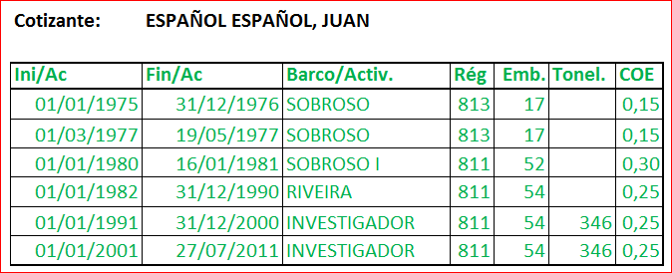



RETIREMENT – EXAMPLE 退休-实例
西班牙人，胡安
开始时间
结束时间
工作船只
系数

Slide 21
RETIREMENT – EXAMPLE 退休-实例
CALCULATION OF FIRST BAND 380 days at 0.30
380 days / 365 = 1.04 → 1 year
380-365 = 15 days Under 100, it is added to the next band
CALCULATION OF SECOND BAND 10,792 DAYS AT 0.25
15 + 10,792 = 10807 10,807 / 365 = 29.60
10,807 -10,585 = 222 days (0.60). Over 100 = equivalent to 1 year.
30 years
CALCULATION OF THIRD BAND 809 days at 0.15
809 / 365 = 2.21
809 - 730 = 79 days (0.21). Under 100, but as there is no later band, it is wasted.
  2 years
第一组计算 380 日 0.30
380 日 / 365 = 1.04 → 1 年
380-365 = 15 日
小于100, 加在下一组
第二组计算 10,792 日 0.25
15 + 10,792 = 10807
10,807 / 365 = 29.60
10,807 -10,585 = 222 日 (0.60).
大于100 = 相当于1年.
30年
第三组计算 809 日 0.15
809 / 365 = 2.21
809 - 730 = 79 日 (0.21).
小于 100,因为无后续组, 故无效.
2 年

Slide 22
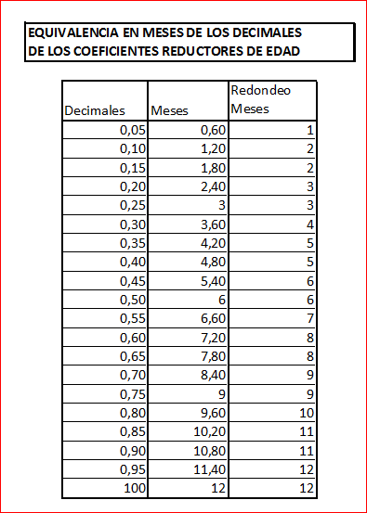
RETIREMENT – EXAMPLE 退休-实例
降低年限系数的十进制同比月数
TOTAL 总计
  0.30 x 1 years（年） = 0.30
  0.25 x 30 years（年） = 7.50
  0.15 x 2 years （年）= 0.30
  8.10 → 8 years（年）
  0.10 (equivalency table 同比表) = 2 months （月）
  COE: 8 YEARS 2 MONTHS
  降低系数：8年零2个月

Slide 23
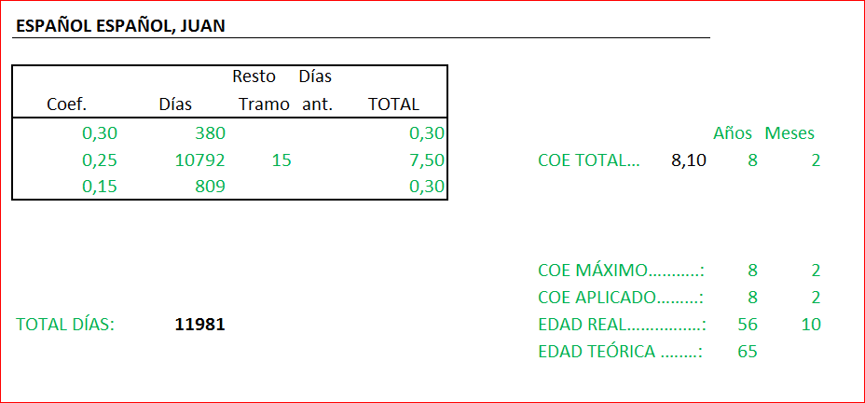
RETIREMENT – EXAMPLE 退休-实例
西班牙人，胡安
余数
总数
系数
日数
总系数
最高降低系数
应用降低系数
实际年限
总日数
理论年限

Slide 24
RETIREMENT – EXAMPLE 退休-实例
ORDINARY RETIREMENT WITH COEs
  2016 To retire at 65 years: 13,140 days of contributions (36 or more years)
  Date of Birth: 13-04-1959 Retirement.: 13-02-2016
  Days of contributions: 14,030
  Age at retirement: 56 years and 10 months COE: 8 years and 2 months
  THEORETICAL AGE: 65
  Application date: 15-02-2016
  Effective date: 14-02-2016
  REGULATORY BASE 2016 19 years 01/1997 to 12/2015
  Regulatory Base: 964.42 X 100%
按照降低年限系数计算的正常退休
  2016年以65岁退休: 13140日缴费 (36年或更多)
  出生日期: 13-04-1959
  退休日期: 13-02-2016
  缴费日数: 14030
  退休年龄: 56 years and 10 months
  降低系数: 8年零2个月
  理论年龄: 65
  应用日期: 15-02-2016
  生效日期: 14-02-2016
  计算基础 到2016年满19年：1997年01月到2015年12月
  计算基础: 964.42 X 100%

Slide 25
RETIREMENT WITH COEs BY AGGREGATION – EXAMPLE
按照年龄降低系数总合计算的退休-实例
Date of Birth: 01-01-1959
Effective Date: 14-02-2016
Retirement date: 13-02-2016
Contribution in 2016 for 65 years: 14,030
Age at retirement date: 57 years and 1 month Date of application: 15-02-2016
If under 14,030: 65 years and 4 months
Periods accredited in France: 2,639 days
COE by periods on board in France: 11 months (330 days)
Periods accredited in Spain: 5,342 days
COE by periods on board in Spain: 7 years and 4 months (2,675 days)
Total…. 7,981 days
Total days accredited in Spain: 5,342 + 2,675 = 8,017 days
Pro rata paid by Spain: 2,639 + 8,017 = 10,656 days 8,017 / 10,656 = 75.23 % pro rata paid by Spain
CALCULATION 7,981 = 21 years and 316 days
COEs = 8 years and 90 days
30 years and 6 months
PERCENTAGE 15 years = 50%
15 years = (180 + 6 months) 163 x 0.21 = 34.23 %
23 x 0.19 = 4.37 %
Total: 50+34.23+4.37 = 88.60% percentage for years of contributions
REGULATORY BASE 934.98 X 88.60% = €828.39
PRO RATA PAID BY SPAIN: 828.39 X 75.23% = €623.20
出生日期: 01-01-1959
生效日期: 14-02-2016
退休日期: 13-02-2016
到2016年年满65周岁: 14030日
退休年龄: 57 年零1个月
应用日期: 15-02-2016
若小于14030天：65岁零4个月
在法国积累的年限: 2,639日
在法船只工作年龄降低系数: 11 月 (330日)
在西班牙的积累年限: 5,342日
在西班牙船只工作年龄降低系数: 7年零4个月(2,675日)
总合…. 7,981日
西班牙累计总日数: 5342 + 2675 = 8017日
西班牙给付比例: 2639 + 8017 = 10,656 日
8,017 / 10,656 = 75.23 % 西班牙给付比例
计算 7,981 = 21年零316日
年龄降低系数= 8年零90日
年零6个月
比例 15年 = 50%
15 年 = (180 + 6月) 163 x 0.21 = 34.23 %
23 x 0.19 = 4.37 %
总合: 50+34.23+4.37 = 88.60% 缴费年限比例
计算基础 934.98 X 88.60% = €828.39
西班牙给付比例: 828.39 X 75.23% = €623.20

