Slide 1
DIRECT PAYMENT SYSTEM
直接支付系统
Valladolid, 30th Jun 2016
2016年6月30日，巴利阿多利德

Slide 2
Contents
内容
1. GENERAL TREASURY OF THE SOCIAL SECURITY DEPARTMENT: Mission and Competences
社保基金总会：使命与职权
2. PAYMENT SYSTEMS: Classification
支付系统：分类
3. DIRECT PAYMENT SYSTEM: Concept and procedure
直接支付系统：概念与程序

Slide 3
Contents
内容
1. GENERAL TREASURY OF THE SOCIAL SECURITY DEPARTMENT: Mission and Competences
社保基金总会：使命和职权
2. PAYMENT SYSTEMS: Classification
支付系统：分类
3. DIRECT PAYMENT SYSTEM: Concept and procedure
直接支付系统：概念与程序

Slide 4
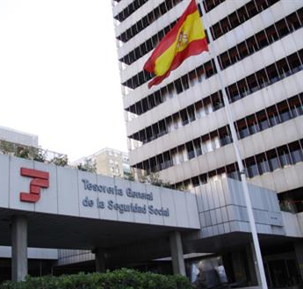
1. GENERAL TREASURY OF THE SOCIAL SECURITY DEPARTMENT
社保基金总会
Madrid
Madrid

Slide 5
1. GENERAL TREASURY OF THE SOCIAL SECURITY DEPARTMENT
社保基金总会
PROVINCIAL HEADQUARTERS
省级总部
Valladolid
Valladolid

Slide 6
1. GENERAL TREASURY OF THE SOCIAL SECURITY DEPARTMENT
社保基金总会
我们的使命
The mission of the General Treasury of the Social Security (TGSS) is to provide an effective service with the highest levels of quality, meeting the demands of citizens, providing the widest range of facilities to accomplish their obligations, with the minimum cost to society. 社保基金总会（TGSS）的使命就是提供高质量的有效服务，满足公民的需求，同时提供大量的便利设施完成公民的各项义务，最大限度地节省社会成本。

Slide 7
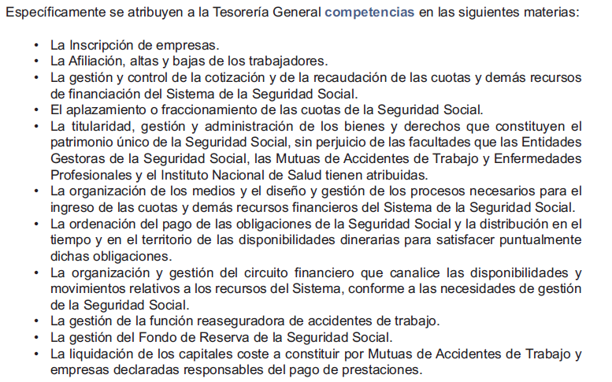
1. GENERAL TREASURY OF THE SOCIAL SECURITY DEPARTMENT
社保基金总会
职权范围
Specifically the TGSS is attributed the following competences:
社保基金总会被特别富裕下列职权：
The management and control of the contribution and the collection of quotas and other funding resources of the Social Security System.
管理和掌控规定常规缴费征收和社保体系其他筹资渠道。

Slide 8
Contents
内容
1. GENERAL TREASURY OF THE SOCIAL SECURITY DEPARTMENT: Mission and Competences
社保基金总会：使命与职权
2. PAYMENT SYSTEMS: Classification
支付系统：分类
3. DIRECT PAYMENT SYSTEM: Concept and procedure
直接支付系统：概念与程序

Slide 9
2. PAYMENT SYSTEMS: Classification
支付系统：分类
1
Self-assessment
system
Self-assessment payment system by the person responsible for making the Social Security contributions and for joint collection. 自估自我评估支付系统：由社保征缴与联合征缴责任人实现
自我评估系统
2
Simplified liquidation system
Direct simplified liquidation system by the General Treasury of the Social Security system for Special Regimes.
直接简化清算系统：由社保基金总会特别计划的负责部门管理
简化清算系统
3
Direct payment system by the General Treasury of the Social Security system, for each worker, according to the data available about the workers obliged to make contributions and the data that must be submitted by the persons responsible for making contribution payments.
直接支付系统：由社保基金总会负责，根据个人有效数据对每一工作者进行征缴，且数据须由征缴责任人提交。
Direct Payment
System
直接支付系统

Slide 10
Contents
内容
1. GENERAL TREASURY OF THE SOCIAL SECURITY DEPARTMENT: Mission and Competences
社保基金总会：使命与职权
2. PAYMENT SYSTEMS: Classification
支付系统：分类t
3. DIRECT PAYMENT SYSTEM: Concept and procedure
直接支付系统：概念与程序

Slide 11
Contents
内容
1. GENERAL TREASURY OF THE SOCIAL SECURITY DEPARTMENT: Mission and Competences
社保基金总会：使命和职权
2. PAYMENT SYSTEMS: Classification
支付系统：分类
3. DIRECT PAYMENT SYSTEM: Concept and procedure
直接支付系统
3.1. Concept
概念
3.2. Contribution Payment procedure
缴费支付程序
3.3. Implementation
运行
3.4. Advantages
优点

Slide 12
Contents
内容
1. GENERAL TREASURY OF THE SOCIAL SECURITY DEPARTMENT: Mission and Competences
社保基金总会：使命和职权
2. PAYMENT SYSTEMS: Classification
支付系统：分类
3. DIRECT PAYMENT SYSTEM: Concept and procedure
直接支付系统：概念和程序
3.1. Concept
概念
3.2. Contribution Payment procedure
缴费支付程序
3.3. Implementation
运行
3.4. Advantages
优点

Slide 13
3. DIRECT PAYMENT SYSTEM 直接支付系统
3.1. Concept 概念
SECRETARY OF STATE OF THE SOCIAL SECURITY DEPARTMENT
社会保障部国务委员
“It represents a historic change in the way of contributing to the Social Security System”
Madrid, 10/4/2014
“这昭示着社保体系缴费方式的历史性变革。”
马德里, 2014年4月10日

Slide 14
3. DIRECT PAYMENT SYSTEM 直接支付系统
3.1. Concept 概念
What is SLD (Direct Payment System)?何谓SLD（直接支付系统）
A new procedure for exchanging information via the Internet, allowing companies and professionals to manage all the information needed for payment of contributions for their workers, without a limit to the number of workers.
是通过互联网交换信息的新程序，可让企业与专业机构管理所有与其员工缴费相关的必要信息，而不限制员工数量。
An application adapted to the Direct Payment System is required to send the different files and receive the answers.
直接支付系统所运用的程序必须能够发送不同文件并接受回应信息。

Slide 15
3. DIRECT PAYMENT SYSTEM 直接支付系统
3.1. Concept 概念
Evolution RED System RED系统演变史
RED SYSTEM
RED系统实施
CHRONOGRAPHY
编年表
1995
Direct RED – Contributions
General Regime of SS
直接RED系统：向普通社保计划缴费
2008
2011
Mandatory RED
法定RED系统实施
Mandatory NOTESS
法定NOTESS系统实施
2013
2015
DIRECT PAYMENT SYSTEM
直接支付系统建立

Slide 16
3. DIRECT PAYMENT SYSTEM 直接支付系统
3.1. Concept 概念
LAW OF DIRECT PAYMENT SYSTEM 直接支付系统法律
ACT 34/2014 OF 26 DECEMBER, ON MEASURES RELATED TO THE PAYMENT AND RECEIPT OF SOCIAL SECURITY PAYMENTS
2014年第34号（12月26日）社会保障支付款项计算及其收据管理法案
Social Security contributions payable jointly will be paid in accordance with this Act and in its implementing regulations
可联合支付的社保缴费应根据该法案及其执行规定
CONTRIBUTIONS/
COLLECTION
缴费/征缴
Scope of management 管理范围
It adapts the social security legislation to the new payment system 社保法律修订并适用于新的缴费支付系统
It regulates the progressive implementation of the Direct Payment System 规范直接支付系统的进一步运行

Slide 17
3. DIRECT PAYMENT SYSTEM 直接支付系统
3.1. Concept 概念
What is Direct RED? 何谓直接RED
It is a service that allows small companies to meet their Social Security obligations via a direct Internet connection with the TGSS in real time.
该服务可让小型企业直接通过互联网与社保基金总会进行实时互动，履行社保义务。
Aimed at companies with 15 or fewer workers at the time of requesting the authorisation, although the company may continue to be managed through Direct RED until the CCC includes 25 workers
目标在于具有15名或更少职工的企业，助其完成义务，在其缴费账户号码达到25名员工以前，仍通过直接RED系统处理社保事务。
In production since February 2008
2008年2月开始运行

Slide 18
Contents
内容
1. GENERAL TREASURY OF THE SOCIAL SECURITY DEPARTMENT: Mission and Competences
社保基金总会：使命和职权
2. PAYMENT SYSTEMS: Classification
支付系统：分类
3. DIRECT PAYMENT SYSTEM: Concept and procedure
直接支付系统：概念和程序
3.1. Concept
概念
3.2. Contribution Payment procedure
缴费支付程序
3.3. Implementation
运行
3.4. Advantages
优点

Slide 19
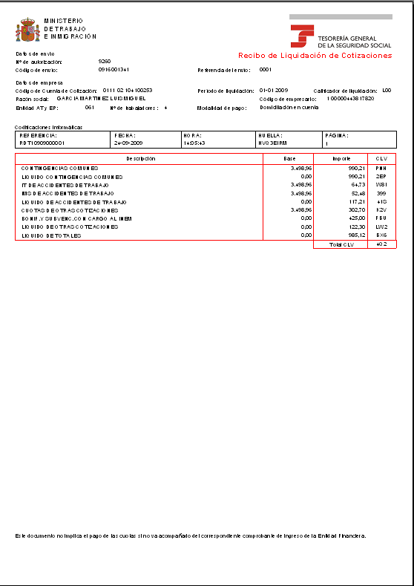
3. DIRECT PAYMENT SYSTEM 直接支付系统
3.2. Contribution Payment procedure
缴费支付程序
How does Direct RED work? 直接RED系统如何运作?
USERS
Direct RED Mailbox
直接RED邮箱
Professionals in Associations
协会专业人士
FGB
(contribution base file)
缴费基础文件
TC2
Payment receipt 支付收据
Decision on Membership
参保成员决定书
Companies
企业
Correct processing
Consolidation
Incorrect action/
error 错误
FGA
(Membership file)
参保成员文件
Third Parties
第三方
Does not allow submission with error
Internet
互联网
TGSS
社保基金总会
SILCON certificate or electronic DNI (ID)
SILCON证书或电子DNI(身份证)
The user initiates the action of Membership or Contributions
用户开启参保人员事务或开始缴费
The TGSS requests data from the user
社保基金总会要求用户提供数据
Checks 检查
Validations 效用
Calculations 计算

Slide 20
3. DIRECT PAYMENT SYSTEM 直接支付系统
3.2. Contribution Payment procedure
缴费支付程序
CHARACTERISTICS OF THE NEW PROCEDURE 新程序特征
Old model
现行模式
New model
新模式
Calculations made with information submitted by the company in the FAN file.
根据企业在FAN文档中提供的信息进行缴费计算
Calculations at the level of Contribution Account Code (CCC) 通过缴费账户号码中进行缴费计算
Calculations made based on the information available in our databases and the minimum information submitted by the company.
根据数据库与企业提交的最低数据进行缴费计算
Calculations at the worker level. 根据职工个人情况进行计算
SELF-ASSESSMENT FORM
自我评估形式
INVOICING FORM
缴费凭据形式

Slide 21
3. DIRECT PAYMENT SYSTEM 直接支付系统
3.2. Contribution Payment procedure
缴费支付程序
How does the new procedure work? 新程序如何运作？
TGSS INVOICE
社保发票
TOTAL PAYMENT
完全总额
AUTHORISED PERSON 管理方
AUTHORISED PERSON
管理方
AUTHORISED PERSON REQUESTS PAYMENT
管理房要求缴费
TOTAL PAYMENT
完全总额
NOTIFICATION OF ERRORS
错误通知
CORRECTION OF ERRORS 错误修复
COMMUNICATION OF DATA
(bases, part-time hours...)
信息交换 （基数、兼职、工时
CORRECTION OF TGSS DATABASE INFORMATION
修复社保基金总库数据库信息
ACCEPTS BASES OF THE PREVIOUS MONTH
(Workers without changes with respect to the previous month) 接受之前月份缴费基数
PARTIAL PAYMENT
部分总额
NOTIFICATION OF NEW DATA 新信息通知
POSSIBILITY OF RECEIPT FOR CORRECT WORKERS
无误员工可获取收据
CONSULTATION OF CALCULATIONS
计算咨询

Slide 22
3. DIRECT PAYMENT SYSTEM 直接支付系统
3.2. Contribution Payment procedure
缴费支付程序
AUTHORISED PERSON
管理方
TGSS INVOICE
TOTAL PAYMENT
COMMUNICATION OF DATA
(bases, part-time hours...)
信息交换 （基数、兼职、工时
NOTIFICATION OF ERRORS
AUTHORISED PERSON
CORRECTION OF ERRORS
TOTAL PAYMENT
ACCEPTS BASES OF THE PREVIOUS MONTH
(Workers without changes with respect to the previous month)
接受之前月份缴费基数
POSSIBILITY OF RECEIPT FOR CORRECT WORKERS
PARTIAL PAYMENT
CONSULTATION OF CALCULATIONS
CHARACTERISTICS 特点
The authorised person requests the procedure for invoicing 管理方要求提供发票
The authorised person may request payment until the penultimate day of the month of collection.
管理方可要求在缴费月最后一日前缴费
Only the information not available in the TGSS is transmitted (bases by sections, part-time work coefficient...). 只有社保基金总会不可提供的资料才需传送（各行业基数、兼职工作系数…）
Only the data on workers affected by changes with respect to the previous month.
只有职工数据会因前期月份情况改变而受到影响
The effects of presentation are produced when the invoicing can be calculated.
演示效果在可进行计算时即生成

Slide 23
3. DIRECT PAYMENT SYSTEM 直接支付系统
3.2. Contribution Payment procedure
缴费支付程序
TGSS INVOICE
社保发票
TOTAL PAYMENT
完全支付
AUTHORISED PERSON
AUTHORISED PERSON
AUTHORISED PERSON REQUESTS PAYMENT
NOTIFICATION OF ERRORS
CORRECTION OF ERRORS
TOTAL PAYMENT
CONSULTATION OF CALCULATIONS
POSSIBILITY OF RECEIPT FOR CORRECT WORKERS
PARTIAL PAYMENT
CHARACTERISTICS 特点
Calculation based on information of membership, and that provided by the INSS, SEPE and mutual societies. 缴费根据参保人员及国家社保署、SEPE和互助社的信息计算。
Before generating the receipt, a draft with the calculations is submitted to the employer. 在生成收据前，计算稿本会传送至雇佣企业。
On 24th, 28th and every day after 28th, the TGSS closes the drafts and submits the settlement receipts, although the employer may request them before those days. 在24号、28号及29号以后的每一日，社保基金总会都会停止稿本并传输确定收据，即使企业要求早发。
Update of the calculation at the close. 在缴费月结束前更新计算。

Slide 24
3. DIRECT PAYMENT SYSTEM 直接支付系统
3.2. Contribution Payment procedure
缴费支付程序
TGSS INVOICE
AUTHORISED PERSON
AUTHORISED PERSON REQUESTS PAYMENT
NOTIFICATION OF ERRORS 错误提示
AUTHORISED PERSON
CORRECTION OF ERRORS
TOTAL PAYMENT
POSSIBILITY OF RECEIPT FOR CORRECT WORKERS
PARTIAL PAYMENT
CONSULTATION OF CALCULATIONS
CHARACTERISTICS 特点
The TGSS notifies the employer about any errors and the information needed to complete the calculation of the payment. 社保基金总会提醒雇佣方任何错误以及任何为完成缴费计数而必须的信息。
In the event that the calculation related to all the workers is not possible, the TGSS allows consultation of the workers calculated. 即使未包括所有无误职工，社保基金总会也允许已获得计算的职工进行咨询。

Slide 25
3. DIRECT PAYMENT SYSTEM 直接支付系统
3.2. Contribution Payment procedure
缴费支付程序
TGSS INVOICE
AUTHORISED PERSON
管理方
TOTAL PAYMENT
完全总额
AUTHORISED PERSON REQUESTS PAYMENT
AUTHORISED PERSON
CORRECTION OF ERRORS 错误修复
NOTIFICATION OF ERRORS
CORRECTION OF TGSS DATABASE INFORMATION
修复社保基金总库数据库信息
PARTIAL PAYMENT
部分总额
CONSULTATION OF CALCULATIONS
NOTIFICATION OF NEW DATA 新信息通知
POSSIBILITY OF RECEIPT FOR CORRECT WORKERS
无误员工可获取收据
CHARACTERISTICS 特点
The authorised person may correct the errors that prevent the calculation before the conclusion of the presentation period by procedures that are exclusively electronic. 在演示结束前，管理方会修复为防止电子程序计算错误而出现的错误。
If it is not possible to correct the errors, starting on 24th, the TGSS issues a partial payment receipt for the workers whose calculation has been properly done, as long as it is requested by the authorised person. 从每月24号开始，在社保基金总会在管理方要求下计算部分支付收据时，无法修复错误。

Slide 26
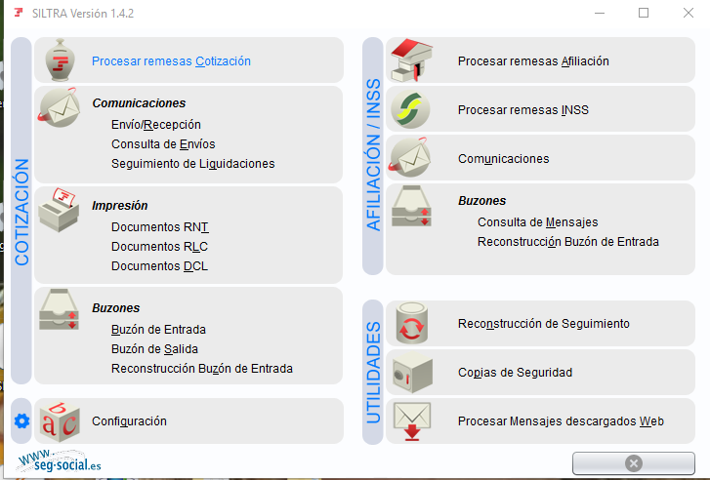
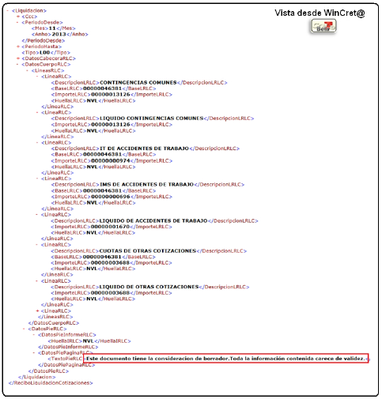
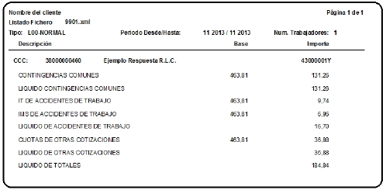
3. DIRECT PAYMENT SYSTEM 直接支付系统
3.2. Contribution Payment procedure
缴费支付程序

Slide 27
Contents
内容
1. GENERAL TREASURY OF THE SOCIAL SECURITY DEPARTMENT: Mission and Competences
社保基金总会：使命与职权
2. PAYMENT SYSTEMS: Classification
支付系统：分类
3. DIRECT PAYMENT SYSTEM: Concept and procedure
直接支付系统：概念与程序
3.1. Concept
概念
3.2. Contribution Payment procedure
缴费支付程序
3.3. Implementation
运行
3.4. Advantages
优点

Slide 28
3. DIRECT PAYMENT SYSTEM 直接支付系统
3.3. Implementation 运行
Implementation of the Direct Payment System
直接支付系统运作
Run-in period, initial authorisations
运行阶段，授权正规运作起步
JAN
2015年1月
FEB
2015年2月
MAY
2015年5月
…
OBLIGATION 义务
Start of notification of obligation
开始确认义务
1st transmission in real SLD (auth. Direct RED)
第1次传入真实SLD系统
（直接RED）
1st transmission in real SLD (auth. RED Internet)
第1次转入真实SLD系统
（在线RED）
8 JANUARY 2015: Approval of Resolution of 8 January 2015 by the SESS, which regulates the online notification of mandatory incorporation into the Direct Payment System.
2015年1月8日：《SESS系统批准决议》，规定了与直接支付系统的法定整合及其在线确认方式。

Slide 29
3. DIRECT PAYMENT SYSTEM 直接支付系统
3.3. Implementation 运行
Implementation of the Direct Payment System 直接支付系统运作
Companies notified 通知企业
Accumulated data
January
2015年1月
February
2015年2月
March
2015年3月
…
April
2016年4月
April
2016年4月
…
RED authorisations
管理部门
24
285
42.486
73
1.412
50.982
1.285
20.209
602.560
2.635
11.688
398.951
46.593
723.749
6.574.312
…
Companies
企业
…
Workers
职工
MOVE TO REAL 移至现实
May
2015年5月
June
2015年6月
July
2015年7月
…
August
2016年8月

Slide 30
3. DIRECT PAYMENT SYSTEM 直接支付系统
3.3. Implementation 运行
TOTAL FIGURES
总数
2,4
million
Companies
2400万家企业
11.540
civil servants TGSS
11540位社保基金总会公务员
131.000
Authorisations
1131，000例授权正规运作
13,3 million
Workers
1330万工作者

Slide 31
Contents
内容
1. GENERAL TREASURY OF THE SOCIAL SECURITY DEPARTMENT: Mission and Competences
社保基金总会：使命与职权
2. PAYMENT SYSTEMS: Classification
支付系统：分类
3. DIRECT PAYMENT SYSTEM: Concept and procedure
直接支付系统
3.1. Concept
概念
3.2. Contribution Payment procedure
缴费支付程序
3.3. Implementation
运行
3.4. Advantages
优点

Slide 32
3. DIRECT PAYMENT SYSTEM 直接支付系统
3.4. Advantages 优点
MAIN ADVANTAGES 主要优点
SIMPLIFICATION OF COMPLIANCE WITH OBLIGATIONS
简化义务履行方式
Application by TGSS of the regulations governing contributions
通过社保基金总会执行缴费管理规则
Reduction of burdens on employers as less information has to be transmitted
减轻企业信息报告负担
FOR COMPANIES
对于企业
MORE INFORMATION
更多信息
Availability of information on contributions and details of calculation of the payment at worker level
对职工缴费计算细节有更多的了解
FOR WORKERS
对于职工
IMPROVED MONITORING AND CONTROL
改善监管
Improved control of the obligation to make contributions
改善对企业职工义务的监督，增加缴费
A priori control
系优先监管
FOR THE TGSS
对于社保基金总会

Slide 33
THANK YOU
谢谢

