Slide 1
Organization and functioning of employment and social protection Committees of the UE Commission and its subgroups.
欧盟委员会就业与社保委员会及其下属机关的组织与作用
Madrid, 21 June 2016
2016年6月21日 马德里

Slide 2
Index 目录
Part. I: General Background of the UE
第一部分：欧盟背景情况
Part II. Economic Policy coordination in the UE. The European Semester
第二部分：欧盟经济政策协调：“欧盟经济季度”制度

Slide 3
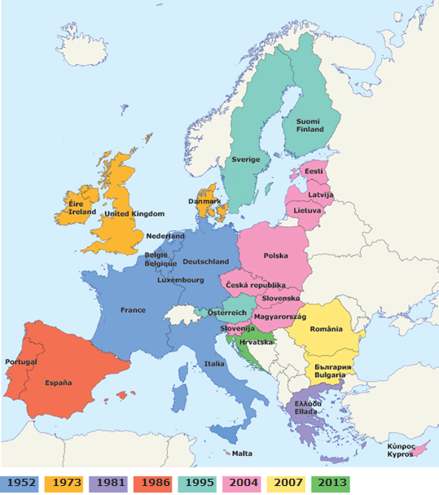
U.E. MEMBER STATES 欧盟成员国
28 MMEE
500 million people.
24 official languages
Big enlargement: From 2014 onwards
28个成员国
5亿人口
24门官方语言
2014年以来持续扩大

Slide 4
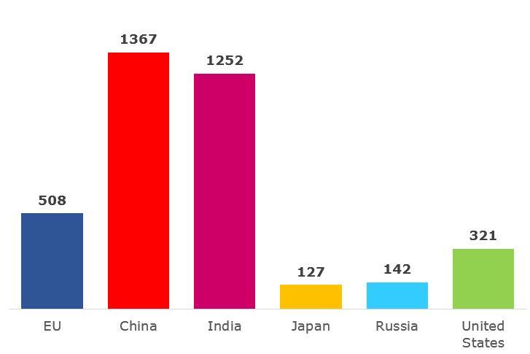
U.E. POPULATION COMPARE TO THE REST OF THE WORLD 欧盟人口与世界其他地区人口比较
Population range from 81,2 million Germany to 0,4 Malta
5 countries: Germany, France, UK, Italy and Spain = 320 millions
人口最多为德国（8120万），最小为马耳他（40万）
5大国：德、法、英、意、西=3200万人口

Slide 5
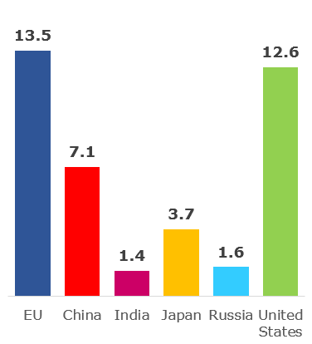
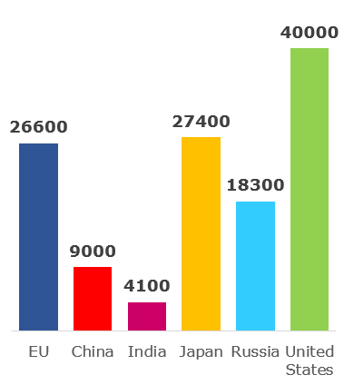
HOW RICH COMPARE TO THE REST OF THE WORLD? 欧盟比其他地区富裕多少？
Size of economy:
GDP in trillions of euro (2013)
经济规模：
GDP，万亿欧元（2013年）
Wealth per person:
GDP per person (2013)
人均财富：人均GDP（2013年）
UE: media 28 100 = 25.700
Range: from 263 Luxembourg to 45 Bulgaria
欧盟28国平均值：100=25.700
最大：卢森堡 263
最小：保加利亚 45
欧 中 印 日 俄 美
欧 中 印 日 俄 美

Slide 6
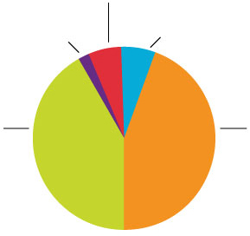
UE BUDGET: HOW IS IT SPENT? 欧盟预算：如何支出？
2015 EU budget: € 145.3 billion
2015年欧盟预算：1453亿欧元
Global Europe:
including development aid
欧洲全球支出：包括发展援助
6 %
Security and citizenship, justice
安全事务、公民权、法律正义事务
2 %
Other, administration
其他，行政事务
6 %
Sustainable growth –
natural resources:
agriculture, environment
可持续发展-自然资源：农业，环境
40 %
Smart and inclusive growth:
jobs, competitiveness,
regional development
欧洲智能型包容性发展事务：
工作、竞争力、地区发展
46 %

Slide 7
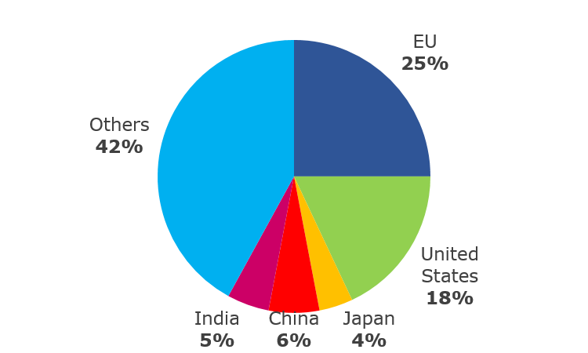
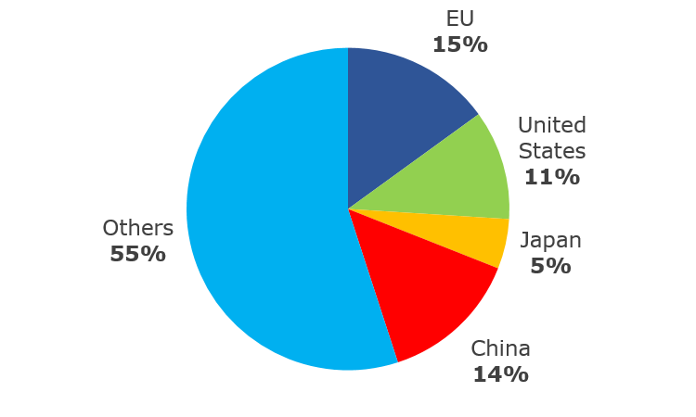
THE UE A MAJOR TRADING POWER 欧盟：世界主要商贸力量
% of global exports
goods (2012)
全球商品出口百分比（2012）
% of global exports
services (2012)
全球服务出口百分比（2012）
欧盟
欧盟
其他
美国
其他
日本
美国
中国
印度
中国
日本

Slide 8
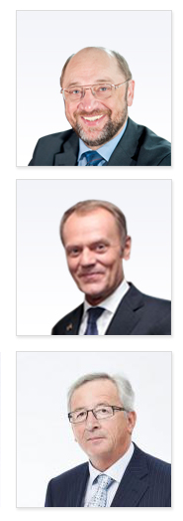
THREE MAIN PLAYERS 三大机构要员
The European Parliament
- voice of the people
Martin Schulz, President of the European Parliament: 751 Members: >50% Socialist Party and EPP Party
欧洲议会
- 人民的声音
马丁·舒尔茨，欧洲议会主席；全会751名议员；50%以上为社会主义党团和欧洲人民党团（EPP）
The European Council and the Council
- voice of the Member States
Donald Tusk, President of the European Council: Heads of States. 352 votes.
欧盟理事会
-成员国的声音
唐纳德·图斯克，欧盟理事会主席；理事会成员各国首脑；共352票。
The European Commission
- promoting the common interest
Jean-Claude Juncker, President of the European Commission: 28 Commissioners; 34.000 workers.
欧盟委员会
- 推进共同利益
让-克劳德·容克，欧盟委员会主席；全会25名委员；34000名工作人员

Slide 9
INSTITUTIONS 欧盟机构
European Parliament
欧洲议会
European Council
欧盟理事会
Commission
欧盟委员会
Council of Ministers
部长理事会
Commissioners
委员
UE Court
欧盟法庭
Auditors
审计会
Economic and Social Committee
经济社会委员会
Agencies
各机关
European Investment Bank
欧洲投资银行
Committee of the Regions
各地区委员会
European Central Bank
欧洲中央银行

Slide 10
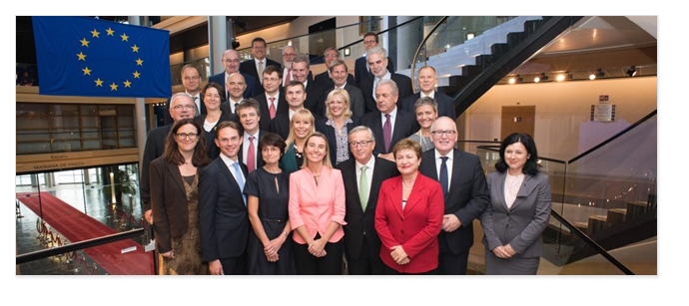
THE EUROPEAN COMISSION: PROMOTING COMMON INTERESTS 欧盟委员会：推进共同利益
28 independent members, one from each EU country
28个独立成员国，每一国派驻一位代表委员.
Proposes new legislation 提出立法新案
Executive organ 执行机关
Guardian of the treaties 维护诸项条约
Represents the EU on the international stage 在国际上代表欧盟

Slide 11
COUNCIL OF MINISTERS: VOICE OF THE MMSS 欧盟部长理事会：成员国的声音
One minister from each EU country 每一成员国派驻一位部长级官员
Presidency: rotates every six months 主席职权：每六月轮值
Decides EU laws and budget together with Parliament 与欧洲议会共议法律和预算
Manages the common foreign and security policy 掌管共同外交与安全政策

Slide 12
COUNCIL OF MINISTER: HOW THEY VOTE 欧盟部长理事会：如何投票
Most decisions in the Council are taken by ‘double majority’.
理事会的大多数决策通过“双重多数制”决定
A decision must have the support of at least:
每一项决策均须至少得到：
• 55 % of Member States (16 countries)
55%成员国（即16国）的支持；
• Member States that represent 65 % of the EU’s population
人口总数达欧盟65%的成员国支持。

Slide 13
Index 目录
Part II. Economic Policy coordination in the UE. The European Semester
第二部分：欧盟经济政策协调: “欧盟经济季度”制度

Slide 14
STEPS TO THE COORDINATION OF THE ECONOMIC POLICY (1) 经济政策协调步骤（1）
The process of economic integration goes in parallel with the history of the EU.
EU Member States focused on the establishment of a single market when the EU was founded in 1957. Eventually it turned clear a need for economic and monetary cooperation for further development and flourishing of the internal market.
However, only with the Treaty of Maastricht in 1992 this idea start making feasible. The Treaty defines:
The basic rules for the introduction of the single currency.
The convergence criteria to adopt a single currency the euro, which are low and stable inflation, stable exchange rates and sound public finances
欧盟经济政策过程与欧盟历史并道而行
1957年欧盟成立时，各成员国即致力于建立统一市场。最终表明内部市场的深入发展与繁荣需要经济与货币上的合作
但是，直到《1992年马斯特里赫特条约》签署，方使该理念开始落实。条约界定了：
引入统一货币的基本规则；
统一货币——欧元的加盟标准，即低度且稳定的统账水平、稳定的汇率和良好的公共财政状况。

Slide 15
STEPS TO THE COORDINATION OF THE ECONOMIC POLICY. (2) 经济政策协调步骤（2）
In a single market to coordinate national economic policies is common sense. (19 countries have gone even further by adopting the EURO)
The framework cooperation of the Economic and Monetary Union is the UME itself (which all countries are part of). Here all MMEE agree on common economic guidelines. These common policies reap more growth, more employment and social welfare. Additionally these guidelines provide for a coordinated action of responses before asymmetric shocks and challenges
在统一市场内协调各国经济政策已成共识.(欧盟19个成员国甚至走的更远，已共同采用欧元为货币)
经济与货币联盟就是各国成员都加入所组成的合作框架组织。在此框架之下，所有成员国均同意共同经济指导路线。这些共同的政策路线推进经济增长、促进就业和社会福利。此外，这些指导路线还可在各国出现不均衡的经济动荡和挑战之前，提供协调应对措施。

Slide 16
COORDINATION AND THE SURVEILLANCE. 协调与监测
The surveillance of economic policies focuses on the following areas:
经济政策监测工作聚焦于下列领域：
EEMM macroeconomic developments and evolution of the exchange rate of the euro.
Budgetary positions and policies.
Structural policies in labor markets, products and services as well as cost and price trends.
成员国微观经济发展与欧元汇率变动
预算处境与政策
产品、服务、成本、价格趋势和劳动力市场的结构性政策

Slide 17
THE SEMESTER. (yearly cycle of economic policy coordination) “欧洲经济季度”制度（年度经济政策协调）
November (year “n-1”): Autumn Economic Forecast:
Annual Growth Survey
Alert mechanism report
Commission opinion on draft budgetary plans
UE Specific Recommendation
February: Winter Economic Forcast: (year “n”)
Country Report
May and June: Spring economic forcast: (year “n”)
Country Specific Recommendations （CSRs）
Annual Multilateral Surveillance ( from October year “n” to May year “n+1”)
CSRs and Key Challanges. (Conclusións feeding into the Recomendations year “n+1”)
十一月（“n-1”年度）：秋季经济预测：
年度增长调查
预警机制报告
欧委会预算草案意见
欧盟专项建议
二月：冬季经济预测（“n”年度）
国别报告
五月和六月：春季经济预测：（“n”年度）
国别专项建议（CSRs）
年度多边监测（自“n”年度十月至“n+1”年度五月）
国别专项建议与关键性挑战（嵌入“n+1”年度建议之结论）

Slide 18
INSTITUTIAL COOPERATION TO ISSUE THE COUNTRI SPECIFIC RECOMMENDATION 制定“国别专项建议”的制度层面合作
Commission: Proposal of the CSRs.
欧委会：国别专项建议提案
Council (working through Committees): Last say.
欧理会（通过下属各委员会开展工作）：最后一日
President (MMEE) 主席（各国部长）
28 MMSS （28成员国）
Secretariat (Commission) 秘书处（欧委会）

Slide 19
DECISION TAKEN PROCES ON THE RECOMMENDATION: A DEMOCRATIC PROCEDURE. “国别专项建议”决议过程：民主程序
• Rule comply or explain: the Commission proposal can only be revoked by 合议或解释规则：欧委会提案仅可以下列理由召回：
verifiable and different statistical information.
出现不同并可检验的统计信息；
conclusions multilateral surveillance process.
多边监测过程后的结论认为可召回。
Consensus or MMSS Voting : Qualified majority. (vote)
一致同意或成员国票决：具有资格（有效）的多数（投票）

Slide 20
WHAT THE UE SAY ABOUT PENSIONS?.(1). 欧盟如何处理养老金问题？（1）
Pensions are essential for sustainability of public finances in the medium to long run. Therefore, Minister of Economy and Finance must pay them a lot of attention. Additionally, pensions are: 1) An important element of social stability; 2)Adequacy pensions prevent poverty; 3) There is a close link between employment and pensions (especially in a pay as you go system). Therefore they are of the most concern for Minister of the Employment and social security.
Pension specific recommendation need to be studied by Social Protection Committee –SPC-, Employment Committee –EMCO- (Ministries of Labour and Social Protection), and Economic Policy Committee –EPC- and Financial Committee –EFC- (Ministries of Economy and Finance), having the last say the latter.
养老金是公共财政中长期可持续性问题的关键。因此，经济与财政部长应在此多加注意。此外，养老金是：1）社会稳定的重要元素；2）充足的养老金可预防贫困；3）养老金与就业之间关系密切（特别是在现收现付模式下）。故而，这些都是就业与社会保障部长最为关切的问题。
“养老金专项建议”须由社会保护/保障委员会（SPC）、就业委员会（EMCO，由各国劳动与社会保护/保障部长组成）和财政委员会（EFC,由各国经济与财政部长组成）进行研究。各会对此有发言权。

Slide 21
WHAT THE UE SAY ABOUT PENSIONS?. (2) 欧盟如何处理养老金问题？（2）
From 2010 onwards, almost all EU countries has received CSRs to reform their pension system taken some of the following measures: 1) Increase real age retirement; 2) Eliminate early retirement; 3) Link the retirement age with life expectancy; 4) Link previous social contributions to retirement system to the amount of the retirement benefit
The working age population is expected to decline (a. a rate of 0.4% over the next four decades).
Unless corrective measures are taken, more than half of the Member States face either medium or high sustainability challenges.
Despite, some good progress in fiscal consolidation In many countries due to pension reforms, significant challenges remain to be faced.
自2010年始，几乎所有欧盟国家均会收到国别专项建议，以改革其养老金制度。其办法如下：1）提高实际退休年龄；2）取消提前退休；3）将退休年龄与寿命预期挂钩；4）将过往养老金缴费与退休金额度挂钩。
工作年龄段内人口预期将减少（接下来40年内减率为0.4%）
除非采取正确措施，不然超过半数的成员国将面临中度或高度的可持续性问题。
虽然许多国家因进行了养老金制度改革而在增强财政方面取得了良好的进展，但却仍须面对许多重大的挑战。

Slide 22
WHAT THE UE SAY ABOUT PENSIONS. (2) 欧盟如何处理养老金问题？（2）
Progress in reforming pension systems varies among the Member States.
The pension system was identified as a longer term challenge in a number of Member States (Belgium, Bulgaria, Croatia, Lithuania, Luxembourg, Malta, Austria, Poland, Portugal, Romania and Slovenia) in last year's country-specific recommendations.
Belgium increase the statutory retirement age to 66 years in 2025 and 67 in 2030.
Finland, the earliest eligibility age for old age pension will be gradually raised to 65 by 2025. As of 2027, old age pension will be linked to life expectancy.
France, is expected to improve the financial situation of the complementary pension scheme.
各成员国养老金制度改革过程各有不同
在去年的“国别专项建议”中，许多国家将养老金制度改革视为相当长期的挑战（比利时、保加利亚、立陶宛、卢森堡、马耳他、奥地利、波兰、葡萄牙、罗马尼亚和斯洛文尼亚）
比利时 将法定退休年龄分别在2025年提高到66岁、2030年提高到67岁。
芬兰 养老金最低领取年龄到2025年将逐渐提高到65岁。到2027年以后，养老金将与寿命预期挂钩。
法国 预期将改补充性养老金计划的进财政状况。

Slide 23
WAGE PAGES 网站链接
http://ec.europa.eu/europe2020/images/europeansemestser_big_en.jpg
http://ec.europa.eu/europe2020/making-it-happen/country-specific-recommendations/index_en.htm

Slide 24
谢谢聆听！
THAN YOU VERY MUCH
FOR YOUR ATTENTION

