Slide 1
The impact of ageing on pension systems 人口老龄化对养老金体系的影响
Madrid, 22 June 2016
Antonella Delle Monache – Ministry of Labour and Social policies – Department of pensions and insurance

Slide 2
Index
Demographic analysis: 人口形势分析
Italian population – 2015 indicators 意大利人口 2015指标
European comparison 欧洲横向比较
Ageing definition and measurement 老龄化定义和测算
Impact of ageing on social protection systems 老龄化对社保体系的影响
Italian pension system 意大利养老金体系
Challenges for the future 未来的挑战

Slide 3
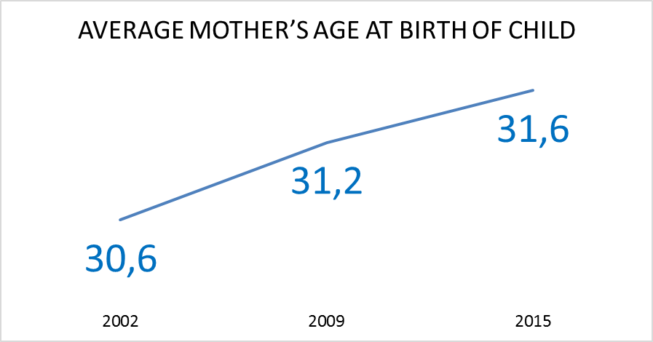
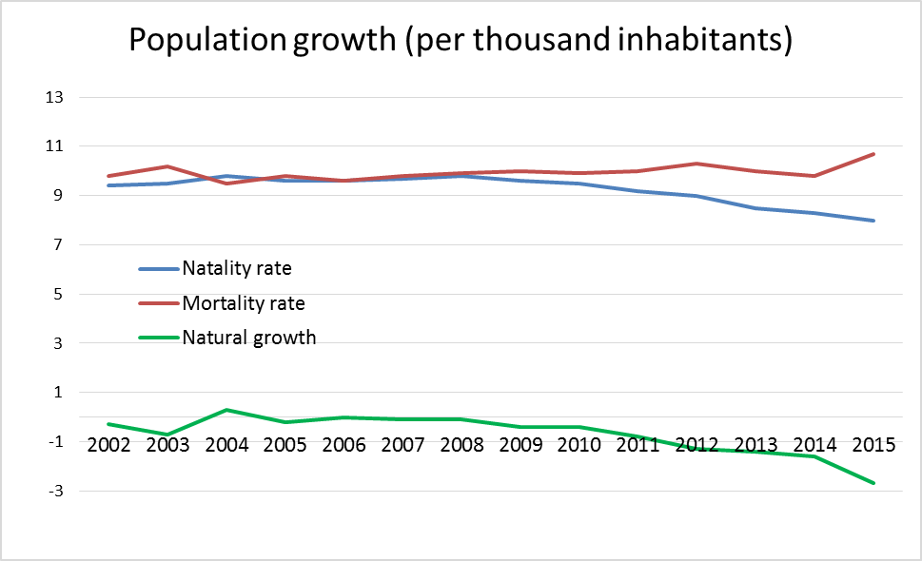
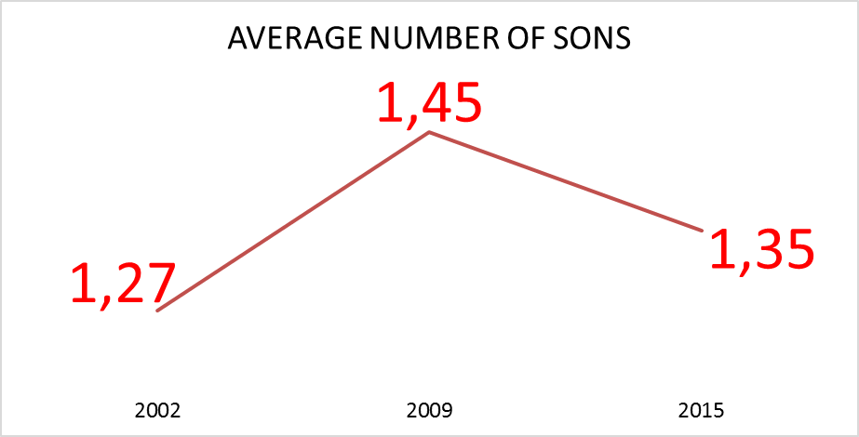
Demographic analysis: Italian population – 2015 indicators 人口形势分析
FECONDITY: natality rate + average number of sons per woman 生育率：出生率＋妇女平均育儿数
MORTALITY: mortality rate + life expectancy (simple but powerful way of illustrating mortality development) 死亡率：死亡率＋寿命（简单而有效地体现死亡率发展趋势）
Source: Elaborations on 2015 Demographic indicators – Italian National Institute of Statistics (ISTAT)

Slide 4
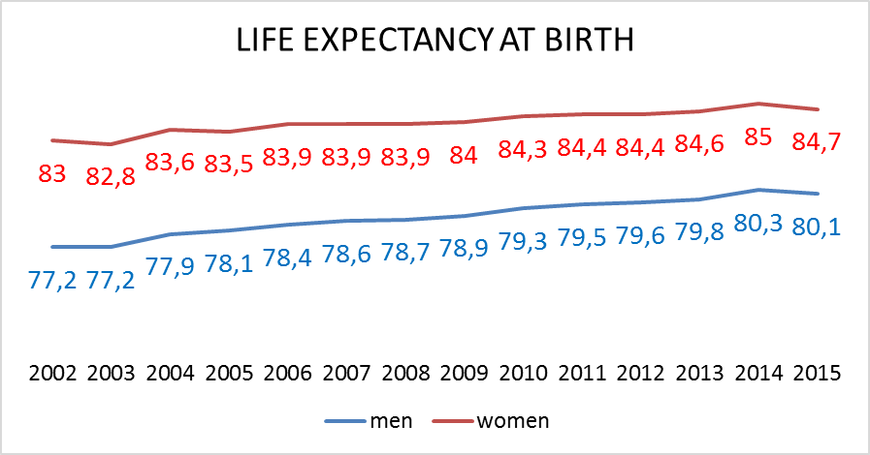
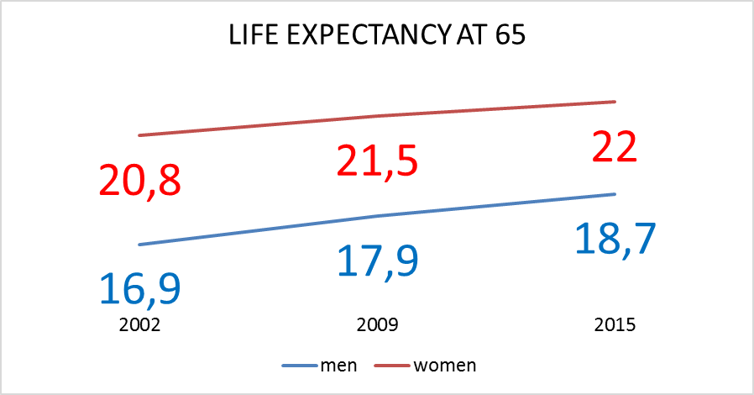
Demographic analysis: Italian population – 2015 indicators 人口形势分析
The mean number of years that a newborn child is expected to live if subjected throughout his life to the current mortality conditions throughout the rest of his or her life
新生儿在当前死亡率水平下平均预期寿命
The mean number of years still to be lived by a man or a woman who has reached the age 65 65周岁后平均预期寿命年限
Source: Elaborations on 2015 Demographic indicators – Italian National Institute of Statistics (ISTAT)

Slide 5
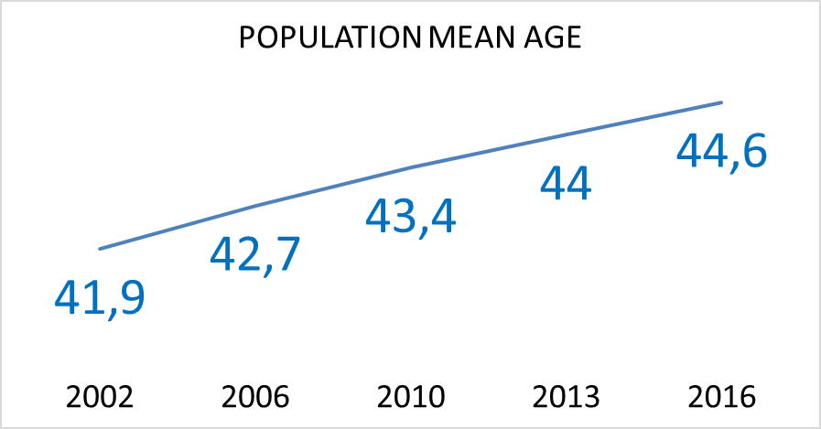
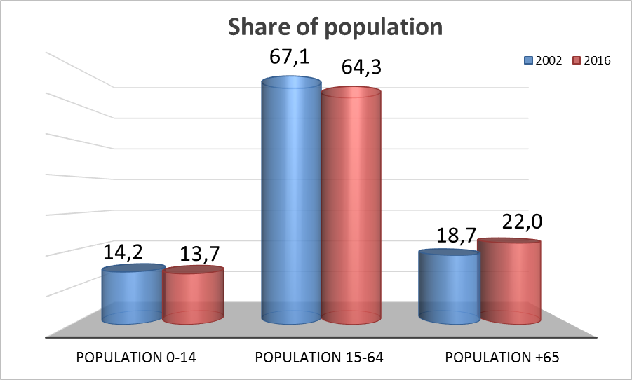
Demographic analysis: Italian population – 2015 indicators 人口形势分析
Development of the age structure of population at 1° January 1月人口年龄结构发展
An increasing share of older persons coupled with a declining share of working-age persons in the total population.
老年人口增加伴随着劳动力人口减少
Source: Elaborations on 2015 Demographic indicators – Italian National Institute of Statistics (ISTAT)

Slide 6
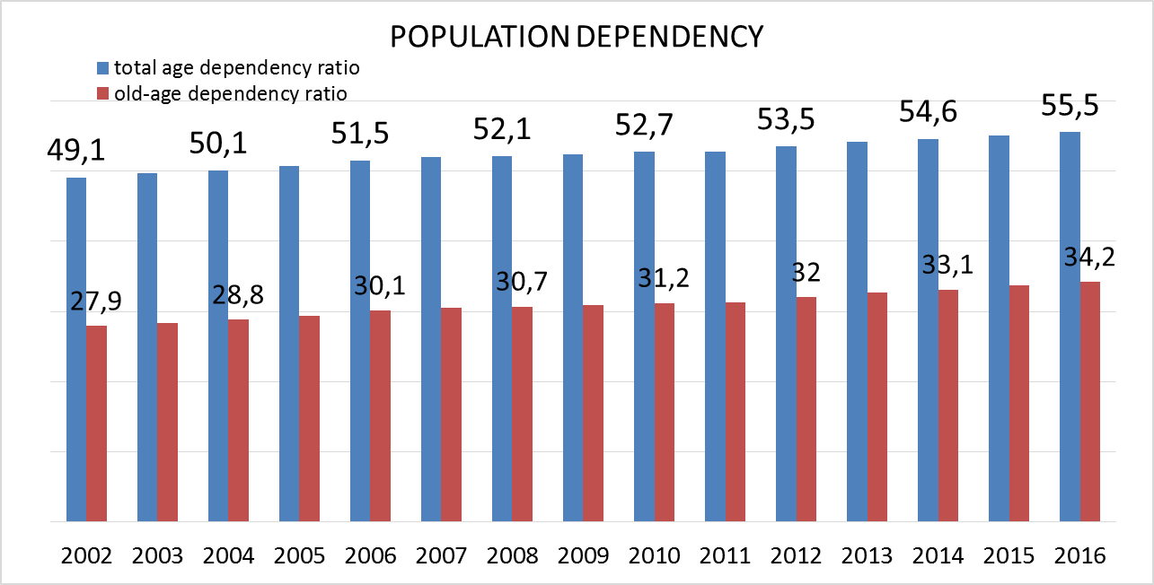
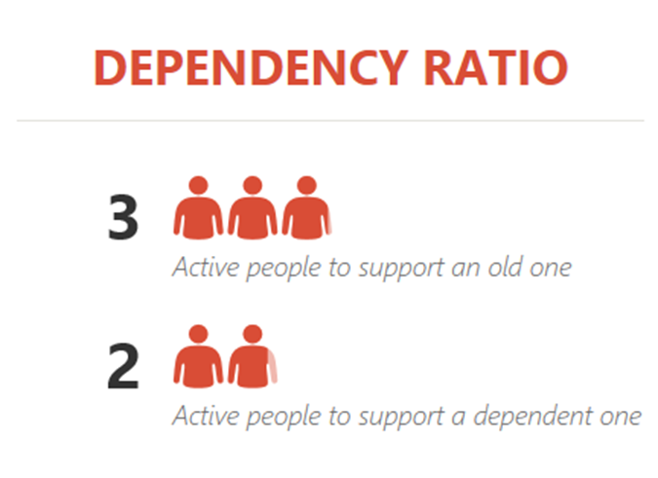
Demographic analysis: Italian population – 2015 indicators 人口形势分析
DEPENDENCY RATIO: population 0-14 and 65+/population 15-64 – measures the economic dependence of people, young and old, in relation to active population 赡养率：0-14岁人口与65岁以上人口数量之和 ／ 15-64岁人口数量 － 测算老年儿童相较于劳动力人口的经济依赖
OLD-AGE DEPENDECY RATIO: population 65+/population 15-64 – measures the level of support given to older persons by the working age population 养老赡养：65岁以上人口／15-64岁人口 － 测算劳动人口对老年人口的支持水平
Source: Elaborations on 2015 Demographic indicators – Italian National Institute of Statistics (ISTAT)

Slide 7
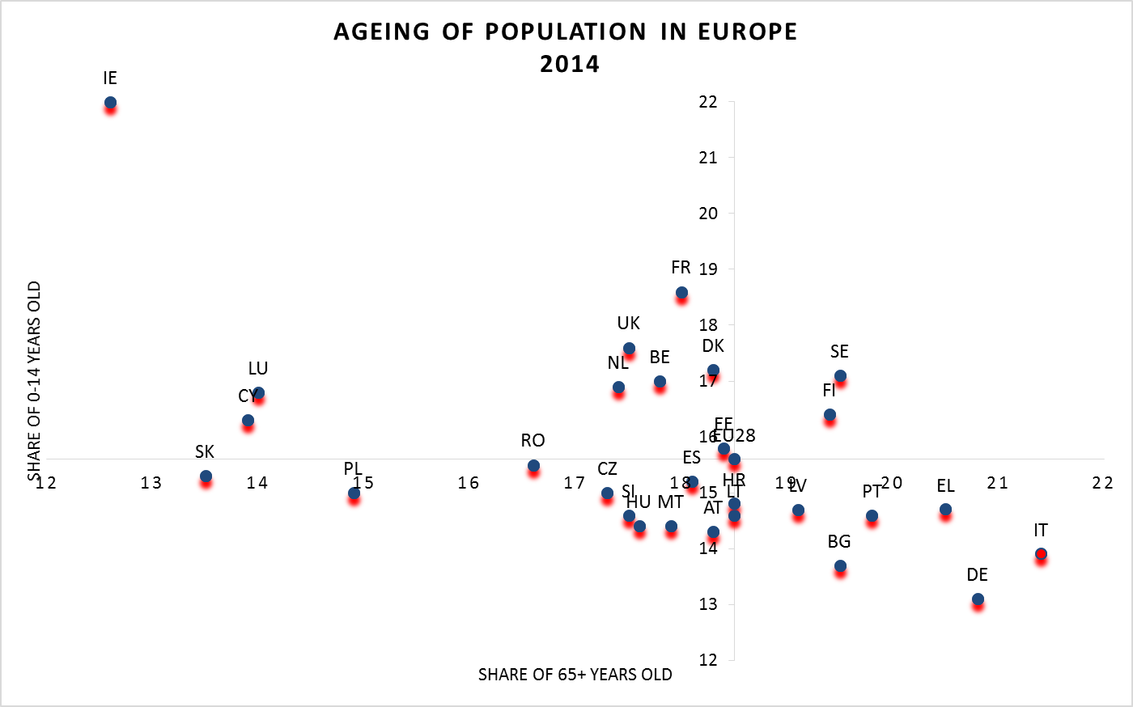
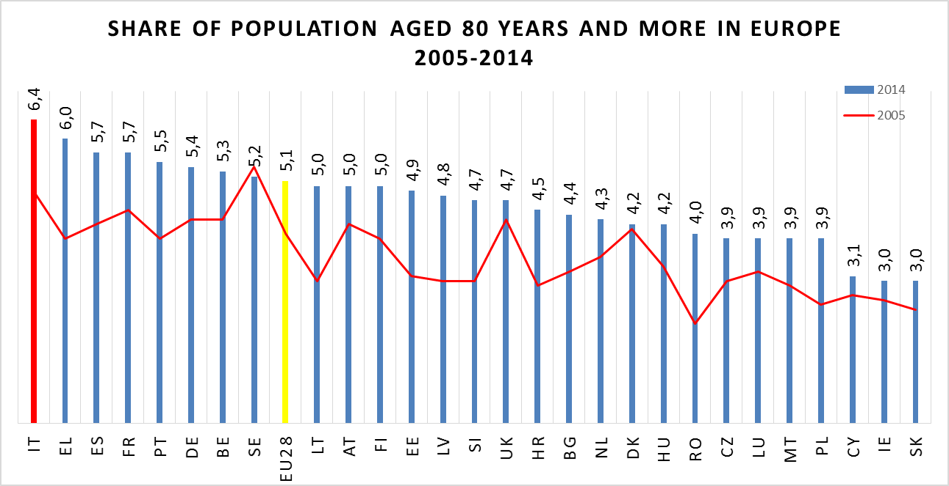
Demographic analysis: European comparison
欧洲横向比较
Italy is one of the countries with high share of population aged 65+ and low share of population aged 0-14
意大利是拥有高65岁以上人口比例、低0-14岁人口比例的国家之一
The share of population aged 80 years or above increased progressively from 2005 to 2014
80岁以上人口在2005年至2014年间逐年攀升
Source: Elaborations on 2014 Eurostat data

Slide 8
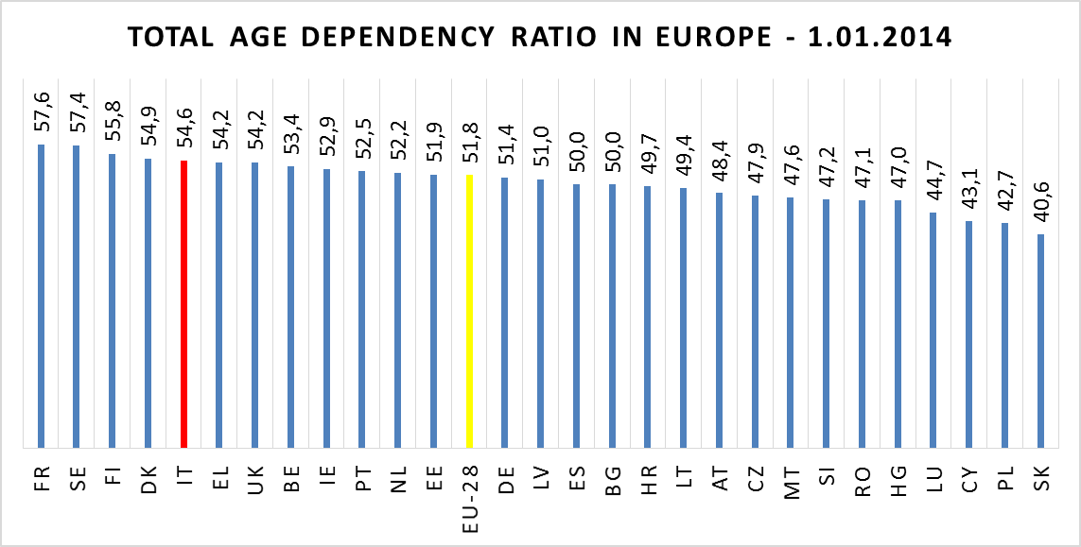
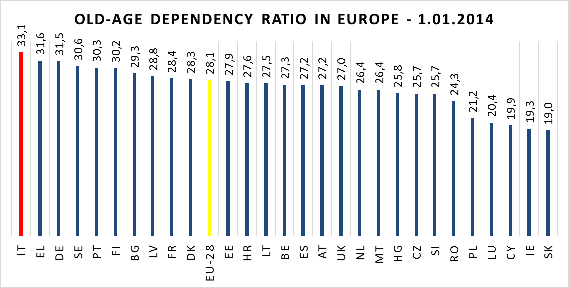
Demographic analysis: European comparison
欧洲横向比较
Approximately two working age persons, aged 15 to 64 years old, for every dependent one, young and old.
大约每2名适龄劳动人口供养1名被赡养者（老人／儿童）
Highest ratio among European countries Approximately three working age persons for every dependent one
老龄赡养率全欧洲最高：大约每3名适龄劳动人口赡养1名老年者
Source: Elaborations on 2014 Eurostat data

Slide 9
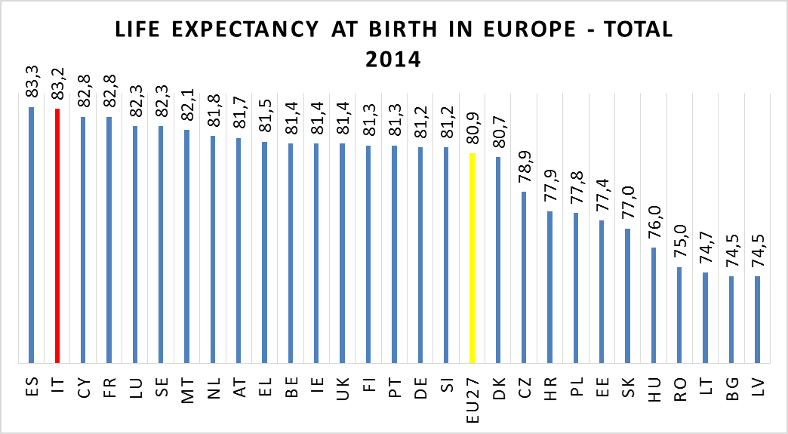
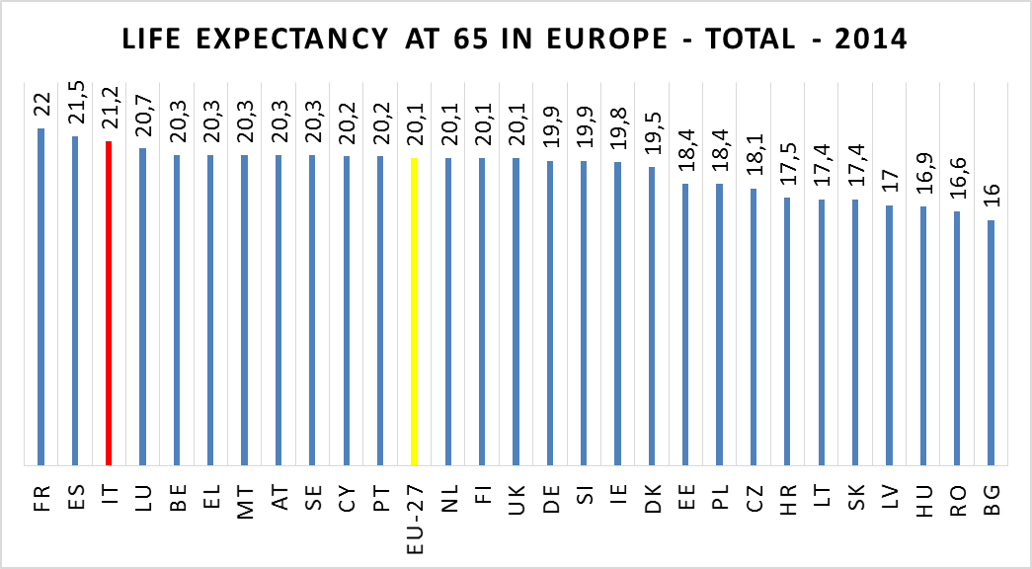
Demographic analysis: European comparison
欧洲横向比较
Italy is among the European countries with high level of life expectancy.
意大利是寿命水平最高的国家之一。
In 2014, once an Italian man had reached the age of 65 he could, on average, expect to live another 21 years
根据2014年数据，达到65岁的人口平均可再活21年。
Source: Elaborations on 2014 Eurostat data

Slide 10
Impact of ageing on social protection systems
ITALIAN POPULATION AGEING MORE THE OTHER EUROPEAN COUNTRIES 意大利的人口老龄化程度高于其他欧洲国家
WHAT IS THE IMPACT ON SOCIAL PROTECTION SYSTEM? 对社保系统的影响？
FIRST CHALLENGE: SUSTAINIBILITY OF PUBLIC FINANCES 首要挑战：财务可持续性
INSTITUTIONAL DEFINITION OF AGEING = 65 YEARS OLD 老龄化的界定：65周岁以上
DOES NOT REFLECT CHANGES OCCURRED TO SOCIAL, ECONOMIC AND HEALTHY CONDITIONS 并不反映社会、经济、卫生条件上的变化
NOWDAYS PEOPLE FROM 65 TO 75 YEARS OLD REACH A GOOD HEALTH STATUS AND LIVE IN GOOD ECONOMIC CONDITIONS 如今65-75岁人口健康状况、经济状况良好
CONSEQUENT SHIFTING OF THE «OLD-AGE THRESHOLD» IS NEEDED TO AVOID EFFECTS ON SUSTAINIBILITY OF SOCIAL PROTECTION SYSTEMS 需要相应地调整‘老龄临界点’以规避对社保系统可持续性的影响

Slide 11
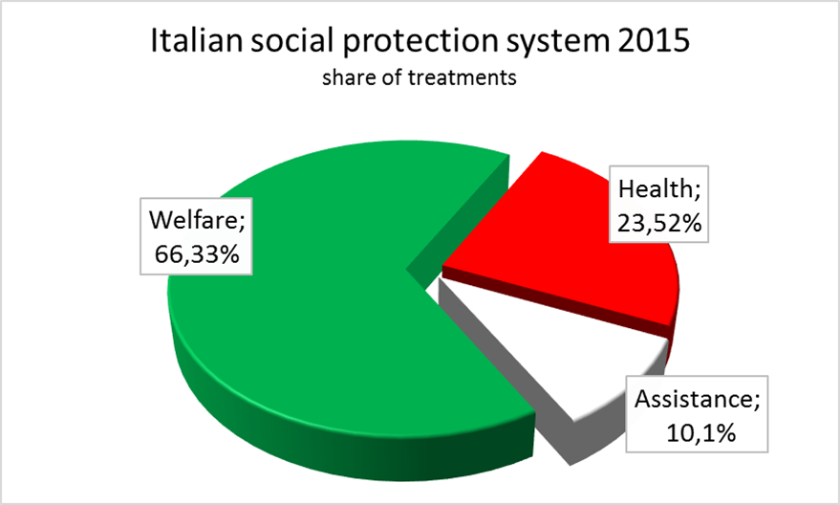
Impact of ageing into the national balance 老龄化对财政收支平衡的影响
ALMOST THE TOTAL EXPENDITURE FOR SOCIAL PROTECTION TREATMENTS IN ITALY IS IN CHARGE TO A PUBBLIC ADMINISTRATION 几乎全部社保待遇管理由一个公共管理机构管理
PENSIONS
养老金 58%
OTHER其他 8%
Medical treatments
医疗待遇
Hospital assistance
医院补贴
Social allowances
社会救助
Source: Elaborations on National Accounts data – Italian National Institute of Statistics (ISTAT)

Slide 12
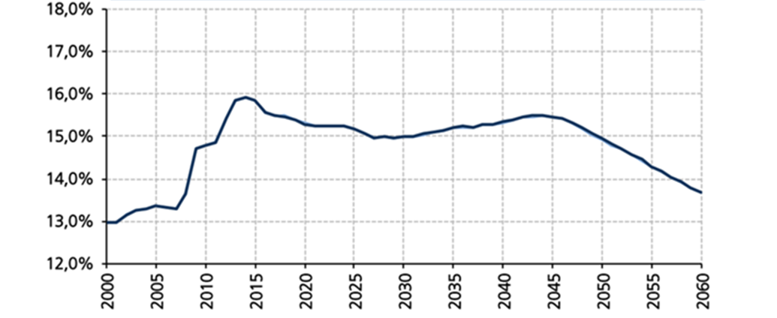
Impact of ageing into the national balance
Italy spends more than a quarter of its GDP on social protection, most of it for the benefit of older people in the form of pensions, health and long-term care.
意大利社保支出占GDP的比例接近25%。其中大部分用以给付老年人口的各项福利待遇，包括养老金、健康及长期照顾。
the baby boomers born in the two decades after World-War II, start to retire
二战20年后出现的婴儿潮一代开始进入退休
PENSIONS EXPENDITURE/GDP PROJECTIONS
A slight decrease due to changes in eligibility conditions 由于准入条件的变化带来的小幅度回落
full implementation of the NDC system
NDC体系的全面实施
Source: MEF, National General Accounting Office, Le tendenze di medio-lungo periodo del sistema pensionistico e socio-sanitario. Report n. 16/2015

Slide 13
Italian pension system 意大利社保体系
Pay-as-you-go system 即收即付体系
defined-benefits (DB) scheme until 1995 1995年以前，固定待遇（DB）计划
Notional Defined Contribution (NDC) scheme since 1996 1996年以后，名义固定缴费（NDC）计划
FIRST PUBBLIC PILLAR 第一公共支柱
- private and public employees 私人－公共领域职工
- self-employed 自雇人员
almost 90% of labour force 90%劳动力
PROFESSIONALS 专业人员
Lawyers, Engineers 律师、工程师
Medical doctors 医生
Accountants, notaries 会计师，公证人员
Specific financing system
特殊财务体系
- DB scheme
- NDC scheme
FIRST PRIVATE PILLAR 第一非公支柱

Slide 14
Italian pension system
1992-1995
PENSION REFORM 养老金改革 (L. n. 335/1995)
applied NDC to new entrants in the labour market after 1.1.1996 对1996年1月1日后加入劳动力市场人员实行NDC
2009-2010-2011
TIGHTENING PENSION REQUIREMENTS 收紧养老金要求
LINK TO LIFE EXPECTANCY 与寿命相关联
FIRST PILLAR REFORMS 第一支柱改革
The DB system remained in force for workers with at least 18 years of contributions in 1995.
DB计划对截至1995年已持续缴费超过18年的职工依然有效
For those with fewer than 18 years the NDC system applies pro rata: only for working years after 1995 缴费年限不足18年的，实行分段计算：只计算1995年之后的工作时间
L. n. 214/2011 accelerated the phasing in the NDC system 加快NDC计划实施进度:
- application to all workers from 2012 2012年起对所有职工施行
- very rapid increase of pensionable age
快速提高养老金领取年限
- minimum contributory period for old-age pensions 施行养老金最低缴费年限

Slide 15
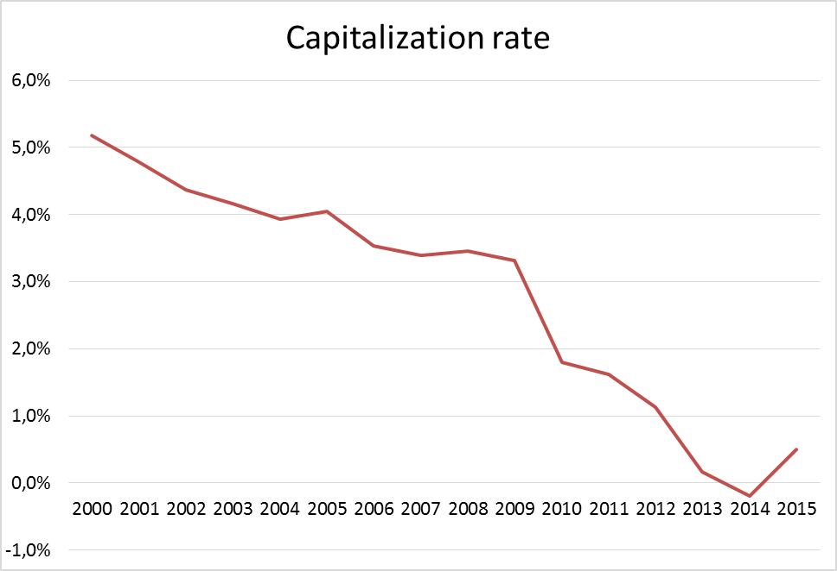
Italian pension system
Contribution rates 缴费水平
33% of gross earnings for private and public employees; 公私职工总收入的33%
20-21% for self-employed, gradually increased to 24% of declared income by 2018; 自雇人员收入的20-21%；2018前提升至申报收入的24％
27% for “project workers” of declared income gradually increased to 33% by 2018. ‘项目职工’申报收入的27%；2018前逐步提升至33%.
Valorization of contributions 缴费稳定措施
Five-years mean of annual nominal GDP growth rate in current prices
Source: Elaborations on data of Italian National Institute of Statistics

Slide 16
Italian pension system
2016 Eligibility conditions old-age pensions 2016年养老金准入条件
66 years岁/7 months月
Employees in public sector (male/female) 公共领域职工（男／女）
Workers in private sector (male) 非公领域职工（男）
66 years岁/1 month月
Self-employed (female) 自雇人员（女）
65 years岁/7 months月
Workers in private sector (female) 非公领域职工（女）
2016 conditions early retirement pensions
2016提前退休养老金条件
42 years岁/10 months 月
Employees in public and private sector and self-employed (male) 公私职工和自雇人员（男）
41 years岁/10 months 月
Employees in public and private sector and self-employed (female) 公私职工和自雇人员（女）

Slide 17
Italian pension system
CHANCE TO GET RETIRED EARLIER THAN STANDARD CONDITIONS 提前于标准退休有可能
BUT 然而
only for workers fully included in the NDC system FULLFILLING the following conditions: 只适用于完全参与NDC计划并且满足以下条件的职工
minimum contribution period of 20 years (instead of the previous 5 years) 缴费超过20年（之前的标准是5年）
Fixed age (not less than 63 years old) 固定退休年龄（不得低于63周岁）
pension amount at least 2.8 times a specific pension threshold “old-age social allowance” (€ 1,200 a month in 2012). 养老金数额至少是‘老年养老补贴’的2.8倍（2012年补贴水平每月1200欧）
Penalizations apply in any case if retirement age is before age 62 针对早于62周岁退休的情况进行处罚

Slide 18
Italian pension system
Pensionable age is automatically adjusted to 养老金领取年龄自动适应于
changes in life expectancy
寿命变化
Variation of life expectancy at age 65 occurred three years prior the evaluation period
评估期前三年间出现65周岁时寿命变化
UPDATING BY MINISTRY OF ECONOMY AND MINISTRY OF LABOUR 财政部及劳动部进行更新
Every 3 years: 2013; 2016; 2019
Every 2 years: afterwards
每三年：2013; 2016; 2019
每两年：之后
First adjustment 1.01.2013: 3 months 第一次调整：2013年1月1日：3个月
Last updating 1.01.2016: 4 months 最新调整：2016年1月1日：4个月
Pensionable age grows in combination of effects: 养老金可领取年龄随着以下因素变化增长
Pension reforms 养老金改革
Life expectancy increasing 寿命增长

Slide 19
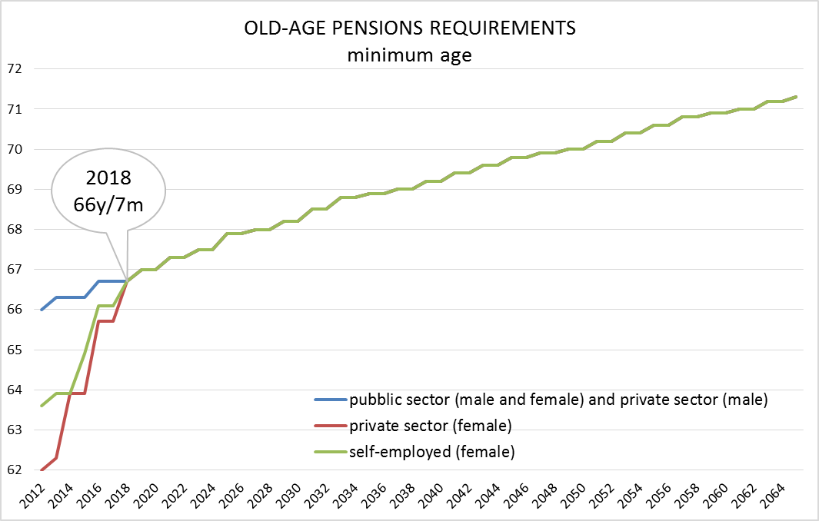
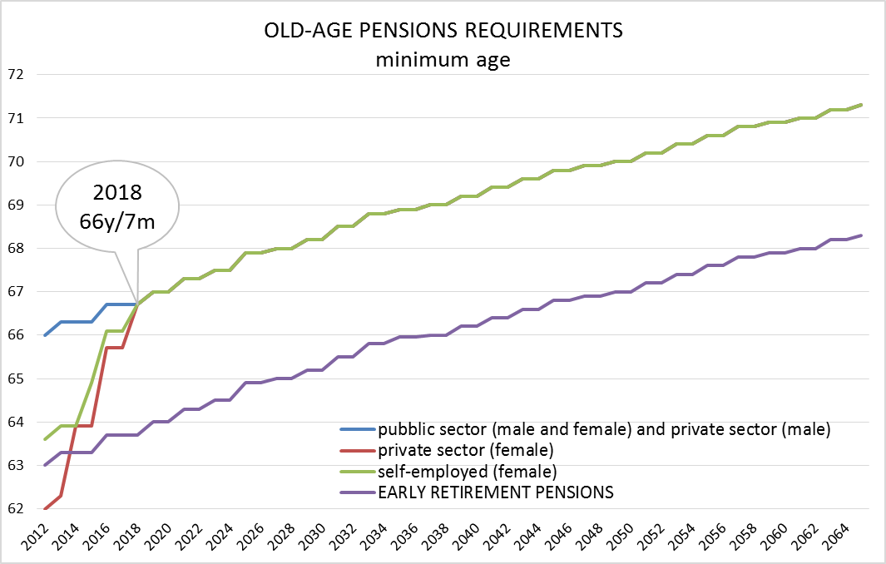
Italian pension system
In line with the ISTAT life expectancy estimations in 2011, pensionable age is expected to converge at 2018 at the age of 66 years and 7 months for all workers, male and female
根据ISTAT 2011年寿命估算，各类男女职工整体可领取养老金年龄预计在2018达到66周岁7个月
Workers fully included in the NDC system are allowed to retire at 63 years and 7 months in 2016 完全参与NDC系统职工在2016年达到63周岁7个月即可退休
Source: MEF, National General Accounting Office, Le tendenze di medio-lungo periodo del sistema pensionistico e socio-sanitario. Report n. 16/2015

Slide 20
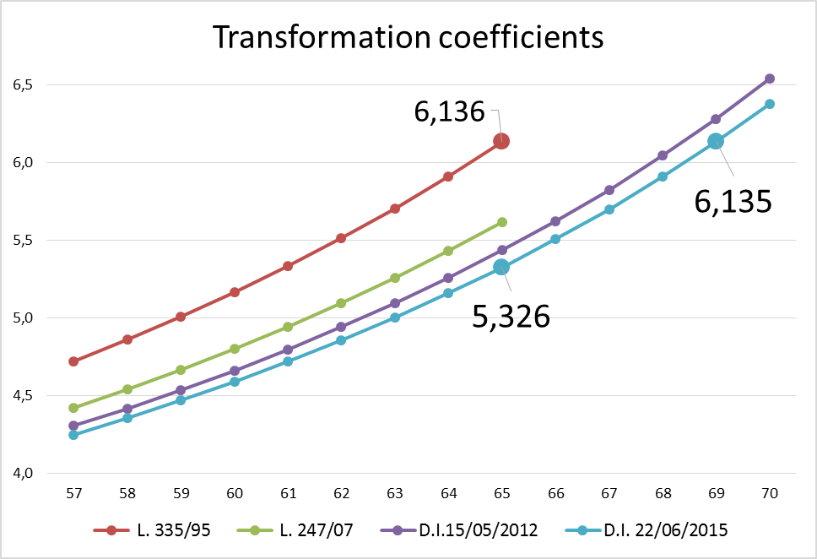
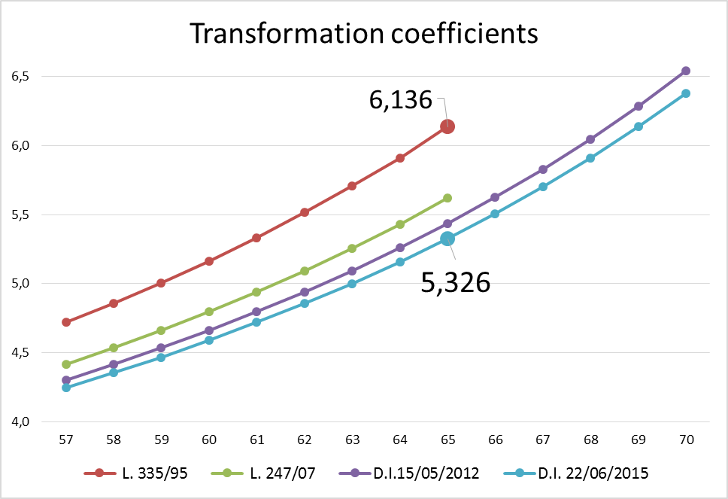
Italian pension system
Automatically adjustement to changes in mortality is also applied to contributive pensions formula 根据死亡率自动调整也适用于缴费型养老金计算公式
Annual pension = Contributive accounts* C 年度养老金＝缴费帐户＊C
Transformation coefficient that reflects the surviving probability.
变化系数反映存活几率
Updated every three years until 2019 and every 2 years afterward through a simplified procedure by administrative rules 2019年前每三年更新一次，之后每两年通过行政管理规则的简化程序进行更新

Slide 21
Challenges for the future 未来面临的挑战
Reforms adopted from the early-1990s until 2011 are expected to immunize the pension system from the impact of the demographic transformation by rapid implementation of eligibility conditions. 1990年初起至2011年的改革方案通过一系列针对准入条件的政策措施意在保护养老金体系不受人口结构变化的冲击
While improving financial sustainability, recent reforms also created challenges mostly related to :
就改善财务可持续性而言，近期改革也带来了以下方面的挑战：
higher participation rates for older people to the labour market;
老年人在劳动力市场较高的参与绿
avoid the “old in, young out” effect;
避免‘老年排挤青年’效应
good level of adequacy of all contributive pensions.
保证所有缴费型养老金充分性水平

Slide 22
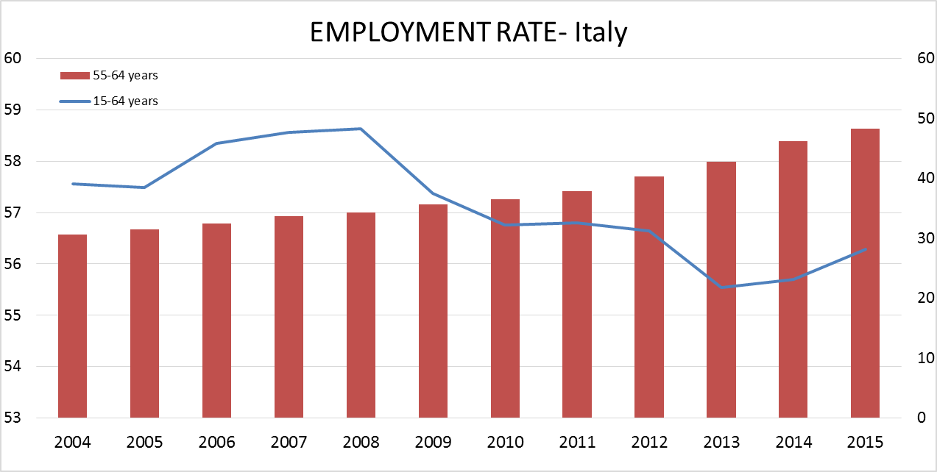
Challenges for the future
Italian labour market is in slight increase after the 2008 crisis 2008年危机后意大利劳动力市场小幅度回升
Unemployement rate starts to decrease in 2015, setting around 12% 失业率2015年开始降低，稳定于12%
Source: Elaborations on Labour forces data – Italian National Institute of Statistics (ISTAT)

Slide 23
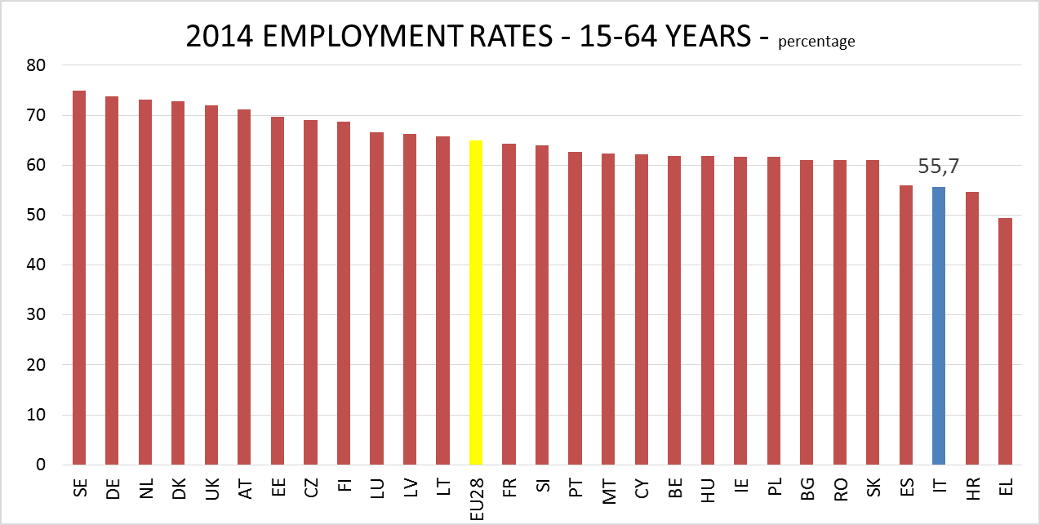
Challenges for the future
Analyzing the European context, Italy is among the countries with lower levels of employment rates. 根据欧洲相关情况的分析，意大利是就业率水平较低的国家之一
Unemployement rate in EU28, in January 2016 is around 9% 2016年欧盟28国平均失业率为9%
Source: Elaborations on 2014 Eurostat data

Slide 24
Challenges for the future
The solution for ageing could be 老龄化的解决措施是
LIVING LONGER – WORKING LONGER? 活得更长，工作得更长？
Current political debate is now concentrating to allow a flexibility to the 2011 pension reform eligibility conditions (there are no legislated proposals so far); 目前讨论关注针对2011年养老金改革准入条件增加灵活性（目前尚无相关立法）
Prolonging working life for older people could stop entrance of the younger ones (“old in, young out” effect), so thinking about part-time job for older people and retired ones; 延长老龄人劳动年龄可能阻碍年轻人进入劳动力市场，因此考虑对老年人和退休人员提供兼职工作
Improving health care services and welfare; 改善健康服务和福利
Reducing risk of poverty (adequacy of pensions) 降低贫困风险（养老金充分性）

Slide 25
The impact of ageing on pension systems
THANK YOU VERY MUCH FOR YOUR ATTENTION
MUCHAS GRACIAS POR SU ATENCION 谢谢
IF YOU WANT TO LEARN MORE
List of sources:
ISTAT, Labour forces, http://www.istat.it/it/lavoro-e-retribuzioni
ISTAT, National accounts, http://www.istat.it/it/conti-nazionali
ISTAT, Annual Report 2016, http://www.istat.it
EUROSTAT, Data base on Population, http://ec.europa.eu/eurostat/data/database
MINISTRY OF ECONOMY AND FINANCE (MEF), «Le tendenze di medio-lungo periodo del sistema pensionistico e socio-sanitario. Nota di aggiornamento 2015», www.mef.tesoro.it
Italian Institute of Social Pension (INPS), www.inps.it
SPC, European Commission, «Pension adequacy Report 2015», http://ec.europa.eu/social/main.jsp?catId=758&langId=en

