Slide 1
Ageing and Labor Shortage:
EU and China
Michele Bruni
EU-China SPRP
Center for Public Policies
University of Modena

Slide 2
Ageing and labor shortage
EU countries and China are affected by similar
demographic trends, namely a progressive
population ageing and an increasing labor shortage.
What are the causes of these trends that already
affect around 70 countries and during this century
will spread in all the others?

Slide 3
The demographic transition
The origin and main cause of the structural trends that are affecting the world population and will become a dominant feature of the XXI century have to be found in the so called Demographic Transition (DT).
The DT is a process that brings a population from a traditional regime, characterized by high rates of fertility and mortality, to a modern regime, characterized by low fertility and low mortality.

Slide 4
The origin of the DT
The demographic transition is a very complex phenomenon that started to affect some European countries at the end of the XVIII century and has then spread to other countries (the more developed and some of the developing ones) together with socioeconomic development.
Although there is not general agreement on the causes of the phenomenon, the DT is certainly connected to economic growth and social development, while religious, political and ideological factors play a relevant role in determining its pace and impact.

Slide 5
The phases of the DT (1)
The DT is characterized by a series of successive phases:
In the first, the death rate declines mainly as a consequence of the decline in infant and child mortality;
In the second -that starts around thirty years after the first- also the rate of birth starts to decline, progressively converging toward the rate of mortality;
Finally the birth rate falls below the death rate

Slide 6
The impact of the DT on Total population
These phases have an impact on the dynamic of total population. Also in this we can distinguish three main phases:
In the first total population increases at an increasing rate;
In the second it continues to increase but a decreasing rate;
In the third total population declines

Slide 7
The following graphs illustrates the phases of DT in Sweden since the end of the XVIII and its impact in Europe and China since 1950

Slide 8
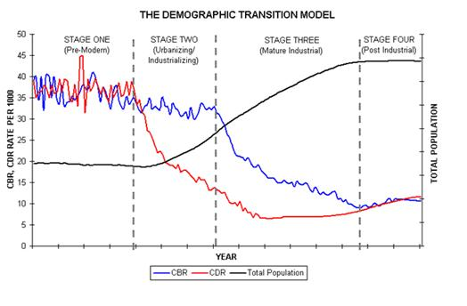
The demographic transition, the Swedish case

Slide 9
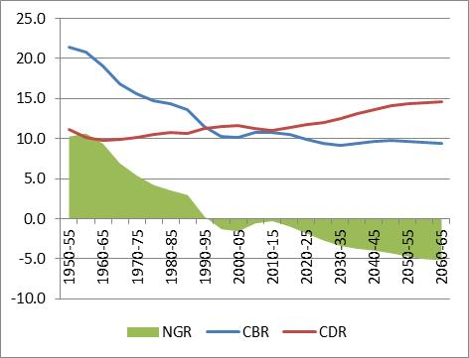
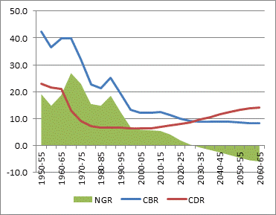
Europe and China – Crude birth rate, crude death rate and natural rate of growth; 1950-2070
Europe
China

Slide 10
The Total Fertility Rate
A synthetic way to capture the development of the DT and the position of a country or a region along its path is that of analyzing the Total Fertility Rate (TFR)
Roughly speaking the TFR) measures the average number of children made by a woman during her life.
If every woman on the average gives birth to 2 children, the population will remain stable (one child will substitute the father, the other the mother).
When the TFR declines below 2, everything else being equal, total population will start to decline
Then the moment comes that the number of births will start to decline and first the young generations and then the Working Age Population become smaller in relation to the older population.

Slide 11
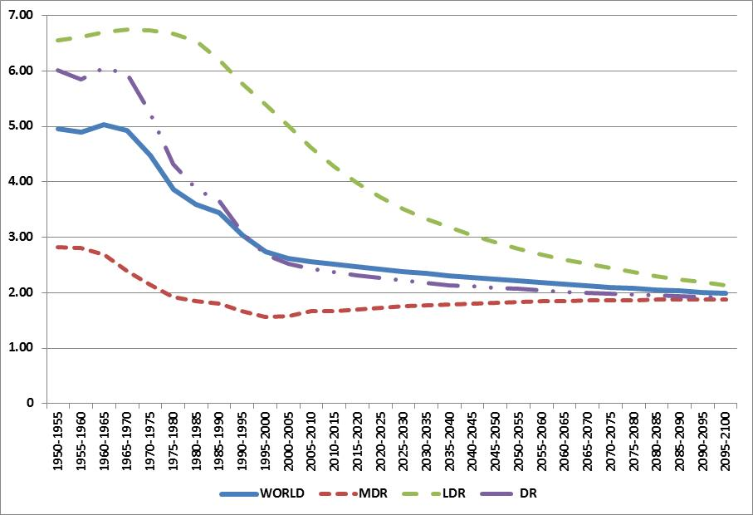
Total Fertility Rate - World, More Developed Regions, Developing Regions, and Least developed Regions; 1950-2100

Slide 12
Two important remarks
Due to the decline in fertility, all the segments of a population and more specifically, the youth, the working age population, and the elderly will be affected by the DT in a way similar to that of total population.
All the three groups, starting with the young, will experience first an increasing growth, then a declining growth and will then decline.
This explain while the populations in the last phase of the transition will be characterized by a declining population in working age and by an increasing number of old people.
The Demographic Transition has started in different countries in different moments of time. In some the transition began during the XIX century, in others after WW2, in the poorest countries of the world is starting now.
Moreover the speed of the DT has been and is different in the various countries affected by the phenomenon. In China the DT has been very fast.
Therefore what we are witnessing is the co-presence of countries whose population and more importantly whose WAP are declining and others whose Total population and working age populations are exploding.

Slide 13
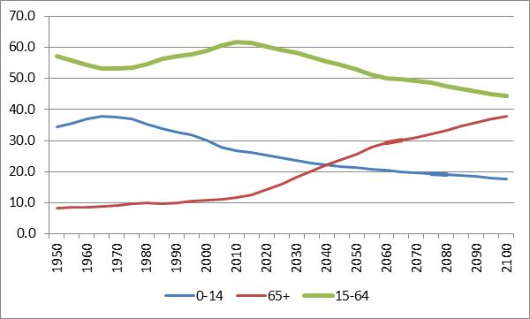
World population – Percentage composition by main age groups; 1950-2100
The first point can be well captured by observing the relative weights of the three main age groups, at the world level, between 1950 and 2100

Slide 14
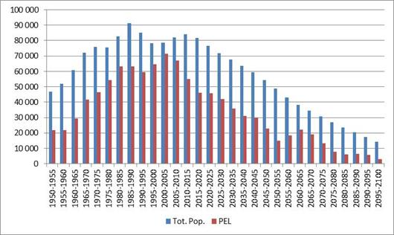
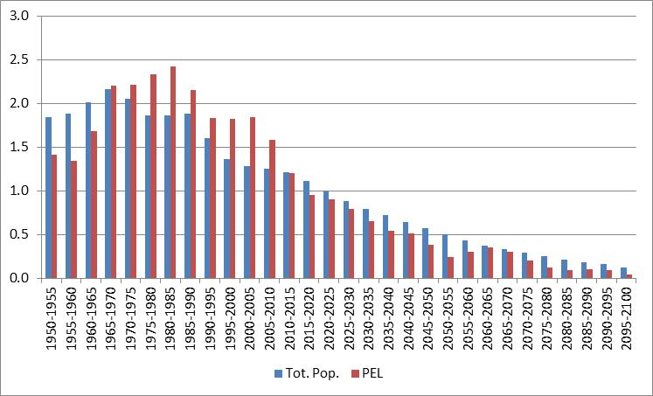
World – Total population and working age population; 1950-2100
Absolute growth
Rate of growth

Slide 15
Ageing: definitions and causes
What do we mean when we say that a populations is aging?
Why does a population age
A population is aging when the number and/or the percentage of people above a given age, normally 64, increases. The phenomenon is also capture by another indicator, the expected life at birth
Let’s however observe that ageing is a relative phenomenon that is paralleled by the decline in the weight of working age population
The causes of aging :
As we have already seen, for a closed population, aging is an unavoidable consequence of the decline in fertility brought about by the DT.
Starting from the XIX century in the MDR and later on in DC , the phenomenon has been notably enhanced by the reduction of the mortality rates of the generations below the old age threshold and the consequent concentration of deaths in the last part of life.
This phenomenon is certainly linked to economic development and has been made possible by the advancement of medicine.

Slide 16
Europe and China: the causes of aging

Slide 17
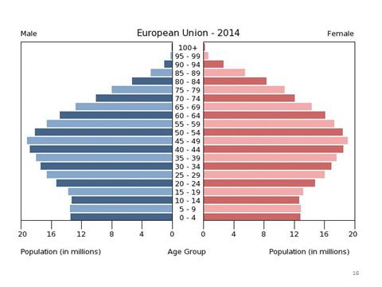
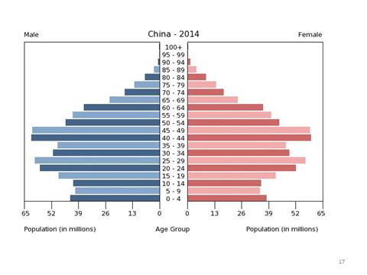
Age Pyramid
European Union
China

Slide 18
Measuring aging with demographic indicators
The simplest indicator of aging is represented by the percentage of elderly people.
Another very common way to measure aging is by the Age dependency ratios (ADRs).
The Old Age Dependency Ratio (OADR) is computed dividing the number of elderly (normally 65+) by the number of people in Working age;
The Young Age Dependency Ratio (YADR) is computed dividing the number of Youth (normally 0-14) by the number of people in Working age;
The Total Age Dependency Ratio (TADR) is given by the sum of the YADR and the OADR;

Slide 19
EU and China – Demographic Indicators of Aging

Slide 20
EU 28 countries ; Total Age Dependency Ratio; 2015

Slide 21
China; Demographic total Dependency Ratio; 2014

Slide 22
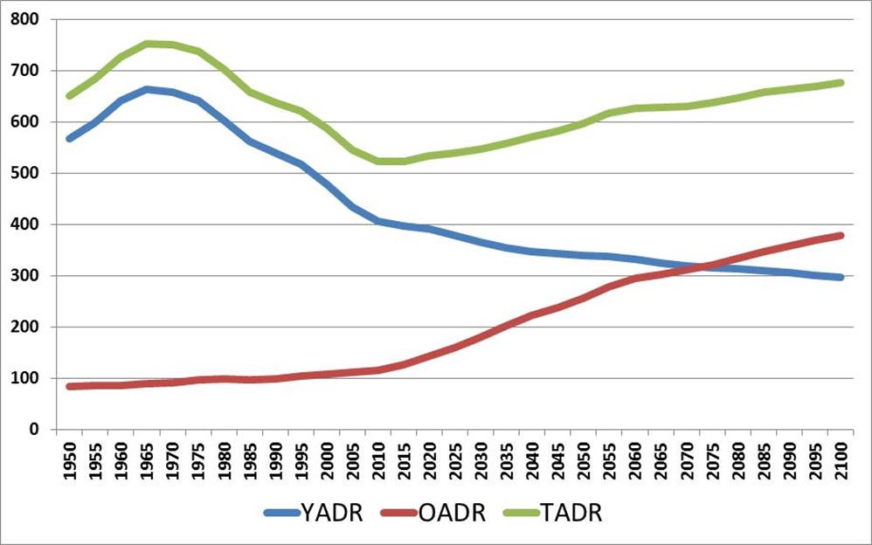
Demographic and Economic dependency ratios
The Demographic Dependency Ratio is not a suitable measure of the socio-economic burden since:
WAP includes many people that do not sustain, but need to be sustained; their number depends on the level of economic development, the characteristics of the education system, the structure of production, the technology adopted, etc.
The average age of entry in the working phase of life is progressively increasing and is already above 20 in many countries
a growing number of employed is 65 and above
What the DDR show (as indicated by the graph on the side) is simply where a country is located along the path of the DT.
A simple way to obtain a correct indicator Is to substitute WAP with the number of those who who sustain, that is the employed. This indicator allows:
To estimate the weight of more Interesting categories of dependents;
To verify whether and in which measure the changes in the socioeconomic burden are due to economic trends and/or demographic trends;
does not depend on the definition of WAP;
can be used to evaluate different economic and demographic policies.

Slide 23
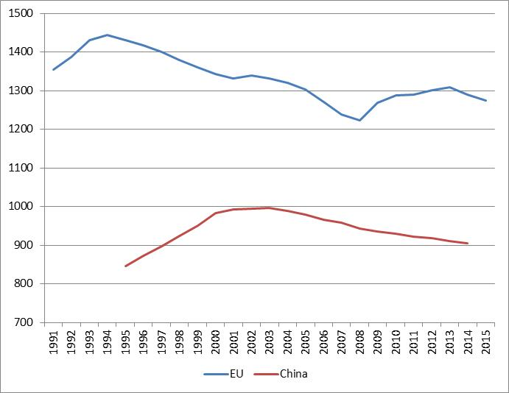
China and EU 28 – Total Economic Dependency Ratio; 1991-2015

Slide 24
EU 28 – Economic Dependency Ratio by main components; absolute values and percentage composition; 1991, 1994, 2008, 2013, and 2015

Slide 25
EU countries; Total Economic Dependency Ratio; 2015

Slide 26
EU countries; Elderly Economic Dependency Ratio; 2015

Slide 27
EU 28 labour market and demographic scenarios, 2015-2030
The hypothesis of the scenarios
The scenarios
In absence of migration, WAP is expected to decline by almost 30 million over the 15 year period.
Two labour force scenarios
A - RoA constant at 2015 level
B –RoA progressively increases to 77.5 % per in 2030
Three Employment scenarios
Employment constant at 2015 level
Employment grows at an average yearly rate of 0.4 per cent
Employment grows at an average yearly rate of 0.8 per cent

Slide 28
EU 28 – Economic indicators of socioeconomic burden in 2015 and in 2030 in six alternative scenarios of LF participation and employment growth

