Slide 1
EU-CHINA Social Protection Reform Project
Financial management of Complementary Pension Funds
Riccardo Cesari
(University of Bologna and IVASS)
Rome, October, 25, 2016

Slide 2
Outline
SAA and TAA
PF alternative investment plans / options
  Guaranteed
  Target risk/return
  Benchmark
  Life-cycle
Passive/active management
Quantitative/discretional management
PF costs and benefits

Slide 3
Stakeholders

Slide 4
The flow of the money
From salary
From employer
From TFR (*)
But: withdrawals and early redemptions
Subscription
accumulation
contribution
Pension capital or annuity
Administration service
(accounting etc.)
Asset managers
Promoters
(voluntary system)
Insurance company
Depository bank
(*) TFR=trattamento di fine rapporto (labour end-contract compensation)
Annual item accumulated by law in a special fund of the balance sheet of the firm
If not put into the PF, it grows at 1.5%+75% of annual inflation

Slide 5
The accumulation phase
Outflow: accumulated capital or annuities
Asset management
inflows
Risks
IR risk
Equity risk
Exchage rate risk
Credit risk
Liquidity risk
Operational risk
Legal risk
…..
Gross returns (mark-to-market valuation)
- Coupons/dividends
- Capital gains/losses
Costs
Depository fee
Asset managers
  Fixed fee
  Incentive fee
Trading costs
Taxes
Administration fee
Net returns

Slide 6

Total rate of return (1)
Without in/out flows:
  RPF(t) = $\frac{P\left(t\right)−P(t−1)}{P(t−1)}+\frac{Coupon(t−1,t)}{P(t−1)}$ gross return
  RPF(t) = $\frac{P\left(t\right)−P(t−1)}{P(t−1)}+\frac{Coupon(t−1,t)}{P(t−1)}−\frac{Costs(t−1,t)}{P(t−1)}$
Capital gain/loss
Coupon/dividend yield
net returns

Slide 7
Total rate of return (2)
With in/out flows:
Method of quotes
V(t)= net asset value of the PF (asset –liability)
N(t)= number of participating quotes
Q(t)=V(t)/N(t) unit value of 1 quote
RPF(t)=Q(t)/Q(t-1)-1 = total return between t-1 and t

Slide 8
Total return index
IPF(t)=IPF(t-1)*(1+RPF(t)) IPF(0)=100

Slide 9
Different investment plans: the strategic asset allocation (SAA)
Pension Fund
B
G
D
Different investment plans
Guaranteed (eg. min 0% return or max 3% volatility)
Balanced (eg. 75% bonds, 25% equity)
Growth (eg. 60% bonds, 40% equity)
Dynamic (eg. 50% bonds, 50% equity)
Target return
Target risk
Benchmark allocation

Slide 10
Different plans = different bond/equity mix
  75/25
  60/40 etc.
Different starting points

Slide 11
Bond/equity mix (asset allocation) (1)
Benchmark for the PF from market data
  Bond: I1(t) R1(t) w1
  Stock: I2(t) R2(t) w2
bond weight bond return
RB(t)=w1*R1(t)+ w2*R2(t)
equity weight equity return
IB(t)
Benchmark index or market index

Slide 12
Total return index of PF, benchmark and TFR

Slide 13
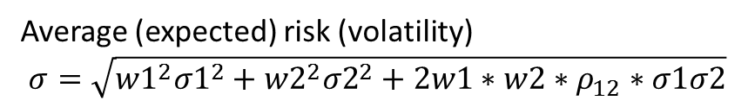
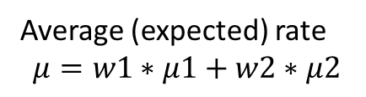

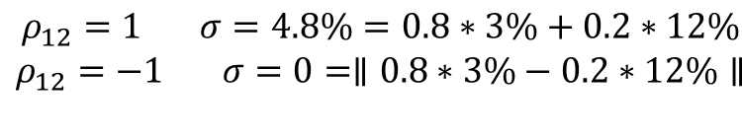
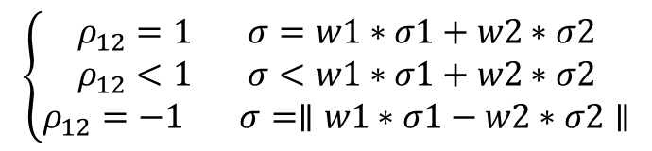
Bond/equity mix (asset allocation) (2)
(approximated) risk level of the PF
R(t)=w1*R1(t)+w2*R2(t)
Average (expected) rate
$$μ=w1∗μ1+w2∗μ2$$
Average (expected) risk (volatility)
$$σ=\sqrt{{w1}^{2}{σ1}^{2}+{w2}^{2}{σ2}^{2}+2w1∗w2∗ρ_{12}∗σ1σ2}$$
$$\left\{\begin{aligned}ρ_{12}=1 σ=w1∗σ1+w2∗σ2 \\ ρ_{12}<1 σ<w1∗σ1+w2∗σ2 \\ ρ_{12}=−1 σ=∥w1∗σ1−w2∗σ2∥\end{aligned}\right.$$
Diversification
Max diversification
correlation
$$\begin{aligned}ρ_{12}=1 σ=4.8\%=0.8∗3\%+0.2∗12\% \\ ρ_{12}=−1 σ=0=∥0.8∗3\%−0.2∗12\%∥ \\ \end{aligned}$$
Equity vol
Portfolio vol
Bond vol
$$ρ_{12}=−0.4 σ=2.6\%$$

Slide 14
Risks
Expected return (μ) : mean of R(t)
Risk (σ): volatility or standard deviation of R(t)
European equity
European Gov bond

Slide 15
Meaning of volatility
Under normality the range μ±σ has a probability of 68%
Eg. 3%±2% is +1% to +5% (bond)
3%±4% is -1% to +7% (more risk)
In general high expected return means high risk (and viceversa)
5%±12% i.e. -7% to +17% (equity)
<<Every investor has to decide if they prefer to eat well or to sleep well>>
B. G. Malkiel

Slide 16
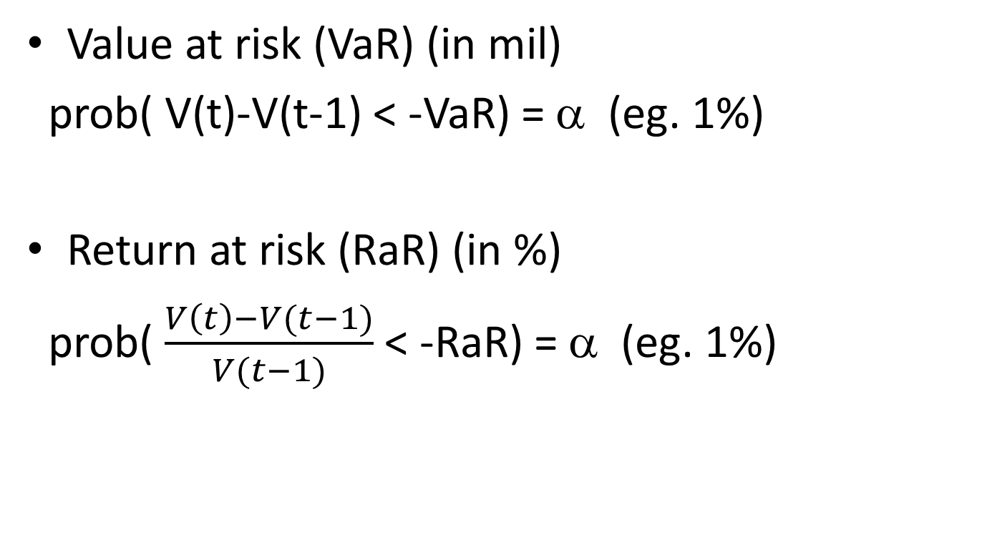
Alternative measures of risk
(downside risk)
Value at risk (VaR) (in mil)
prob( V(t)-V(t-1) < -VaR) = α (eg. 1%)
Return at risk (RaR) (in %)
prob( $\frac{V\left(t\right)−V(t−1)}{V(t−1)}$ < -RaR) = α (eg. 1%)
Portfolio loss in 1 period

Slide 17
Financial management of PF
Passive management
  Buy and hold (e.g 80 mil bonds, 20 mil equity)
  Rebalancing or benchmarking (sell high, buy low) (replicate the market: keep 80% / 20%)
Active management (to beat the market)
  Quantitative
    Portfolio insurance (sell low, buy high)
    Forecasting models
  Discretional

Slide 18
Active financial management of PF
Tactical asset management: allocation (dynamic weights)
RB(t)=wB1*RB1(t)+ wB2*RB2(t)
RPF(t)=wPF1(t-1)*RPF1(t)+wPF2(t-1)*RPF2(t)
Eg. wPF1=85% vs wB1=80% (overweight of bonds)
Benchmark (fixed weights) eg. 80% / 20%
Changing tactically and dynamically the weights of bonds and equity in the PF portfolio wrt benchmark
e.g. wPF1(t-1)>wB1 (more bonds than in the benchmark) if bonds are expected to outperform equity
A bet (a gamble) of the asset manager (macro-forecast)
If correct RPF(t)>RB(t) abd the asset manager beats the benchmark (the market)

Slide 19
Active financial management of PF
Tactical asset management: selection of securities
RB(t)=wB1*RB1(t)+ wB2*RB2(t)
RPF(t)=wPF1(t-1)*RPF1(t)+wPF2(t-1)*RPF2(t)
Selecting tactically the composition of bond class (equity class) in the PF portfolio wrt benchmark
e.g. Benchmark bond class is 50% short and 50% long maturity;
PF bond class is 100% short maturity
Benchmark equity class is a mix of all industry sectors;
PF equity class is all energy (or all sectors but utilities…..)
Bets of the asset manager: if correct RPF1(t)>RB1(t) and the asset manager beats the benchmark (the market)

Slide 20
Performance evaluation
RPF(t)-RB(t) = allocation +selection
market timing + asset picking
Eg.
Positive total performance:
negative allocation ability (overweight of bonds just before a rise in interest rate or a rally of equities)
positive selection ability (right picking of bond/equity names)
4%-3% = -2% + 3%

Slide 21
Preparing for retirement
<<The old age is the most unexpected thing can happen to a man>> (L. Trotzky)

Slide 22
A1) A few definitions
Pension systems
  Calculation of pensions:
    Salary based (e.g. 80% of last salary) defined benefit PF
    Contribution based (in proportion of contributions) defined contribution PF
  Funding of pensions:
    Pay-as-you-go (actual workers pay for actual retired)
    Capitalization (from invested contributions)

Slide 23
A2) Italian pension system (1995-2007)
Three pillars
  State pension: I pillar
    Base (minimum) level for all citizens (e.g housewife)
    Retirement pension for workers (compulsory contributions)
  Occupational PF (voluntary subscription): II pillar
  Individual PF (voluntary contributions): III pillar
Complementary pension system

Slide 24
A3) Typologies of PF
Occupational PF (closed in entrance)
  Governance by Trade unions+firms representatives
  E.g. FONCHIM for workers in Chemical industry, COMETA for workers in Manufacturing industry, Public employees, commerce, railways….
Open (in entrance) PF
  Created by banks, insurance companies, financial institutions
  For collective subscription (see closed PF: II pillar) or individual subscriprion (see mutual funds: III pillar)
Insurance separated accounts
  Created by insurance companies

Slide 25
A4) Incentive taxation: ETt
Subscription
accumulation
contribution
Pension capital or annuity
Exempt (E)
Taxed (T)
slightly taxed (t)
deductible from taxable income
Taxation of income
12.5% gov bonds
20% non gov (vs 26%)
(11% up to 2014)
15% rate with 0.30% reduction per year of participation from 16 to 35 years (=9% rate)
TFR=trattamento di fine rapporto (end-contract compensation)
Income taxed at the 17%

