Slide 1
Means testing: The Slovenian experience,
Davor Dominkuš
(Ministry of Labour, Family, Social Affairs and Equal Opportunities - Republic of Slovenia)
Component Two- 2016 Training Course “European practices in the Governance, Financial Management and Strategies for a Sustainable Social Security System”
Italy, October 16th-30th, 2016

Slide 2
CONTENT OF THE PRESENTATION
Situation related to means testing before the reform 2010
Key futures of new system
Means testing of social assistance
ELEGIBILITY
BENEFICIARIES
AMOUNTS
PROCEDURES
IT support to means testing

Slide 3
REFORM OF SOCIAL TRANSFERS SYSTEM 2010
NEW LEGISLATION WAS ADOPTED IN 2010 AND IMPEMENTED IN 2012
Two new acts:
Exercise of Rights to Public Funds Act,
The Social Benefits Act
Fundamental changes in the access to and delivery of social benefits and subsidies that are means-tested
Other proposed reforms (with the connection to active inclusion) – pension reform, Small jobs Act and Act on preventing the undeclared work – rejected on referendums (in 2011)

Slide 4
Situation BEFORE IMPLEMENTATION OF NEW LEGISLATION
Means-tested benefits and subsidies depending on a person’s or family’s material situation were granted on a basis of different criteria; Procedures were based on different legal foundation and conducted by different authorities (social work centers, schools, Pension and Invalidity Insurance Institute, municipalities (local communities)); Different definitions of income, family and other elements of means testing were used; In some cases only income was taken into account, in others the property was also considered.

Slide 5
Situation BEFORE IMPLEMENTATION OF NEW LEGISLATION
System was not transparent, it enabled abuse and accumulation of different rights in some groups and it was not enough support for high-risk-of poverty groups; IT support and databases on recipients were not linked, centralized; Not enough focus on activation measures for the recipients of social assistance; Low level of minimum income for long-term beneficiaries (people who were not capable of work).

Slide 6
THE MAIN GOALS OF THE 2010 REFORM
More transparent, efficient and user-friendly distribution of social transfers and subsidies that are means-tested (one-stop shop, one application form, one decision about all rights)
Harmonisation of criteria for granting 4 types of social transfers and 9 types of subsidies that are means-tested (income, property, movable assets)
More targeted system (to those that really need the transfers)
More adequate income support (increase of minimum income as a base for social transfers – based on a study on minimum life costs from 2009)

Slide 7
THE MAIN GOALS OF THE 2010 REFORM
Incentives for work and active search for solutions to one’s problems (activity supplement for beneficiaries working or in active programmes - amount depending on duration and character of the activity)
More focus on activation of long-term recipients capable of work
Income support for pensioners transferred from pension system to social benefits system (income supplement for those not capable to work).

Slide 8
RIGHTS UNDER THE NEW MEANS TESTING SYSTEM
cash benefits:
CHILD (BENEFIT) ALLOWANCE
(FINANCIAL) SOCIAL ASSISTANCE
INCOME SUPPORT
(Supplementary allowance for pensioners and people long-term incapable of work)
STATE SCHOLARSHIPS
subsidies and REDUCED payments:
reduced kindergarten fee
subsidy for school meals (lunch/snack )in elementary and high schools
exemption from payment of social care services
contribution to the payment of a family assistant
rent subsidy
subsidy covering the difference to full value of health care services
payment of contribution for compulsory health insurance

Slide 9
Social work centers: one-stop shop
Single entry point for all means tested social rights = social work centers; Basically one application per applicant ( in most cases no supporting documents needed); Priority order for exercising rights; Single scale for determining entitlement to social rights (based on scale for child benefit; except for financial social assistance and income support for pensioners); Simplified procedure supported by centralized information system;

Slide 10
Means testing of social assistance
TYPES OF SOCIAL ASSISTANCE:
Regular social assistance (with activity supplement);
Social assistance is intended to provide resources so that minimum living requirements are met.
directly linked to health care insurance and
(co)payment of health care services
Extraordinary social assistance
special type of extraordinary social assistance is payment of funeral costs
Income support (supplementary allowance)for the elderly and unemployable persons (disabled)
Income support is intended to cover long-term living expenses (accommodation expenses etc.) including expenses for meeting minimum living requirements.

Slide 11
Means testing of social assistance
Eligibility (for financial social assistance)
Single person (or family) is eligible for financial social assistance if living in the Republic of Slovenia and is:
citizen of the Republic of Slovenia with permanent residence in Slovenia,
foreigner with a permanent residence permit in the Republic of Slovenia and actually living in the Republic of Slovenia,
a person who may benefit from financial social assistance on the basis of international acts that are binding for Slovenia, persons who have been granted international protection and members of their family with temporary or permanent residence in Slovenia are also entitled to social assistance.
At the same time one should not have enough resources to survive or have no assets and savings above the legal limit and must actively address his/her social problem.

Slide 12
MEANS TESTING OF SOCIAL ASSISTANCE
Eligibility (for income support):
Single person (or family member ) is eligible for income support if living in the Republic of Slovenia and:
who are permanently unemployable or permanently unable to work or women over 63 or men over 65;
who are entitled or could be entitled to social assistance;
for whom income does not exceed the threshold for income support (EUR 470,76).

Slide 13
Means testing of social assistance
Beneficiaries
The beneficiaries of financial social assistance are as follows:
those who cannot provide their living conditions with the work or rights from work or insurance, income from the property and from other sources, or with benefits according to other regulations, or with the help of those who are obliged to support them, or on the basis of other legislation,
those who are not able to provide funds for themselves and their family members at the amount of minimum income for reasons beyond their control, and have exercised the right to cash benefits under other regulations.

Slide 14
Means testing of social assistance
Amount/ Height
Social assistance depends on income (the beneficiary receives the difference between identified income and the census), number of family members, assets (property, savings), the care provided and possible existence of fault-based grounds. (for example, failure to register with the employment office or imprisonment,).
Description | weighting | Amount 2016
the first person or a single person or adult who is in institutional care | 1 | 288.81
the first person or a single person, who is active in the range of 60 to 128 hours per month | 1,28 | 369,67
the first adult or single person who is economically active more than 128 hours per month | 1,56 | 450,54

Slide 15
Means testing of social assistance
a single person between the age of 18 and completed 26, registered with the Employment Service, who have registered permanent residence at the same address as parents or actually live with them, (under the condition that the parents have sufficient own funds for livelihood) | 0,7 | 202,16
a single person, who is permanently unemployable or permanently incapable of work or is older than 63 years (women) or 65 (men) who have registered permanent or temporary residence at the same address as those persons who are not family members under this Act and have sufficient means of subsistence, or actually residing with them | 0,76 | 219,50
every additional adult | 0,57 | 164,62
every additional adult person who is economically active to the extent of more than 128 hours per month | 0,85 | 245,48
each following adult who is active in the range of 60 to 128 hours per month | 0,71 | 205,05
first child, (child which is the oldest) | 0,76 | 219,50
each subsequent child | 0,66 | 190,61
increase for each child in a single parent family where the other parent and the child died after not receiving remuneration or the other parent is unknown or where the child the other parent remuneration for spending actually does not receive | 0,2 | 57,76

Slide 16
Means testing of social assistance
Types of income and period taken into account for means testing:
The income received in the last 3 or 4-12 months (or 13 months prior to the month of application; discretion of SWC).
Act which regulate social assistance distinguish between different types of incomes and the way they are taken into account:
regular (net) income (salaries, pensions, alimony, rents, other income - in the same or similar amounts or periods) (3 months)
occasional income-not from occasional work (inheritance, gifts, compensation, severance pay, bonuses and other income received only once,) (4-12 months)
occasional income from work (income received in the last 3 months before the month of application for any type of occasional work) (4-12 months) .

Slide 17
MEANS TESTING OF SOCIAL ASSISTANCE
Assets taken into account:
immovable property,
passenger cars and other vehicles,
watercraft
shares of companies or cooperatives,
valuable papers,
money on the transaction or other account, deposits and other funds after the statement of the individual (savings)
other movable assets.

Slide 18
MEANS TESTING OF SOCIAL ASSISTANCE
Assets not taken into account:
aapartment (or house) in which the person (family) actually resides, up to adequate housing limit,
each car or motorcycle to a value of 28 times the minimum income (€ 8,086.68) each car, adapted for a transport of physically handicapped persons,
property that gives the income and that is already included in means testing.

Slide 19
Means testing of social assistance
Duration of the (right) social assistance
Financial social assistance is granted for a limited period of time, depending on the circumstances, which are the basis for the granting and the amount of social assistance. Granted period is:
1 to 3 months: when the application is submitted for the first time,
from 1 to 6 months: in the case of repeated applications, if the circumstances for the first SA remain unchanged,
1 year: due to the age over 63 years for women and over 65 for men or illness, disability or other circumstances due to which the social situation of the beneficiary will not change,
permanently: for a person who is permanently unemployable or permanently unfit for work or aged over 63 years for women and over 65 for men and has no assets, or in institutional care.

Slide 20
MEANS TESTING OF SOCIAL ASSISTANCE
Procedure :
submission of an application (either in person or by mail)
reception of applications / consultancy with applicant
processing of the application
adoption of a decision/ issuance of a decision
payment
monitoring and support of the recipient/family is provided in all phases of procedure

Slide 21
IT SUPPORT FOR THE IMPLEMENTATION OF THE NEW LEGISLATION
OBJECTIVES OF A NEW IT SYSTEM
The implementation of the new legislatin required comprihensive information systems capable of ensuring and exchanging data in real time on the basis of standardized legal and information infrastructure at institutions, provided for by the act as the data sources.
The following information is needed:
personal status,
income,
property,
other statuses.

Slide 22
SOURCES OF DATA FOR IT SUPPORTED DECISION MAKING
Ministry of interior (MI);
Ministry of Defence (MD);
Ministry of Education and Sport (MES);
Ministry of Higher Education, Science and Technology (MHEST);
Social Work Centres (SWC);
The Pension and Invalidity Insurance Institute of Slovenia (PIII);
The Health Insurance Institute of Slovenia (HII);
The Employment Service of Slovenia (ESS);
The Public Guarantee and Maintenance Found of the Republic of Slovenia (PGMF);
Tax Administration of the Republic of Slovenia (TA);
The Surveying and Mapping Authority of the Republic of Slovenia (SMA);
Administrative units (AU);
Prison Administration of the Republic of Slovenia (PA);
Slovenian Maritime Administration (MA);
Local Courts (LC);
Central Securities Clearing Corporation (CSCC);
The Agency of The Republic of Slovenia for Public Legal Records and Related Services (APLRRS);
Pension Founds (PF);
Municipalities (M);
Credit institutions/Banks (CI);
Asset Management Companies (AMC);
Stock Brokerage Companies (SBC);
Regional Development Agencies (RDA);
Slovene Human Resources Development and Scholarship Fund (SHRDSF).

Slide 23
MEANS TESTING OF SOCIAL ASSISTANCE – IT SUPPORT

Slide 24
MEANS TESTING OF SOCIAL ASSISTANCE – IT SUPPORT

Slide 25
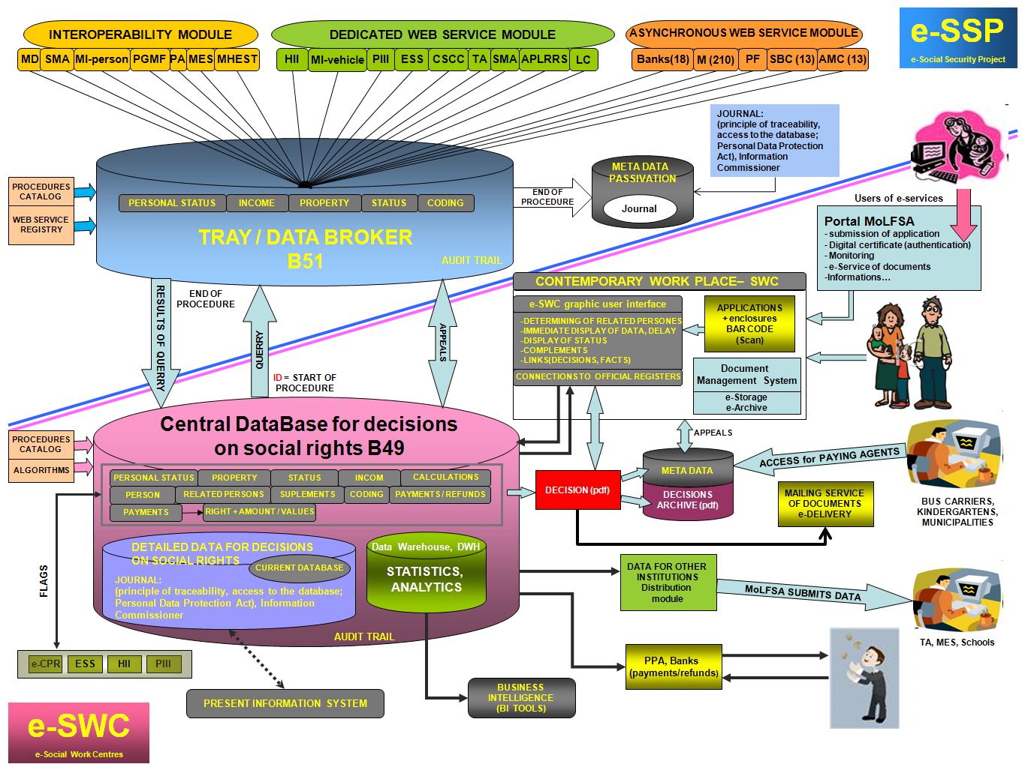
MEANS TESTING OF SOCIAL ASSISTANCE – IT SUPPORT

Slide 26
MEANS TESTING OF SOCIAL ASSISTANCE – IT SUPPORT

Slide 27
MEANS TESTING OF SOCIAL ASSISTANCE – IT SUPPORT

Slide 28
RESULTS
After one year of implementation of new system, (legislation) a comprehensive evaluation has been carried out, under which amendments to legislative acts were adopted and IT support was further improved.
Based on the analysis of the Ministry of Public Administration a uniform IT procedure annually saves millions of EUR
In the year 2013 the IT supported system of data exchange for e-SWC won UN prize

Slide 29
THANK YOU FOR YOUR ATTENTION!
ANY QUESTIONS?

