Slide 1
Registry of Social Assistance
Maria Giovanna De Vivo
Component Two- 2016 Training Course “European practices in the Governance, Financial Management and Strategies for a Sustainable Social Security System”
Italy, October 16th -30th, 2016

Slide 2
Index
What is the Registry of Social Assistance
The composition of the Registry
Final Goals
Advantages
Information flow
State of Art
Functions of Institute

Slide 3
The composition of the Registry of Social Assistance
The Registry of Social Assistance is a section of INPS (National Institute for Social security). This database is the general register of Welfare payments , this is an important instrument to collect informations regarding the different Social Benefits received by households intended to provide for the needs.

Slide 4
How it is composed:
Database of social benefits, in regard to the economic situation indicator (ISEE).
The database is not conditioned to (ISSE).
Database of multidimensional assessments, if the performance is associated with a take-over by the professional social work. This component will be organized into three sections:
- Children, adolescense and family (SINBA).
- Disabled and not self - sufficient (SINA).
- Poverty, social exclusion and other forms of discomfort (SIP).

Slide 5
Goals of the Registry of Social Assistance
The Registry will have a determinant role to ensure:
  a thorough knowledge of social needs and the integrated system of social service interventions
  the integration of the information sent by the Bodies supplying with those present in other information systems INPS, in the New Health Information System and the placement database targeted.

Slide 6
Goals of the Registry of Social Assistance
After the fully implementation, the Registry could improve the planning of complex processes
  - social spending, allowing for economies of scale through enhanced control
  - social interventions targeted to specific and real needs of citizens

Slide 7
Advantages
Timely consultation of information by agencies.
Representations of aggregated data for monitoring purposes, studies and statistical analysis.
Consultation of informations regarding social benefits payed by INPS and received by beneficiaries of institutions (family allowances, maternity allowances, purchasing card, SIA, welfare, disability, career's allowance, etc.)

Slide 8
Advantages
Control on the regularity and correctness of the statements in the DSU, with specific reference to the correspondence of the ISEE the ceiling allowed by the different services provided.
Communication on discrepancies discovered on ISEE statements with the possibility of recovery of any undue performance and consequent imposition of sanctions (in order to avoid responsibility for loss of revenue).
Programming activities of spending and social services, on the basis of the monitoring control, analysis and study.

Slide 9
Data Transmission
The data is transmitted automatically by local authorities and any other entities which provide social performance and social benefits.
Data transmission occurs through an online channel (the Institute's website), via different technical procedures.

Slide 10
Data Transmission
To achieve the correct and complete power of the Registry, it is crucial that collaboration of entities comply with the obligation of the electronic transmission of data related to performance and to the beneficiaries thereof.
The Registry was founded on the territory of a group of Casellario referents to provide advice and clarification via telephone or email to local administrators and operators identified by various agencies.

Slide 11
Data Transmission
It has been prepared and published on the website INPS a guide for the municipalities and institutions so helping them to send the informations, accompanied by descriptive documents and technical diagrams for the transmission of data across multiple channels (xsd, xml and csv), which check the record layout and ensure the proper production of the files by the equipment suppliers/entities.

Slide 12
State of Art
With Directorial Decree INPS n. 8 of 10 April 2015, after consulting the Ministry of Labour and Social Policy and the Guarantor for the protection of personal data, we have initiated the first component of the Filing of Relief, the database of social benefits (BDPSA), to according to DM March 8.

Slide 13
State of Art
With Directorial Decree INPS n. 103 of 15 September 2016, after hearing the Ministry of Labour, the Authority for the protection of personal data and the Inland Revenue, has initiated the other two components of Filing: database of social benefits (BDPS) and database of multidimensional ratings for taking charge (BDVM), according to DM 206/2014, which was enacted on 25 March 2015.

Slide 14
State of Art
The entities are 10.011:
Municipalities | 7998
Suburbs | 110
Regions | 20
Universities | 112
Health | 125
Departments | 15
Others entities | 1.631
Total | 10.011

Slide 15
State of Art BDSPA
A year into the first component of the Filing, BDPSA on October 13, 2016. A submission of information on 608 municipalities and 23 other entities, for a total of 631 institutions (7.60%); considering among the 23 other bodies are unions of municipalities and territorial areas, representatives of several municipalities, the total data cover more than 700 bodies.

Slide 16
State of Art BDPSA
Benchmarking between Regions

Slide 17
State of Art BDPSA

Slide 18
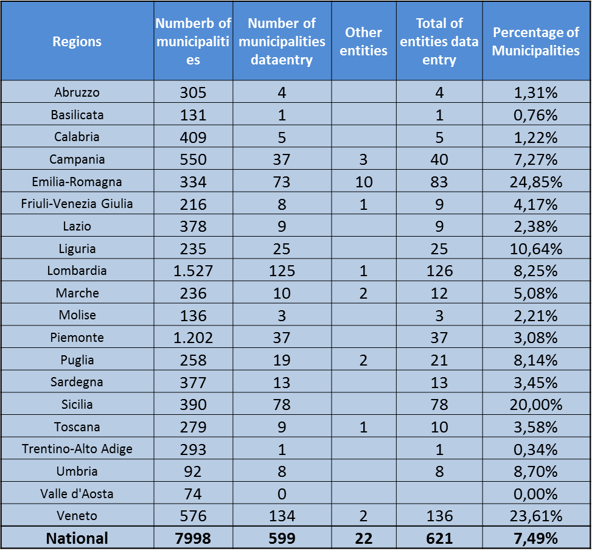
State of Art BDPSA

Slide 19
State of Art BDPSA
The following data on social benefits included in BDPSA including those distributed by INPS are:
Number of social benefits | Kind of social benefit | Time
4.821.543 653.993 160.724 | Social benefits provided by Inps for municipalities: Buy card (number of payments) Child support (number of payments) Maternity support | 27 of September 2016
162.679 | Welfare INPS (home care premium, scholarships, etc.) | 27 of September 2016
142.327 | PSA of entities [631] (starting of BDPSA April 2015) | 20 of October 2016

Slide 20
State of Art BDPS e BDVM
For the other two components of Casellario:
Information notice was sent by the Director General of the Institute to all relevant agencies.
It was published by the new Directorial Decree and the Technical Specifications (by notice in the Gazette) on the website of INPS, with technical and safety specifications.
The new IT system will be available to accommodate the data for this coming November.

Slide 21
Functions of Institute
It is currently functioning to send information and advice to institutions. The Institute is present through the structures responsible for the management and resolution of potential problems posed by regulators bodies.
To date for this purpose their have been over 3,000 contacts, (email and phone). They were published on the Institute's website, a series of answers to frequently asked questions (FAQ) shared with the Ministry of Labour and Social Policy.

Slide 22
Functions of Institute
In connection with agencies, to explore the highlights of Filing and how to access the system, which are held at:
State Conferences – Regions.
Meetings in the area with regional directorates INPS, local authorities, ANCI and other organizations (16 meetings).
Dissemination of best practices from time to time.

Slide 23
Functions of Institute
Development of some IT functions to facilitate the flow of data (mass dispatch), and the use of the database, creating additional benefits for institutions.
Meetings with ANCI to explore the possibility of creating specific thematic webinars on BDPSA for the Towns, using INPS referents to spread, so more widespread and remote, the more informative the experience/training consulting will be.

Slide 24
Functions of Institute
It formulated a series of proposals to boost the implementation of Filings (prediction rules to identify terms and penalties for late or non-submission of data, data acquisition from the third sector, the only public system of detection and information management), presented by the President of the hearing of 4 April 2016 of the parliamentary Committees of the Chamber of deputies gathered XI (work) and XII (social affairs).

Slide 25
Functions of Institute
The bill n. 2494 / AS "Delegation laying down rules on contrast of poverty, the reorganization of services and the system of interventions and social services“, provides for the strengthening of assistance of Casellario and, in particular, of the reporting obligations by agencies including reports of wrongly received treatment and the introduction of penalties for defaulters.

Slide 26
Functions of Institute
The INPS has therefore responded to the obligation to be the Casellario assistant with the last directorial decree adopted, (no. 103/2016).
It is important to continue in connection with the bodies, enhance synergies and advisory contribution to boost the implementation of the information and be able to respond to all of the objectives outlined by the legislature.

Slide 27
Registry of Social Assistance
Thank you
mariagiovanna.devivo@inps.it

