Slide 1
The Belgian experience on the detection of social contribution fraud
Rome
21st October 2016
Gaël KERMARREC
Gael.Kermarrec@minsoc.fed.be

Slide 2
Contents
Context
Data mining
MiningWatch
Results

Slide 3
1. Context
Input = 100%
Reports/complaints
Unions, federations, …
“Hotline”
Free initiative
Demand for investigation
Anybody
Justice, SIOD
Info sources
Datamining

Slide 4
1. Context
Employers 2015
220.000 BE employers
→ 3.500.000 workers private sector
67.578 foreign employers posting to Belgium
→ 566.794 posting notifications for 182.745 posted workers
Social Inspection 2015
236 inspectors
50 mgt, admin, support, juridical, analysts
Results 2015
19.626 investigations of which 33% free initiative
→ of which 10% concern foreign employers
121.6 M€ of which 50% free initiative
Data Mining → initiative

Slide 5
2. Data Mining
Differences between these employers ?
NO
Irregularities
Irregularities
Data Mining
Risk factors / risk profiles

Slide 6
2. Data Mining
EMPLOYER
CHARACTERISTICS
DIMONA: employment declaration
VAT & CLIENT-SUPPLIER
DMFA: salaries, days worked, …
RVA: temporary unemployment
WERK-MELDING: working sites and sub-contracting
RSZ: employer history
LIMOSA:
posting
PROFILE-BASED SCORE FOR ALL
EMPLOYERS
AUDITED EMPLOYERS

Slide 7
2. Data Mining
Step 1:
Use algorithms to find characteristics predictive of irregularities
Step 2:
Validation by expert inspectors
→ Repeat Steps 1 & 2 until characteristics form a risk profile accepted by inspectors
Step 3: Automate risk scoring based on profile
Step 4: Monitor

Slide 8
2. Data Mining
Step 1: Use algorithms to find characteristics
The search for a
GOOD
model
Predictive modelling techniques :
→Is there something ?
Logistic Regression
“Bayesian” Classifiers
Decision Trees
Regression
Random Forests
Supportive techniques :
→Amplify it ?
Neural Networks
Factor Analysis
Cluster Analysis
Model selection :
→ Is it good ?
Strength (“science”)
Simplicity (“craft”)

Slide 9
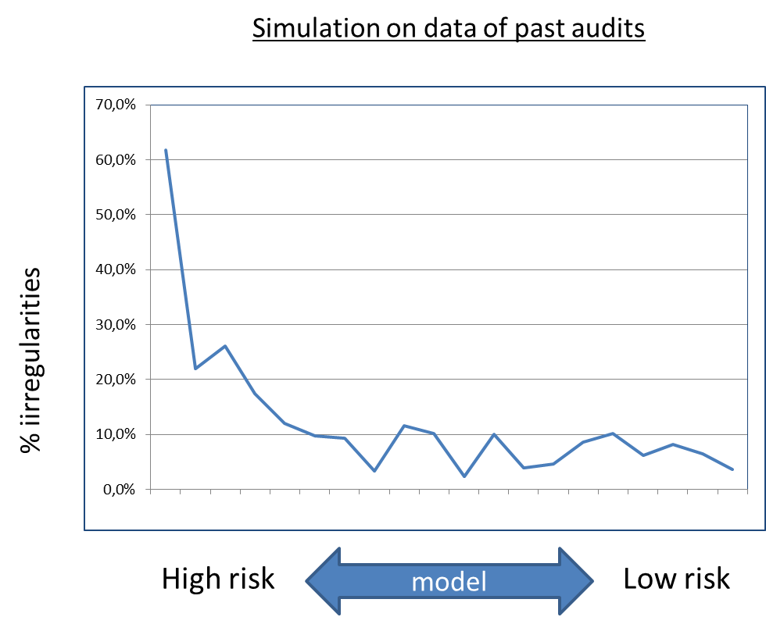
2. Data Mining
Step 1: Use algorithms to find characteristics

Slide 10
2. Data Mining
Step 2: Validation by expert inspectors
→ Do the risk factors correspond to the experience of the professionals ?
50 expert inspectors divided in thematic groups :
Construction
Cleaning
Transport
Restaurants – Hotels
Posting
…
Membership of thematic group lasts 2 years

Slide 11
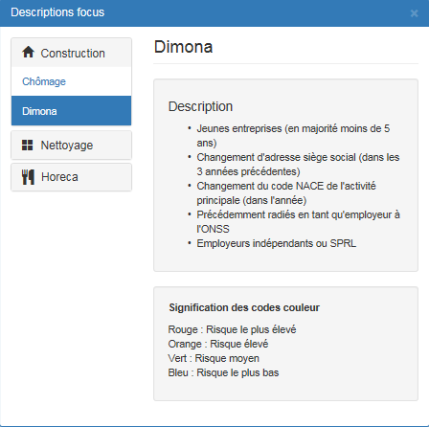
2. Data Mining
Step 2: Validation by expert inspectors
Undeclared employment in construction industry
Young firms
Change(s) of address
Change(s) of main activity
Re-inscription(s) as employer
Legal forms typical of small firms
up to 4 X average risk
&
validated by the professionals

Slide 12
2. Data Mining
Step 3: Automate risk scoring
Automated quarterly scoring
Branch | Started | # Risk models | #Risk factors in each model | # Employers scored (average)
Construction | Q3 2014 | 2 | 5 + 4 | 23.500
Restaurants - Hotels | Q3 2015 | 2 | 5 + 4 | 22.300
Cleaning | Q4 2014 | 3 | 4 + 4 + 5 | 1.650
Foreign posting (all branches) | Q4 2015 | 1 | 14 | 12.400

Slide 13
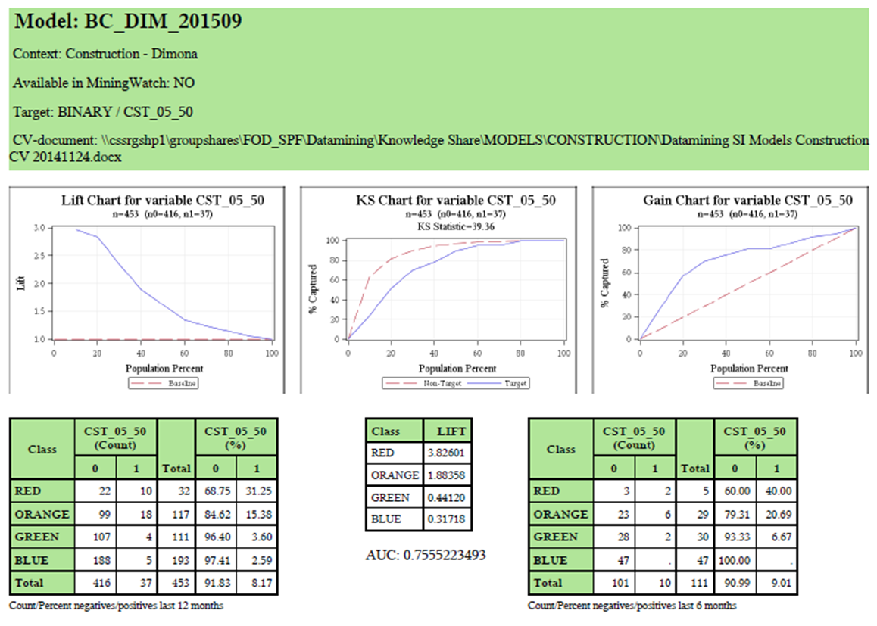
2. Data Mining
Step 4: Monitor
Model performance
Inspector use
Results

Slide 14
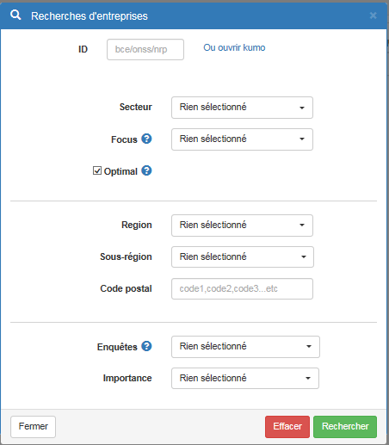
3. MiningWatch

Slide 15
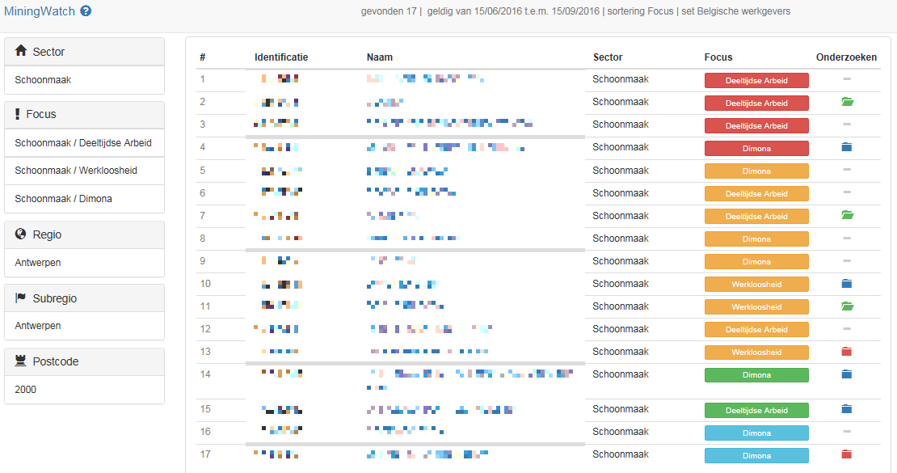
3. MiningWatch

Slide 16
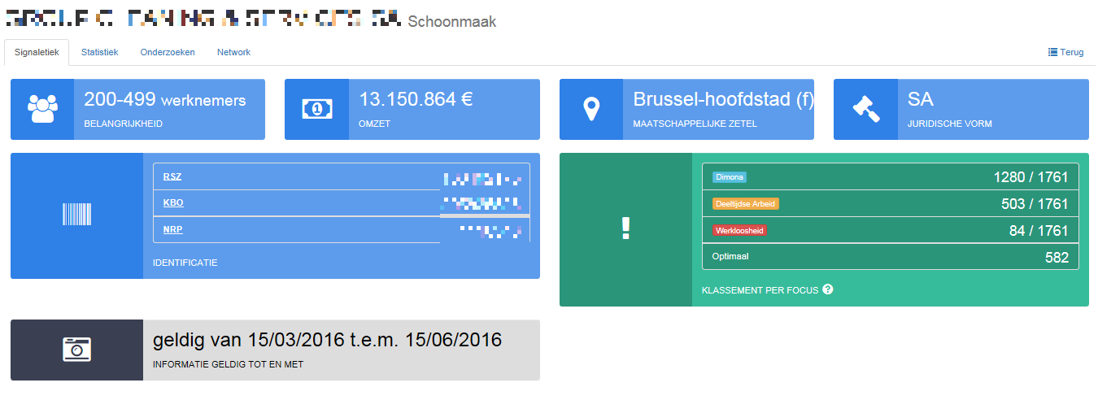
3. MiningWatch

Slide 17
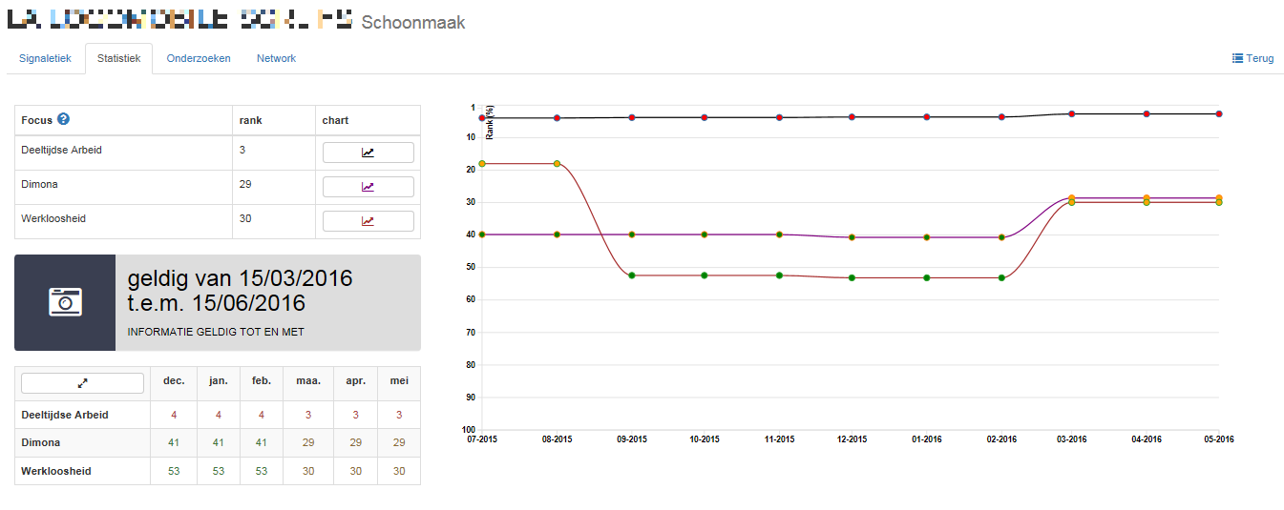
3. MiningWatch

Slide 18
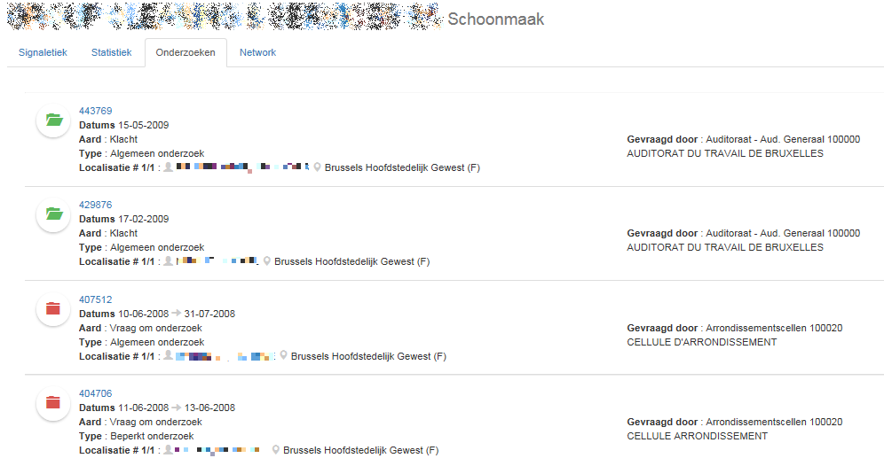
3. MiningWatch

Slide 19
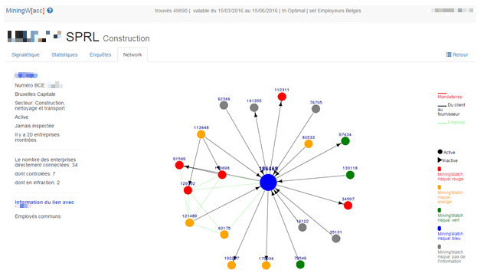
3. MiningWatch

Slide 20
4. Results
180 users → 1225 lists / month
18% of the free initiative = data driven (top risks) construction, restaurants-hotels, cleaning
Construction branch: very good model, but top risks very hard to find on sites
Restaurants-hotels branch:
* Very good model, strong results
* but … 15% of free initiative still in lowest risks → only 6% of the branch result

Slide 21
Thank you.
ADDITIONAL INFORMATION
Belgian Privacy Commission:
http://www.privacycommission.be
Crossroads Bank for Social Security:
https://www.ksz-bcss.fgov.be/en/international/home/index.html
DG Social Inspection:
http://www.socialsecurity.fgov.be/en/index.htm
Data mining at DG Social Inspection:
gael.kermarrec@minsoc.fed.be

