Slide 1
Origin and evolution of the Italian welfare system
Gianni Geroldi
Component Two- 2016 Training Course “European practices in the Governance, Financial Management and Strategies for a Sustainable Social Security System”
Italy, October 16th -30th, 2016

Slide 2
Index
Classification of welfare systems
A well-known typology of welfare systems
Traditional models to group welfare systems
Social protection expenditure as a percentage of GDP (15 EU Member States - Years 1993 and 1998)
Social protection expenditure as a percentage of GDP (16 Countries - Period 1998-2013)
The gradual overcoming of canonical models
Social protection expenditure as a percentage of GDP (28 EU Member States - Year 2013)
Expenditure on social protection and level of economic well-being (28 EU Member States – Year 2013)
Per capita expenditure on social protection (27 EU Member States – Year 2012)
Key aspects of the evolution of welfare systems at the turn of the new century
What about the Italian social protection system ?
The overall situation before the reforms
The years of reforms
Further interventions in recent years
Percentage breakdown of social protection expenditures (Year 2008)
Percentage breakdown of social protection expenditures (Year 2013)
Italy: aging effects on welfare functions
Average rates of growth of pension expenditure and GDP
Long term projections of pension spending and effects of reforms
Long term projections of health care spending

Slide 3
Classification of welfare systems
The classification of social protection systems is usually based on some main features:
size of the area of the handled social risks (narrow or wide range of provisions)
access to benefits (restricted groups or universality; based or not on means-test)
prevailing type of services (cash transfers or services and benefits in kind)
form of financing of the programs (specific contributions or general taxation)
organizational structures (public / private; centralized / local; top down / bottom up;)

Slide 4
A well-known typology of welfare systems
In 1990 Esping Andersen (The Three Worlds of Welfare Capitalism), proposed a classification of the WS models distinguishing three "regimes":
Social Democrat: the rights derive from citizenship.
welfare services offered to all citizens of the State without significant differences
main goal is to promote greater equality of status
typical of the Northern countries of Europe
Liberal: social rights are linked to the state of need.
priority to deserving poor
prevalent address of ''do it yourself ''. Supports not provided to all, but only to the poor in need
model also called "residual", as it reflects a political theory to minimize the State's commitment.
typical of the Anglo-Saxon countries.
Conservative: rights derive mainly from employment status.
provisions linked to minimum requirements and compulsory contributions,
insurance model based on a principle of “correspondence”
typical of continental Europe countries

Slide 5
Traditional models to group welfare systems26
Based on the features seen previously and the classification proposed by E. Andersen, in many research studies the welfare systems of EU member states before enlargement in 2004 have been grouped as follows:
Scandinavian (Denmark, Finland, Sweden)
Anglo-Saxon (UK, Ireland)
Continental Europe (Germany, Austria, France, Belgium, Netherlands, Luxembourg)
Mediterranean (Italy, Spain, Portugal, Greece)
The last group includes countries that did not follow a specific model, and had built their welfare systems with a significant delay in relation to the countries of central and northern Europe

Slide 6
Social protection expenditure as a percentage of GDP
(Years 1993 and 1998)

Slide 7
Social protection expenditure as a percentage of GDP (1998-2013)
(Group of countries average values)

Slide 8
The gradual overcoming of canonical models
There are several reasons to explain the gradual overcoming of welfare models that grouped the 15 EU Member States. They cover issues related to the economic, social and political development, overall and in each country.
Altogether there are three main aspects that have characterized the evolution of the WS in European countries in the last twenty years:
a trend towards convergence in the operating arrangements of some major social protection functions (eg. social security), due to the growing financial burden caused by the aging population and to the objective of strengthening the principle of correspondence between taxation and benefit of each individual
EU enlargement and the entry of new countries with different traditions and welfare models, in particular the former socialist countries
the financial and economic crisis which, since 2008, has significantly worsened public budgets, prompting the European institutions to urge austerity measures (fiscal consolidation), with the limitation of resources for social protection.

Slide 9
Social protection expenditure as a percentage og GDP
(Year 2013)

Slide 10
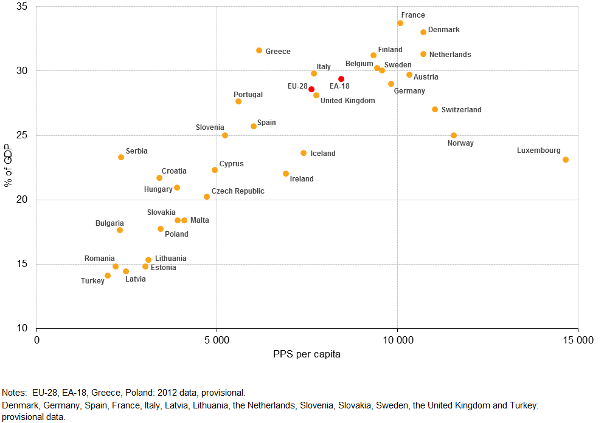
Expenditure on social protection and level of economic well-being
2013
(percentage of GDP and PPS per capita)

Slide 11
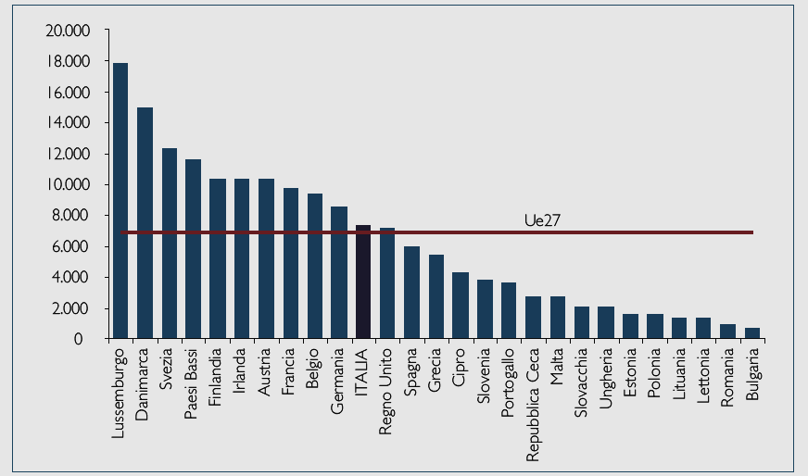
Per capita expenditure on social protection (EU 27)
(2012)
Countries with a larger share of welfare spending to GDP also have much higher values of per capita expenditure. That is, the richer countries provide their citizens with greater support for social risks

Slide 12
Key aspects of the evolution of WS at the turn of the new century
decreasing profile of social spending, though thwarted by the crisis effects
apparent similarities in the reform paths of social protection in each Member State
more restrictive access requirements;
less favourable methods for calculating benefits, embedding rules that take account of ageing;
wider application of means test;
cost of services partially loaded on beneficiaries according to income;
greater efficiency of labour intensive services supply;
less marked characterization of the canonical models
beyond the models, there is clear evidence of a strong correlation between index of well-being of a country and the share of resources directed to social protection (question: insurance purposes has more weight than distributional objectives?)

Slide 13
What about the Italian social protection system ?
the development of the social protection system as we know it today took shape gradually after 1950 and assumed more similar features to those of other national systems after 1970
the main areas of social protection (classified by spending: social security, health care, unemployment benefits, aid to the poorest and social inclusion) all originated in the second half of the nineteenth century.
in all cases they were mostly spontaneous forms independently managed by groups of workers, Christian associations, and smaller non profit organizations
during the first half of the twentieth century, the initial structures began to grow and to see an increasing presence of public institutions, also of great dimension, for the governance and management of services and cash benefit
in the period of greatest economic growth (since the 50s until the early 80s) increased the demands by workers and their families to have a more adequate welfare state to ensure security for employment, for health and for income after retirement.

Slide 14
The overall situation before the reforms
Studies and research regarding the chaotic path of growth of the social protection system in Italy until the end of the seventies of the last century brought to light a multitude of flaws and inconsistencies. In particular, the most critical analysis underlined that the system was:
very unbalanced in the areas of social protection compared to other developed countries
"categorializzato" (certain categories of workers were much more protected than others)
uneven in the quality of services offered by territory and by type and level of organization
unfair in determining certain benefits
costly and inefficient

Slide 15
The years of reforms
In 1978 it was established the National Health Service based on a universalist vision and on a solidarity-model in the delivery of benefits. Health coverage was extended to everyone, not just to certain categories who paid the contributions. Consequently, health care spending has begun to be financed from general taxes.
In 1993 and 1995 it was made significant reforms of the pension system, with the transition of the calculation from an earning related method to a NDC (notional defined contribution) system, the gradual raising of the retirement age and linking pensions to the price index instead of the wage dynamics
in 2000 a “framework law" reorganized the social welfare system with an “integrated model" based on territorial decentralization, subsidiarity, cooperation and self-organization. The same law also established a National Fund for Social Policies and gave a substantial responsibility to the Regions and municipalities for the execution of the intervention plans.
The unemployment benefits system has been amended several times since the early 90s and has had a recent reformulation (2015) with the "Jobs Act". The address is to have a system of monetary compensation similar to that of the main European countries, and to strengthen active policies (not very effective in the Italian system) for the reintegration at work

Slide 16
Further interventions in recent years
The most acute period of economic crisis that began in 2008 and the constraints on public budgets set by the Fiscal Compact in the EU has led governments in recent years to intervene with new restraint in social spending measures.
Pension system: the retirement age has been raised further (about 67 years is the standard age) and linked to life expectancy.
Health services: further measures have been taken (regarding operational models, the territorial reorganization of the units, the rationalization of structures) in order to avoid unnecessary waste and to increase the efficiency of the system.
Social inclusion: the National Fund for Social Policies has had a strong contraction for a few years and the financing has again started to grow only in 2013

Slide 17
Percentage breakdown of social protection expenditures
Year 2008

Slide 18
Percentage breakdown of social protection expenditures
Year 2013

Slide 19
Italy: aging effects on welfare functions

Slide 20
Average rates of growth of pension expenditure and GDP

Slide 21
Long term projections of pension spending and effects of reforms

Slide 22
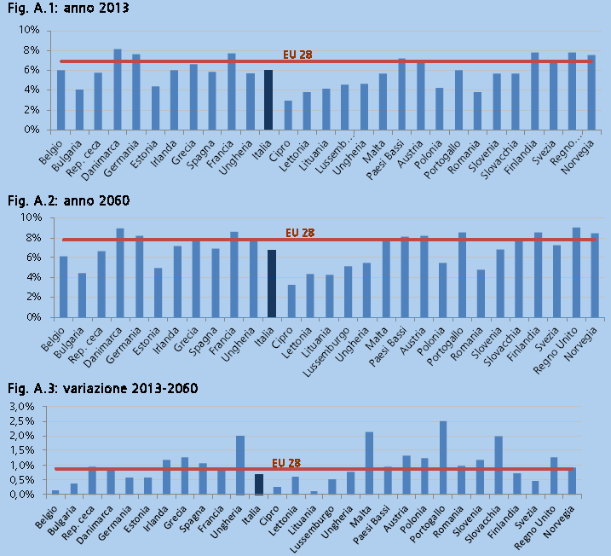
Long term projections of health care spending

