Slide 1
Atypical employment and social security coverage: a EU overview
Dr. Koen Vleminckx
Component Two- 2016 Training Course “European practices in the Governance, Financial Management and Strategies for a Sustainable Social Security System”
Italy, October 16th -30th, 2016

Slide 2
Index
Labour market reforms and flexibility
Flexibility and Atypical Employment
  Part-time employment
  Temporary employment
  Self-employment
Providing social security coverage to atypical workers

Slide 3

Labour market reforms and flexibility

Slide 4
Labour market reforms and flexibility
Labour market flexibility is a multidimensional concept
Partialy a result of a need for “numerical flexibility” and high unemployment
Several EU countries introduced labour market reforms “at the margin”
In doing so, they sought to shelter the core workforce from regulatory changes, shifting the burden of functional adjustment mostly on new entrants in the labour market.

Slide 5

FLEXIBILITY AND ATYPICAL WORK

Slide 6
FLEXIBILITY AND “atypical work”
A standard employment relationship exists when an individual is in a dependent employment relationship for at least 35 hours weekly and has a permanent employment contract.
Part-time employment is employment with less than 35 hours a week (substantial: 20 hours and more a week; marginal: less than 20 hours a week).
Fixed-term employment exists when the period during which a contract is valid is limited (can be part-time).
Self-employment exists when an individual’s main economic activity is not dependent employment.
Quid informal employment?

Slide 7
Incidence and evolution of part-time employment (% of employment)
Source: Eurostat
 | 2007 | 2010 | 2013
Netherlands | 46.3 | 48.3 | 49.8
Germany | 25.4 | 25.5 | 26.7
UK | 24.1 | 25.7 | 25.6
Denmark | 23.0 | 25.6 | 24.7
France | 17.2 | 17.6 | 18.1
Italy | 13.4 | 14.8 | 17.6
Spain | 11.4 | 12.9 | 15.7
EU-27 | 17.6 | 18.6 | 19.7

Slide 8
Incidence and evolution of involuntary part-time employment (% of part-time employment)
Source: Eurostat
 | 2007 | 2010 | 2013
Netherlands | 5.1 | 5.7 | 9.9
Germany | 22.6 | 21.9 | 15.6
UK | 10.6
Denmark | 13.4 | 15.6 | 18.3
France | 31.5 | 31.7 | 39.3
Italy | 39.5 | 50.5 | 63.0
Spain | 33.3 | 50.1 | 63.3
EU-27 | 22.4 | 26.7 | 29.4

Slide 9
Title

Slide 10
Share (%) of temporary employment in total dependent employment
Source: OECD
 | 1990 | 2000 | 2012
UK | 5 | 7 | 6
Denmark | 11 | 10 | 9
France | 11 | 16 | 15
Germany | 11 | 13 | 14
Italy | 5 | 10 | 14
Spain | 30 | 32 | 24
EU-21 | 10 | 13 | 14
OECD | 10 | 11 | 12

Slide 11
Share (%) of temporary employment in total dependent employment, 15-24 Source: OECD
 | 1990 | 2000 | 2012
UK | 10 | 13 | 15
Denmark | 30 | 30 | 21
France | 38 | 55 | 55
Germany | 34 | 52 | 54
Italy | 11 | 26 | 53
Spain | 66 | 69 | 63
EU-21 | 26 | 36 | 39
OECD | 20 | 24 | 24

Slide 12
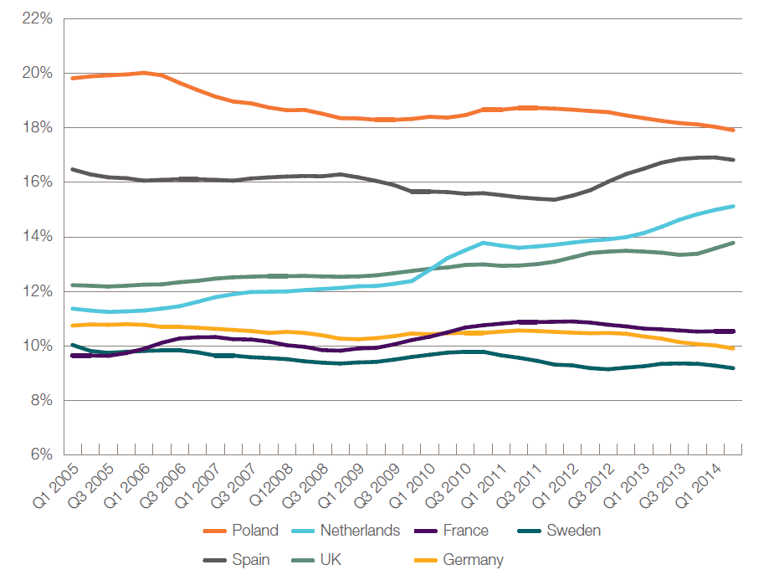
Self-employment rate across selected EU Countries, 2005-2014

Slide 13
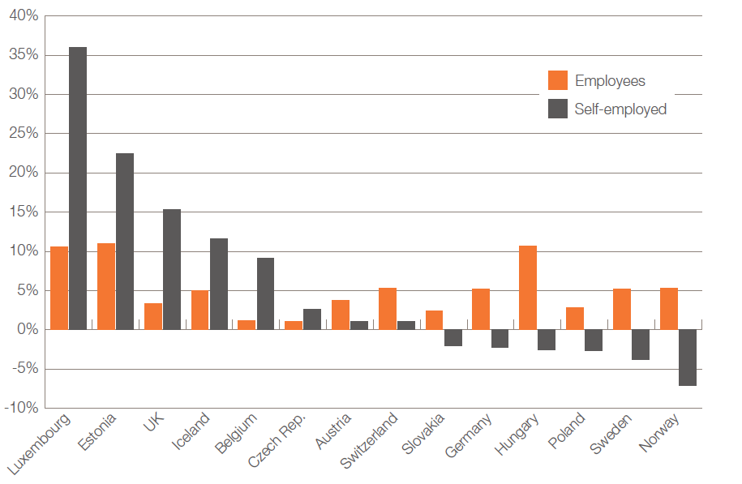
Percentage change employment and self-employment rate
across selected EU Countries, 2005-2014

Slide 14
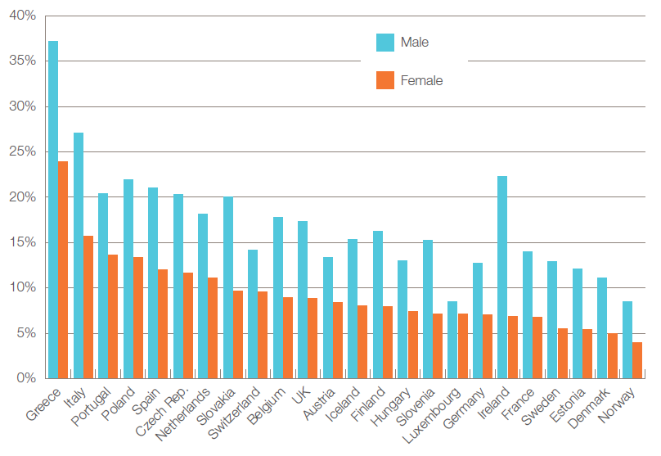
Male and female self-employment rate, EU Countries, 2013

Slide 15
The issue of dependent self-employment”
Dependent self-employment is defined as a working relationship where the worker is formally self-employed yet under conditions of work similar to those of dependent employees.
Dependent self-employment more frequently occurs in construction, transport, insurance and accounting, business services, architecture and the creative sector.

Slide 16
The issue of dependent self-employment”
Example 1: A truck driver who owns his (only) truck and runs a trucking company, but works only for one forwarding company. The latter determines the work schedule and the appearance of the trucks, etc. The self-employed truck driver bears the cost and risk of the functioning of the truck, only earns when s/he works (i.e. no paid holidays) and is responsible for social insurance contributions.
Example 2: Tied agents in the insurance industry are self-employed insurance agents selling insurance products of only one insurance company. They usually appear under the logo of the respective insurance company, although they are self-employed. They have a binding contract forbidding them to sell insurance products from other companies.

Slide 17
Little numerical data concerning dependent self-employment
UK: Burchell et al. (1999) find that 5 per cent of those in employment are individuals who
contract to supply their own personal services to an employer without having a contract of
employment yet are economically dependent on the employer’s business to some degree
given that they derive a substantial part of their income from this particular work.
Germany: Dietrich (1996) affirms that around 3 per cent of the labour force work in the grey
zone between self-employment and employment.
Italy: Berton et al. (2005) states that there were more than half a million “parasubordinati”
(i.e. self-employed without employees working for one company) representing 2.5 % of those
in employment.
Austria: around 1.1 per cent of the labour force worked as self-employed for only one
employer and were bound by the instructions of the employer or contract partner
(in terms of labour time and methods) in 2001 (Statistik Austria 2002).

Slide 18

Providing social security coverage to atypical workers

Slide 19
Challenges of covering atypical work
Design challenges
Administrative challenges
Challenge of compliance

Slide 20
Design challenge
Main challenge: extending social protection, and particularly social insurance, to
atypical workers by providing more inclusive coverage through the main social insurance
schemes or by the creation of specific social security regimes.
Social security coverage often depends on employment status
Social insurance schemes are often complex and fragmented

Slide 21
Ideal-typical models of Social Insurance

Slide 22
Ideal-typical models of Social Insurance

Slide 23
Administrative challenges
Formal employment
Self-employed
Yes
Self-employed?
No
Dependent employment
Temporary employment
Yes
Temporary?
One client
?
Yes
Dependent self-employemt
No
Less than 35 hours?
Less than 35 hours?
No
Yes
Yes
No
Regular self-employment
Temporary Part-time employment
Part-time employment
Typical employment

Slide 24
Coverage of “atypical work”
Part-time employment:
Unrestricted coverage by citizenship based schemes, while in insurance based schemes coverage uncertain as entitlement can depend on the number of hours worked , the income earned, or contributions paid. In insurance based systems lower earnings and lower contributions lead to lower benefits.Sometimes corrected through social pooling and subsidies.
Fixed-term employment:
Full coverage by citizenship based schemes, even during periods of unemployment. In contributory insurance based schemes no guarantee of continued insurance, although continued insurance is occasionally provided for those covered by unemployment insurance etc.
Self-employment:
Full coverage by citizenship based schemes. In some countries categorical social insurance for the self-employed is in place, but not always and not for all social risks. Different earnings concept (gross income – costs = profit), irregular, different timing.
Dependent self-employed:
The social rights of dependent self-employed are sometimes regulated through a legal hybrid category between genuine self-employment and ‘standard’ dependent employment (Italy, Austria and Germany). If such a legal hybrid category does not exist, their social protection rights are either similar to those of genuine self-employed or can be derived from universal benefits for all inhabitants. In other systems they are identified as so-called “phantom self-employed” and complied to coverage as employee through the “employer” from which they are depending.

Slide 25
Informal employment
Employment deficit:
People cannot find work or business opportunities in the formal economy
Social Protection Deficit:
Even though the workers in the informal sector are most in need of social protection, they are unable to access formal schemes owing to membership and contribution issues.
Rights deficit:
People in informal employment are more vulnerable for the violation of other rights
Information deficit:
Very difficult to monitor the quantity and quality of informal employment

Slide 26
Providing coverage for informal workers
Pragmatic approach:
Create a separate framework within the existing schemes to accommodate these workers, tailor made to suit their needs.
Rights approach:
Bring informal workers within the legal framework to be reistred, recognized and protected.
Information deficit:
Research needed to establish categories of informll-sector workers in order to be able to determine relevant aspects such as contribution capacit, collection of contributions, and distribution of benefits.

Slide 27
Flexicurity in the EU
Adoption by Member States
The flexicurity concept was adopted by the Council of Employment Ministers of the EU in December 2007 following an intensive dialogue with Member States and a strong involvement of social partners.

Slide 28
Flexicurity in the EU
4 components:
Flexible and reliable contractual arrangements (from the perspective of the employer and the employee) through modern labour laws, collective agreements and work organisation;
Comprehensive lifelong learning (LLL) strategies to ensure the continual adaptability and employability of workers, particularly the most vulnerable;
Active labour market policies (ALMP) that help people cope with rapid change, reduce unemployment spells and ease transitions to new jobs;
Modern social security systems that provide adequate income support, encourage employment and facilitate labour market mobility: unemployment benefits, pensions and healthcare.

