Slide 1
The INPS actuarial forecasts and evaluations
Angela Legini
Component Two- 2016 Training Course “European practices in the Governance, Financial Management and Strategies for a Sustainable Social Security System”
Italy, October 16th -30th, 2016

Slide 2
Index - The INPS actuarial forecasts system
SHORT - MEDIUM TERM ACTUARIAL FORECASTS
LONG TERM ACTUARIAL FORECASTS
FOR ESTIMATING THE COSTS OF GOVERNEMENT
AND PARLIAMENT REGULATORY CHANGES
TO VERIFY THE ACTUARIAL BALANCE OF PENSION FUNDS

Slide 3
SHORT - MEDIUM TERM ACTUARIAL FORECASTS - The budget cycle
INPS manages many Funds for pensions and social assistance. The set of their balance sheets form the INPS budget.
The budget cycle is:
THE BUDGET FORECAST: planning instrument
THE BUDGET FORECAST UPDATES: revised budget for better planning
THE FINAL BALANCE: results achieved

Slide 4
SHORT - MEDIUM TERM ACTUARIAL FORECASTS - The INPS budget
The INPS accounting system is based on the asset held system with the double-entry method.
The INPS general budget of annual forecast and the budget for each fund have the following main components:
• BALANCE SHEET – PROFIT AND LOSS ACCOUNT
• FINANCIAL BUDGET
      ACCRUAL BASIS
      CASH BASIS (accruals/deferrals)

Slide 5
SHORT - MEDIUM TERM ACTUARIAL FORECASTS - The assumptions
The INPS budget forecast and its frequency depends upon:
• LEGISLATIVE FRAMEWORK
MACROECONOMIC FRAMEWORK - Document of Economics and Finance and related updates containing the main reference indicators:
    GDP,
      expected inflation,
        rate of employment,
          amount of wages and incomes,
            etc.

Slide 6
SHORT - MEDIUM TERM ACTUARIAL FORECASTS - The probabilities
Probabilities for changing the state of the insured or pensioner
Insured
Death of insured
Survivor
(new pensioner)
Old-age pension
Disability pension
Death of pensioner
Survivor
(new pensioner)

Slide 7
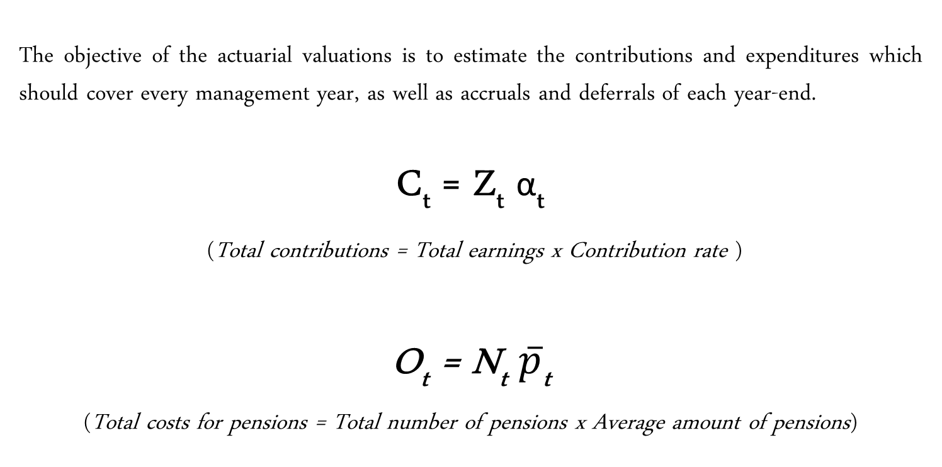
SHORT - MEDIUM TERM ACTUARIAL FORECASTS - The methodology
The objective of the actuarial valuations is to estimate the contributions and expenditures which should cover every management year, as well as accruals and deferrals of each year-end.
C_{t} = Z_{t} α_{t}
(Total contributions = Total earnings x Contribution rate )
O_{t} = N_{t} $\overline{p}$_{t}
(Total costs for pensions = Total number of pensions x Average amount of pensions)

Slide 8
LONG TERM ACTUARIAL FORECASTS - Guidelines for regulatory changes
Each law involving financial consequences must be accompanied by a
TECHNICAL REPORT
Prepared by the competent authority (e.g. INPS for pensions, employment, etc.)
Verified by the Ministry of Economy and Finance
It contains:
the ten-year planned expenditure prepared with prudential criteria (the amount authorized is the maximum spending limit)
the number of beneficiaries, the amount of the individual and overall benefits
the description of the process used to calculate the direct and indirect financial effects
the methodology and the calculation in order to reconstruct and verify the "mathematical logic" steps that led to the definition of the burden

Slide 9

LONG TERM ACTUARIAL FORECASTS - Criteria for the multi-annual budget
VALUATION PERIOD
30/50 YEARS FOR PENSION FUNDS
10 YEARS FOR OTHERS FUNDS
FREQUENCY OF THE FORECASTS
EVERY 3 YEARS
PRUDENTIAL CRITERIA
RESPECTING ACCOUNTING PRINCIPLES
INTERNAL COHERENCE
EXTERNAL COHERENCE

Slide 10
LONG TERM ACTUARIAL FORECASTS - The actuarial model
Pension schemes are long-term societal commitments, many of which have to be honored by future generations.
It is, therefore, necessary to have information on the benefits promised before they are actually paid. In particular, the actuary is involved in making assumptions about future events in order to define:
a) when benefit payments are to be made (demographic projections);
b) the level of benefits to be paid (economic projections).
The actuarial model is implemented through a set of mathematical formulae and algorithms, and created by using a set of inputs (data and assumptions) to produce a set of outputs.

Slide 11
LONG TERM ACTUARIAL FORECASTS - Choice of methodology
The exact nature of the required results and their level of disaggregation to be attained can affect the choice of the forecasting model:
Average values for aggregations
Stochastic simulation or "Montecarlo" method:
uses all available information at the individual level
the “history” of individuals is then followed on the basis of their characteristics
the “history” of each individual is replicated to ensure the stability of results

Slide 12
Thanks!!!!
谢谢！

