Slide 1
EU countries pension schemes: a comparative analysis
Carlo Mazzaferro
University of Bologna
Component Two- 2016 Training Course “European practices in the Governance, Financial Management and Strategies for a Sustainable Social Security System”
Italy, October 16th -30th, 2016

Slide 2
European countries have increased the process of reforming their pension system
  Demographic transition will put financial pressure on PAYGO financed social security systems
  In part (not in all) of the EU countries labour force participation is low and the economic research shows that rules of public pension systems in EU (especially DB) distorted labour supply
  The majority of EU national pension schemes are based on rules that have displayed problems in following socio-economic changes
  The economic crisis (after 2008) has speeded up the need to contrast poverty in the short and in the medium term among the older but also among young workers (future pensioners)
According to the European Commision (Green Paper) pension system must be adequate and sustainable
In order to reach these aims (White Paper) national pension system should:
  Better balancing the time spent in work and retirement
  Developing complementary private retirement savings

Slide 3
However there is only limited EU level competence on pension system
EU can only encourage voluntary sharing of best practice and develop common objectives and indicators
Pension systems and pension reforms are typically a national topc among European countries.
At the same time is very complex to classify «national pension system» in Europe
  National pension systems have (all) a complex hysotrical evolution and people in each single country feel that they are an important part of their welfare system
  EU coordination in this field is light and not binding (differently for example from regulation, budget control, etc.)

Slide 4
Detailed comparison of pension systems across EU countries is a difficult task.
  All the countries of the Union have set up schemes whereby workers are assured of a certain level of income upon their retirement.
Schemes are: i) public; ii) mandatory; iii) PAYGO financed
However the degree of development of single national schemes is very different, as it is different the mechanism of determination of pension benefits and social security contributions, the degree of complementarity between public and private sector, the interaction between pension systems and other tier of the social protection system
It is however possible to resort to a very broad distinction between two different type of pension system which finds an explanation into the hystorical evolution of pension systems in Europe.
the Beveridgean system
the Bismarkian system

Slide 5
Index
The Beveridgean system:
  social security benefits ensure for each citizen (resident) a basic income
  (public) pension benefits are flat (and normally means tested).
  individuals who want (and can) supplement this basic income during old age, turn to the market and join private pension schemes (either voluntarily or as part of their labour contract)
  typical countries: Denmark, Ireland, the Netherlands and the United Kingdom
The Bismarkian system:
  people have a right to social security benefits during old age only insofar as they acquire that right by working when adult
  the pension benefits are earnings-related and profession-related, generally subject to maximum limits.
  typical countries Germany, Belgium, Sweden, France and the southern European countries
  often supplemented with a minimum pension guarantee for people who have had only weak attachment to the labour force
  limited role to voluntary pension arrangements

Slide 6
Index
In the economic literature (see for example Conde Ruiz and Profeta 2007) it emerges that Beveridgean countries w.r.t Bismarkian countries are associated with:
  Lower public pension spending
  High-income inequality
  More intense presence of privately financed pension schemes
  Higher replacement rates for low income individuals
In the next slide we show some data in a sample of European countries where Beveridgean, Bismarkian and other countries are represented.

Slide 7
Public, private and total Replacement Rate
Country | PUBLIC | PRIVATE | TOTAL
DENEMARK | 22% | 46% | 68%
NETHERLANDS | 27% | 63% | 90%
UK | 22% | 30% | 51%
FRANCE | 55% | 0% | 55%
GERMANY | 38% | 13% | 50%
ITALY | 70% | 0% | 70%
GREECE | 67% | 0% | 67%
SPAIN | 82% | 0% | 82%
SWEDEN | 37% | 19% | 56%
POLAND | 43% | 0% | 43%

Slide 8
Poverty incidence indicators by age and gender
 | Older people (aged over 65) |  |  |  |  | Whole population
 |  | By age |  | By gender
 | All 65+ | 66-75 | 76+ | Men | Women
Denmark | 4.6 | 2.7 | 7.4 | 3.1 | 5.8 | 5.4
Netherlands | 2.0 | 1.8 | 2.3 | 1.7 | 2.3 | 7.9
United Kingdom | 13.4 | 10.9 | 16.6 | 10.9 | 15.5 | 10.5
France | 3.8 | 2.7 | 5.0 | 3.0 | 4.4 | 8.1
Germany | 9.4 | 8.1 | 10.8 | 6.3 | 12.3 | 8.4
Greece | 6.9 | 5.9 | 8.1 | 5.6 | 8.0 | 15.1
Italy | 9.4 | 9.5 | 9.2 | 6.4 | 11.5 | 12.7
Spain | 6.7 | 6.4 | 7.1 | 5.7 | 7.6 | 14.0
Poland | 8.2 | 10.4 | 5.6 | 4.4 | 10.5 | 10.2
Sweden | 9.3 | 6.6 | 13.5 | 6.6 | 11.6 | 9.0

Slide 9
Share of private, public and total pension expenditure over Gdp
Country | Private | Public | Total
Denmark | 4.7 | 6.2 | 10.9
Netherlands | 5.8 | 5.4 | 11.2
United Kingdom | 5.3 | 5.6 | 10.9
France | 0.2 | 13.9 | 14.1
Germany | 0.8 | 10.6 | 11.4
Greece | 0.4 | 14.5 | 14.9
Italy | 1.1 | 16.2 | 17.3
Spain | 0.0 | 10.5 | 10.5
Poland | 0.0 | 10.8 | 10.8
Sweden | 2.6 | 7.4 | 10.9

Slide 10
Index
Summarizing:
Different level of RR (always above 50%). Beeing a Beveridgean or a Bismarkian country does it matter
Poverty among older people always below poverty among the total population
  More at risk women and oldest among pensioners
Share of pension expenditure always above 10% over Gdp. Different composition between Beveridgean and Bismarkian countries

Slide 11
Index
A broader and more comprehensive classification is the World Bank/OECD taxonomy.
Pension systems can be classified into a three level scheme, where each level pursues a different objective
  First pillar: avoiding poverty in old age. Typically public and PAYGO, universal or flat rate benefit or minimum pension, contains strong redistributive elments
  Second pillar: ensuring adequacy, occupational schemes, can be public or private, DB or (N)DC, funded or PAYGO, may vary in the degree of redistribution, typically based on the labour market position of the insured
  Third pillar: giving flexibility, individual plans, typically voluntary, private and funded
Remeber that this calssification is roough and that in single countries experiences pension schemes interact across pillars

Slide 12
A more «theoretical» classification
Moving from the idea that the core of the pension system in the majority of EU countries is pillar II.
It is possible to distinguish pension systems according both to the financing method and to the rule of computation of the pension benefit.
Combinig these charateristics 4 pension schemes emerge:

Slide 13
Index
We are going to use these two classification to analyze the reform process among European countires
Differences in the original structure of each national pension system make it difficult to find immediately a common trend among these reforms.
Better to think in a general way:
  Ageing of the population
  Inappropriateness of current system to face changes in the economy
Look at reform process in term of risks that each pension system faces
Fertility
Longevity
Economic
Financial
Political

Slide 14
Index
What is the expected interrelation between the ageing of the population and each of the above described risks?
  Fertility decrease
  Longevity increase
  Reduction in the economic growth
  Reduction in the rate of return of capital
  Increasing political weitght of the old part of the population
Pension policy reforms should find solutions that redistribute optimally risks among individuals and generations
Broadly speacking two fundamentals different approaches to reform pension systems:
  Radical reforms: change the financing method
  Parametric reforms: change the computational rule and/or retirement age

Slide 15
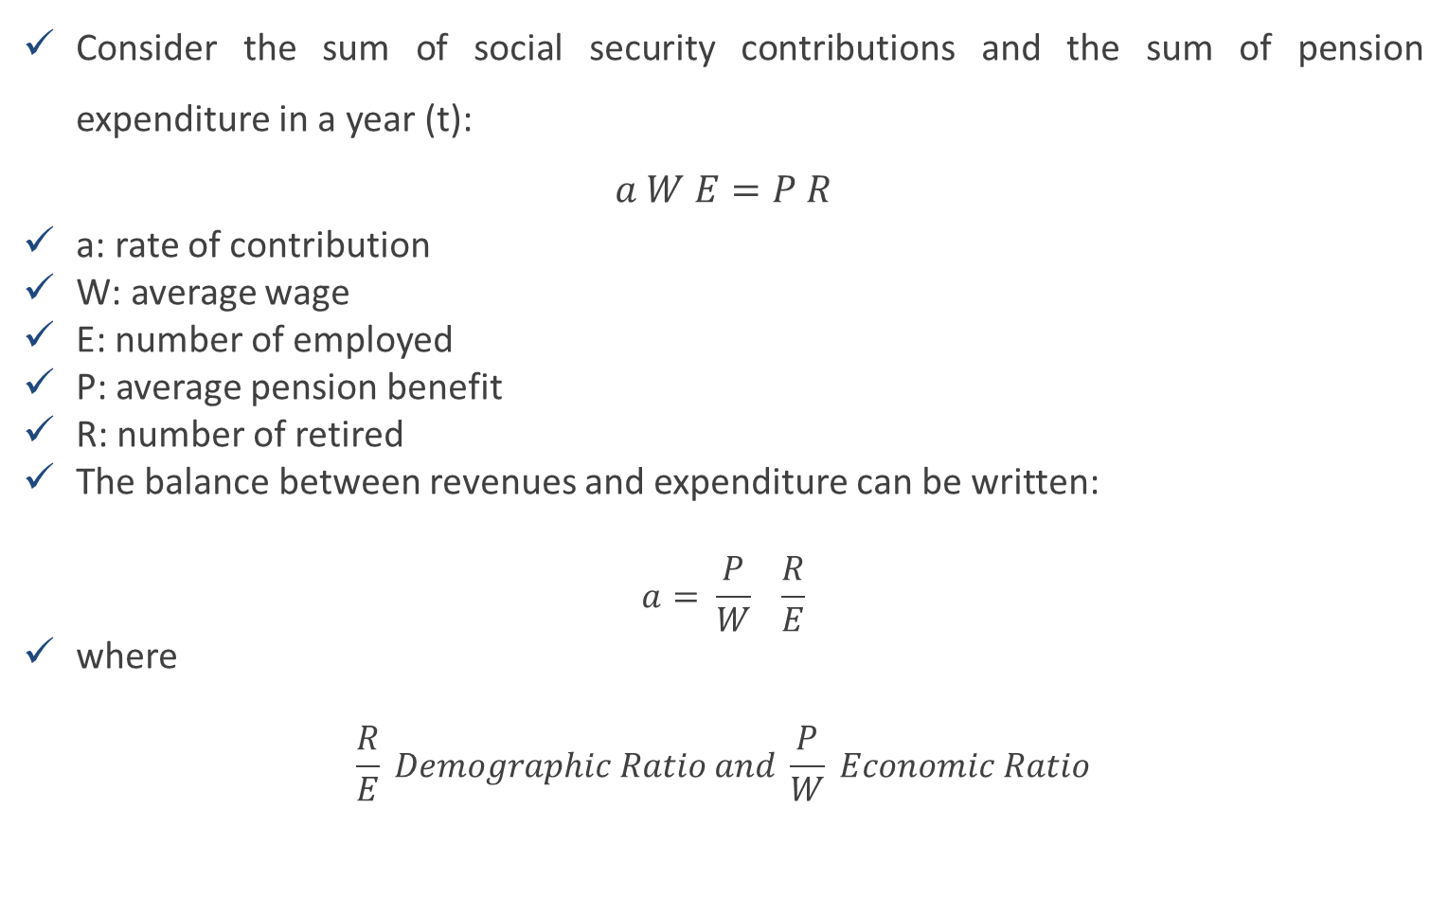
Index
Consider the sum of social security contributions and the sum of pension expenditure in a year (t):
$$a W E=P R$$
a: rate of contribution
W: average wage
E: number of employed
P: average pension benefit
R: number of retired
The balance between revenues and expenditure can be written:
$$a= \frac{P}{W} \frac{R}{E}$$
where
$$\frac{R}{E} Demographic Ratio and \frac{P}{W} Economic Ratio$$

Slide 16
Index
Fertility reduction and increasing longevity make the demographic ratio higher
Labour productivity reduction (associated with ageing of the population) makes the economic ratio higher
Political weight of the old tend to increase the economic ratio
Reduction in the rate of return of capital reduces the economic ratio
XXX
XXX
XXX

Slide 17
Index
What kind of policies can be implemented in order to face the expected ageing of the European population and the slowdown in economic growth?
  Modify pension portfolio: substitutability vs complementarity
  Increase contributions
  Decrease pension benefits
  Increase retirement age
Each of policy has important economic effects. All of them are difficult to implement even if for different reasons
  Financial risks in an era of low interest rates; intergenerational distribution of burden
  Tax wedge and distortions
  Political cost and intergenerational distribution of them
  An old working force and its implication on labour and total productivity

Slide 18
Index
What have European government done on their pension system in order to face these problems?
No single analysis of country experiences.
There are however some common trends:
  Substantially increased retirement age
  Reduced valorization of past earnings in the pension formula
  Modified indexation mechanism of pension benefits
  Introduced different kind of automatic adjustment (NDC, linking ret age to lifetime expectations; sustainability adjustments)
Were these poicies successful? Probably too early to give a definitive answer
Is it possible to identifiy who pays and who gains from these reforms?

Slide 19
INDICATORS OF THE EFFECTS OF PENSION REFORMS IN SOME EU COUNTRIES
Country | TYPE OF SYSTEM | EFFECTIVE RET AGE | RET AGE 2020 | RET AGE 2060 | Exp / gdp 2015 | Exp / gdp 2060
Denmark | FLAT + DB | 65.6 | 66 (63) | 72.5 (69) | 10.3% | 7.2%
Netherlands | FLAT + DB | 65.5 | 66.3 | 71.5 | 6.9% | 7.8%
United Kingdom | FLAT + DB | 64.9 | 66 | 68 | 7.7% | 8.4%
France | PS + DB | 60.8 | 67 (62) | 67 (62) | 14.9% | 12.1%
Germany | PS | 65.1 | 65.8 (63) | 67 (63) | 10.0% | 12.7%
Greece | FLAT + DB + NDC | 64.4 | 67 (62) | 71.9 (66.9) | 16.2% | 14.3%
Italy | DB + NDC | 62.4 | 66.8 (63.8) | 70 (67) | 15.7% | 13.8%
Spain | DB | 62.8 | 65.8 (63) | 67 (63) | 11.8% | 11.0%
Poland | NDC | 63.9 | 67 | 67 | 8.2% | 8.1%
Sweden | NDC | 65.8 | 67 (61) | 67 (61) | 8.9% | 7.5%

Slide 20
Country | TYPE OF SYSTEM | Rep rate in 2010 | Rep rate in 2060 | Difference
Denmark | FLAT + DB | 69% | 67% | -2%
Netherlands | FLAT + DB | 105% | 101% | -4%
United Kingdom | FLAT + DB | 60.30% | 50.30% | -10%
France | PS + DB | 77.60% | 58.80% | -19%
Germany | PS | 59.10% | 63.40% | 4%
Greece | FLAT + DB + NDC | 121% | 83% | -38%
Italy | DB + NDC | 89.10% | 69.10% | -20%
Spain | DB | 94.50% | 86.50% | -8%
Poland | NDC | 75.50% | 53.30% | -22%
Sweden | NDC | 60.30% | 50.30% | -10%

Slide 21
Summarizing
Reforms enacted in EU countries seem to be able to realize the aim of maintain (or recover) financial sustainability in the long run.
As for the adequacy it seems the, in a large share of countries, RR would remain similar to those of todays new pensioners
The possibility to reach at the same time objectives of points 1. and 2. is realized more through a substantial increase in the average retirement age and less thorough the development of a more thight complementary private pension pillar.
The main open question regards the real ability of an ageing future working force to deliver reasonable rate of growth in the future.

