Slide 1
RGS Pension Model
Legal framework, methodology and results
Rome, 20 October 2016

Slide 2
RGS PENSION MODEL - THE MAIN TOPICS (slide 2)
An overview of the legal-institutional framework of the Italian pension system
The outline of the model
Internal consistency of the model
  Result under the National baseline scenario
  Consistency with scenario assumptions
  Long run convergence of projections
RGS Pension Model
2

Slide 3
LEGAL-INSTITUTIONAL FRAMEWORK – AN OVERVIEW (slide 3)
Public pension system
compulsory, pay-as-you-go system
provides: old age (and early), disability, survivors’ pensions, and old age allowances
applies the same general rules across all participants, in the mid-long run
covers all workers: public sector employees (expenditure 25%), private sector employees (60%) and the self-employed (15%)
all labour income are subject to contribution
greatly reformed during the last two decades
RGS Pension Model
3

Slide 4
LEGAL FRAMEWORK – THE REFORM PROCESS (slide 4)
Elimination of indexation to real wages (law 503/1992)
Introduction of the NDC (Notional Defined Contribution) method and the periodic update of the transformation coefficients (1/annuity factor) to changes in mortality rates (law 335/1995 and Law 247/2007);
Tightening of the eligibility requirements for earnings-related and social assistance pensions (law 503/1992, law 335/1995, law 449/1997 and law 243/2004, as modified by law 247/2007);
Alignment of the statutory retirement age of women to that of men, thus eliminating a 5-year gap (law 122/2010, law 214/2011);
Indexation of the eligibility requirements to changes in life expectancy for earnings-related and social assistance pensions.
RGS Pension Model
4

Slide 5
LEGAL FRAMEWORK - TOWARDS A NDC REGIME (slide 5)
The NDC regime, based on an actuarial equivalence, is
  fully applied to all entrants into the labour market after 1995 (fully phased-in in 2030-2035)
    partly applied to workers with less than 18 years of contribution at the of 1995, according to the pro rata rule (‘mixed’ regime) starting from 1996
    also applied to workers with more than 18 years of contribution at the of 1995, for contribution paid from 2012 (almost phased out)
    The previous DB regime is applied to workers already insured at the end of 1995, limited to contribution periods not subject to NDC regime
RGS Pension Model
5

Slide 6
LEGAL FRAMEWORK – CALCULATION RULES UNDER THE NDC (slide 6)
Calculation formula: p = M tc
where: P = pension
M = total life-long contributions
tc = transformation coefficient (1/annuity factor)
Contributions are capitalised with GDP growth rates (5-year mobile avg)
Transformation coefficients
  approximately the inverse of the number of years the pension is paid to the pensioner and their surviving spouse (weighted with the reversibility rate)
  subject to a 3-year revision (2-year from 2021) according to changes in mortality rates
  range from 4.25% at 57 to 6.38% at 70 (3-year period 2016-2018)
  upper age limit increases in line with the SRA (linked to changes in life expectancy)
RGS Pension Model
6

Slide 7
LEGAL FRAMEWORK - CALCULATION RULES UNDER THE DB REGIME (slide 7)
Calculation formula: P = 2% a W
where:
P = pension
a = contribution years
2% = accrual rate
W = reference wage
The reference wage is an average of last annual wages (or earnings), the number of which depends on sector, year of retirement and period of contribution
RGS Pension Model
7

Slide 8
LEGAL FRAMEWORK – ELIGIBILITY REQUIREMENTS IN 2016 (slide 8)
Statutory Retirement Age (old age pensions)
SRA is 66 years and 7 months for men and female employees in the public sector
temporary lower for female employees in the private sector and the female self-employed (aligned to the SRA of other workers as of 2018)
Early retirement
early retirement, regardless of age (all regimes) with 42 years and 10 months of contributions (1 year less for women)
under NDC regime alone: up to 3 years earlier than the SRA, with 20 years of contributions and a pension at least of 1,200 euro per month in 2012 (2.8 times the old age allowance, in 2012), indexed with 5-year average of nominal GDP.
All the eligibility requirements are indexed to changes in life expectancy at 65 (every 3 years up to 2019, every 2 years from 2021)
RGS Pension Model
8

Slide 9
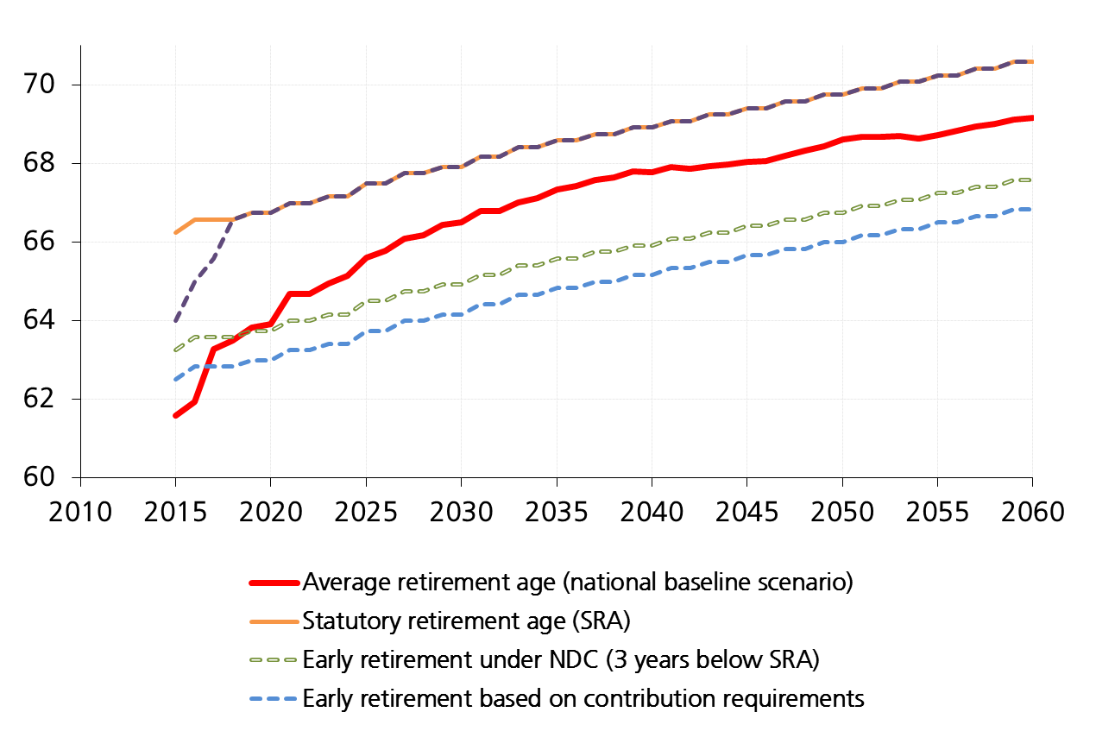
LEGAL FRAMEWORK - ELEGIBILITY REQUIREMENTS AND AVERAGE RETIREMENT AGE (slide 9)
Entry age: M=20; F=21
RGS Pension Model
9

Slide 10
LEGAL FRAMEWORK – A SAFETY NET (slide 10)
Social assistance benefits are provided to the elderly on low income, regardless of contributions. They include:
  old age allowance (5,824.91 euro per year, in 2016): acknowledged to the elderly with a personal income below the benefit itself or, if married, with a couple’s income below twice as much.
  social assistance additional lump sums (maggiorazioni sociali): foreseen to supplement the old age allowance to given income thresholds, depending on age and marital status (For those over 70’s, 8,298.29 euro of personal income and 14,123.20 euro of couple's income, in 2016).
They are means-tested
The minimum age requirement is 65 years and 7 months in 2016 and is fully aligned to the SRA in 2018.
RGS Pension Model
10

Slide 11
LEGAL FRAMEWORK – PENSION INDEXATION (slide 11)
Pensions are indexed to price inflation
  100% for the part up to 3 times the Minimum Pension (MP), 90% for the part between 3 and 5 times the MP, and 75% for the part above 5 times the MP
  For 2014-2018, indexation to price inflation is reduced for pensions above 3 times the minimum pension.
  There is no link to real wage growth (abolished with the 1992-reform)
According to the current legislation, old age allowances are indexed to prices while additional social assistance components are constant in nominal terms
  in the projections, they are both indexed to nominal GDP per capita after 2018. In the short term, the current legislation is applied
RGS Pension Model
11

Slide 12
LEGAL FRAMEWORK – TAXATION AND CONTRIBUTION RATES (slide 12)
All pensions are taxed as labour-income
The average incidence of taxation on public pension expenditure was 18.6% in 2015 (2.9% of GDP)
Contributions are fully deductible from taxable income
Contribution rates
  private and public employees: 33% (of which 2/3rd employer)
  the self-employed: gradual increasing from around 22.2% in 2014 to 24% in 2018
  atypical workers: from 31% in 2016 to 33% in 2018. Such percentages are reduced to 22% and 24% (from 2016), respectively, for those already pensioners or contributors to other pension schemes
RGS Pension Model
12

Slide 13
LEGAL FRAMEWORK – ACCUMULATION OF PENSION AND LABOUR INCOME (slide 13)
Old age and early pensions
  all restrictions concerning the possibility of accumulating pension and labour income have been eliminated (Law 133/2008)
Disability pensions
  accumulating is allowed with 40 years of contributions. Otherwise the pensioner is subject to withdrawal from the pension
Survivor’s pensions
  accumulating without any curtail is only allowed when the pensioner’s income falls below 3 times the minimum pension
RGS Pension Model
13

Slide 14
RGS Pension Model – THE GENERAL OUTLINE (slide 14)
  Macrosimulation model composed of four modules: Demography, labour market, productivity and pension modules
RGS Pension Model
14

Slide 15
RGS Pension Model – THE METHODOLOGY (slide 15)
  Demography, labour market and pension modules are based on a cohort approach
  Productivity module based on a Cobb Douglas production function Total Factor Productivity plus capital deepening
  Pension module:
    based on a dynamic, multistate approach involving a large number of “state” variables
    members enrolled in the pension system are projected according to the level of disaggregation provided by the state variables
    “monetary” variables (pension amount, wages) are projected in terms of their mean value associated to each possible “position” within the system
    Includes a specific module for survivor’s pensions
  Data source: population, labour force, social security system databases
RGS Pension Model
15

Slide 16
RGS Pension Model – THE MAIN EQUATION TO PROJECT POPULATION (slide 16)
P = population
ϕ = probability of surviving
β = probability of not leaving the country
l = new Immigrants
B = new births
RGS Pension Model
16

Slide 17
RGS Pension Model – THE MAIN EQUATION TO PROJECT LBOUR FORCE AND EMPLOYMENT (slide 17)
v = activity rate ( = 1-v)
λ= probability of leaving permanently the wokforce (retirement…)
π = probability of leaving permanently the non-workforce (emplyment..)
k = level of education
N = emplyment (n = employment rate)
e = workers entering the labour market on a permant basis
RGS Pension Model
17

Slide 18
NATIONAL BASELINE SCENARIO – COHORT profile of activities Rates and enrolment rates by level of education (slide 18)
MALES
Activity rates
Enrolment rates
RGS Pension Model
18

Slide 19
NATIONAL BASELINE SCENARIO – cOHORT profile of activities rates and school enrolment rates by level of education (slide 19)
FEMALE
Activity rates
Enrolment rates
RGS Pension Model
19

Slide 20
NATIONAL BASELINE SCENARIO – age profile of activity rates by level of education (slide 20)
MALES
Activity rates (source: labour force 2015)
Cohort profile of activity rates (forecast)
RGS Pension Model
20

Slide 21
NATIONAL BASELINE SCENARIO – age profile of activity rates by level of education (slide 21)
FEMALES
Activity rates (source: labour force 2015)
Cohort profile of activity rates (forecast)
RGS Pension Model
21

Slide 22
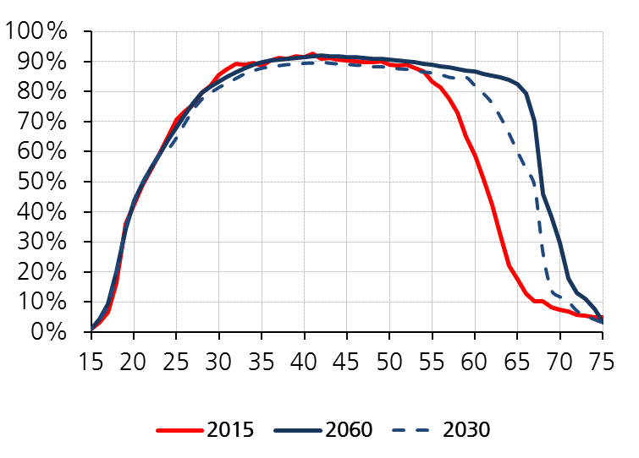
NATIONAL BASELINE SCENARIO – ACTIVITY RATES (slide 22)
MALES
RGS Pension Model
22

Slide 23
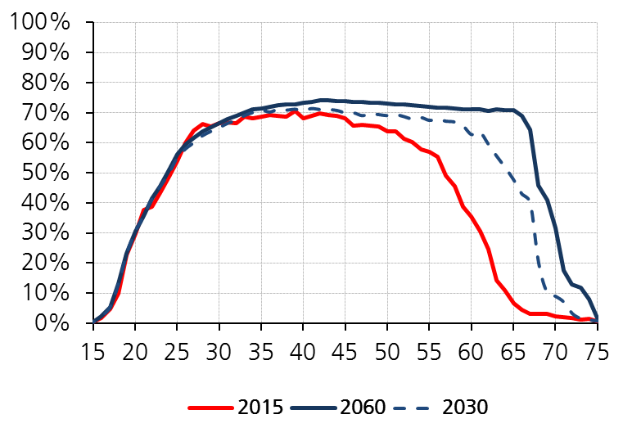
NATIONAL BASELINE SCENARIO – ACTIVITY RATES (slide 23)
FEMALES
RGS Pension Model
23

Slide 24
RGS Pension Model – THE MAIN EQUATION TO PROJECT NUMBERS ENROLLED IN THE PENSION SYSTEM (slide 24)
a = members
ϕ = probability of surviving
T = transition matrix
e = new entrants
RGS Pension Model
24

Slide 25
RGS Pension Model – STATE VARIABLES AND THEIR SPECIFICATIONS (slide 25)
RGS Pension Model
25

Slide 26
RGS Pension Model – PROJECTION OF MONETARY VARIABLES (slide 26)
The mean value associated to each position within the pension system is calculated and projected according to
  the legal-institutional framework
  macroeconomic assumptions
  state variable specifications
  variation coefficient and distribution function
Wages are projected by cohort on the basis of
  inflation rate and productivity growth rate
  career progression (when an additional year of contribution is matured)
Career progression is calibrate in order to guarantee that the average contribution base (wages, earnings) grows in line with productivity
RGS Pension Model
26

Slide 27
RGS Pension Model – THE PROJECTION OF SURVIVORS’ PENSIONS (slide 27)
Survivor’s pensions are calculated applying to dead members of the pension system
  the probabilities of leaving a survivor in possession of the required prerequisites
  a permutation matrix to attribute an age to the survivor spouse starting from that of the deceased
  the probabilities of surviving to the stock of survivors’ pensions
The average amount of pension is calulated and projected applying the same methodology as that for members
RGS Pension Model
27

Slide 28
RGS Pension Model – INTERNAL CONSISTENCY (slide 28)
All modules are based on a cohort approach
Probability of surviving on average are the same for population, labour force and the ensured (contributors, pensioners,…)
New ensured are consistent with cohort changes in employment
Exit probabilities from labour market are linked to retirement rates
Average wage/earnings grows in line with productivity
Migration flows
  immigrants under 43 and their descendents are treated as natives
  immigrants aged between 43 and 60, are assumed to enter the labour market according to the corresponding employment rates
  immigrants above 60 are assumed not to be able to get any contribution-related pension
RGS Pension Model
28

Slide 29
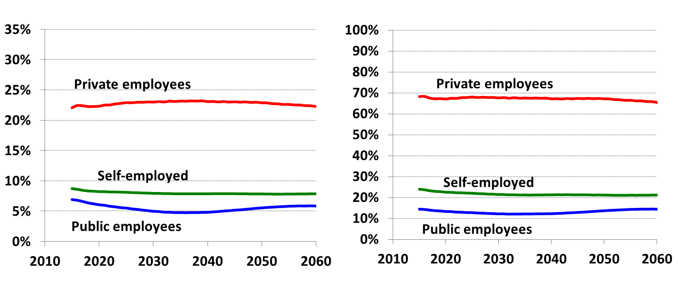
NATIONAL BASELINE SCENARIO – CONTRIBUTION BASE TO GDP RATIO AND ITS DECOMPOSITION (slide 29)
Contribution base/GDP
Contributors /Employees
RGS Pension Model
29

Slide 30
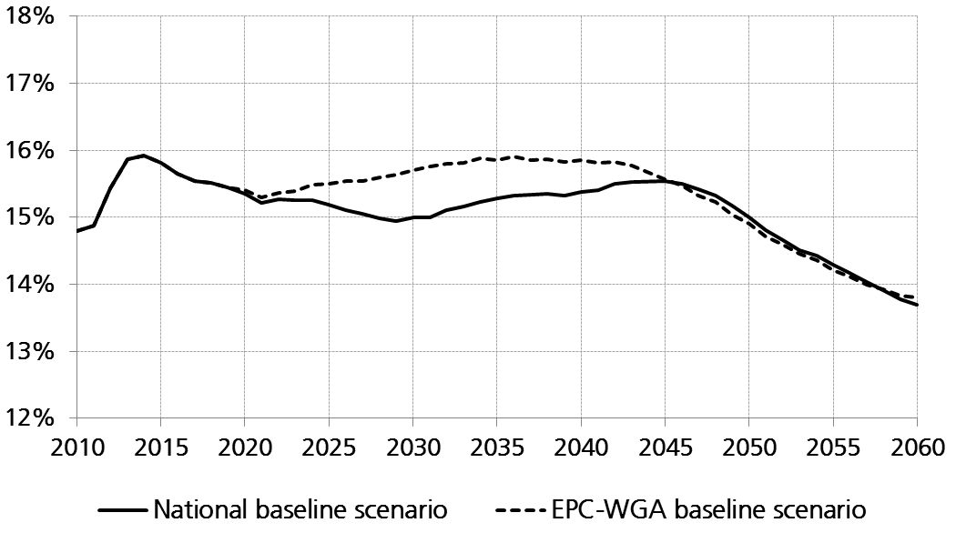
NATIONAL BASELINE SCENARIO – Comparison between different scenarios (slide 30)
PENSION EXPENDITURE AS A SHARE OF GDP
RGS Pension Model
30

Slide 31
NATIONAL BASELINE SCENARIO – DECOMPOSITION OF PENSION EXPENDITURE AS A SHARE OF GDP (slide 31)
RGS Pension Model
31

Slide 32
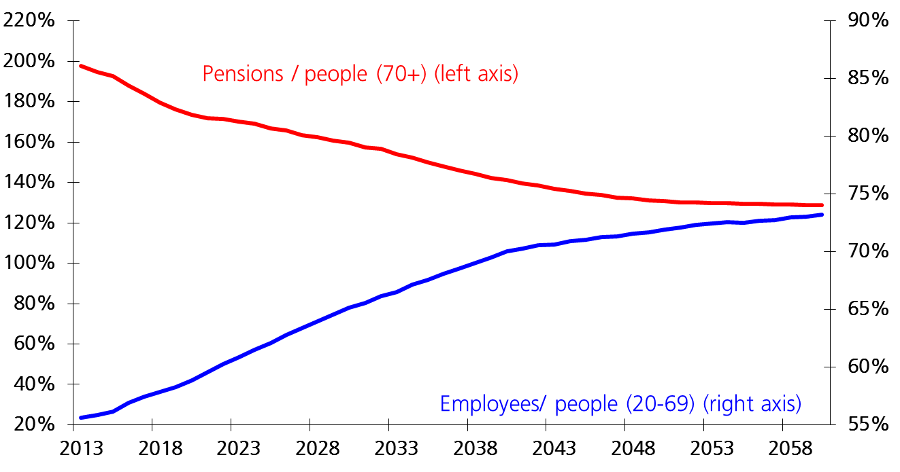
NATIONAL BASELINE SCENARIO – DECOMPOSITION OF PENSIONS TO EMPLOYEES RATIO (slide 32)
Pensions
Pop
Pensions
Employees
=
(
)
⋅
70
+
Employees
Pop
Pop
Pop
1
4
(
)
(
)
(
)
2
4
3
1
20
−
69
70
+
20
−
69
4
2
4
3
1
4
2
4
3
1
4
2
4
3
-1.6%
98%
−
35%
31%
RGS Pension Model
32

Slide 33
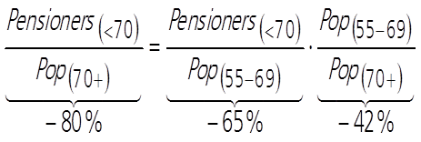
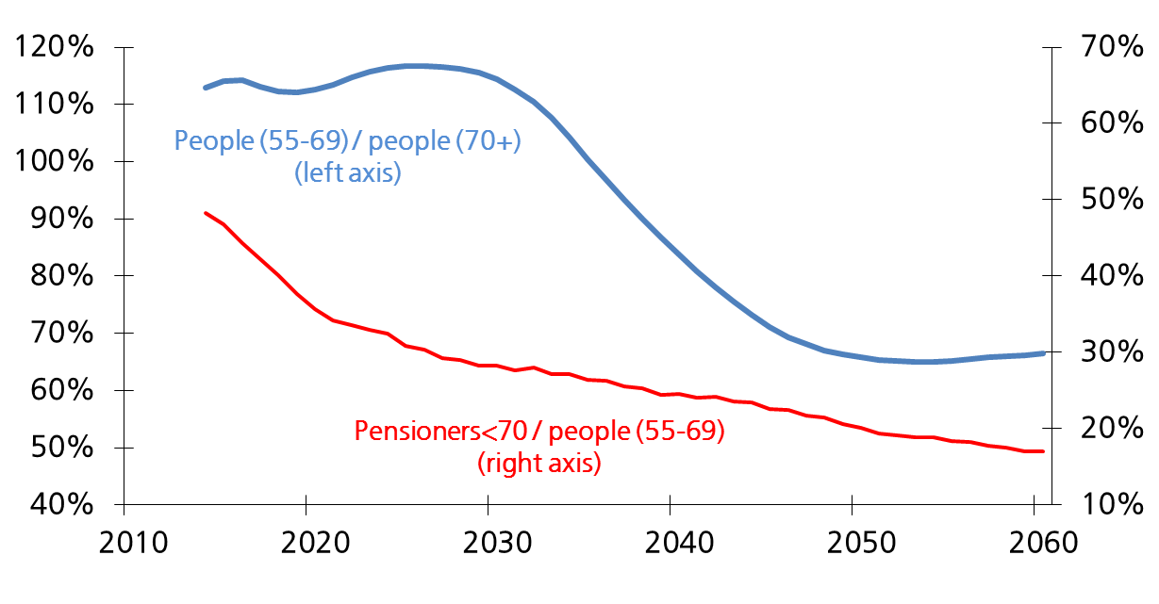
NATIONAL BASELINE SCENARIO - LABOUR FORCE VS PENSIONERS IN THE AGE CLASS 55-69 (slide 33)
% Change in the period 2015-2060
RGS Pension Model
33

Slide 34
NATIONAL BASELINE SCENARIO – ANALYSIS OF THE RATIO OF PENSIONS TO PEOPLE 70+ (slide 34)
RGS Pension Model
34
Notes:
34

Slide 35
NATIONAL BASELINE SCENARIO – ANALYSIS OF THE RATIO OF PENSIONS TO PEOPLE 70+ (slide 35)
RGS Pension Model
35
Notes:
35

Slide 36
NATIONAL BASELINE SCENARIO – ANALYSIS OF THE RATIO OF PENSIONS TO PEOPLE 70+ (slide 36)
RGS Pension Model
36
Notes:
36

Slide 37
NATIONAL BASELINE SCENARIO – DECOMPOSITION OF PENSIONERS 70+ (slide 37)
RGS Pension Model
37

Slide 38
NATIONAL BASELINE SCENARIO – DECOMPOSITION OF PENSIONERS 75+ (slide 38)
RGS Pension Model
38

Slide 39
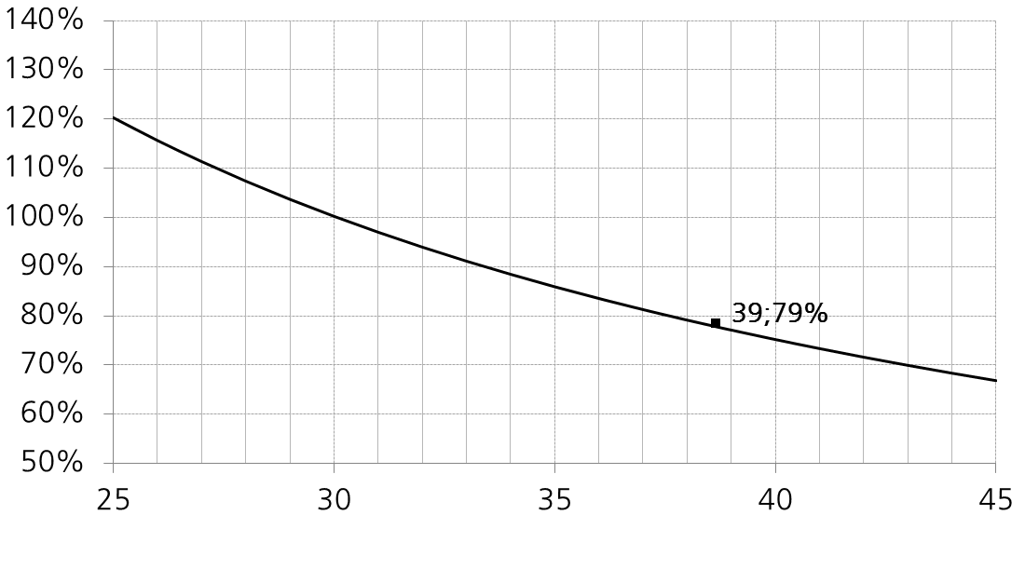
NATIONAL BASELINE SCENARIO – CONSISTENCY OF PENSIONERS AND AVERAGE CONTRIBUTION PERIOD WITH EMPLOYMENT (slide 39)
RGS Pension Model
39

Slide 40
PENSION ADEQUACY – EVOLUTION OF AVERAGE PENSION BY AGE CLASS (slide 40)
RGS Pension Model
40

Slide 41
NATIONAL BASELINE SCENARIO – DECOMPOSITION OF AVERAGE AMOUNT OF NEW PENSIONS (slide 41)
Average accrual rate = weighted average between 2% and ct ԑ
Average pensionable earnings = weigthed average between R^{DB} and R^{NDC}
RGS Pension Model
41

Slide 42
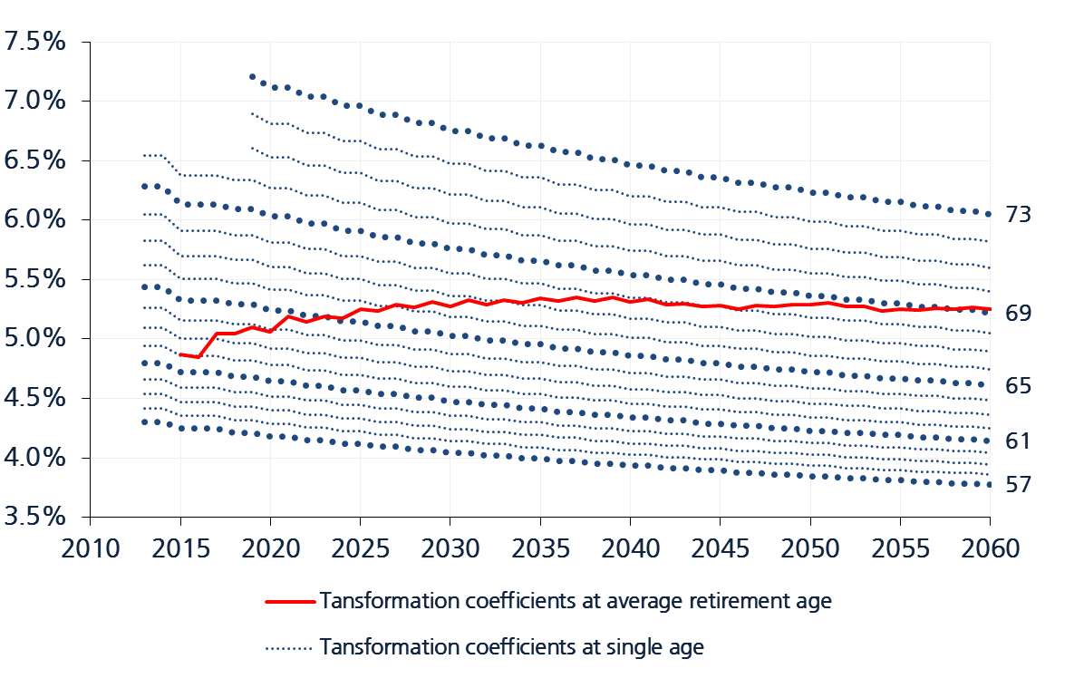
NATIONAL BASELINE SCENARIO – PERIODIC UPDATES OF TRANSFORMATION COEFFICIENTS (slide 42)
RGS Pension Model
42

Slide 43
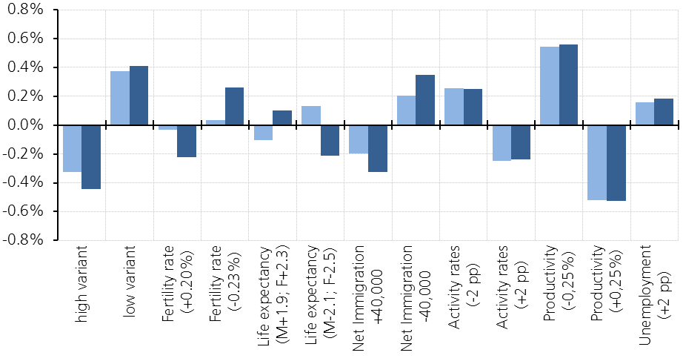
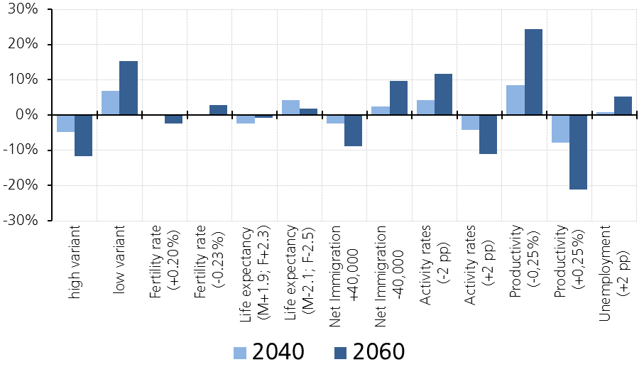
SENSITIVITY ANALYSIS – DEVIATION FROM THE BASELINE (slide 43)
Pension expenditure as percentage of GDP
Public debt as a percentage of GDP
RGS Pension Model

Slide 44
CONVERGENCE LEVEL OF EXPENDITURE TO GDP BEYOND 2060
(source: 2015 EPC-WGA projections) (slide 44)
A pay-as-you go pension system is in equilibrium when:
  The IRR = growth rate of contribution base (Aaron 1966)
  Expenditure/contribution base = contribution rate
NDC regime is structurally in equilibrium (earnings related pensions) being based on:
  actuarial equivalence (minor exceptions)
  IRR = GDP growth rate = contribution base growth rate (AWG assumption)
The convergence level of pension expenditure to GDP ranges in between 12- 12.2%, since:
  the average (weighted) contribution rate is approximately 31%
  the ratio between the contribution base and GDP is about 39%
RGS Pension Model
44

Slide 45
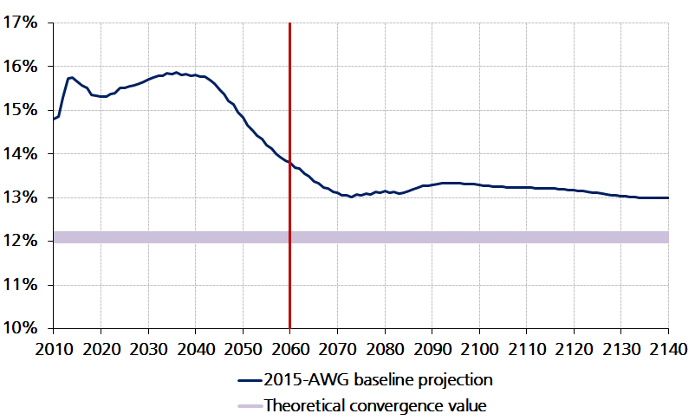
BASELINE PROJECTION – PENSION EXPENDITURE TO GDP RATIO BEYOND 2060 (slide 45)
Contr. Rate X Contr. Base/GDP
31% X 39% = 12.1%
(source: 2015 EPC-WGA projections)
RGS Pension Model
45

Slide 46
RGS Pension Model – UPDATING AND INSTITUTIONAL UTILIZATION (slide 46)
  Yearly updated since 1999 (twice a year since 2011)
  Updating procedures and results are illustrated in the annual report published by the Department of General Accounts (RGS): www.rgs.mef.gov.it
  Projections, based on AWG scenarios, are regularly presented in the updates of Italy’s Stability Programmes
  Projections based on national scenarios are also reported in the Economic and Financial Documents (latest update: September 2016)
  Currently utilised for assessing the financial effects of pension reforms
  The latest RGS annual report (No. 17) is updated to March 2016. The next update is in October 2016 (Update Note of RGS Report no. 17)
RGS Pension Model
46

Slide 47
Thank you for your attention
RGS Pension Model

