Slide 1
Commissione di Vigilanza
sui Fondi Pensione
THE PENSION FUNDS SYSTEM IN ITALY
REGULATION, STRUCTURAL DEVELOPMENT
AND THE ROLE OF THE SUPERVISOR (COVIP)
Ambrogio Rinaldi
Elisabetta Giacomel
Training Programme for Officials of the Chinese Ministry of Finance
COVIP, Rome, 25 October 2016

Slide 2
Main characteristics of the private pension system
Private pension plans are mainly defined contribution and can be both occupational and personal. Membership is voluntary, with auto-enrolment for new members of workforce.
Occupational plans are set up by collective bargaining between employers’ associations and trade unions at several levels. Membership occurs on a collective basis.
Personal plans are provided by banks, insurance companies, investment firms and asset management companies. Membership is on an individual basis.
The regulatory framework regarding, with a few exemptions, is the same both for occupational and personal pensions.
The supervision is concentrated in an independent specialised authority (COVIP)
Notes:
2

Slide 3
The Italian private pension system: an overview
CONTRACTUAL PENSION FUNDS (Fondi pensione negoziali)
Instituted after 1993 legislation. Typically set up by collective bargaining and closed to the workers not pertaining to a given economic sector or professional category. They support only occupational pensions.
EIOPA Database code: IT 1
OPEN PENSION FUNDS (Fondi pensione aperti)
Instituted after 1993 legislation. Promoted by banks, insurance and investment companies, “open” to the general public. They support both occupational and personal pensions.
EIOPA Database code: IT 2
PERSONAL RETIREMENT PLANS IMPLEMENTED THROUGH INSURANCE POLICIES (Piani individuali pensionistici - PIPs)
Instituted after D.lgs 252/2005 (New PIP) or before (Old PIP). Unit linked policies and traditional life policies promoted by insurance companies with specific characteristics common to all pension funds. They support only personal pensions.
EIOPA Database code: IT 3
“OLD” CONTRACTUAL PENSION FUNDS (Fondi preesistenti)
Instituted before November 1992 – can be autonomous or non-autonomous. They are both DC and DB funds (the latter closed to new members). They support only occupational pensions.
EIOPA Database code: IT 4 - IT 5
ENTI PREVIDENZIALI PRIVATI DI BASE
EIOPA Database code: IT 6
Notes:
3

Slide 4
Type of Funds/Plans
Autonomous Pension Funds
Contractula Pension Funds
Open Pension Funds
Pre-existing Pension Funds
Non-Autonomous Pension Funds
PPFs as Book reserves
Insurance-Based Personal Pension Plans
PIPs (Old and New)

Slide 5
Benefits
Benefits – distributed as annuities (max 50% could be in lump sum) Retirement age – the same as for the compulsory system (at least 5 years of contributions to the fund) The payment of pension annuities are, in general, entrusted to a life insurance company (annuities could be paid out directly by the pension funds if previously authorized by COVIP) Benefits could be received as cash advance for buying house or for other reasons

Slide 6
Fiscal treatment
Employee contributions are tax-deductible up to an upper limit on total employee and employer contributions of EUR 5,164 a year
Net investment income is taxed at an annual rate of 12,50-20%
Pension benefits (annuity or lump sum), net of the amount on which tax has already been paid, are taxed in a more favourable manner than general tax income
The tax rate is 15%, with a reduction of 0,3% for every year of participation after 15, not beyond a maximum reduction of 6%
Benefits received as cash advance for buying house or for other reasons or as lump sum in case of voluntary left employment are taxed less favourably (23%)

Slide 7
MARKET STRUCTURE AND DEVELOPMENT

Slide 8
Market structure
(data at 31.12.2015)
 | Number of funds | Membership | Net asset value/Technical provisions (millions of euro)
Contractual Pension Funds | 36 | 2,419,103 | 42,546
Open Pension Funds | 50 | 1,150,096 | 15,430
“New” PIPs | 78 | 2,595,804 | 20,056
“Old” PIPs | - | 431,811 | 6,779
Pre-existing Pension Funds | 304 | 644,797 | 55,299
Total Private Pension System | 469 | 7,226,907 | 140,180
28% of the labor force
8,5% of the GDP
3 % of households financial assets

Slide 9
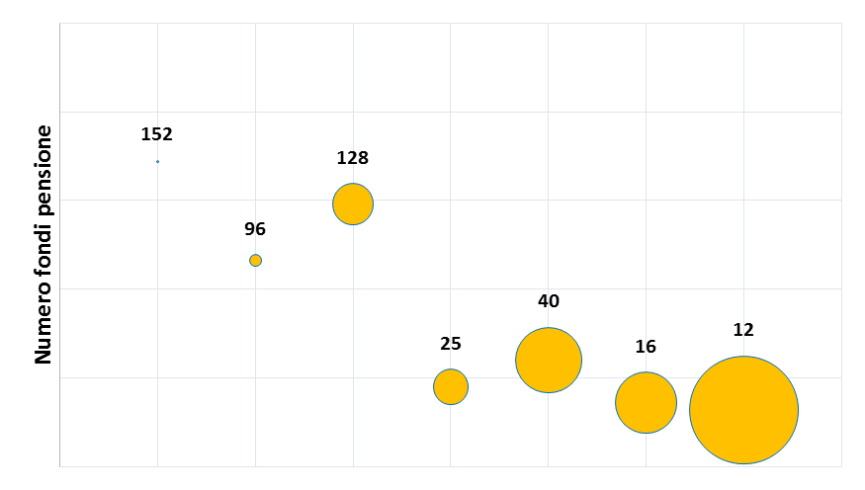
Distribution of pension funds by members
N of pension funds
< 100
100 -
1.000
1.000 -
10 mila
10 mila - 20 mila
20 mila - 50 mila
50 mila - 100 mila
> 100 mila
Members: size classes

Slide 10
Market structure
(data at 31.12.2015)

Slide 11
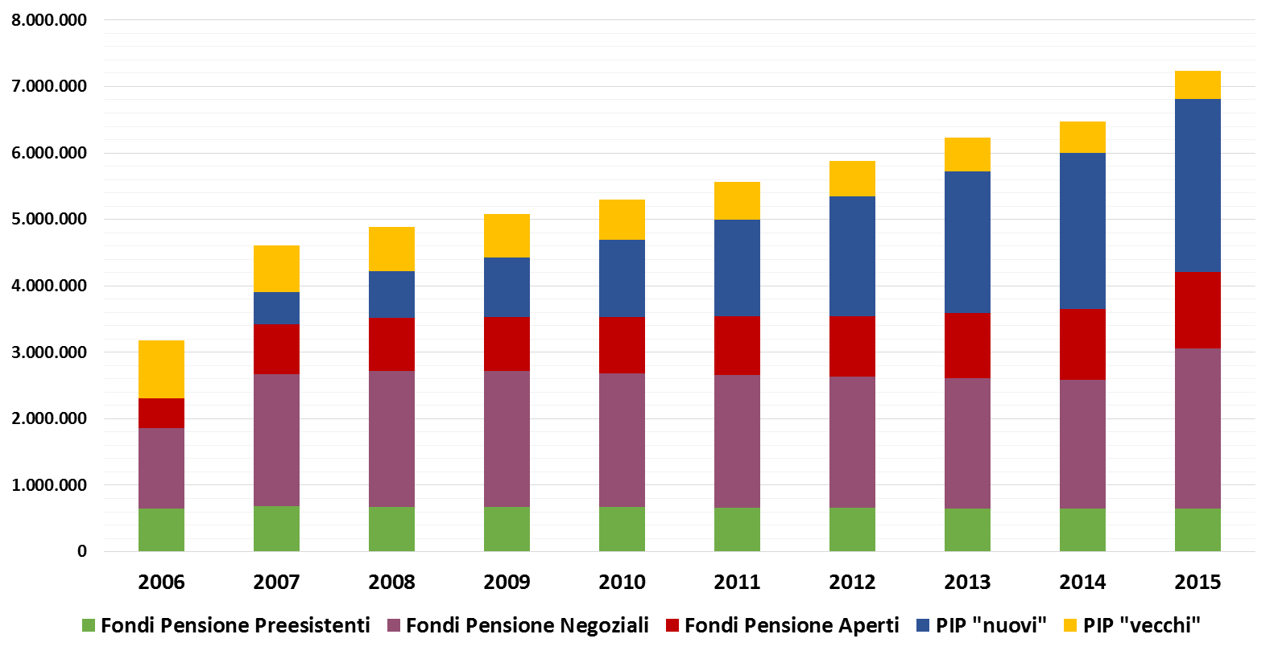
Development of the years: members

Slide 12
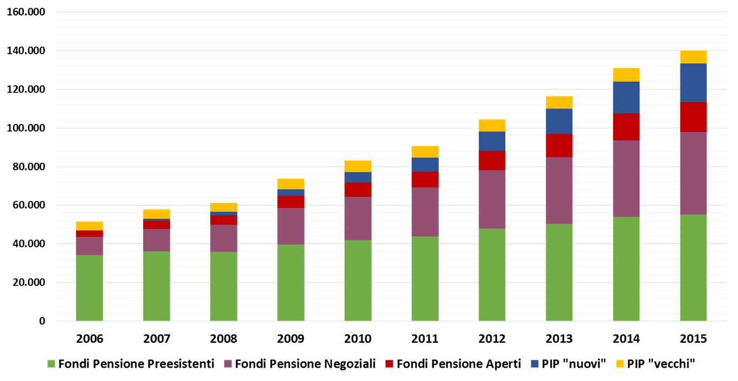
Development of the years: assets
Milions of euro

Slide 13
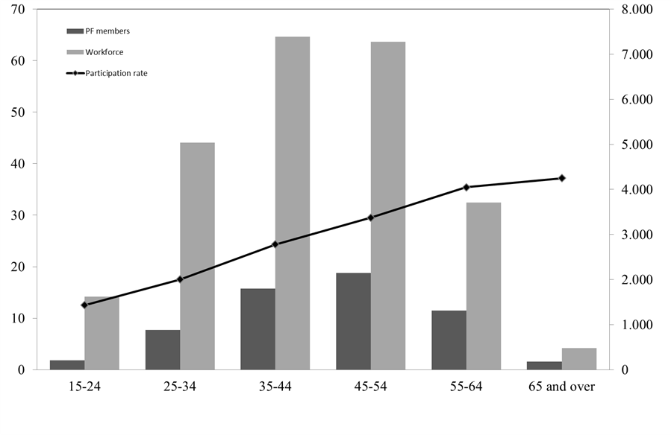
Members, workforce and participation rate by age groups
(end-2014 data)
Average partecipation rate: 28,3%

Slide 14
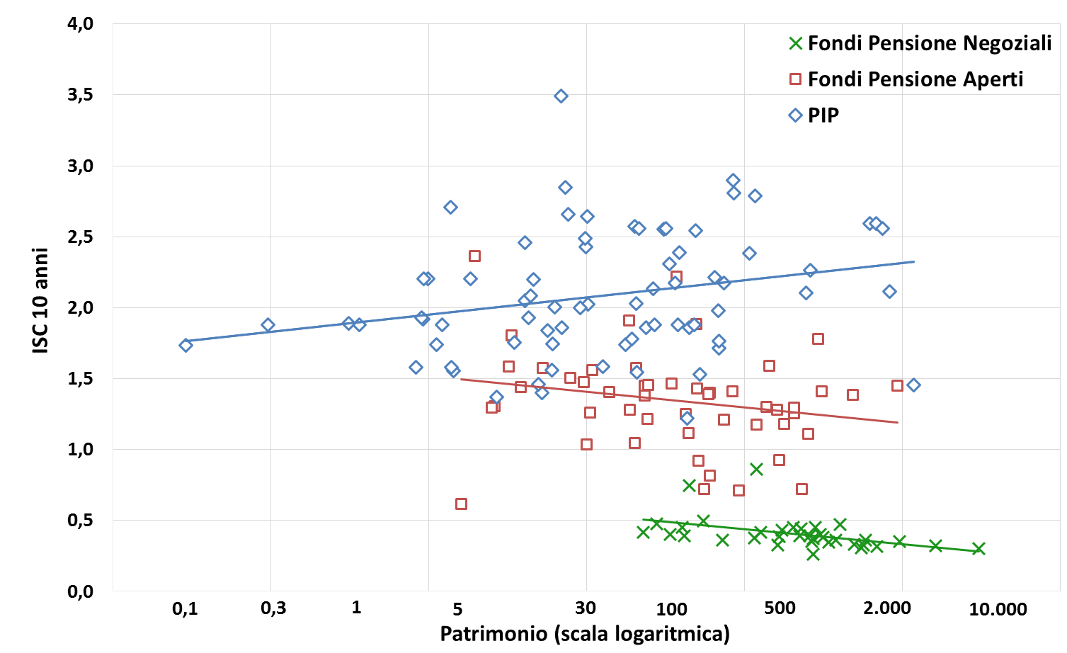
Synthetic Cost Indicator (10 years)
(end-2015 data; per cent; assets in millions of euros)
SCI
Assets (log)

Slide 15
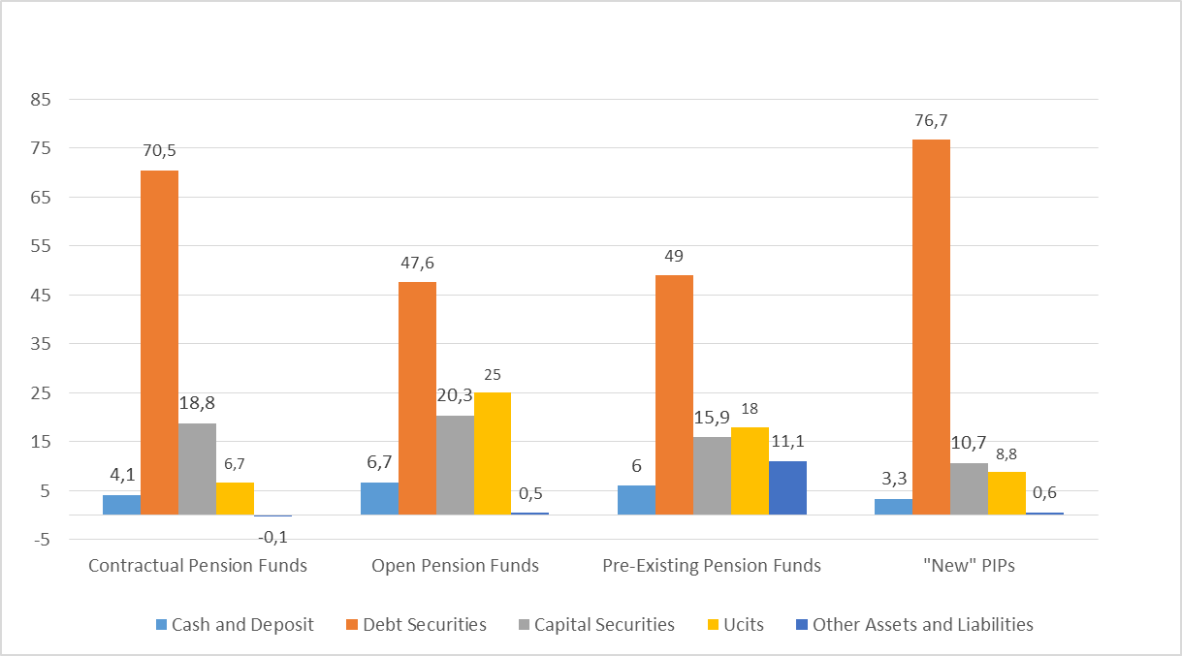
Investments
(data at 31.12.2015- percentages)

Slide 16
Foreign investments: international comparison
(data at 31.12.2014, percentages)

Slide 17
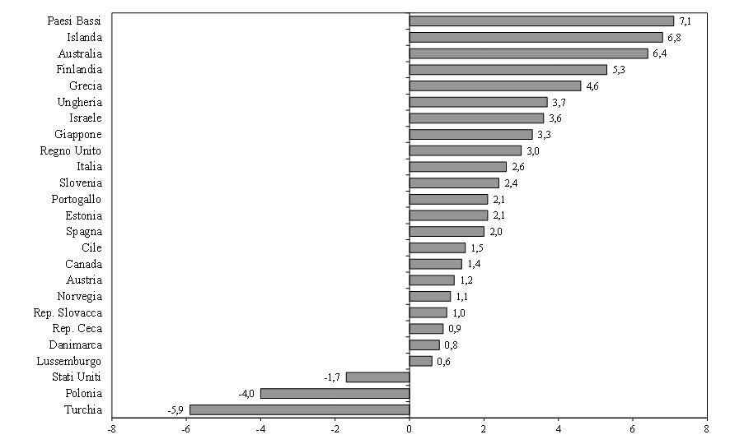
Returns: international comparison
(data at 31.12.2015- percentages)

Slide 18
MAIN REGULATION

Slide 19
Investments rules
Rules set by the Legislative Decree no. 252 of 2005 and the Decree of the Ministry of the Treasury no. 166/2014 are fully applicable to contractual and open pension funds; several exceptions are provided for pre-existing pension funds. With respect to PIPs, investment rules for insurance products do apply.
INVESTMENTS | LIMITS
Cash | no specific limit
Direct investments in real estate | not allowed
Securities not traded on regulated markets and FIA | < 30%; Investments in FIA: < 20% of the pension fund’s asset and < 25% of the FIA’s assets
Borrowing, lending and short selling | not allowed
Derivative contracts | only if the financial leverage is < 1
Currency exposure | 30%
Investments in single issuer | 5% (10% group)
Investments in securities issued by the sponsoring employer | Single-employer funds: 5% (10% group of the sponsoring employers) Multi-employer funds: 20% Industry-wide pension funds: 30%

Slide 20
Investment managment
Investment management carried out by | Professional managers | Institution setting up the plan/fund | Directly managed by the fund
Contractual pension funds: | X (Banks, insurance companies, investment firms, asset management companies.An agreement must be signed between the governing board of the pension fund and the asset manager outlining the guidelines for the investment of fund assets) | - | Not allowed
Open pension funds | X
Pre-existing pension funds | Allowed | Allowed | Allowed
Pip | X

Slide 21
Investment regulation
Legislative Decree 252/2005 – some investment rules and COVIP powers
Ministry Decree 166/2014 - from a quantitative regulation towards governance attention
Covip provision del 16 marzo 2012 - SIPP
Written statement of investment-policy principles
Common regulatory framework for all kinds of pension funds (with more than 100 members)
Implementation of the investment policy
Clarification of the role and duties of bodies/responsibles involved in the investment process – introduction of the investment management function

Slide 22
Role and duties of bodies/responsible involved in the investment process
IT-1; IT-4 (artt. 2, 5 COVIP Regulation of 16/3/2012)
Management board | Set and approve the investment policy Approve and withdraw the mandate of asset managers Supervise on the activity of the investment management function Approve the internal control procedures
Investment management function | - contributes to define the investment policy and to select the asset managers; - checks the financial management by evaluating the performance over time; - monitors the implementation of the strategy and assesses the work of asset managers; - checks the compliance of the investment policy with ethical principles (if they are provided); - proposes to the financial committees and to the management board any changes to the investment policy; - supports advisor and other parties involved in the investment process on issues relating to the implementation of the strategy and the investment performance; - is responsible in defining, developing and updating the internal control procedures of financial management.
Investment committee | Evaluate suggestions of the investment management function and financial advisor to the board Recommendation to the board

Slide 23
Role and duties of bodies/responsible involved in the investment process
IT-1; IT-4 (artt. 2, 5 COVIP Regulation of 16/3/2012)
Financial advisor | - contributes to define the investment policy and to select the asset managers; - checks the financial management by evaluating the performance over time; - monitors the implementation of the strategy and assesses the work of asset managers; - checks the compliance of the investment policy with ethical principles (if they are provided); - proposes to the financial committees and to the management board any changes to the investment policy; - supports advisor and other parties involved in the investment process on issues relating to the implementation of the strategy and the investment performance; - is responsible in defining, developing and updating the internal control procedures of financial management.
Asset manager | Manage assets according to mandate Periodical report to the board
Custodian bank | Custodian of assets Other activities (e.g. transmission of data)
IT-2 (IT - 3) (art. 1 COVIP Regulation of 16/3/2012). | Sponsor companies apply their industry regulation (e.g. financial or insurance laws) with regards to organizational profiles and allocation of responsibilities

Slide 24
Role and duties of bodies/responsible involved in the investment process
IT-1; IT-4 (artt. 2, 5 COVIP Regulation of 16/3/2012)
Management board | Board members are appointed according to criteria of professional qualification and competence between subjects that have collected an experience of at least three years performing the activities indicated in art. 2 of DM n. 79/2007. Board members in companies different from banks, financial intermediaries and insurance companies, or in national associations representing categories, sectors or contractual areas, and members of public sector committees and organisms with similar functions must complete, for being appointed, specific learning programs indicated in art. 3 of DM n. 79/2007 (art. 2.1, lett. g), DM n. 79/2007).
Investment committee | Proper professional qualification and experience to carry out their duties
Investment management function | Proper professional qualification and experience to carry out their duties IORPs with limited assets or very simple management models, can outsource the investment management function. In this case, they have to exhaustively illustrate to COVIP the outsourced activities, the ways of interaction with the outsourcer and the control system applied to its activity (COVIP Circular n. 5405 of 30/10/2012).
Financial advisor | Proper professional qualification and experience to carry out their duties.

Slide 25
Transparency and comparability
All the pension funds have to respect COVIP rules related to :
informative documents to made available to members (written in conformity with schemes provided by COVIP)
calculation and disclosure of costs applied to members
advertisement
collection of new adhesion
COVIP publishes on its web site the ISCs of all funds
Notes:
25

Slide 26
Information to potential members
Documents (of few pages) to be provided to members
At adhesion
- Informazioni chiave per l’aderente- a key information document with the main characteristiscs of the pension funds (e.g. investment policy, contributions, costs, returns )
La mia pensione complementare, versione standardizzata - a document containing pension projections for an hypotetical member, according to COVIP rules -
On going
Comunicazione periodica – a document with the main information related to individual retirement position (e.g. contribution paid, investment returns)
La mia pensione complementare – a document containing the pension projections taking into account member’ information and according to COVIP rules, taking into account
The other documents have to be made available on the web of the pension fund, or provided on request.

Slide 27
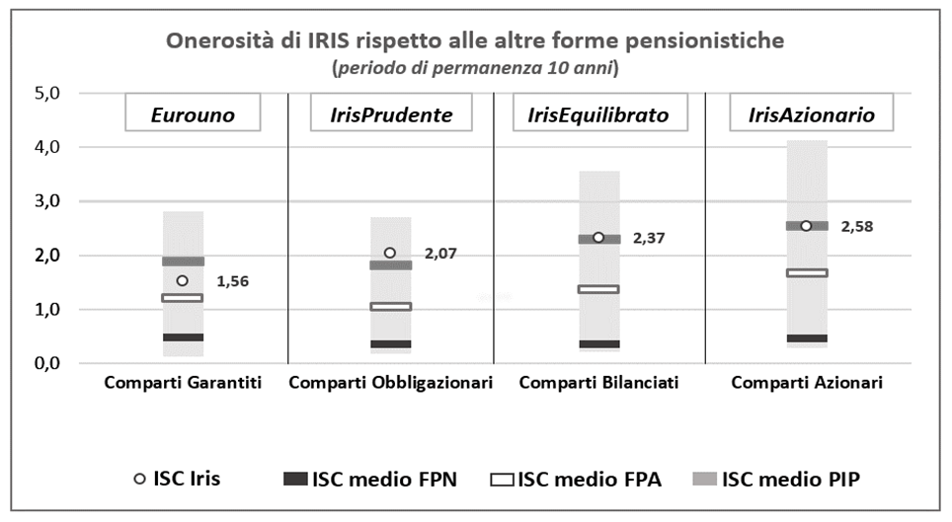
A new approach to compare costs

Slide 28
COVIP

Slide 29
Governance
COVIP Governing Board: 1 President and 2 Commissioners (appointed by the Government) – mandate of 4 years
A staff of about 80 persons (based in Rome)
Main contributions from pension funds
Notes:
29

Slide 30
COVIP supervisory activities
General supervisory competence on all forms of private pensions
Setting rules addressed to all kinds of pension funds - Particular attention to transparency, comparability, information as a support to individual members’ decisions (major risk factor)
Provision of standards for information documents to be adopted (publication of examples of compiled standard documents for a virtual PF)
Collection of data
Meetings with fund administrators/directors
Request of information for on-site supervision
Off-site supervision
Fines

Slide 31
Information disclosed on COVIP web site - costs

Slide 32
Information disclosed on COVIP web site – rate of returns

Slide 33
Enti previdenziali private di base (Casse)

Slide 34
Enti previdenziali private di base (Casse)
20 first pillar schemes, closed to the workers not pertaining to the categories of professional workers (e.g. lawyers, doctors, etc)
Mandatory contribution of members
Partially funded
Different entities are responsibile for the supervision of the Casse with different tasks – COVIP supervises on their investments
Investment regulations under definition (similar approach followed for the regulation of pension funds’ investments)

Slide 35
Main data
(data at 31.12.2014)
Investments
(percentages)

