Slide 1
Long-term care in OECD countries
Tim Muir, OECD Health Division
Component Two- 2016 Training Course “European practices in the Governance, Financial Management and Strategies for a Sustainable Social Security System”
Italy, October 16th -30th, 2016

Slide 2
Contents of this presentation
Part 1 – Some generalisations about long-term care in OECD countries
Part 2 – Comparative data on LTC systems in OECD countries
Part 3 – Three case studies
Notes:
There may be some overlap here with what Marcello talked about this morning
But I think that I will provide a slightly different angle on the issues – although I don’t think I’m going to contradict him on any points
In particular, I’m going to show you some of the data that the OECD has on LTC systems
That data is quite limited relative to the data that we have on acute health systems
You’ll notice that there is no data on any of my slides for China
One thing I would be very interested in exploring in the future is whether similar data can be collected for China so that we can compare the situation there with OECD countries

Slide 3
Some generalisations about long-term care in OECD countries
Part 1

Slide 4
The OECD definition of long-term care
A range of services
Personal care
Assistance services
Some medical care
that aim to
Alleviate pain
Reduce or manage deterioration
for people with a degree of long-term dependency
Notes:
This is the definition used in the Joint Health Accounts Questionnaire – it’s very much in line with what Marcello outlined this morning
It defines long-term care in terms of
The services that are included
The purpose of these services
And the recipients of the services
So we are talking about:
personal care (things like washing and dressing)
Assistance services (such as help with housework)
And some aspects of medical care
With the aim of alleviating pain or preventing or managing deterioration
For people with some degree of ongoing dependency

Slide 5
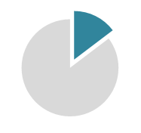
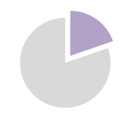
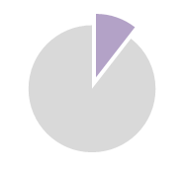
Who provides LTC?
Professional care workers
Informal carers
14.7% of people aged over 50 say that they provide informal care at least weekly
6 workers per 100 people aged over 65 on average across OECD countries
Over 19% of over-50s in Belgium and Estonia
Norway and Sweden have more than 12
Less than 11% of over-50s in Australia and Israel
Turkey and Portugal have less than 1
Sources: OECD Health Data, OECD analysis of SHARE and similar surveys
Notes:
So who provides these service?
Marcello mentioned that most LTC is provided informally
The OECD has some data on this that broadly agrees with what he says
We collect data from countries on the number of professional (that is, paid) care workers
These people are a mix of nurses and lower-skilled personal care workers
But the levels of training and pay vary a lot between countries
We can also get some information on informal carers by looking at survey data
As you can see, there are more informal carers on average than professional care workers
But only around 2/3 of these people are providing care every day, so in terms of the total amount of care, it’s hard to compare the two
There is a link between the two:
Sweden has a low rate of informal care – only just over 11%
Israel has a lot of formal care workers – more than 11 per 100 people aged over 65

Slide 6
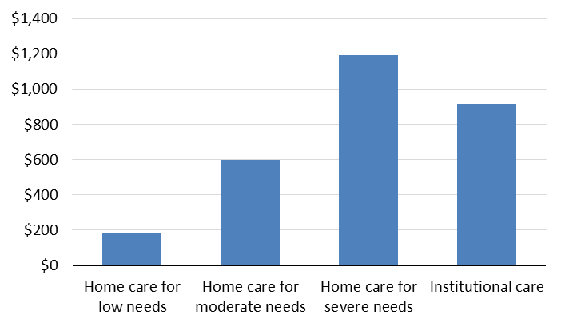
The cost of professional LTC services can be large
The weekly cost of care for different scenarios, US dollars, PPP
(average of 15 OECD countries)
Source: OECD Social Protection for LTC Dataset, provisional figures
Notes:
This is perhaps the only time when I will contradict something that Marcello said
When people have very severe needs, home care can actually be more expensive than institutional care
The reason why it is often cheaper is that for many people it isn’t all provided formally
Family and friends do a significant share
This reduces the financial cost
But it isn’t free – it has costs for those providing the care in terms of the time they give up, their health, and work opportunities

Slide 7
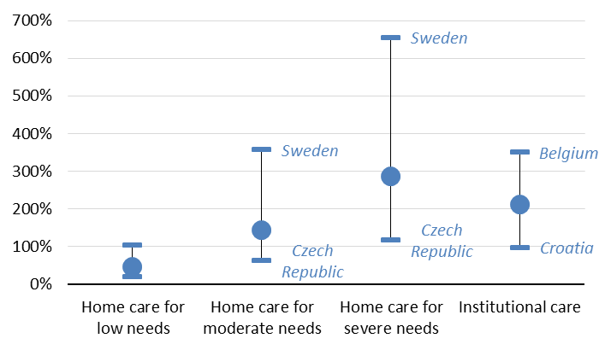
Most people can’t afford the cost from their income alone
The cost of care for different scenarios as a % of median disposable income among people aged over 65 (average of 15 OECD countries)
Source: OECD Social Protection for LTC Dataset, provisional figures

Slide 8
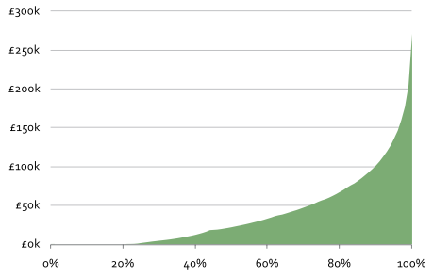
People can end up spending a lot over their lifetime
Expected future lifetime cost of care for people aged 65 in 2009/10, by percentile (2009/10 prices)
Source: Dilnot Commission, 2011
Notes:
In many countries, when people can’t afford to fund LTC from their income, they use their asset – their savings, or if they go into institutional care they may sell their home
When we are thinking about asset

Slide 9
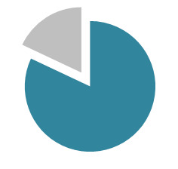
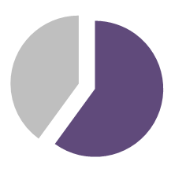
So governments in OECD countries pay a significant share of the cost of LTC
82%
of reported LTC spending is public on average across OECD countries
60%
is the lowest proportion of public spending reported – in Portugal and the United States
But private spending is hard to measure and therefore underreported. Some countries report zero private spending when we know there is some.

Slide 10
Countries help people with the cost of LTC through a range of programmes
Tax-funded universal coverage
e.g. Nordic countries
Users pay only small copayments
High public expenditure (2-4% of GDP)
Dedicated LTC insurance
Often found in countries that finance health via health insurance
e.g. Germany, Japan, Korea, Netherlands
Variation in comprehensiveness: low (Germany, Korea) or high (Japan, Netherlands)
Tax-funded safety net systems
e.g. UK and US
Only people who can’t afford to pay out of pocket are covered
Cash benefits
e.g. the Czech Republic has universal cash benefits that cover a proportion of the cost of care
Notes:
This is not an exhaustive list of the types of programme that we see, and some countries have a mix of different systems

Slide 11
Comparative data on LTC systems in OECD countries
Part 2

Slide 12
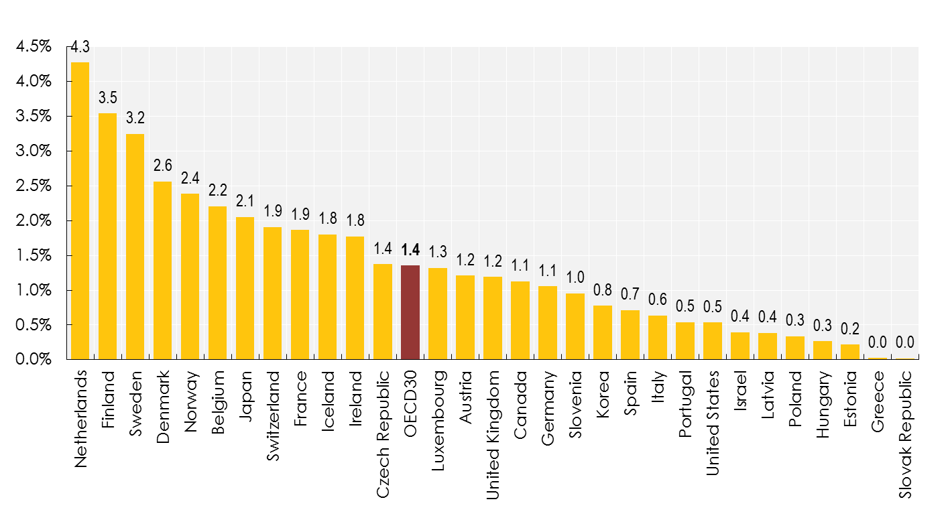
Wide variations in public LTC spending are driven by choices about who pays
Long-term care public expenditure, as share of GDP, 2014 (or nearest year)
Source: OECD Health Accounts

Slide 13
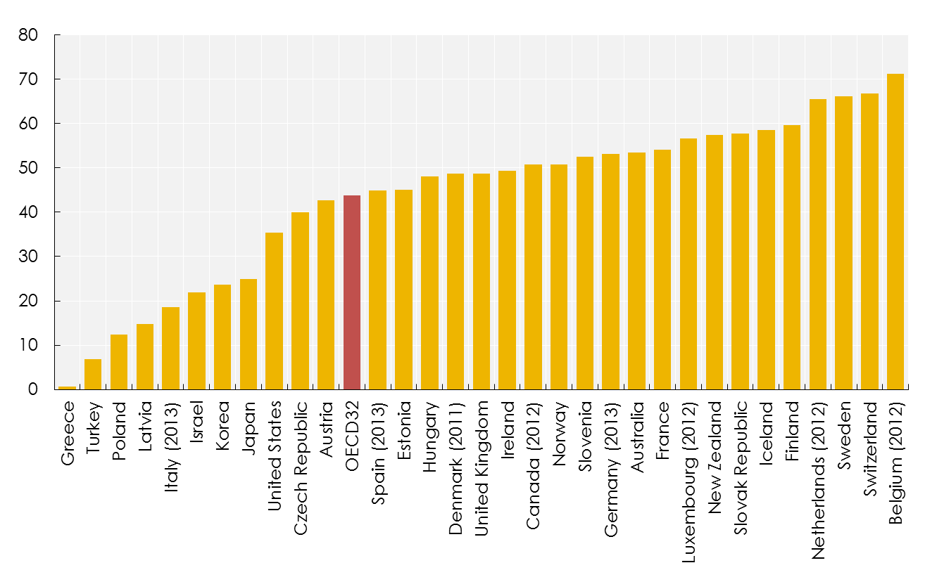
Most OECD countries have a well-developed institutional care sector
Beds in residential long-term care facilities per 1,000 population aged 65+, 2014 or nearest year
Source: OECD Health Data
Notes:
The data for this indicator seem plausible
The countries with the highest concentration of beds are those with strong public LTC provision and a well-developed institutional care sector
Those with the fewest beds are generally those with the least developed public systems
Korea and Japan are an interesting case, since they have well-developed public systems but few beds – the answer to this lies in the next indicator

Slide 14
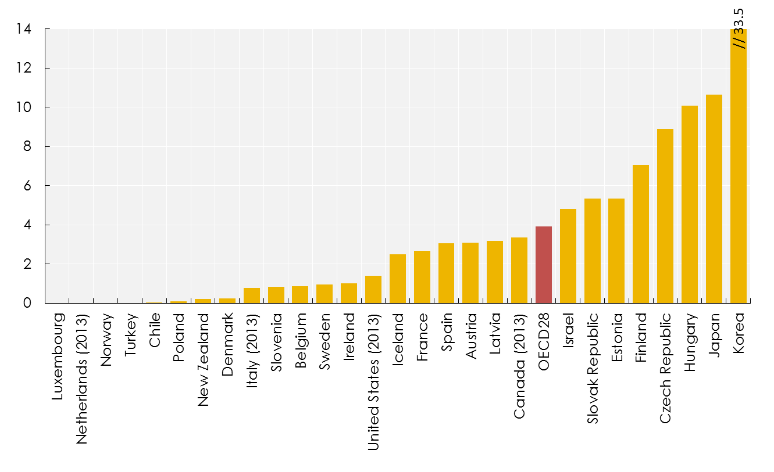
Some countries have a care model that makes more use of hospital beds
LTC beds in hospitals per 1,000 population aged 65+, 2014 or nearest year
Source: OECD Health Data
Notes:
We can see that in the latest data
Luxembourg, the Netherlands, Norway and Turkey all report zero beds
In general, most countries report low numbers
But there are a few reporting much higher numbers, especially Japan and Korea
We can see now why they report low numbers of beds in institutions – many people are cared for in hospitals instead – although this number is falling

Slide 15
But most LTC users in OECD countries live in the community
% of population receiving LTC at home and in institutions, average across OECD countries
Switzerland:
3.4%
Over 2%
of the population receives home care
Belgium:
1.6%
0.75%
receives institutional care
Portugal: 0.15%
Turkey: 0.05%
At home
In institutions

Slide 16
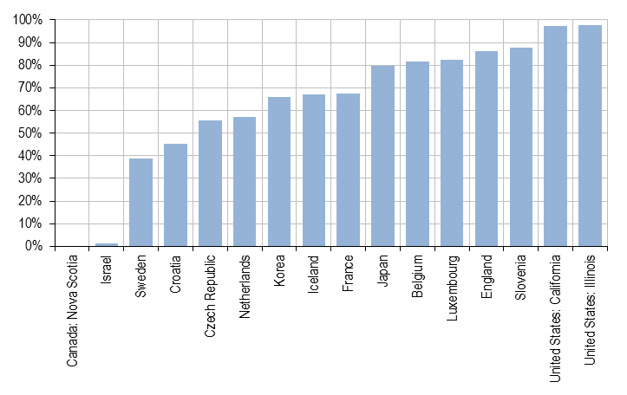
Social protection systems generally ensure access to institutional care, even for poorer older people
Out-of-pocket costs for institutional care as a proportion of income, for low-income older people in OECD countries
Source: OECD Social Protection for LTC Dataset, provisional figures

Slide 17
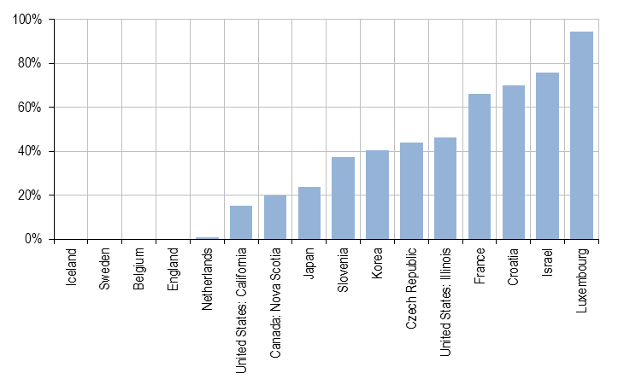
Out-of-pocket costs for community care tend to be lower…
Out-of-pocket costs for home care (moderate needs) as a proportion of income, for low-income older people in OECD countries
Source: OECD Social Protection for LTC Dataset, provisional figures

Slide 18
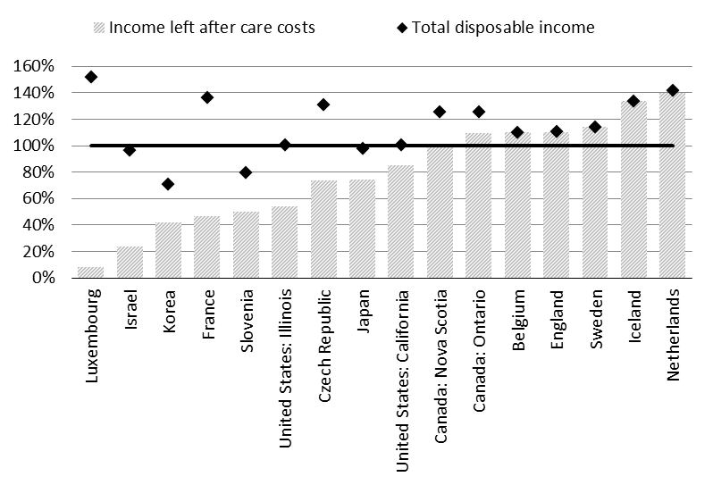
…but people have other living costs, so those with low incomes may not be able to afford to stay at home
The effect of out-of-pocket costs on disposable income for low-income older people receiving home care for moderate LTC needs
Source: OECD Social Protection for LTC Dataset, provisional figures

Slide 19
Three case studies
Part 3

Slide 20
We will look at three case studies with different types of system
Netherlands
Dedicated LTC insurance
England
Tax-funded safety net system
Czech Republic
Universal cash benefits

Slide 21
How the Dutch system is organised
Financing
Dedicated LTC insurance scheme
Regional schemes administered by private insurance companies
But contribution rate set by national law
Mandatory contributions paid by all working age and retired people with taxable income
Eligibility
8 levels of need defined in law (AWBZ)
All 8 levels are eligible for home care
Higher levels of need qualify for more comprehensive coverage or residential care
Copayments (home care for moderate needs)
EUR 16,456 per year is “exempted income” (2014 figure)
Broadly speaking, people pay up to 15% of their non-exempted income
Higher contributions for people with assets

Slide 22
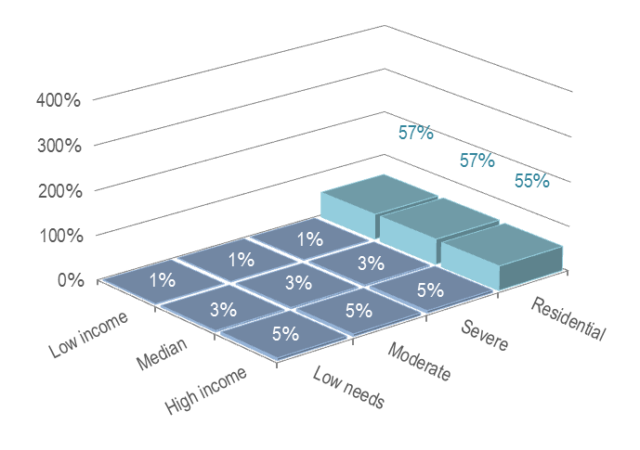
Out-of-pocket costs in the Netherlands are among the lowest in any OECD country
Out-of-pocket costs for as a proportion of income for different scenarios of income, LTC needs and care setting in the Netherlands (2014)
Source: OECD Social Protection for LTC Dataset, provisional figures

Slide 23
What does this system deliver?
4.3%
OECD
of GDP spent on LTC – the highest in any OECD country
3.2%
of the population receives LTC at home, the third highest proportion in any OECD country
OECD
1.5%
OECD
of the population lives in LTC institutions – twice the OECD average
15.9%
OECD
of over-50s say that they are informal carers – but a lower proportion provide care every day than in other countries

Slide 24
Key policy issues for LTC in the Netherlands
Concern about high cost of system
Recent reforms moved responsibility for home help services to local government
Budget for these services also reduced
Aim to get families and informal carers to provide a greater share of LTC
So coverage may be less comprehensive in the future
Notes:
This is an example of what Marcello was talking about earlier

Slide 25
How the English system is organised
Financing
Tax-funded system
Administered by local government
Local government has some flexibility on spending, but is ultimately dependent on funding from central government
Eligibility
Everyone above a minimum level of need is eligible for “social care”
Historically a lot of variation in eligibility thresholds between regions, but new “national eligibility threshold” may reduce variation
Budget restrictions have led to people with lower levels of need being excluded
Copayments
GBP 9,828 per year is “exempted income” (2014 figure)
People are expected to pay all of their non-exempted income towards the cost of care
People with assets of more than GBP 23,250 pay the full cost of care

Slide 26
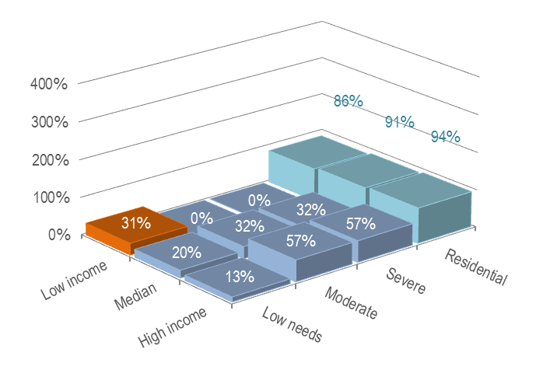
Strong means-testing protects people with low income from the cost of LTC
Out-of-pocket costs for as a proportion of income for different scenarios of income, LTC needs and care setting in England (2014)
Source: OECD Social Protection for LTC Dataset, provisional figures

Slide 27
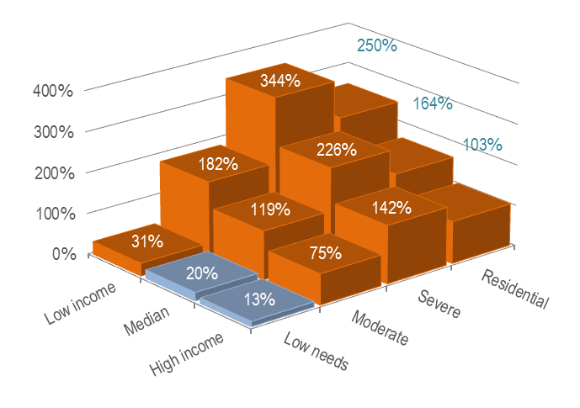
But people who have any significant savings are expected to use them to pay for care
Out-of-pocket costs for as a proportion of income for different scenarios of income, LTC needs and care setting in England, for people with more than GBP 23,250 in assets (2014)
Source: OECD Social Protection for LTC Dataset, provisional figures

Slide 28
What does this system deliver?
OECD
1.2%
of GDP spent on public LTC – just below the OECD average
4.9
OECD
beds in LTC institutions per 100 people aged over 65 – just above the average
Recent data on user numbers not available, but we can get an idea by looking at other figures
17.5%
OECD
of over-50s say that they are informal carers – the fourth highest of the 17 OECD countries where we have data

Slide 29
Key policy issues for LTC in England
Local government budgets have been cut significantly in recent years
Falling spending on LTC – but rising demand
People with lower-level needs increasingly excluded from coverage
Recent reform proposals to provide more protection to people with assets have been delayed

Slide 30
How the Czech system is organised
Financing
Tax-funded cash benefits
Administered at a national level
Eligibility
Eligibility is defined by a list of ten activities
People needing help with at least 3 activities qualify for some benefit
Benefit amounts
Ranges from CZK 800 (slight need, 3-4 activities) to CZK 12,000 (total need, 9-10 activities)
Benefit amount has no reference to the cost of care and is in general not sufficient to cover costs
Benefits are universal – there is no means-testing

Slide 31
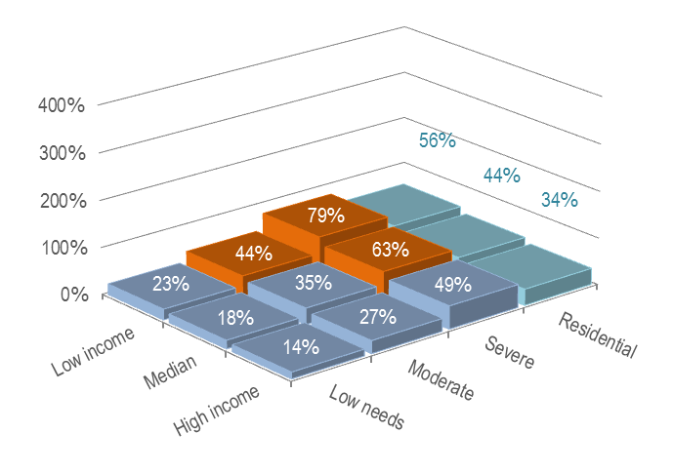
Universal cash benefits are not enough to ensure that low-income people can afford home care
Out-of-pocket costs for as a proportion of income for different scenarios of income, LTC needs and care setting in the Czech Republic (2014)
Source: OECD Social Protection for LTC Dataset, provisional figures

Slide 32
What does this system deliver?
OECD
1.4%
of GDP spent on public LTC – equal to the OECD average
4.0
OECD
beds in LTC institutions per 100 people aged over 65 – just below the average
Recent data on user numbers not available, but we can get an idea by looking at other figures
18.1%
OECD
of over-50s say that they are informal carers – the third highest of the 17 OECD countries where we have data

Slide 33
Key policy issues for LTC in the Czech Republic
Many people with lower income cannot afford home care
What can be done to give these people better protection?
How can this be done within a limited budget?

Slide 34
Key points
All OECD countries have some form of public LTC coverage
But the different choices that countries have made in terms of structure and generosity of the system lead to wide variations in:
who provides care (professionals versus informal carers)
who pays for it
whether home care is affordable to people with low income
Informal care is an important source of support in all countries, but stronger public systems mean fewer people providing care intensively
Collecting reliable data on LTC systems remains a challenge

Slide 35
Thank you
Email me
tim.muir@oecd.org
Follow us on Twitter
@OECD_social
Visit our website
www.oecd.org/els

