Slide 1
Means Testing: theory and facts
The Italian Indicator of “Equivalent Economic Situation” (ISEE)
Component Two - 2016 Training Course “European practices in the Governance, Financial Management and Strategies for a Sustainable Social Security System”
Italy, October 16th - 30th, 2016

Slide 2
ISEE in details
Carmeliana Franzese – Family income support benefits and ISEE
Component Two - 2016 Training Course “European practices in the Governance, Financial Management and Strategies for a Sustainable Social Security System”
Italy, October 16th - 30th, 2016

Slide 3
Index
The Italian Indicator of “Equivalent Economic Situation” (ISEE)
ISEE in details
  Calculation factors
  ISEE request and calculation flows
  ISEE information and controls system
  ISEE Certification
  Next steps

Slide 4





ISEE in details
Calculation factors
ISEE is calculated by INPS taking into account different factors, in order to determine a comprehensive indicator of the actual household condition:
INCOMES OF EVERY HOUSEHOLD MEMBER AND DEDUCTIONS APPLICABLE
    Incomes from working and not working activities, including welfare allowances (not related to disabilities)
    Deductions: house rent, etc.
    ASSETS OF EVERY HOUSEHOLD MEMBER AND DEDUCTION APPLICABLE
    Properties: Houses, lands, etc.
    Financial assets: cash deposits, stocks, bonds, etc.
    Deductions: decrease of the household house value, etc.
    HOUSEHOLD
    CHARACTERISTICS
    Number of people
    Presence of minors or disabled people
    Family peculiarities: large family, single-parent family, presence of children under age of 3, presence etc.

Slide 5
ISEE in details
Calculation factors – ISEE formula
The ISEE is equal to ratio between the Economic Situation Indicator (ISE) of the household and the Equivalence Scale Parameter calculated with reference to the specific household composition
ISE
+
ISR
(20% x ISP)
ISEE
=
=
N
N
ISR
Household Income Indicator is the difference between the summation of the incomes of every household member and the deductions applicable
ISP
Household Asset Indicator is the difference between the summation of the assets of every household member and the deductions applicable
N
Household Equivalence Scale is given by law through a specific table that takes into account the possible different household characteristics

Slide 6


ISEE in details
Calculation factors – Source of data (1/2)
Data source for ISEE calculation is defined by law and can be divided into two main clusters:
SELF-CERTIFIED DATA BY APPLICANTS THROUGH DSU
    DATA AUTOMATICALLY GATHERED
    FROM REVENUE AGENCY AND INPS
    DATA BASES
    Household composition (number of people, presence of minors) and family peculiarities (e.g. single-parent family, presence of people with disabilities, etc.)
    Properties (Houses, lands, etc.) and Financial assets (e.g. cash deposits, stocks, bonds, etc.)
    Expenses related to the whole household (house rent)
    Incomes from working and not working activities
    welfare allowances eligible for ISEE calculation
    Health expenses
    Household composition and peculiarities: DSU transmission date
    Properties and house rent amount (if applicable): 1st solar-year preceding the DSU transmission date
    2nd solar year preceding the DSU transmission date
Reference Period
Reference Period

Slide 7







ISEE in details
Calculation factors – Source of data (2/2)
In Italy, every year, workers, retired and welfare allowance beneficiaries must fill the Tax Income Return related to the previous solar year
Employer
Income statement
EMPLOYEE
ANNUAL INDIVIDUAL INCOME TAX RETURN
REVENUE AGENCY
SELF-EMPLOYED
Pension and welfare allowances statement
INPS and other welfare institutions (e.g. private
pension funds)
RETIRED WORKER and
WELFARE ALLOWANCES* BENEFICIARIES
*Only tax-relevant allowances must be included in the annual individual income tax return

Slide 8









ISEE in details
ISEE request and calculation flow
The following figure describes the ISEE request and calculation flow:
SOCIAL BENEFITS APPLICANTS
ISEE
DATABASE
  REVENUE AGENCY DATABASE
Assets and household data necessary to calculate ISEE
Income data necessary to calculate ISEE
ISEE
Applicants can use different channels to supply INPS the necessary data needed to calculate ISEE that cannot be found in Revenue Agency’s or INPS databases:
assisted web application available on the INPS website
intermediaries and tax assistance centers
municipalities

Slide 9






ISEE in details
ISEE release in ordinary way
The following picture shows the complete work flow for the ISEE calculation release by INPS in ordinary way; INPS must release the ISEE calculation to applicant citizens within 10 working days from the request
10 WORKING DAYS FROM DSU SUBMISSION
Data request
DSU submit on INPS website
Data acquisition within 4 working days of DSU receipt and request to the Revenue Agency
DSU data trasmission within 4 working days
INPS calculates the ISEE and releases it to citizen* within 2 working day of data acquisition from the Revenue Agency,
alternatively
INTERMEDIARIES
CITIZEN
* Via reserved page on INPS website or persons in charge (the intermediaries) depending on the DSU submission modality
Legend
Flow in
Flow out

Slide 10



ISEE in details
ISEE release with amendments
The figure below shows the two scenarios that might occur after the ISEE Certification release if the citizen reveals mistakes on data of the ISEE Certification and what the citizen can do
DSU submit on INPS website
DSU data trasmission within 4 working days
within 2 working day of data acquisition from the Revenue Agency, INPS calculates the ISEE and releases it to citizen
alternatively
PERSONS IN CHARGE
CITIZEN
MISTAKES ON SELF-CERTIFIED DATA
The citizen may transmit corrections submitting a new DSU. The new DSU, with amended data, cancels the previous one and, through the same work-flow, the citizen will receive the new rectified ISEE Certification
!
CITIZEN DETECT MISTAKES
MISTAKES ON NOT SELF-CERTIFIED DATA
The citizen may challenge the data acquired by INPS and Revenue Agency, and may self-certifies them. The citizen will receive a new ISEE Certification with evidence of the amended data

Slide 11

ISEE in details
ISEE information and controls system
All the information flows needed to provide INPS the necessary data to calculate ISEE are totally digitalized and no paper forms are used.
SOCIAL BENEFITS APPLICANTS
ISEE
DATABASE
  REVENUE AGENCY DATABASE
Assets and household data necessary to calculate ISEE
Income data necessary to calculate ISEE
SUBMITED TO AUTOMATIC CONTROLS:
personal data
number of assets and their value
actual existence of the household’s members
SUBMITED TO AUTOMATIC CONTROLS:
income data
tax-deducible expenses amount
ISEE
Several controls are carried out in order to identify frauds attempts and to use only real information to calculate the indicators

Slide 12
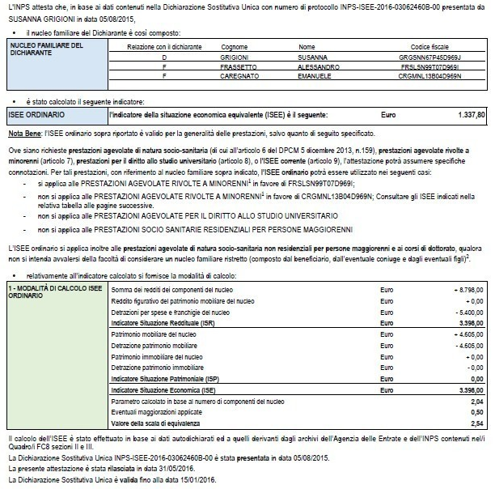
ISEE in details
ISEE Certification
The following picture exemplifies the ISEE Certificate released to applicants citizens from INPS
EXAMPLE
household of reference for the ISEE calculation and, for each members, the relationship with the applicant
indicator value
social benefits to which it is possible to access and the specific beneficiary
indicator calculation method and intermediate data, such as ISR, ISP and Equivalence Scale Parameter
period of certificate validity

Slide 13





ISEE in details
Next steps
The extensive set of information owned by INPS regarding the citizens, obtained by the ISEE system, also leveraging on the ones acquired by the cooperation with other Public Administrations, could allow to totally automate the ISEE calculation and release flow.
FUTURE ISEE FLOW
COOPERATION TO SHARING DATA AND INFORMATION
ISEE calculation request without submission of the DSU
CITIZEN
SOCIAL ASSISTANCE DATABASE
Revenue Agency
Other Public Administration
Employers
Financial institutions
ISEE calculation release
Legend
Flow in
Flow out

