Slide 1
New technologies in service of caring needs: Technologies for distance monitoring
Dr. Mario Ciampi
Institute for High Performance Computing and Networking of the
National Research Council of Italy – ICAR-CNR
Marseilles, 20th September 2017

Slide 2
Index
ICT in Healthcare
  Medical informatics standards and commercial devices
  Overview of the application of e-Health technologies in different medical fields
eHealth Networks: the case of Italy
  ePrescription, Disease Certificates, Clinical Reports
  Electronic Health Record
  Telemedicine Address Lines
Analysis of narrative health documents: a practical scenario

Slide 3
ict in healthcare
Medical informatics standards and their applications in medical fields

Slide 4
E-Health
The application of ICT in Healthcare (e-Health) is a key tool to address the challenges of the healthcare system for:
  meeting the needs and expectations of quality and efficiency expressed by citizens
  reversing the growth trend of spending
The increases in the average age and healthcare culture and the greater availability of care paths are causing a greater demand for services
In this scenario, the use of ICT technologies can be both an enabling factor to facilitate the access to patient-citizen care and social inclusion, and the tool to reduce the cost of healthcare, making care paths more efficient

Slide 5
Information and Communication Technologies and Paradigms for Healthcare
Devices
  Wearable devices
  Biomedical sensors
  Sensing devices
Big Data Analytics
  Linked Open Data
  Machine learning
Internet Of Things
  Smart devices
Interoperability
  Standard
  Communication Protocols
  Shared Interfaces
Security
  Authentication, Authorization, …
Paradigms
  Service-Oriented Architectures
    Web Services
  Enterprise Architecture Integration

Slide 6
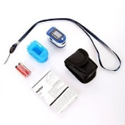



E-Health Technologies for distance monitoring
IC hardware and software technologies are increasingly applied for a moltitude of health applications, in order to provide services for caring needs
  Teleradiology, Telemonitoring, Telerehabilitation, Dematerialization, Electronic Health Record, …
The need to facilitate de-hospedalization is leading to use e-Health technologies for distance monitoring

Slide 7






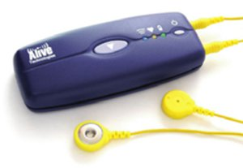
Medical informatics standards
Medical informatics standards
  The development of efficient and uniform ICT systems requires open standards in order to promote interoperability, reuse and exchange of information among different organizations
  Several medical informatics standards have been defined for multiple fields of healthcare
Widespread commercial devices
  Numerous non-standard biomedical devices are typically used for e-Health applications
    e.g. ECG, pulse oximeter,…
  Commercial devices commonly used for a specific target are often used to solve different kind of problems in respect they were designed
    e.g. Mobile phones, Wii

Slide 8
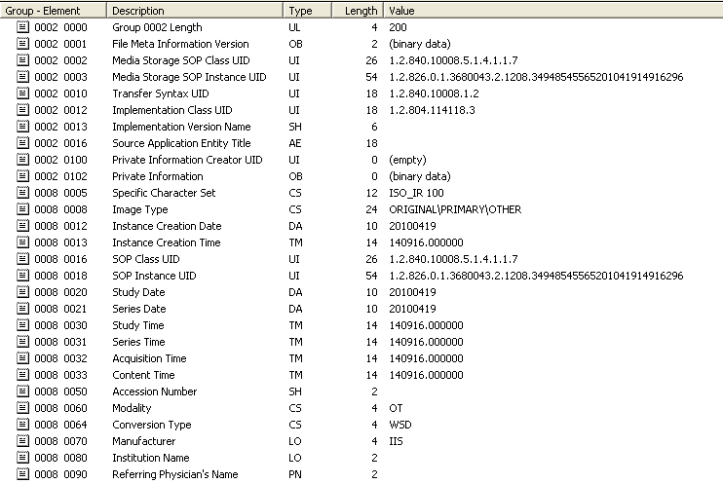
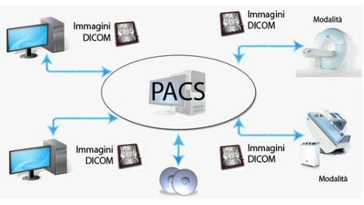
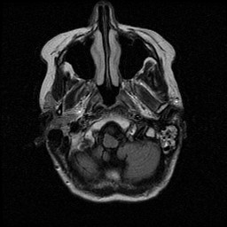
Radiology: DICOM Standard
Digital Imaging and COmmunication in Medicine (DICOM)
  Describes both a format for
    Image representation
    Communication protocol for image exchange
Medical imaging modalities
Magnetic Resonance Imaging
Computed Tomography
Positron Emission Tomography
Computed Radiography
…

Slide 9


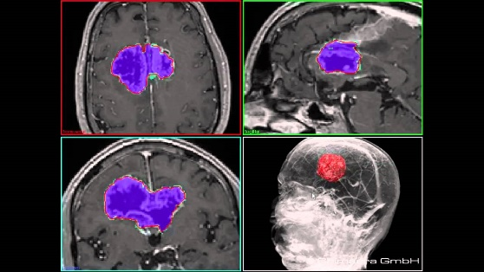
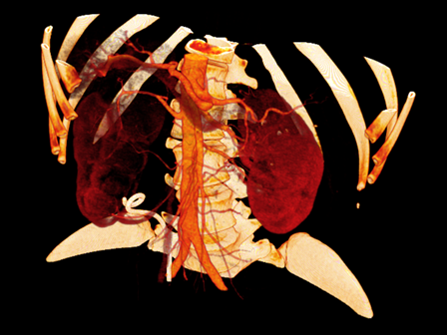
Radiology: Medical image processing
Numerous advanced techniques can be applied for processing medical images
  Image segmentation
  Region extraction
  Image fusion
  3d reconstruction

Slide 10
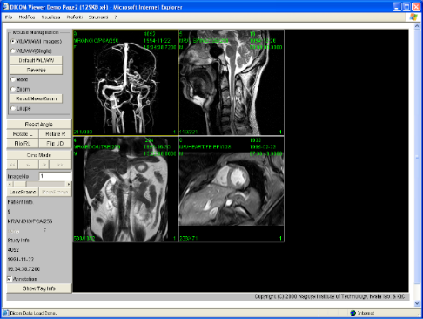


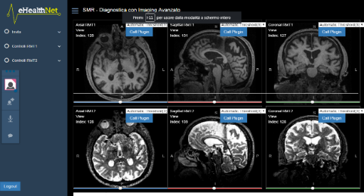

Teleradiology and collaborative visualization
Medical images can be easily transmitted from one location to another for sharing them with other specialists and physicians
Clinicians can be supported in a remote multi-specialist reporting process and in requesting a second opinion by allowing cooperating and simultaneously displaying the same scene
PACS

Slide 11

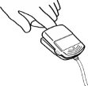




















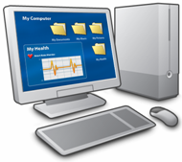
Continua Health Alliance standard
End-to-end plug-and-play connectivity
Telehealth
Service
Center
Health
Records
Personal Device (Agent)
Aggregation
Manager
Thermometer
Pulse Oximeter
Pulse /
Blood Pressure
Weight Scale
Glucose Meter
Cardio / Strength
Independent
Living Activity
Peak Flow
Medication
Adherence
Physical Activity
PAN-IF
LAN-IF
WAN-IF
HRN-IF

Slide 12
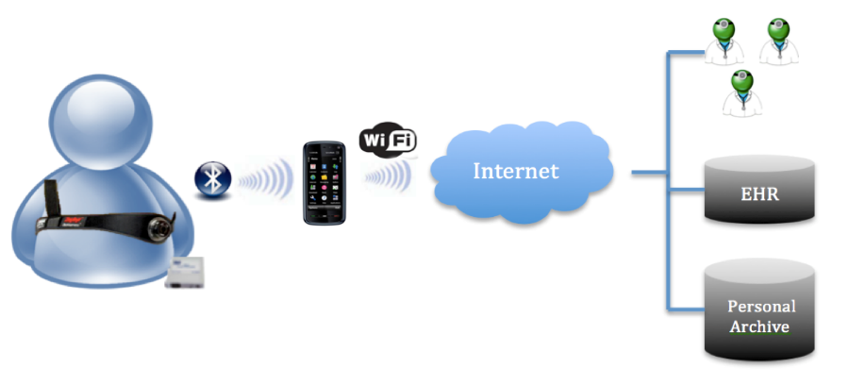
Smart monitoring systems
Numerous biomedical devices are extensively used for developing smart telemonitoring systems
Such systems, through one or more wearable sensors, are able to monitor vital signals and parameters of a patient at his/her home, such as:
  Electrocardiogram, heart rate, breath frequency, posture, …

Slide 13
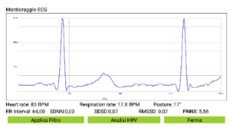


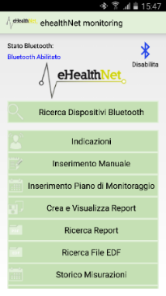


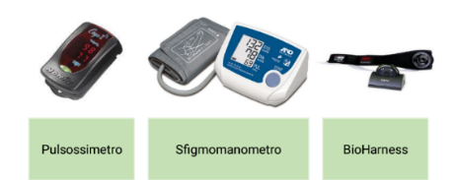
Smart monitoring systems
Acquired data can be sent in real-time to a mobile device (smartphone/tablet)
  The device can process this information through the use of Decisions Support Systems
  The collected data is automatically entered into health information systems
  In the event of anomalies detected, the system sends an alarm message to the treating physician
Alert
Consults
EHR/PHR
DSS

Slide 14



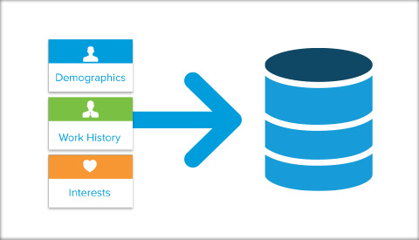

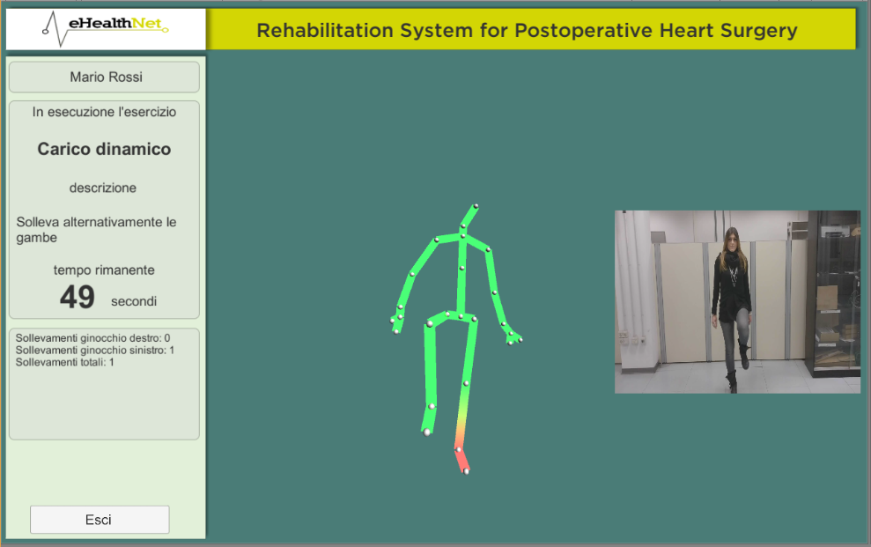
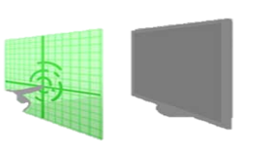

Sensing devices: Telerehabilitation
Use of motion sensing input devices for:
  Acquiring biomedical and motion data in real time via wireless and minimally invasive sensors
  Continuously monitoring motor activities and physiological parameters of the patient during exercises
  Memorizing acquired data to reconstruct a history of patient activity
Kinect
Entità
Dati motori
Dati fisiologici

Slide 15


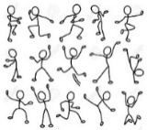

Sensing devices: Telerehabilitation
  Customizing rehabilitation activities on the needs of the individual patient modifying exercises and levels of difficulty
  Performing patient exercises for the recovery of both physical and cognitive capabilities
  Motivating the patient to continue performing rehabilitation exercises through the use of gaming techniques
1
2
3

Slide 16
E-Health Networks
The case of Italy

Slide 17

Need of ICT in healthcare
High health costs impose synergies between process-level operators (e.g. guidelines, protocols)
Passage from a hospital-centered vision to a territorial cooperation
Managing of document information units, validated and adhering to the organizational cycle
Clinical process management, pathology networks, connection with remote diagnostic and teleconsultation facilities
Integration of health information systems architectures, development methodology, semantics
e-Health
Networks

Slide 18
Levels of design of the e-Health Networks
Legal level
Regulatory
Business level
Processes
Content level
Information
Technical level
IT Infrastructure

Slide 19

Italy: Autonomy in healthcare
Italy is composed in 20 Regions
  1 Region is composed in 2 autonomous provinces
According to the Italian Constitution, the Regions and Autonomous Provinces have the autonomy of planning, management and administration of health services

Slide 20
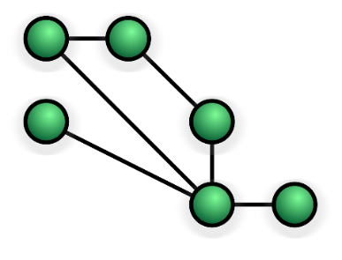
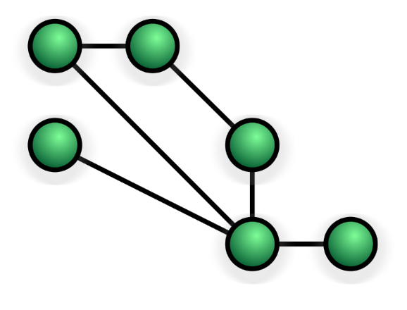
Italian e-Health Networks
Several e-Health Networks distributed on the territory have been realizing in Italy
  The development of such e-Health Networks have been established by regulations and technical specifications
Multiple ICT services are realized from a variety of organizations:
  Ministries, Regions, Health Companies, etc.
  These services are typically implemented using Web Services technology
E-Prescription
Clinical Reports
Disease Certificates
Electronic Health Record

Slide 21
E-Prescription
Main regulations
Art. 50 Decree Law 30 September 2003, no. 269 and ss.mm.ii
DPCM of 26 March 2008
Decree of 2 November 2011 of the Ministry of Economy and Finance, in agreement with the Ministry of Health
Decree of 2 July 2012 of the Ministry of Economy and Finance

Slide 22
E-Prescription
Actors
General Practitioner
  Prescribes a digital recipe
Patient
  Subject of the prescription
Healthcare Facility
  Delivers a health service
Ministry of Economy and Finance
  SAC (Central Reception System)
    Central repository services able to store and make available digital recipes
    Functionalities implemented both as Web Services and Web Application technologies
Region
  SAR (Regional Reception System)
    Local repository services connected to SAR able to store and make available digital recipes

Slide 23

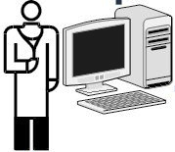



E-Prescription
Data flow: SAC
Ministry of Economy
and Finance
8. Data on the delivered service
1. Electronic recipe data
6. Data of the service to deliver + exemptions
010101011100
SAC – Central Reception System
5. Data request of the service to deliver
2. Positive confirmation of receiving data
General Practitioner
4. Delivery of paper memo
3. Paper memo of electronic recipe
Patient
7. Dispensation
Healthcare Facility
(Farmacy, Hospital, etc.)

Slide 24

E-Prescription
Data flow: SAR-SAC
SAC – Central Reception System
Telematic transmission of the collected information
Ministry of Economy
and Finance
8 Data on the delivered service
Region
6. Data of the service to deliver + exemptions
1. Electronic recipe data
SAR – Regional Reception System
010101011100
5. Data request of the service to deliver
2. Positive confirmation of receiving data
General Practitioner
4. Delivery of paper memo
3. Paper memo of electronic recipe
Patient
7. Dispensation
Healthcare Facility
(Farmacy, Hospital, etc.)

Slide 25
On-line Disease Certificates
Main regulations
Law n. 311 of 2004 (Financial Law 2005): defines electronic transmission of disease certificates to INPS
Law n. 296 of December 27, 2006 (Financial Law 2007): introduces the obligation to send electronic disease certificates for private sector workers to INPS
DPCM of 28 March 2008: defines the procedures for the electronic submission of certificates to the SAC
Legislative Decree n. 150/2009: obliges the physicians to send electronically the disease certificate of the public employee
Decree of the Minister of Health of 26 February 2010: defines the technical modalities of the electrical sending of the certificate
Law n. 183 of 4 November 2010, art. 25: establishes the modalities for issuing and transmitting of disease certificates

Slide 26
On-line Disease Certificates
Actors
General Practitioner
  Produces a digital disease certificate
Patient/Worker
  Subject of the certificate
Company
  Receives copy of the disease declaration
Ministry of Economy and Finance
  SAC (Central Reception System)
    Central repository services able to receive digital disease certificates an interact with INPS
    Functionalities implemented both as Web Services and Web Application technologies
INPS
  Receives and stores digital disease certificates
  Assigns protocol numbers
  Issues disease declarations to public and private companies

Slide 27
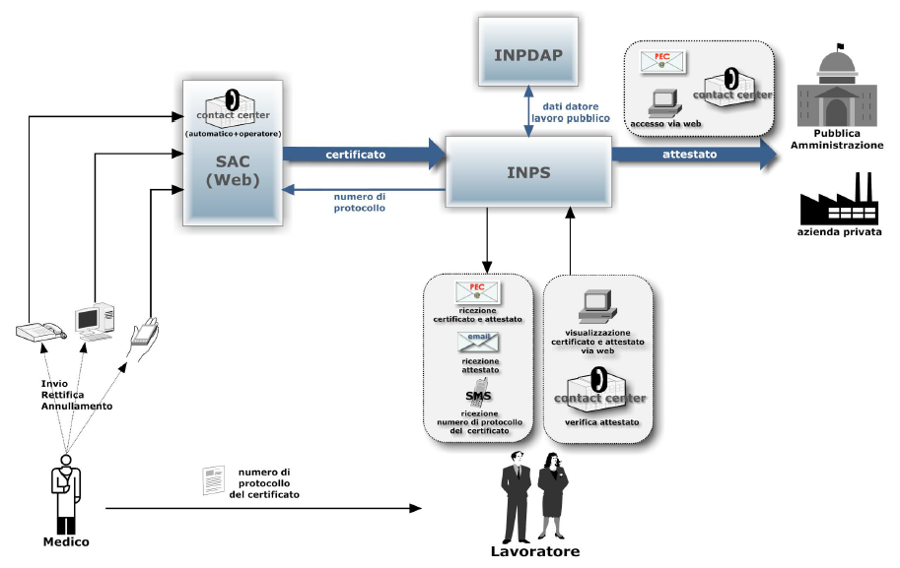
On-line Disease Certificates
Data Flow

Slide 28
On-line Clinical Reports
Main regulations
Guidelines on On-line Reports - June 25, 2009 (Guarantor of Privacy)
Law n. 106/2011
  National Health Service healthcare companies must adopt:
    telematic procedures to allow online payment of delivered services
    the delivery of medical reports through web, certified electronic mail or other digital modalities
    a citizen has in any case the right to obtain, even at home, a hard copy of the report

Slide 29
On-line Disease Certificates
Actors
Laboratory Operator
  Produces a digital clinical report
Laboratory Responsible
  Signs the digital clinical report
Citizen
  Receives copy of the digital clinical report
Clinical laboratory
  Document Management System
    Stores digital clinical reports and makes them avialable to the citizen via e-mail or a Web Portal

Slide 30
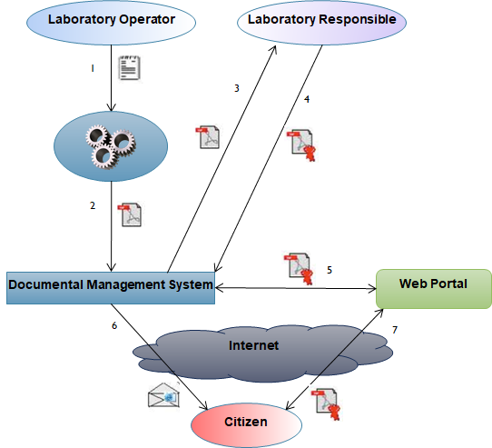
On-line Clinical Reports
Data Flow

Slide 31
Electronic health record
Italian processes and ICT architecture

Slide 32
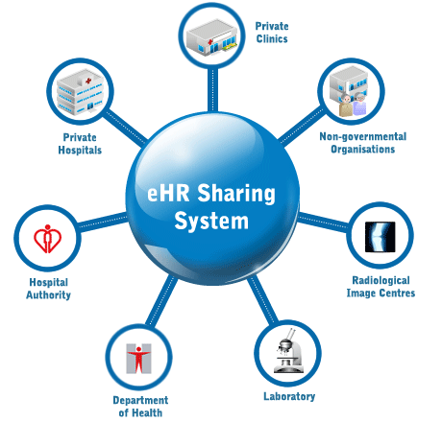
Electronic Health Record System
An Electronic Health Record (EHR)
  is the collection of health and socio-health digital data and documents generated by present and past clinical events concerning the patient
  has a time horizon that covers the entire life of the patient and is continuously fed by the subjects who take care of him/her in the NHS and regional health services
  has 3 main finalities:
    Care
    Research
    Planning
EHR System
EHR System

Slide 33
Electronic Health Record
Main regulations
Art. 12 Decret Law no. 179 of 18 October 2012, coordinated with conversion Law no. 221 of 17 December 2012
Amendment to the Law no. 221/2012 with the Decret Law no. 69 of 21 June 2013 coordinated with the conversion Law no. 98 of 9 August 2013
DPCM no. 178 of 29 September 2015
Amendment to the Law no. 221/2012 and ss.mm.ii. with the art. 1 paragraph 382 of the Law no. 232 of 11 December 2016 (2017 Budget Law)

Slide 34
EHR Contents
Minimal core documents e data
  Identification and administrative information of the assistant
  Clinical reports
    Laboratory reports
    …
  First aid verbals
  Discharge letters
  Patient summary
  Pharmaceutical dossier
  Consent or denial of organ and tissue donation
Supplementary documents e data
  Prescriptions (specialist, pharmaceutical, etc.)
  Reservations (specialist, hospitalization, etc.)
  Medical records
  Health Balance
  Home care: clinic-assistance module, program, and record
  Diagnostic-therapeutic plans
  …

Slide 35
Patient summary
Patient summary is a health document with the following characteristics:
  synthetic: contains only essential information
  with one author: it is created and updated by the General Practitioner
  compiled by a human specialist: it cannot be created in an automatic way
  not clinically specializied: it does not have a predefined recipient
  unique: only one patient summary per patient is valid

Slide 36



Italian context
In Italy, in the absence of a specific norm, most of the regional administrations have launched a series of initiatives for the realization of their EHR systems
All of these systems are based on the registry/repository paradigm
  Digital health documents are stored in document repositories (located in healthcare facilities, healthcare companies or regions)
  Documents are indexed in the registry by storing appropriate metadata describing the documents
EHR Regional System
Registry
Repository
Repository

Slide 37
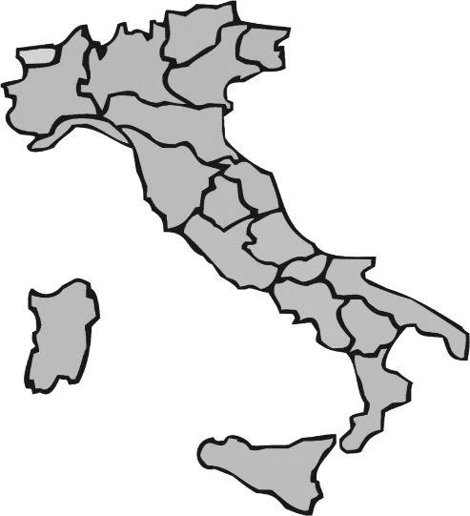
National Technical Board
Regional autonomy has caused a proliferation of heterogeneous EHR-S not interoperable with each other
The issuance of a first law has permitted to establish a National Technical Board composed by
  Agency for Digital Italy, Ministry of Health, Ministry of Economy and Finance, Regions and CNR
The Technical Board has defined:
  the national architectural model of reference, and
  the functional and technical requirements to be respected by all the Italian Regions

Slide 38











EHR Infrastructure architecture
RDA
RDE
Registry
Repository
Ministry of Economy
and Finance
Interoperability Services
Repository
Interoperability Services
RCD
Repository
RPDA
Interoperability Services
Interoperability Services
National Interoperability Infrastructure
Registry
Sistema TS
ANA

Slide 39
Interoperability services
Regions and autonomous provinces assure:
  availability of services for making patients able to access their EHR
  availability of services making GPs as well as healthcare facilities able to connect and feed EHR
  availability of services for EHR interoperability
  availability of laboratory report management services
  availability of patient summary management services

Slide 40
Electronic Health Records
Interoperability healthcare standards
Functional model
  HL7 EHR-S FM
Clinical documents structuring and coding
  HL7 CDA
  LOINC, ICD-9-CM, AIC, ATC
IT infrastructure
  IHE XDS

Slide 41

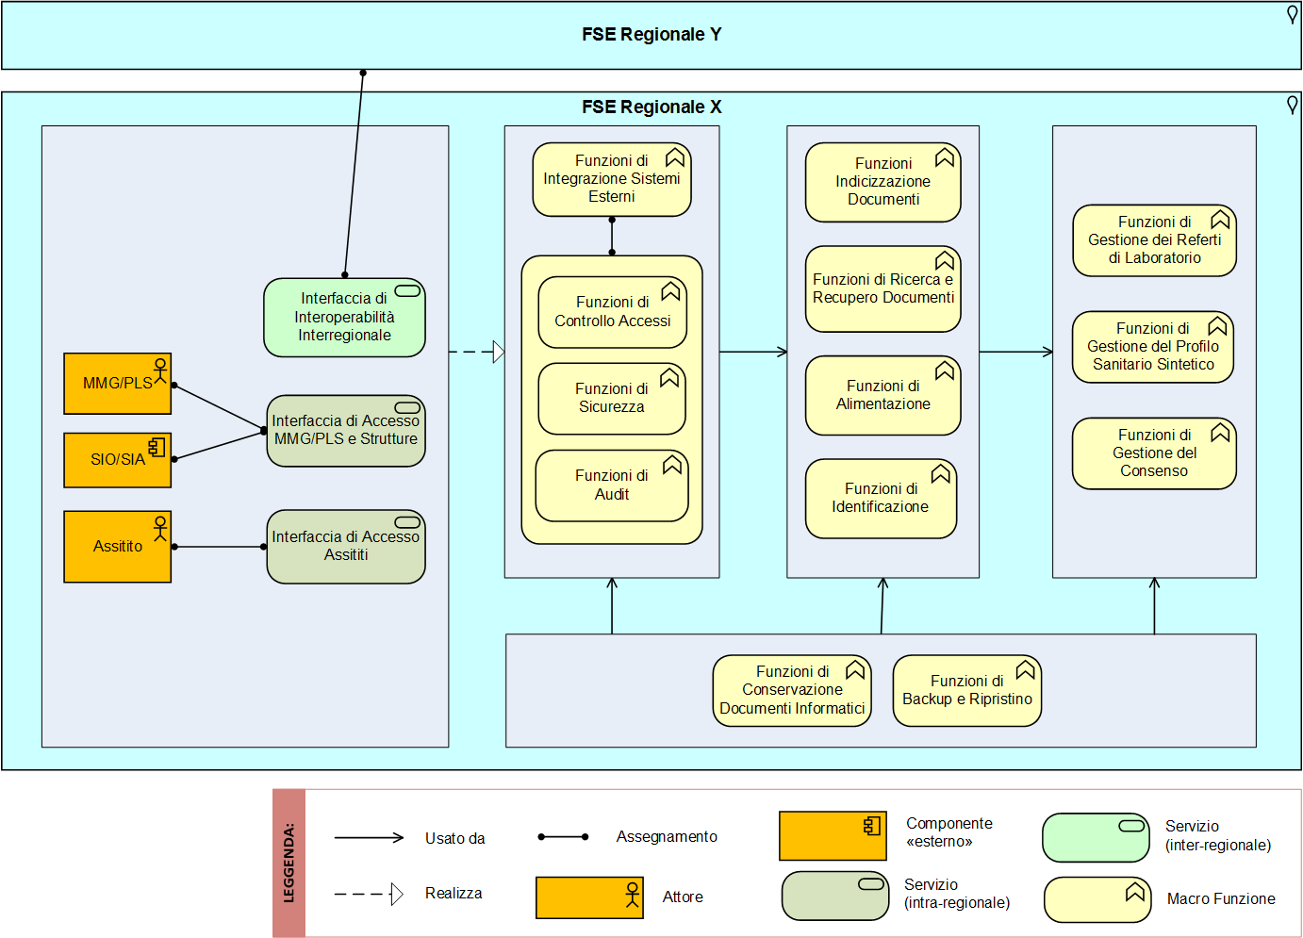
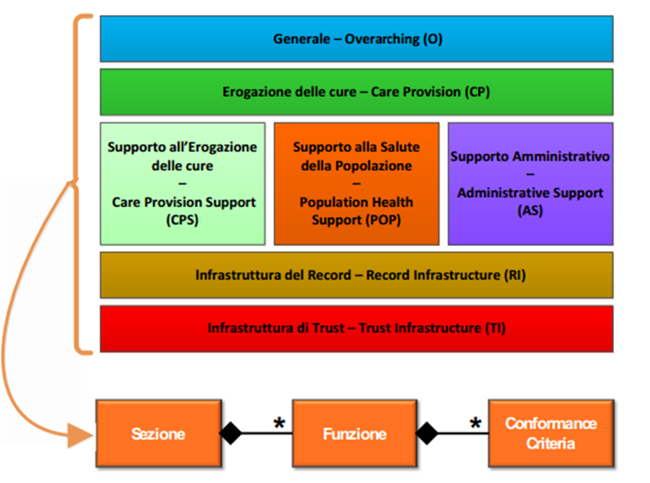
Functional profile for regional EHR systems
A functional EHR profile has been obtained by localizing the international standard HL7/ISO EHR-S FM R2 (Electronic Health Record – System Functional Model Release 2)

Slide 42
Consent and privacy management
National technical groups attended by the Italian Guarantor of Privacy have defined a set of informed consents and privacy policies necessary for handling data in EHR systems:
  Feed consent
  Consultation consent
  Consent for minor or subject to protection
  Consent for data and documents with greater protection of anonymity
  Obscurement of data and documents

Slide 43
Health Level Seven (HL7) Standard
Global Authority on Interoperability Standards in IT Healthcare with members in more than 55 countries
It provides standards for interoperability that:
  improve the performance of medical care
  optimize workflows
  reduce the ambiguity
  increase the knowledge transfer among stakeholders including health service providers, government agencies, other SDOs and patients

Slide 44
HL7 CDA standard for document structuring
CDA health document
Identifies and classifies the document, represents information about authentication, patient, care event, and health actors involved
Header
Memorizes the clinical content and may alternatively contain an unstructured body (eg BLOB PDF) or a set of markup describing its content
Body

Slide 45
Clinical document management
Healthcare facilities have to implement, within their Laboratory Information Systems, these services:
  Service for structuring laboratory reports according to HL7 CDA2 standard
  Service for coding data contained in the laboratory reports according to LOINC standard
General Practitioner applications have to provide these services:
  Service for structuring laboratory reports according to HL7 CDA2 standard
  Service for coding data contained in the laboratory reports according to LOINC, ICD9CM, AIC and ATC standards

Slide 46
Implementation guide HL7 CDA for laboratory report
Author of the document
Custodian
Creation date
  Data enterer
Documento versioning
Header
Patient demographics
Signer
  Validator of the document
Document type
Id document
Single exam
Repeated exams
Battery of exams
Microbiological study
StructuredBody

Slide 47
Implementation guide HL7 CDA for patient summary
Author of the document
Custodian
Creation date
  Data enterer
Documento versioning
Header
Patient demographics
Signer
  Validator of the document
Document type
Id document
Allergies, intolerances and alarms
Family history
Prostheses, implants and aids
Patient status
Pathology networks
Pharmacological Therapies
Life style
Care plans
Diagnostic and laboratory tests
Exemptions
StructuredBody
Immunizations
Pregnancy and childbirth
Therapeutic, surgical and diagnostic treatments and procedures
Assent/dissent
donating organs
Visits and admissions
Problem list
Vital parameters
MAN
REC
OPT

Slide 48
Interoperability business processes
Consent and Informative Management
Document Search
Document Retrieval
Metadata Communication
Metadata Cancellarion
Index Transfer

Slide 49
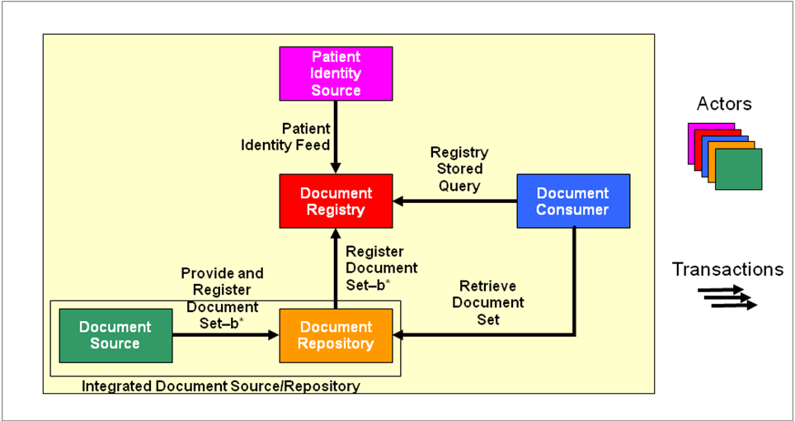
IHE XDS standard architecture

Slide 50


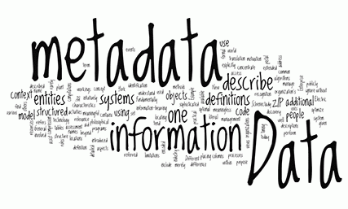
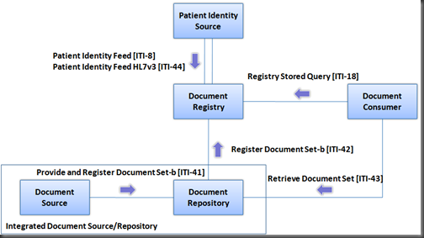
IHE XDS-based EHR Cross-Border Services
Document search
Document retrieval
Metadata communication
Metadata cancellation
Index transfer
Italian XDS Affinity Domain
Communication
Cancellation
Index tranfer

Slide 51





IHE XDS-based interoperability among e-Health systems
Repository
Repository
Patient’s Domain EHR (RDA)
Registry
Registry
Repository
Repository
National Interoperability
Infrastructure
Doctor’s Domain EHR (RDE)

Slide 52
Electronic Health Record
Main security aspects
Authentication & Authorization
  Users (operators and patients) are authenticated by RDE
  The access to EHR systems is authorized by RDA
    Specific security tokens are transmitted within messages
Digital Signatures
  XAdES enveloped of the CDA document with/without PDF document injected
  PAdES of the PDF document with CDA2 document injected
Auditing
  All the operations are traced by all the involved systems

Slide 53
Telemedicine
Italian national guidelines

Slide 54
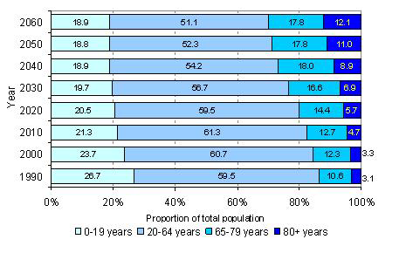
Need for a Telemedicine Model
The ongoing demographic evolution, with an increasing proportion of elderly people and chronic illnesses, requires a structural and organizational redesign of the health services network
The purpose of this reorganization is to facilitate the shift of the focus of health care from the hospital to the territory through

Slide 55
Need for a Telemedicine Model
The heterogeneous diffusion of telemedicine health services required the provision of a shared governance model of Telemedicine initiatives, with the aim of harmonizing its addresses and application models
In this regard, the Working Board for Telemedicine, established by the Ministry of Health at the Higher Health Council, has defined the National Address lines for Telemedicine¹, approved at the State-Regions Conference on 20 February 2014
¹http://www.salute.gov.it/imgs/C_17_pubblicazioni_2129_allegato.pdf

Slide 56
Classification of Telemedicine services
TELEMEDICINE
CLASSIFICATION |  | SCOPE | PATIENT | RELATION
SPECIALISTIC TELEMEDICINE | TELE VISIT | Healthcare | Active Presence | B2C B2B2C
 | TELE CONSULTATION |  | Absence | B2B
 | TELE HEALTH COOPERATION |  | Real-time present | B2B2C
TELE HEALTH |  | Healthcare | Active Presence | B2C B2B2C
TELE ASSISTANCE |  | Social-Assistance

Slide 57
Classification of Telemedicine services
Specialistic Telemedicine
  Tele Visit
    medical act where the doctor interacts remotely with the patient
    the connection should allow the physician to see and interact with the patient and must take place on real or deferred time
  Tele Consultation
    distance counseling between doctors that allows a physician to seek the advice of one or more physicians
  Tele Health Cooperation
    act consisting of the assistance provided by a doctor or other healthcare practitioner to another doctor or other healthcare practitioner involved in a medical act

Slide 58
Classification of Telemedicine services
Tele Health
  concerns systems and services that connect patients, especially chronic, with doctors to assist in diagnosis, monitoring, management, and accountability
  allows a physician (often a general practitioner in collaboration with a specialist) to interrogate the data necessary for the patient’s telemonitoring
Tele Assistance
  social-assistance system for the care of elderly or frail persons at home, through the management of alarms, the activation of emergency services, support calls from a service center

Slide 59
Actors involved in a service delivered in Telemedicine
Users (P = Patient, M = Physician)
  Those who benefit from a Telemedicine service (patient/caregiver, physician in the presence or absence of the patient)
Providing Center
  NHS facilities or operators providing healthcare services through a telecommunications network
Service Center (CS)
  Structure with management and maintenance functions of an information system, through which the Dispensing Center performs a Telemedicine service
  In the absence of a Service Center, its functions are performed by the Providing Center

Slide 60
Technological components
Interface (I)
  All the systems able to guarantee the connection and access of the User, Providing Center and Service Center to the Telemedicine Service Network
    Biomedical apparatuses, hardware and software systems for acquiring and processing signals, images, data, including also through mobile devices (smartphones, tablets), related to the User, suitable and compatible with Telemedicine services (medical devices)
    Web applications, also accessible via mobile devices (smartphones, tablets) for the bidirectional transmission of health information
    Portals dedicated to the purpose

Slide 61
Technological components
Telecommunication infrastructures (-)
  Telecommunication plays a key role in Telemedicine services, in the end of the transmission of data and communication between the User, Providing Center, and eventually Service Center

Slide 62
Relational organizational models in Telemedicine
USER
SERVICE CENTER
PROVIDING CENTER
P
M
I
I
TELE VISIT
TELE HEALTH
B2C
P
CS
M
I
I
P
M
M
I
I
TELE VISIT
TELE HEALTH COOPERATION
B2B2C
P
M
CS
M
I
I
REQUESTER
CONSULTANT
M
M
TELE CONSULTATION
B2B
I
I
M
CS
M
I
I

Slide 63
A System for the Automatic Extraction of a Patient Problem Summary

Slide 64

Objective
Collecting and synthesizing patient’s significant data
Saving time in the analysis of large amounts of medical data
Detecting and automatically processing relevant information
Supporting physicians in the process and efficiency of healthcare

Slide 65
Problem
Current EHR systems often do not present the large amount of patient data in a way suitable to support the clinical reasoning
Medical information about a patient can be fragmented since it may be included within a number of different reports
Medical records contain a large amount of clinical data in the form of narrative text rich in mentions about patient's significant problems

Slide 66
Clinical Summarization
“The act of presenting patient-specific data in a format that supports clinical decision-making, undertaken by a healthcare provider and facilitated by a computer system”
It means the collection and synthesis of a patient’s significant data for supporting healthcare providers in the process of care
An automatic system of summarization may be very effective in terms of saving time in the analysis of large amounts of medical data

Slide 67

State of the Art
Problem-oriented summarization studies mainly consider English as their domain language
NLP can support the process of problem list generation unlocking information in clinical narratives
Absence of effective tools able to support physicians in the detection of relevant data

Slide 68
The Proposal
An Automatic Patient Problem Summary able to:
  Make the patient medical history more accessible
  Provide the clinician with a rapid snapshot of the patient’s data
  Report a problem list with references to medications and procedures
  Assign a standard code to recognized disorders

Slide 69
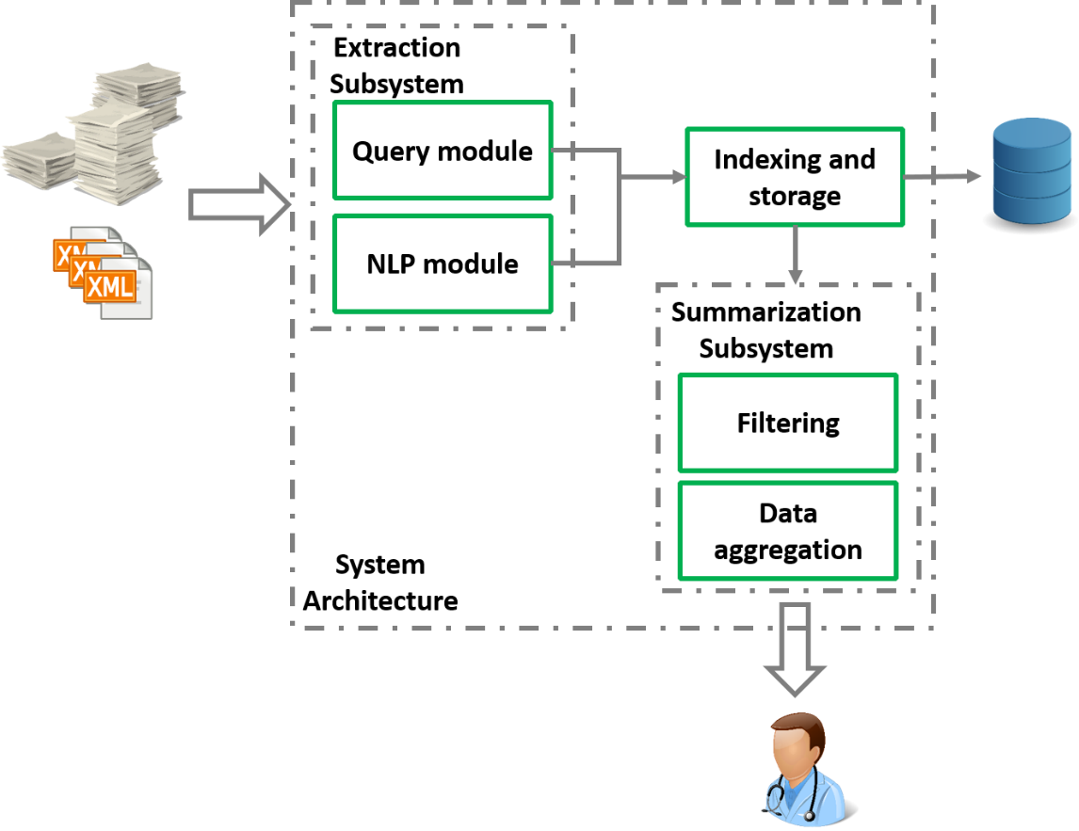
The Proposal
EXTRACTION SUBSYSTEM
For extracting information from any type of medical records
SUMMARIZATION SUBSYSTEM
For summarizing data regarding a specific patient

Slide 70
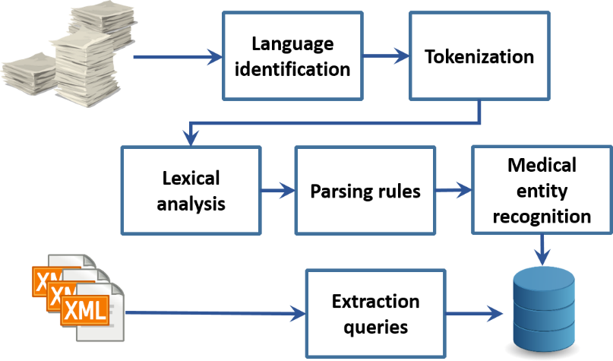
Extraction Subsystem (1)
NLP MODULE
  Tokenization for splitting the text into meaningful pieces
  Lexical Analysis for assigning part of speech tags to tokens, both a grammatical label and medical domain label
  Parsing Rules for annotating token combinations of interest, such as negative expressions and relations among concepts
  Medical Entity Recognition for highlighting medical entities in the narrative documents

Slide 71
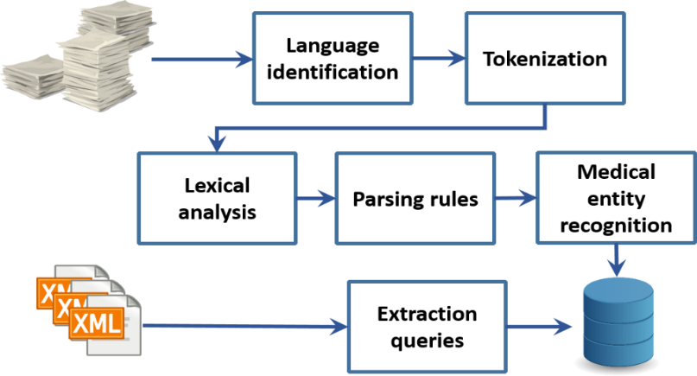
Extraction Subsystem (2)
QUERY MODULE
Obtains relevant information from structured text
Identifies section containing problem references, including disorder’s description and code
ClinicalDocument/component/structuredBody/component/section /code[@code=”11450-4”]/entry[@typeCode=”DRIV”]/act/entry Relationship[@typeCode=”SUBJ”]/observation/value/@displayName
ClinicalDocument/component/structuredBody/component/section /code[@code=”11450-4”]/entry[@typeCode=”DRIV”]/act/entry Relationship[@typeCode=”SUBJ”]/observation/value/@code

Slide 72
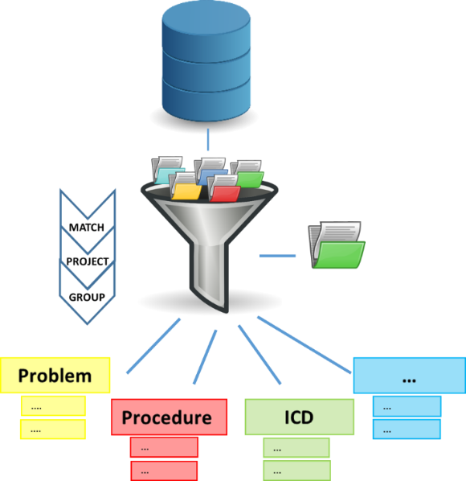
Summarization Subsystem
Takes as its input medical keywords of interest, recognized due to the extraction components
Assigns an identifier to the document, containing a label with the patient name
Stores a list containing medical entities, characterized by a label and a value
Aggregates the information by type presenting a visual summarization to the clinicians

Slide 73



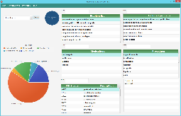
Use Case
A clinician can examine the medical problems of a patient, quickly and easily, starting from a variety of health records
For each document, relevant medical concepts are annotated and a Problem Summarization is shown to the user
He/she can observe medical problems, procedures performed, and drugs prescribed, extracted from both narrative reports and structured documents
Problem List Generator
Notes:
Completare disegnino

Slide 74
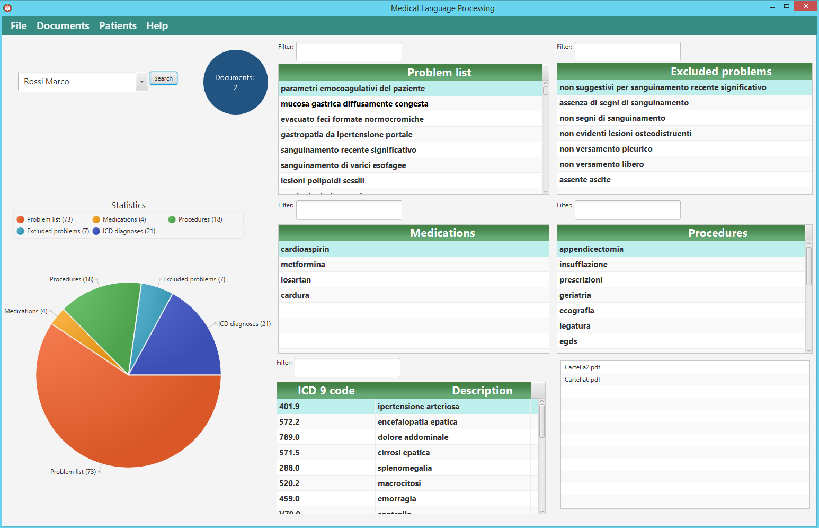
Use Case

Slide 75
Results
Selection of information for patient
Visualization of data by type
Filtering of the information
Summary of:
  Recognized problems
  Excluded disorders
  Standard terms
  Prescribed medications
  Performed procedures
Type of Documents | Number of Documents
Narrative Health Reports | 80
Structured Clinical Documents | 20

Slide 76
Thank you for your attention
Contacts
Mario Ciampi
Institute for High Performance Computing and Networking
National Research Council of Italy
mario.ciampi@icar.cnr.it

