Slide 1
The role of private pensions to guarantee the financial sustainability in a context of aging population
Prof. Agar Brugiavini
Ca’ Foscari University of Venice, Italy
Component Two- 2017 Training Course “Social Security in an Ageing Society: EU Practices Responding to the Demographic Challenge”
Paris, September 10 - 24, 2017

Slide 2
Plan of the presentation
Ageing: a sustainability challenge
Patterns of Ageing in Europe
Life Cycle Theory and the Accumulation of Capital
Pension System Structure
Pension Funds Characteristics Throughout Europe
Models and Governance in the EU
Learning from Ageing Surveys: SHARE and CHARLS

Slide 3
AGEING: A SUSTAINABILITY CHALLENGE
By 2050 there will be an unprecedented increase in the number of people aged 55-plus representing nearly a quarter of the global population (UNPD, 2010)
Longevity is “good news” but poses important challenges to society and policy makers.
An ageing population has wide-ranging implications for the economy and for society.

Slide 4
THE DIMENSIONS OF AGEING: FEEDBACKS
We need to understand the ageing process:
Income and wealth
environment
←welfare
system
Lifetime process: longitudinal dimension
Physical health,
mental health
Relatives, friends,
housing

Slide 5
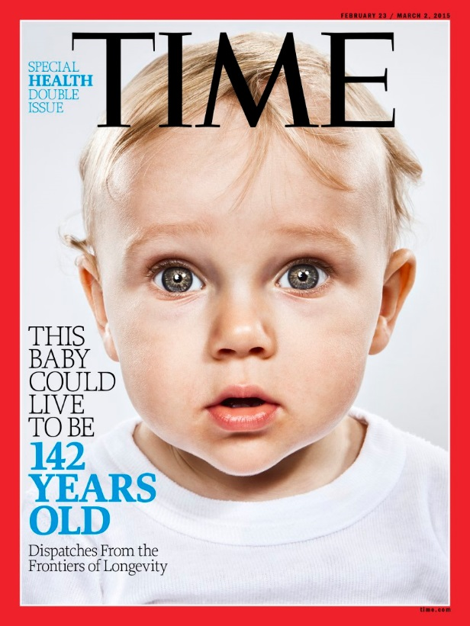
DRIVING FORCES FOR THE PENSION CHALLENGE
Increase in the share of the older people (increased longevity, reduction of fertility)
Labour market
Generosity of public pensions (social security)

Slide 6
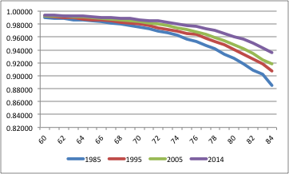
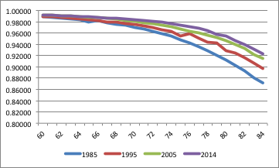
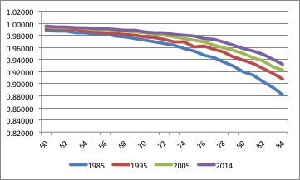
SURVIVAL PROBABILITIES, 60+
Italy
Germany
Spain
Source: Eurostat

Slide 7
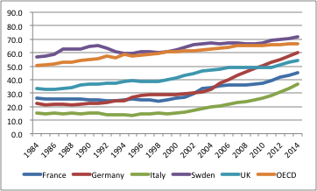
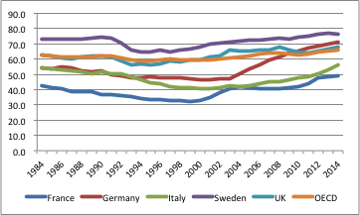
EMPLOYMENT RATE FOR 55-64 BY GENDER
Men
Women

Slide 8
OLD AGE DEPENDENCY RATIO
Source: United Nations, Department of Economic and Social Affairs, Population Division, World Population Prospects: The 2012 Revision, New York, 2013.

Slide 9
ECONOMIC THEORY: LIFE CYCLE MODEL
Forward-looking individuals plan their choices
25 30-35 50 90 120
Child care
Unemployment/
Pension
Health related risks
Longevity
Long-term care
Liquidity

Slide 10
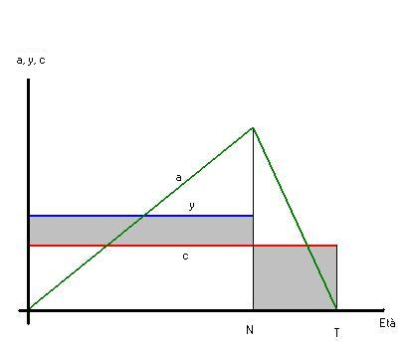
IMPLICATIONS OF THE MODEL
a is wealth
c consumption
y income (constant until retirement N)
Source: Jappelli and Pistaferri, 1994

Slide 11
ACCUMULATION OF WEALTH
Individuals want to maintain a CONSTANT (or at least STABLE) level of consumption along the entire life.
The wealth profile is “hump-shaped”: individuals save during their working life and decumulate after retirement.

Slide 12
OPTIMAL PORTFOLIO FOR OLDER AGES
  Under longevity risk annuities (pensions) represent the optimal instrument of saving-insurance. The entire wealth should be in the form of pensions!
  Still, households face other risks and for precautionary reasons they may want to have access to liquidity.
  The existence of public pension benefits reduces the need to save for old age.

Slide 13
SAVINGS, WEALTH AND PENSIONS
Savings and wealth:
  Adequacy of savings for retirement: do people plan correctly if left on their own?
The demand for annuities (for private pensions):
  Households portfolios should include two components:
    An income component (annuity);
    A financial asset component, with higher liquidity, for other contingencies.
Poor financial knowledge or a short planning horizon could imply low levels of demand for pension products.

Slide 14
EDUCATION INITIATIVES FOR RETIREMENT
 | INFORMATION and AWARENESS |  |  |  |  |  |  |  | INSTRUCTION | ADVICE
 | General |  |  | Personalised
 | Websites | Awareness campaigns and events | Comparison tools | Public pension statements | Private pension statements | Online personal info -- Public pension | Online personal info -- Private pensions | Calculators and simulators | Retirement planning seminars | Counselling / advice
Denmark | X |  | x | x | x | x | x
Finland | x |  |  | x |  | x |  | x
France | x |  |  | x |  | x |  | x |  | x
Germany | x |  |  | x | x | x | x |  |  | x
Ireland | x |  | x |  | x |  |  | x
Italy | x | x |  | x | x | x
Netherlands | x | x |  | x | x | x | x | x | x | x
Portugal | x |  |  |  |  | x
Spain | x |  | x | x | x | x |  | x
Sweden | x |  |  | x | x | x | x
Switzerland | x |  |  | x | x
United Kingdom | x | x |  | x | x | x | x | x |  | x
United States | x | x | x | x | x | x | x | x | x | x

Slide 15
INCOME SOURCES FOR OLDER PEOPLE
Source: OECD

Slide 16
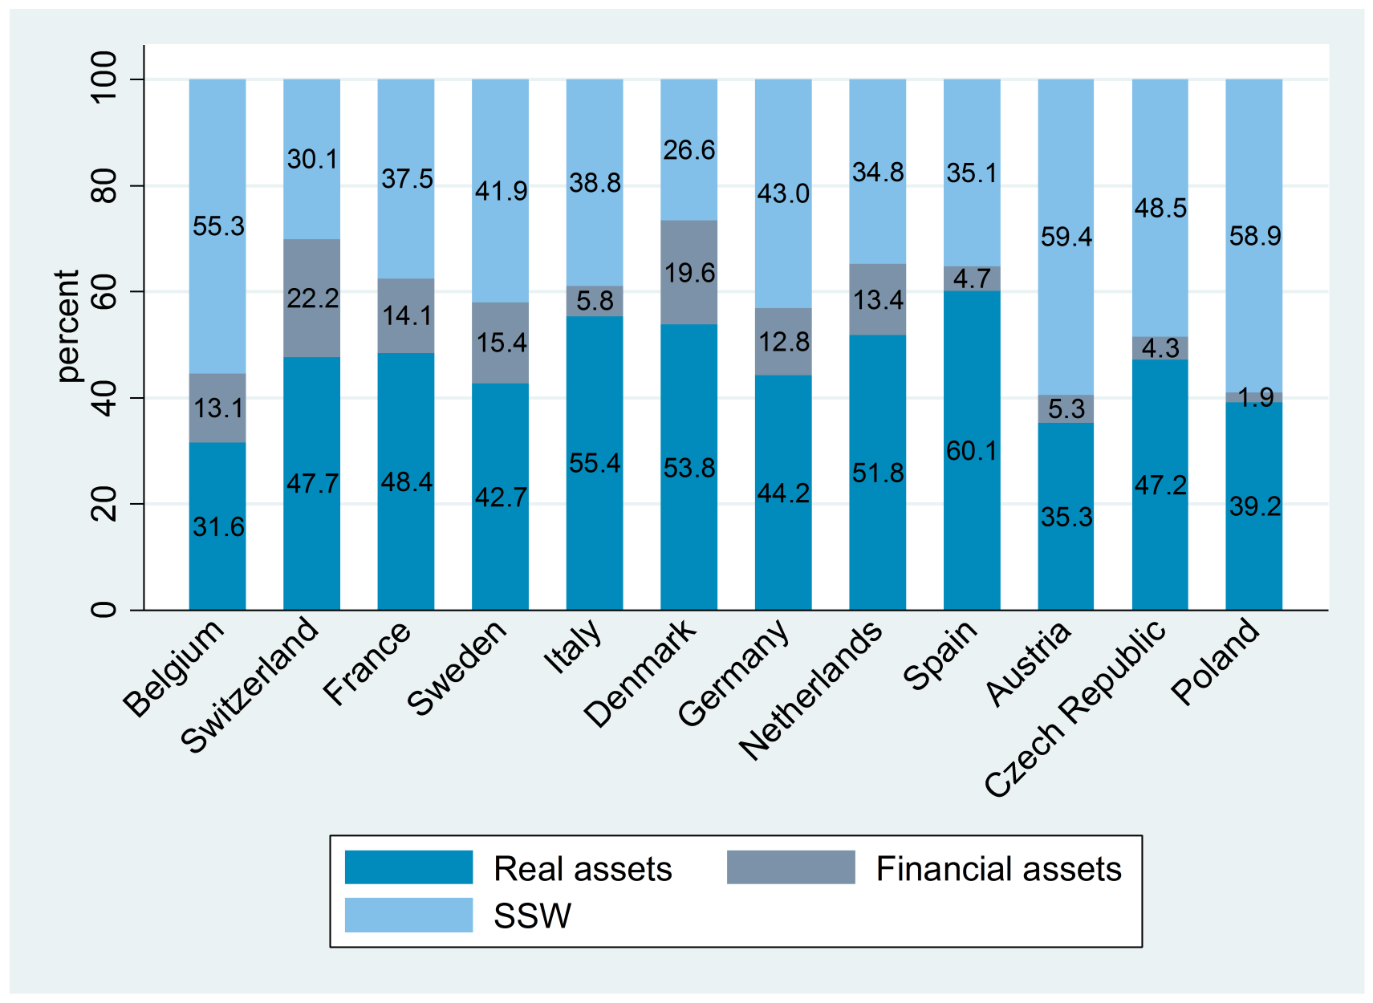
HOUSEHOLDS’ WEALTH in EUROPE
SOCIAL SECURITY W, REAL ASSETS, AND FINANCIAL ASSETS
Source: Elaborations using SHARE wave 4 data

Slide 17
STRUCTURE OF PENSION SYSTEMS
A pension system is typically based on three pillars:
  First pillar: public, compulsory Social Security System. High coverage.
  Second pillar: occupational or sector-specific pensions schemes. Low/medium Coverage.
  Third pillar: individual contracts. Very low coverage.
Generally, only the first (public) pillar is MANDATORY and the benefits may be flat rate or wage-related.

Slide 18
STRUCTURE OF PENSION SYSTEMS
Funding. Normally the first pillar is Pay-As-You-Go (PAYG) while the second pillar (collective contract) and the third pillar (individual contract) are based on capitalization schemes. In the latter case there is accumulation of funds.
Benefits. Pension (or social security) benefits can be wage-related «defined benefit», or based on the amount of contributions paid, «defined contribution».

Slide 19
EXPENDITURE IN PUBLIC PENSIONS (% GDP)
Source: OECD

Slide 20
FINANCIAL SUSTAINABILITY OF SOCIAL SECURITY
In order to achieve sustainability of social security, European countries have enacted retrenchement policies
  Increase in the retirement age
  Reduce the pensions benefits (lower indexation, changes in the way that the benefits are computed)
Private pensions
  Seen as a complement to social security, that guarantees pension benefits adequacy and mantains the standard of living

Slide 21
PRIVATE PENSIONS
Pension funds: offered by a pension institution (e.g. a pension company or another financial institution – separate from the firm) OR book reserves
Pension insurance contracts/Personal pensions offered by a life or pension insurance company
Other retirement products offered by a bank or an investment company
Note: pension funds are the largest institutional investors in most OECD countries

Slide 22
TAXONOMY OF PRIVATE PENSIONS
Second Pillar. Occupational pensions
Provided by employers (or employer-sponsored) at the company or industry level.
Often involve compulsory contributions, as established in collective agreements.
Traditionally “defined benefit-DB”, but recently more and more “defined contribution-DC”. They can also be “hybrid pension schemes”. In DB plans the employer bears most of the risk, in DC plans the risk is mostly on the workers
Third Pillar. Individual contracts or personal pensions fill the gap in coverage. Very important for the self-employed.

Slide 23
TAXONOMY
Occupational pensions are cost-efficient:
  Employees do not need to have a lot of financial knowledge
  Attract higher contributions also from employers
  They allow for risk sharing
Personal pensions are more flexible and portable from the point of view of the individual (but expensive). Particularly portable if in the DC form.
Occupational and personal schemes are not necessarily mutually exclusive
NOTE: important to know the tax treatment of pensions. See next.

Slide 24
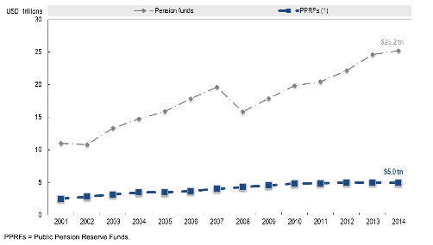
PENSION FUNDS AND PUBLIC PENSION RESERVE FUNDS
The accumulation of wealth in pension funds and public pension reserve funds has grown over the last 15 years in OECD countries
Source: OECD 2015, Annual Survey of Large Pension Funds and Public Pension Reserve Funds

Slide 25
RATIO OF PRIVATE PENSION WEALTH TO GDP

Slide 26
TYPE OF PRIVATE PENSION WEALTH
(as % of total assets)

Slide 27
COVERAGE OF PRIVATE PENSIONS BY TYPE OF PLAN, 2013
(% OF WORKING AGE POPULATION, 15-64 years)
Country | Mandatory / Quasi-mandatory | Voluntary
 |  | Occupational | Personal | Total
Belgium | n.a. | 57.3
Czech Republic | n.a. | n.a. | 66.2 | 66.2
Denmark | ATP: 83.3 | n.a. | 22.4 | 22.4
Finland | 84.1 | 9.2 | 20.9 | 29.1
France | n.a. | 20.2 | 5.3
Germany | n.a. | 56.4 | 35.2 | 71.3
Ireland | n.a. | 31.0 | 12.0 | 41.3
Italy | n.a. | 7.4 | 8.9 | 15.7
Netherlands | 88.0 | n.a. | 28.3 | 28.3
Norway | 68.6 |  | 22.3
Poland | 60.3 | 1.4 | ..
Slovak Republic | 55.3 | n.a.
Slovenia | n.a. |  |  | 36.3
Spain | n.a. | 3.3 | 15.7 | 18.6
Sweden | PPS: ~100 | n.a. | 36.0 | 36.0
United Kingdom (1) | n.a. | 30.0 | 11.1 | 43.3
Source: Pensions at a glance 2015, OECD

Slide 28
SHARE OF PRIVATE PENSION INVESTMENTS:
OCCUPATIONAL vs PERSONAL PLANS
(1) Data refer to 2014. (2) Data refer to 2013.

Slide 29
SHARE OF PENSION INVESTMENTS: DB vs DC
(% OF TOTAL INVESTMENT)
Source: OECD Global Pension Statistics.

Slide 30
PRIVATE PENSION ASSETS BY TYPE OF PENSION PLAN, 2015
 | Assets (in USD m.)
 | Occupational DB plans | Occupational DC plans | Personal plans
Denmark | 8 759 | 523 632 | 66 184
Finland | 118 783 | 786 | 13 336
France | 39 008 | 164 339 | 23 025
Germany | 218 473 | x | ..
Ireland | 78 169 | 47 903 | 5 674
Italy | 10 236 | 101 606 | 43 145
Norway | 34 210 | .. | ..
Poland | x | 2 736 | 37 734
Portugal | 16 295 | 2 984 | 2 009
Spain | 69 923 | 9 795 | 88 327
Sweden | 56 633 | 157 369 | 116 446
Switzerland | 793 201 | x | ..
United Kingdom | 1 923 951 | 49 850 | ..
United States | 7 985 785 | 6 263 961 | 9 604 933
Source: OECD Pension Outlook 2016

Slide 31
PRIVATE PENSION MEMBERS BY TYPE OF PENSION PLAN, 2015
 | Members (in thousands)
 | Occupational DB plans | Occupational DC plans | Personal plans
Denmark | 15 | 4 783 | 812
Finland | .. | .. | ..
France | 884 | 10 689 | 2 614
Germany | 9 318 | x | ..
Ireland | 126 | 282 | ..
Italy | 160 | 3 448 | 4 090
Netherlands | 5 110 | 355 | ..
Norway | 5 209 | .. | 1 155
Poland | x | 393 | 17 988
Portugal | 187 | 149 | 297
Spain | 8 440 | 1 662 | 9 249
Sweden | .. | .. | 7 619
Switzerland | 4 923 | x | ..
United Kingdom | 10 973 | 6 931 | ..
United States | 72 577 | 95 379 | 52 392
Source: OECD Pension Outlook 2016

Slide 32
GOVERNANCE OF PENSION FUNDS
Managerial control of the organization (fund) and how it is regulated.
The main goals of pension funds regulation:
minimize the potential agency problems or conflicts of interest
guarantee the results to the workers.
Good governance:
  aims at delivering high performance at low costs
Key elements:
  Clarity of mission
  Effective risk management
  Performance monitoring

Slide 33
TYPES OF PENSION FUNDS BY GOVERNANCE
Based on the legal and governance structure:
  Institutional type: the fund is an independent entity with legal personality and capacity and has its own internal governing board (e.g. pension foundations and associations such as in Denmark, Finland, Italy, Hungary, Japan, Poland or corporations such as in Austria or Germany)
  Contractual type: segregated pool of assets without legal personality or capacity governed by a separate entity, typically a financial institution.
  Trust form: used by pension funds in countries with Anglo-saxon legal tradition, it is a mixture of the above.

Slide 34
A SIMPLIFIED PENSION FUND

Slide 35
PENSION FUND ASSETS ALLOCATION
Source: OECD Global Pension Statistics.

Slide 36
Tax regime/advantage by type of plan (average earner)
 | Type of plan / contribution | Tax regime | Overall tax advantage
 |  |  | Contributions | Returns | Withdrawals | Total
Denmark | ATP | EtT | 37% | 7% | -30% | 13%
 | Quasi-mandatory occupational | EtT | 37% | 7% | -17% | 27%
 | "Age savings" plans | TtE | -10% | 15% | -3% | 2%
Finland | Voluntary occupational plans | EET | 34% | 17% | -46% | 5%
 | Voluntary personal plans set up by employers | EET | 42% | 17% | -49% | 11%
 | Voluntary personal plans set up by individuals | tET (tax credit) | 27% | 17% | -17% | 27%
France | "Article 83" plans | tEt | 30% | 24% | -29% | 25%
 | "Article 39" plans | EEt | 33% | 24% | -30% | 27%
 | "PERCO" plans | ttt | 15% | 19% | -12% | 21%
 | "PERP" plans | tEt | 30% | 24% | -29% | 25%
Germany | Pension funds | EET | 26% | 14% | -20% | 20%
 | Direct commitments | EET | 40% | 14% | -39% | 15%
 | "Riester" plans | EET + subsidy | 14% | 14% | -9% | 19%
 | Private pension insurance | TEt | 0% | 14% | -3% | 11%
Source: OECD Pension Outlook 2016

Slide 37
Tax regime/advantage by type of plan (average earner)
 | Type of plan / contribution | Tax regime | Overall tax advantage
 |  |  | Contributions | Returns | Withdrawals | Total
Italy | All | Ett | 38% | -1% | -5% | 32%
Netherlands | Occupational DB plans | EET | 48% | 26% | -42% | 32%
 | Occupational DC plans | EET | 49% | 24% | -41% | 32%
 | Personal plans | EET | 48% | 26% | -46% | 29%
Norway | Occupational plans | EET | 35% | 18% | -33% | 20%
 | Personal plans | tET | 5% | 18% | -25% | -2%
Spain | All | EET | 33% | 15% | -38% | 9%
Sweden | Quasi-mandatory occupational | EtT | 44% | 4% | -35% | 13%
 | Individual pension savings | EtT | 39% | 6% | -34% | 12%
Switzerland | Mandatory occupational plans | EET | 31% | 18% | -18% | 31%
 | Personal plans | EET | 30% | 22% | -22% | 30%
United Kingdom | Occupational DB plans | EET | 31% | 26% | -28% | 30%
 | Occupational DC plans | EET | 31% | 26% | -23% | 34%
 | Auto-enrolment plans | EET | 46% | 25% | -23% | 48%
United States | 401(k) plans | EET + tax credit | 25% | 21% | -22% | 24%
 | Individual retirement accounts | EET + tax credit | 25% | 22% | -21% | 26%
 | "Roth" contributions | TEE + tax credit | 0% | 22% | 0% | 22%
Source: OECD Pension Outlook 2016

Slide 38
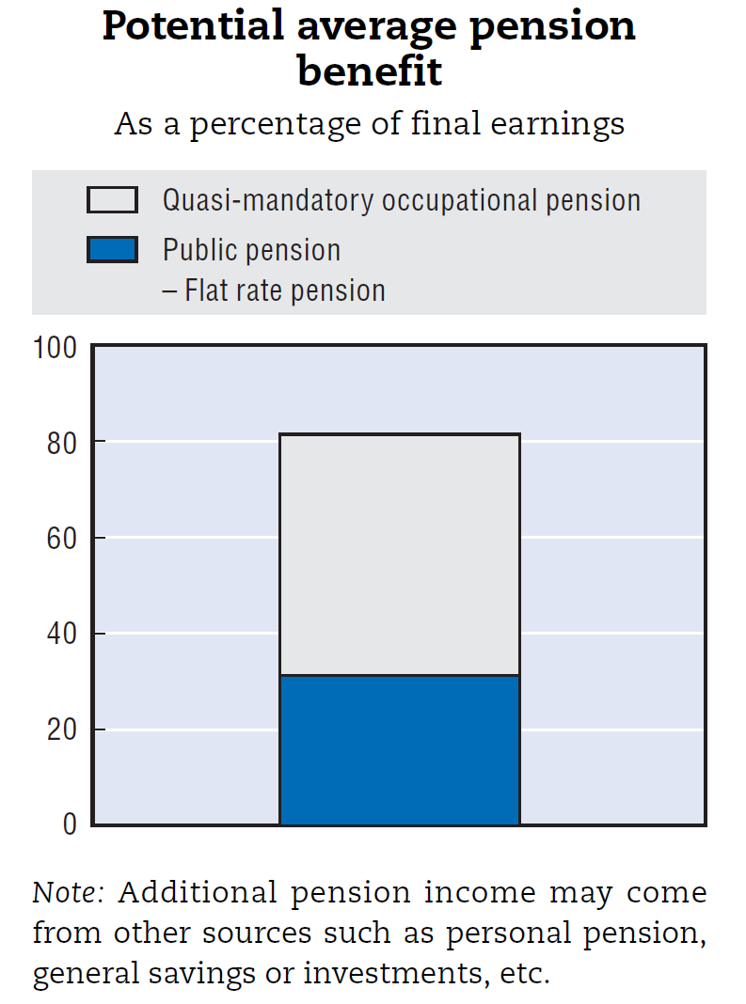
CASE STUDY 1: THE NETHERLANDS
Three pillars:
  a flat-rate state pension (AOW) related to minimum wages and financed via payroll taxes;
  funded occupational pension schemes (quasi-mandatory), cover about 91% of the employees (in 2014);
  individual saving schemes (voluntary).
Occupational schemes:
  94% of the covered employees have a DB plan while the rest a DC plan;
  For 98% of the individuals covered by a DB scheme the entitlements will be based on lifetime average earnings.
Source: OECD Private Pensions Outlook, 2008

Slide 39
CASE 2: SWEDEN
First pillar:
  A pay-as-you-go notional accounts system (earnings related);
  a defined benefit pension income-tested top-up.
Second pillar:
  occupational pensions have broad coverage, about 90% of the workforce and is mandatory/quasi-mandatory
  Generally DC scheme, but for white-collars born before 1979 a mixture between DB and DC
  In addition: a mandatory funded defined contribution – PPM.
Third pillar:
  individual pension savings – voluntary.
Source: OECD Private Pensions Outlook, 2008

Slide 40
CASE 3: ITALY
First pillar, mandatory:
  Defined benefit (wage-related) or mixed for those who started working before 1996
  notionally defined contribution for those that started working after 1996.
Second pillar: voluntary, occupational pensions
  At the end of 2007 about 30% of the private sector employees was covered, that are mainly involved in the diversion of the TFR
  After 2005, an automatic enrollment mechanism as for the TFR;
  Mainly based on the defined contribution method.
Third pillar: voluntary
Source: OECD Private Pensions Outlook, 2008

Slide 41
CASE 4: FRANCE
Regime général:
  full-rate public pension scheme accessible under the minimum contributory record and the minimum legal pension age
  defined benefit scheme based on the best 25 years
Occupational Mandatory:
  ARRCO (Association des régimes de retraites complémentaires) for blue-collar workers
  AGIRC (Association générale des institutions de retraites des cadres) for white-collars and management staff
  Benefits computed based on accumulated points
  Occupational Voluntary: either DB or DC.
  Personal Voluntary: Defined contribution plans.
Source: OECD Private Pensions Outlook, 2008

Slide 42
CHALLENGES FOR CHINA
The Chinese fertility rate has fallen : within 20 years China will have a population older than the USA (also as a result of the one-child policy)
The old age dependency ratio is expected to triple by 2030.
Urbanization and industrialization are weakening the traditional family support networks on which old people depend, while market substitutes are missing or insufficiently covering the risks related to population ageing.

Slide 43
OLD AGE SUPPORT RATE

Slide 44
POTENTIAL DEMAND FOR ANNUITIES: NEED GOOD DATA !!
SHARE (Survey of Health Ageing and Retirement in Europe)
  interdisciplinary survey on ageing collecting a representative panel sample of the individuals aged 50 or over and their spouses in Europe (16 countries plus Israel) ;
HRS in US
ELSA in UK
CHARLS (Chinese Health and Retirement Study):
  pilot survey conducted in two provinces: Zhejiang and Gansu in 2008
  Baseline national wave in 2011: collected data on 17500 individuals aged 45 or over from 450 community units;
  The individuals will be interviewed every two years.

Slide 45



CROSS-NATIONAL ANALYSIS
USA
SE
Korea
Japan
China
IE
UK
DK
ES
Wave 3: 2008/09: Life histories
NL
PL
BE
DE
LUX
CZ
Wave 4: 2010/11: 16 countries
FR
CH
AT
HU
India
Wave 5: 2013
SV
SP
IT
Wave 6: 2015: 18 countries
PT
GR
IL

Slide 46
MULTIDISCIPLINARY APPROACH
1. Health-psychological variables: self-reported health, physical functioning, mental health and cognition,
2. Economic variables: Current work activity and job characteristic, employment history, pension rights,
3. Family and Social Network: Family structure, assistance within families, intergenerational transfers of assets, plus personality data
4. Demographic data: age, gender, marital status..., housing, education….

Slide 47
EMPLOYED VS. RETIRED – EUROPE
SHARE SAMPLE WAVE 5 (2013)

Slide 48
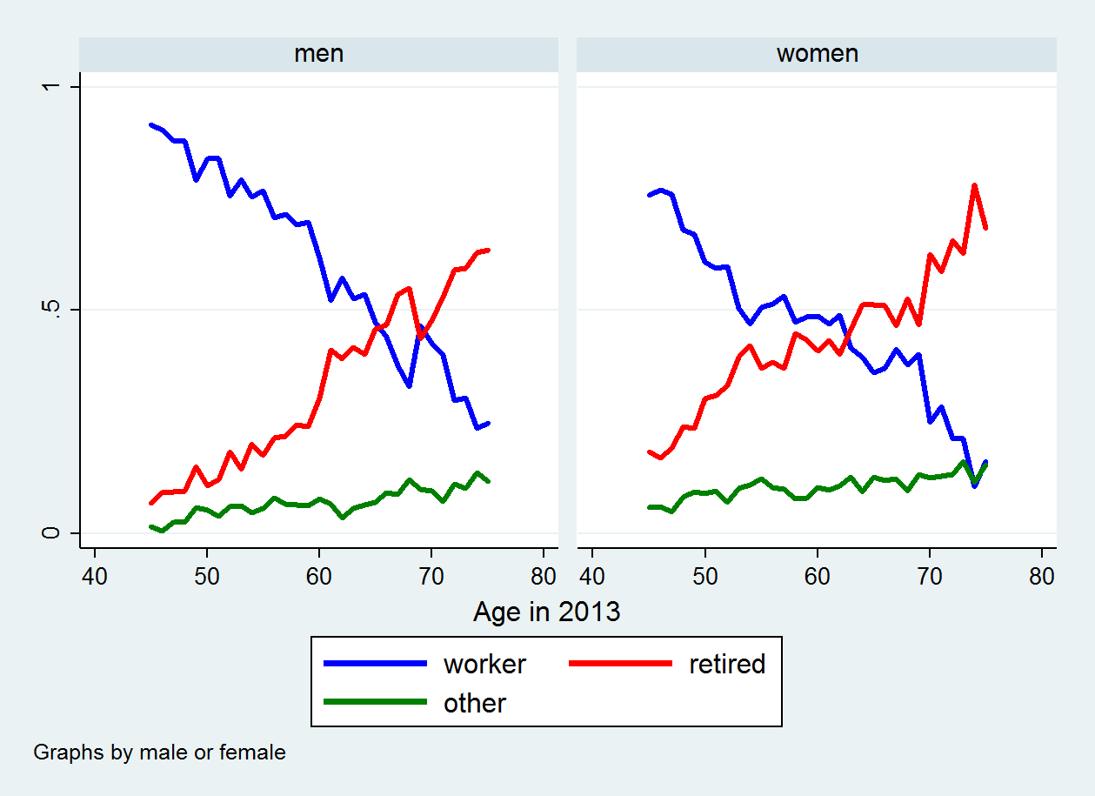
EMPLOYED VS. RETIRED - CHINA
CHARLS WAVE 2 (2013)

Slide 49
CONCLUSIONS
Individuals want to maintain a STABLE level of consumption in old age.
Public (mandatory) pensions are the first pillar, but given the demographic pressure and teh labour market conditions they may be inadeuqate. Likely to fall in the future.
The second and third pillars are very important but thery require proper governance and supervision (market risk), some level of «financial literacy» (especially if self-made).
Great variety in Europe

