Slide 1
The Social Assistance Registry: a functional database for enhanced control
China, August 29th, 2017

Slide 2
社会救助登记系统
——效能数据库，提高监控力
2017年8月29日，中国

Slide 3
Index
What is the Social Assistance Registry
Information contained in Social Assistance Registry
Goals
Utilities
Flow of information
State-of-the-Art
Legislative Innovations
Inps duties

Slide 4
目录
何为社会救助登记系统
社会救助登记系统所含信息
各项目标
各项设施
信息流
State-of-the-Art
新法律
意大利国家社保署任务

Slide 5
What is the Social Assistance Registry
The Social Assistance Registry was set up at INPS. It contains the data required for the Italian welfare system and is the most important tool for collecting information on beneficiaries, social benefits and services granted and delivered to people who need support from social assistance institutions

Slide 6
何为社会救助登记系统
社会救助登记系统设于意大利国家社保署（INPS）。包括了意大利福利体系所要求的数据，是收集受益人、社会福利和社会救助机构所发放的社会服务相关信息的最重要工具

Slide 7
It contains:
Data on social assistance benefits granted after means testing through the Economic Situation Indicator («ISEE»).
Data on non-means tested benefits (not linked to«ISEE»).
Data on benefits, provision of services and in-kind assistance granted after the assessment by professional social workers. This latter provision is composed of three sections relating to the following:
- Children, adolescence and family («SINBA»).
- Disabled and care-dependent people (SINA).
- Poverty, social exclusion and other forms of disadvantage (SIP).

Slide 8
此系统包括:
应用ISEE经济状况指标进行家计调查之后所发放的社会救助福利数据
非家计调查型福利数据（不与ISEE挂钩）
经专业社会工作者评定之后发放的福利信息、服务信息和非现金社会福利的信息。最后一类福利包括下列三个部分:
- 儿童、未成年人和家庭福利 («SINBA»).
- 残障和护理依赖人员福利 (SINA).
- 贫困、社会排斥和针对其他不利条件的福利(SIP).

Slide 9
Goals
The Social Assistance Registry will play an important role in order to ensure :
  a thorough knowledge of social needs and a coherent integration of social service interventions
  that information and data sent by all public bodies involved in Social Assistance will complete the data which are already recorded in other Inps databases and which are available on the Social Assistance Registry, in the New Health Information System and the placement database targeted.

Slide 10
目标
社会救助登记系统扮演重要角色，其目的为:
  对社会需求和社会服务措施统合获取透彻的认知
  通过社会救助领域其他公共机关的信息数据补足INPS数据库、社会救助登记系统、新健康信息系统和目标配置数据库中已有的信息数据，

Slide 11
Goals
The Social Assistance Registry, when fully completed, will operare as a tool for complex planning:
  social expenditure and enhanced control against fraud and, therefore, a means to secure a saving of public money
  welfare measures targeted to alleviate specific needs of citizens

Slide 12
目标
社会救助登记系统完全建成之后，将作为下列复杂计划工作的工具：
  增强社保性支出计划、提高反欺诈监控，并由此成为保障公共资金安全的工具
  完善针对公民特殊需求的福利措施

Slide 13
Advantages
Timely consultation through access to information.
Central aggregation of data for monitoring purposes, studies, survey and statistical analysis.
A facility for data consultation of social benefits paid by INPS to beneficiaries on behalf of other institutions (family allowances, maternity allowances, purchasing card, SIA, welfare, disability, career's allowance, etc.)

Slide 14
优势
可以适时获取信息，进行咨询
通过中央，归总数据，用于监控、研究、调查和统计分析
方面查询关于意大利国家社保署根据其他机关要求提供给受益者的社会福利（家庭补贴、母育补贴、购物券、SIA福利，普通福利，残障福利，就业津贴等）

Slide 15
Advantages
Control over regularity and accuracy of the “DSU” declarations which need to be coherent to ISEE and to all services or benefits provided based on the data.
Communication on discrepancies found on ISEE declarations and the clawback of any undue payments and consequent imposition of sanctions (where applicable) -(to avoid the holding of officials liable for damage to the central treasury).
Planning expenditure for activities and social services thanks to monitoring, control, analysis and studies.

Slide 16
优势
可对“DSU”进行常规和精确的检查；“DSU”须与“ISEE”和所有根据此数据发放的服务和福利保持一致；
通报ISEE内容中不一致之处、通报夺回任何不当福利给付和由此带来的税收制裁（如果施行）（以此避免官员对国家财政的伤害）
通过监控、检查、分析和研究，对工作和社会服务支出进行规划

Slide 17
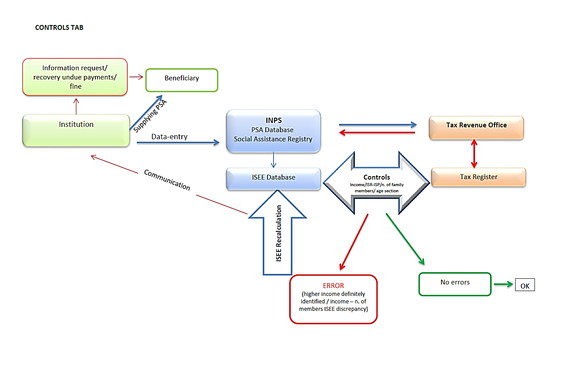

Slide 18
信息要求/夺回不当给付/罚款
受益人
提供PSA
意大利社保署
PSA数据库
社会救助登记系统
税收机关
机构
数据进入
监控
收入/ISR-ISP/家庭成员人数/年龄段
通报
ISEE 数据库
税收登记
ISEE再计算
错误
无误
OK

Slide 19
Data Transmission
Data are automatically and require to be transmitted by local authorities and any other institution which provides social benefits and services.
Data transmission occurs through an online channel (Inps website or applications set up with the collaboration of institutions involved) and compliance with some technical procedures.

Slide 20
数据传输
数据自动并被要求由地方负责机关和其他提供社会福利和服务的机构传输
数据传输通过在线渠道进行（INPS网站或者由各个机构合作构建的应用程序），并遵守某些技术程序

Slide 21
Data Transmission
The collaboration of institutions is crucial to provide the Registry with correct and coherent information pursuant to to their obligations to electronically transmit data regarding beneficiaries and benefits/services.
Inps has established a technical assistance team of experts to help officials of institutions for advice and assistance and can be easily contacted by telephone or email.

Slide 22
数据传输
对于向社会救助等系统传输正确且前后一致的信息而言，各机构的合作非常重要，它们需将受益人、福利/服务信息通过电子方式传输到系统中
INPS组件了一个技术辅助专家组，帮助各机构官员，为期提供建议和服务；可以通过电话或电子邮件轻松联系到专家组成员

Slide 23
Data Transmission
Technical documents and procedures are published on INPS web site, together with explanation and clarification to guide institutions in transmitting data. The transmission of information can be achieved across multiple channels (xsd, xml and csv), which are fundamental to ensure the proper upload of files.

Slide 24
数据传输
技术文件和程序公布在INPS官网上，此外还有指导各家单位进行数据传输的解释和说明性文件。信息传输可以通过多种渠道（xsd,xml和csv）进行，这是保障适当的文件上传的最基本要求。

Slide 25
State of the Art
Inps Directorial Decree n. 8, 10 April 2015, in collaboration with the Ministry of Labour and Social Policy and the Protection of Personal Data Authority, commenced the uploading of the first component of the Registry: “La Banca dati delle prestazioni sociali agevolate” (BDPSA), on the basis of the framework law: D.M. 8th March, 2013.
The BDPSA was terminated on the 3th April 2017 and the new system of Social Assistance Registry was set up.

Slide 26
系统完善
意大利国家社保署2015年4月10日第8号指导令（与劳动和社会政策部、个人数据保障署联合发布）开启了社会救助登记系统的第一个构成部件，即“社会救助福利数据银行”（BDPSA），其法律根据为2013年3月8日部令所定框架。
“社会救助福利数据银行”于2017年4月3日完成构建，而后新的社会救助登记系统建立。

Slide 27
State of the Art
The Directorial Decree INPS n. 103, 15th September 2016, with the consultation of Ministry of Labour, the Protection of Personal Data Authority and Tax Office, established the other two components of the Registry: database of social benefits (BDPS) and database of beneficiaries who qualify for benefits after the assessment of welfare officers (BDVM), according to D.M. 206/2014, which was enacted on 25th March 2015.

Slide 28
系统完善
意大利国家社保署2016年9月15日指导令，根据劳动部、个人信息保障署、税务署的沟通咨询，建立了登记系统的其他两个部件: 社会福利数据库（BDPS）和通过了福利官员测评而获得福利的受益人数据库（BDVM），其法律基础为2014年第206号部令，该令于2015年3月25日发布。

Slide 29
Legal Innovation
D.M. (Decree of Minister) 26 settembre 2016 “2016 Financial provision allotment of the National Fund for dependents” foresees that all the information sent by Institutions to the Registry, will be used by the Ministry of Labour and Social Policy to assess the total number of people with serious disabilities and thus define «the basic level of allowances to be granted to people with serious disability all over Italy, within the limit of the provision available by the Fund for dependents»

Slide 30
法律创新点
2016年9月26日关于“2016年全国扶助依托人员（Dependent）福利基金分配”部令规定，各机构发至登记系统的所有数据将由劳动和社会政策部使用，以测算严重残障人员数量，并据此“在全国扶助依托人员福利基金可用资金限制之内”划定“意大利境内严重残障人员基本补助水平”.

Slide 31
Legal Innovation
D.M. 23 novembre 2016 “Eligibility (qualifying) criteria for social assistance measures, care and protection from Funds for people with serious disability without any family support and distribution of the 2016 resources to Regions” (so called «dopo di noi» «after us») foresees that all the information sent by Institutions to the Registry, will be used by the Ministry of Labour and Social Policy to assess the total number of people with serious disability without any family support

Slide 32
法律创新点
2016年11月23日关于“无家庭依托严重残障人员福利基金所供救助措施、护理和保护福利获取资格标准和2016年各大区资源分配”之部令（简称“依托福利”部令,dopo di noi）规定：各机构发送至登记系统的所有信息，将由劳动和社会政策部用以估算无家庭依托严重残障人员总数。

Slide 33
Legal Innovation
The law n. 33, 15th March 2017 “Delegation of the regulations against poverty, the re-organisation of allowances and the intervention and social services system”, foresees the strengthening of the Social Assistance Registry and, beyond that, the requirement of data transmission by the Institutions, including alerts in cases of undue allowances and the need to impose sanctions on defaulters

Slide 34
法律创新点
2017年3月15日第33号关于“脱贫规章执行办法、补助金重组、干预措施和社会服务制度”法规定：要加强社会救助登记系统，还要对各机构数据传输提高要求，包括对不当补助金发放进行警告，及在欺诈情况下有必要采取制裁措施。

Slide 35
Legal Innovation
The legal Decree against the poverty which is in the process of being approved, foresees very interesting innovation:
Reorganisation of all database and setting up of a Single Integrated System of Social Services that will include the Registry (and will be called Information System of Allowances and Social Needs
Integration with other database (ISEE, BDREI, New Information System of Health Service, BD active and passive policies, BD targeted allotment, unique information system of labour policies and information system of Ministry of Education, University and Scientific Research)
Data transmission by Municipalities even through Regions if regional laws allowed it
Failure to send data will be considered an offence and result in disciplinary sanctions and the most serious administrative offences will be considered a liability for tax losses

Slide 36
法律创新点
《脱贫法令》目前正在经历批准程序，其中包括了一些很重要的创新之处:
要对所有数据库进行重组，建立“社会服务单一整合系统”，其中涵盖社会救助登记系统（名称将为“补助福利和社会需求信息系统”）；
要整合其他数据库（ISEE, BDREI，健康服务信息新系统，BD积极消极政策系统，BD目标分配系统，劳动政策统一信息系统，教育、大学和科学研究部信息系统）；
各市政府要传输其数据，如果大区法律允许，可通过大区传输；
数据传输不利将视为违规，并可导致纪律制裁，且最重要的行政违规将被视为税收损失责任

Slide 37
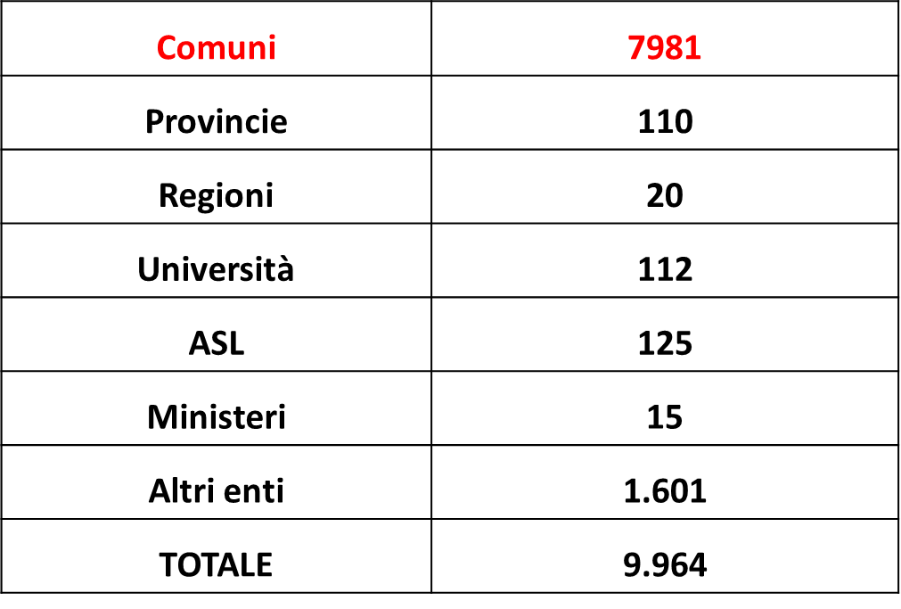
State of the Art
Institutions involved are around 10.000

Slide 38
系统完善
覆盖机构约为10.000家
市镇 | 7981
省 | 110
大区 | 20
大学 | 112
地方卫生服务局 | 125
部委 | 15
其他机关 | 1601
总共 | 9964

Slide 39
State of the Art
A little over a year into the first component of the Registry, the Registry on June 15, 2016, A submission of information on 934 municipalities and 44 other entities, for a total of 978 institutions; considering among the 44 other bodies are unions of municipalities and territorial areas, representatives of several municipalities, the total data cover more than 1000 bodies.

Slide 40
系统构建
社会救助登记系统第一部件投入使用的第一年，截至2016年6月15日，收到934个市政府和44家其他机关上传的数据，总数为978家机关。 而其他44家机关为市政府和区域政府联合体，多市镇代表，所以总数超过了1000家机关。

Slide 41
State of the Art BDPSA
The following data on social benefits included in RSA including those distributed by INPS are detailed as follows:

Slide 42
社会救助福利数据银行
医疗救助院（RSA）的社保福利数据（包括意大利国家社保署发放的）具体信息如下：
福利数量 | 福利类型 | 更新时间
987.099 | 购物券(年度总数) | 2016.12.31
389.473 | 核心家庭福利金 | 2016.12.31
110.444 | 母育福利金 | 2016.12.31
152.030 | 各机关社会救助福利 | 2016.12.31
1.095 | 社会福利 | 2016.12.31
7.087.847 | 社保署社会福利（PSP） | 2016.12.31
9 | SINA福利 | 2016.12.31
总数：8.727.997

Slide 43
Inps duties
Inps is currently offering an information and advice service for institutions and through appropriate offices to help them to sort out problems arising with the implementation of the Registry
So far Inps has received 3000 requests of assistance, by email and phone. A FAQ section has been set up on Inps website and is also shared with the Ministry of Labour and Social Policy.

Slide 44
意大利国家社保署任务
意大利社保署现在为各机关提供信息和建议服务，并通过适当的办公单位，帮助各机关解决社会救助登记系统执行过程中出现的问题。
到目前为止社保署已经从电话和电子邮件收到了3000分协助要求。社保署官网上的FAQ栏目已经成立，并且与劳动和社会政策部实现了共享。

Slide 45
Inps duties
In collaboration with institutions and to explore the highlights of Registry and problems on how to access the system, meetings have been held at:
State-Regions conferences;
Meetings at regional level with Inps regional agencies, local authorities, ANCI and other organizations (17 meetings).
Dissemination of best practices any time they are put into practice.

Slide 46
意大利国家社保署任务
通过与各机关合作，为发现登记系统重点问题和了解如何更好应用系统，社保署举行了下列会议：
国家-大区会议；
国家社保署地方下属机关、地方政府、ANCI和其他组织的大区级别会议（17词）
随时向各机关宣传工作中的最佳经验

Slide 47
Inps duties
Development of some IT functions to facilitate the data flow (massive dispatch) and the use of database and thus creating more advantage for institutions.
Meetings with ANCI (Italian national association of Municipalities) to set up specific thematic webinars on RSA for the Municipalities offering them the Ministry of Labour and Social Policy and INPS know-how.

Slide 48
意大利国家社保署任务
发展IT功能，方便数据流动（大量传输）和数据库的使用，由此为个机关创造更多益处
与意大利全国市镇联合会（ANCI）举行会议，为各市镇建立针对专门主题的RSA网络讨论会，为各市镇提供劳动和社会政策部以及国家社保署的情况

Slide 49
Inps duties
It is important to continue the collaboration with the institutions and enhance synergies to boost the implementation of the information and thus put into practice the objectives outlined by the law.

Slide 50
意大利国家社保署任务
要继续加强与各机关的合作，并提高各方统筹，推进信息工作，完成法律的既定目标

Slide 51
The Social Assistance Registry
Thank you
Xie Xie
谢谢

