Slide 1
The Czech Pension System- the latest policy debate in the EU context
Paris, 15th September 2017

Slide 2
Content
Pension policy in the EU context
  Open method of coordination
  EU 2020 Strategy
  European Semester
Expert Commission for Pension Reform
  Goals
  Structure
Measures implemented or debated during last decade

Slide 3
Pension policy in the EU context
Pension policy as part of Social policy is not a common policy
Pension policy is fully in national competence
Subsidiarity principle is applied
Special procedure called „Open method of coordination“ was built to discuss social field
  Social Protection Committee (SPC) was established as a forum for discussion
  SPC – Indicators Subgroup – data and analysis support for SPC
  SPC – group AGE – Pension Adequacy Report preparatory body
Ageing Working Group – Ageing Report – public finances long term stability and sustainability perspective especially on age related public spending

Slide 4
EU 2020 Strategy
Targets:
  Employment
    - 75% of people aged 20–64 to be in work
  Research and development (R&D)
    - 3% of the EU's GDP to be invested in R&D
  Climate change and energy
    - greenhouse gas emissions 20% lower than 1990 levels
    - 20% of energy coming from renewables
    - 20% increase in energy efficiency
  Education
    - rates of early school leavers below 10%
    - at least 40% of people aged 30–34 having completed higher education
  Poverty and social exclusion
    - at least 20 million fewer people in – or at risk of – poverty/social exclusion

Slide 5
European semester
Goals of the European Semester
  ensuring sound public finances (avoiding excessive government debt)
  preventing excessive macroeconomic imbalances in the EU supporting
  structural reforms, to create more jobs and growth
  boosting investment.

Slide 6
European semester
Role of the Commission
  Each year, the Commission undertakes a detailed analysis of each country's plans for budget, macroeconomic and structural reforms. It then provides EU governments with country-specific recommendations for the next 12-18 months.
  It also monitors EU countries' efforts towards the "Europe 2020" targets.
Role of the Council
  The Commission proposals are endorsed and formally adopted by the Council.
Role of EU governments
  Any policy decisions in response to the country-specific recommendations are made by the national government in question, based on whatever action they deem appropriate

Slide 7
Council Country Specific Recommendations for CZ in Pensions
2011 - Implement the planned pension reform in order to improve the long-term sustainability of public finances and to ensure the future adequacy of pensions. Additional efforts should focus on further changes to the public pillar to ensure that the system is not a source of fiscal imbalances in the future, and on the development of private savings. With a view to raising the effective retirement age, measures such as a link between the statutory retirement age and life expectancy could be considered. Ensure that the envisaged funded scheme attracts broad participation, and is designed to keep administrative costs transparent and low
2012 - Introduce further changes to the public pension scheme to ensure its long-term sustainability. Reconsider plans to allow an earlier exit from the labour market. Promote effective participation of younger workers in the envisaged funded scheme to improve adequacy of pensions.
2013 - Increase the effective retirement age by aligning retirement age or pension benefits to changes in life expectancy, and review the indexation mechanism. Accompany the increase in retirement age with measures promoting employability of older workers and reduce early exit pathways. In particular, remove the public subsidy for the pre-retirement scheme.
2014 -Ensure the long-term sustainability of the public pension scheme, in particular by accelerating the increase of the statutory retirement age and then by linking it more clearly to changes in life expectancy. Promote the employability of older workers and review the pension indexation mechanism.
2017 - Ensure the long-term sustainability of public finances, in view of the ageing population.

Slide 8
Expert Commission for Pension Reform
The main objective of the Expert Committee shall be to prepare a comprehensive and interrelated set of specific proposals to change the pension system in a broader social and economic context
Specific objectives
  mechanism of a periodic assessment of the retirement age setup;
  indexation mechanism that ensures appropriate and dignified amount of pension income throughout its payment;
  method of termination of the system of pension savings (i.e. Pillar II);
  setup of parameters of the pension system leading towards reinforcement of the principle of merit without any negative impact on the welfare of pensioners;
  changes in the parameters of supplementary pension systems in order to encourage forming of long-term savings for retirement (i.e. Pillar III);
  such transfers among citizens, families and the state mediated by the pension system that will ensure a balanced status of all types of households.

Slide 9
Expert Commission for Pension Reform
The Expert Committee is a collective body composed of permanent members and associate members.
Permanent members are
  the Chairman of the Expert Commission,
  representatives of political parties represented in the Chamber of Deputies of the Parliament of the Czech Republic,
  representatives of trade unions,
  representatives of employers' organisations and
  experts from the fields of sociology, demography and economics.
Associate members are
  a representative of the Czech Statistical Office,
  a representative of the Czech Council for Senior Citizens,
  A representative of the National Centre for Family,
  a representative of the Czech Women's Lobby,
  a representative of the Association of Pension Funds of the Czech Republic and
  A representative of the Czech Insurance Association.

Slide 10
Pension reform timeline
1995
2004
2008
2011
2017
1995 – Introduction of the Pension Act (Law No. 155/1995 Coll.)
2004 – Minor parametric changes
2008 – First major parametric reform
2011 – „Small pension reform“
2017 – Further parametric changes – partial reversal of the 2011 reform

Slide 11
Retirement age – pre 2008

Slide 12
Retirement age – after 2008

Slide 13
Retirement age – after 2011

Slide 14
Retirement age – after 2017

Slide 15
Retirement age – change between 2008 and 2017

Slide 16
Pension indexation rules
Originally minimum indexation of 100 % inflation and 1/3 of real wage growth, with Government discretion to more generous indexation
In 2011 the Government discretion was removed and rules stipuleted directly in the Pension Act (100 % inflation + 1/3 real wage growth)
Temporary lowered indexation in 2013 and 2014 (1/3 inflation + 1/3 real wage growth) as austerity measure
In 2016 the Governement discretion renewed with an upper limit of 2,7 %
Since 2017 indexation formula changed to 100 % inflation + 1/2 real wage growth

Slide 17
Disability pensions
Changed in 2008
Former system of partial and full disability
  Reduction of work capacity by 33 % and 66 %
  Separate pensions – a change in disability level led to new application for pension and new granting process
New system of three degrees of disability
  Reduction of work capacity by 35 %, 50 % and 70 %
  Only one disability pension exists – the degrees merely determine the benefit amount
New rules for work capacity reduction assessment put in place
Two targets – modernising the disability pensions and curtailing pension expenditure

Slide 18
Early pensions
New rules for early pensions since 2008
Aimed at increasing flexibility in individual retirement arrangments and providing disincentive for early retirement
Period of early retirement is being increased from 3 to 5 years
Full potential period of 5 years of early retirement will be reached gradually – minimum age for early retirement is 60
Rules slightly tightened in 2011 (period of 361 – 720 days of early retirement)
more than 720 days prior to Ret Age
720 days prior to Ret Age
Ret Age
360 days prior to Ret Age
90
90
90
90
90
90
90
90
90
90
90
90
90
90
90
90
90
90
90
90
90
1,5 % reduction per 90-day period
1,2 % reduction per 90-day period (since 2011)
0,9 % reduction per 90-day period

Slide 19
Other parameters
Qualifying period (2008)
  Minimum required insured period is being extended from 25 to 35 years of insurance
  34 years of insurance required in 2017, final state will be reached in 2018
Reduction in non-contributory periods (2008)
  Periods of college studies will not be counted as insured periods starting with 2009
  Only 80 % of most non-contributory periods will be taken into account when assessing pension entitlement
Reference period extension (2011)
  Reference period for pension calculation (factoring of historical earnings) is being extended to lifelong

Slide 20
Reforms’ impact
Reforms of 2008 and 2011 promoted long-term financial sustainability of pensions
Projected long-term pension system balance in 2008 was negative 4 – 5 % GDP
Projected long-term pension system balance in 2015 was 0,5 % GDP
Pension adequacy (level of benefits) was projected to decrease by approx. 10 % (2015)
Reform reversal (2017) will deteriorate pension sustainbility outlook while improving financial situation of pensioners

Slide 21
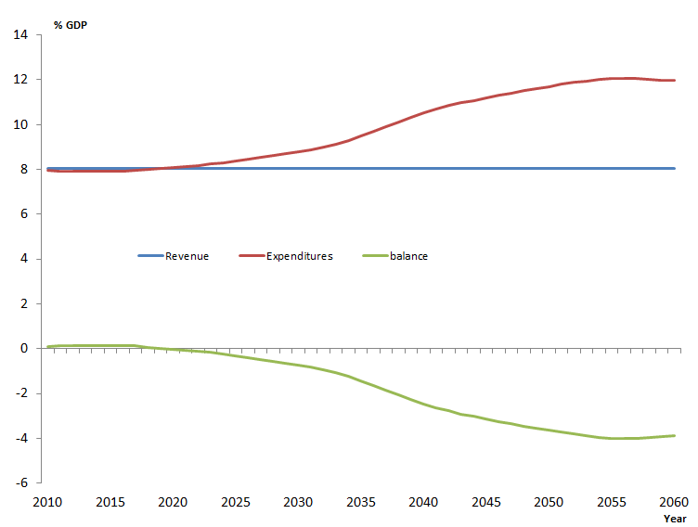
Before 2008 Reform

Slide 22
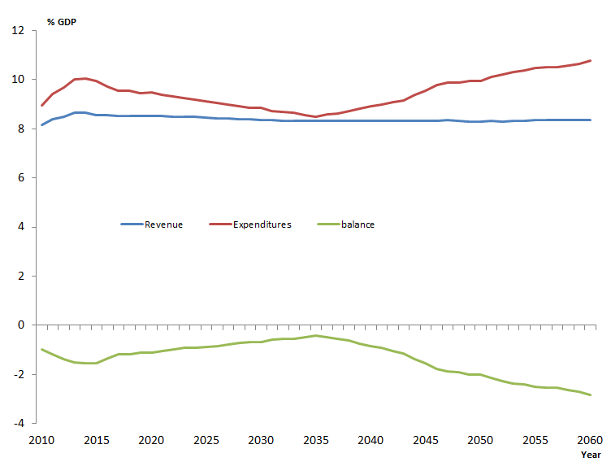
2008 Reform

Slide 23
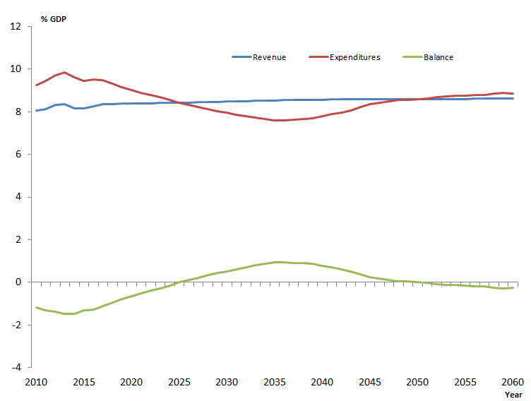
2011 Reform

Slide 24
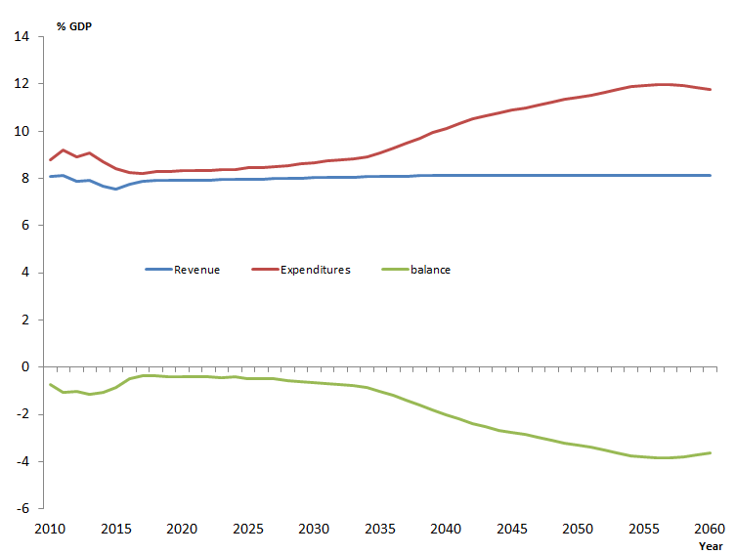
2017 Reform

Slide 25
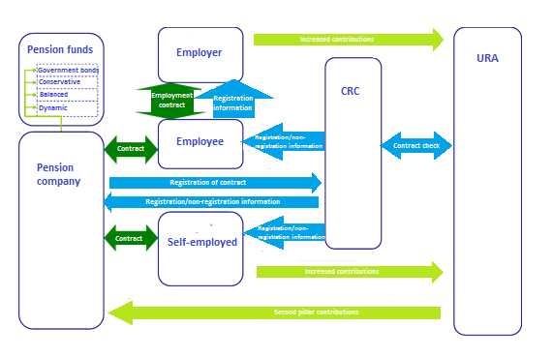
2nd pillar pension epizode – pay in phase

Slide 26
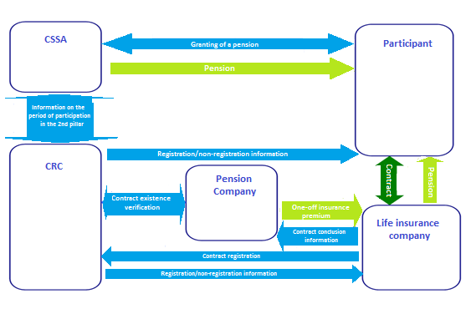
2nd pillar pension epizode – pay out phase

Slide 27
Thank you
Jan Škorpík & Marek Suchomel
jan.skorpik@mpsv.cz
marek.suchomel@mpsv.cz

