Slide 1
Investment Strategies in LGPS Funds in the UK
Social Protection Reform Project
Grayson Clarke
Formerly L-T Fund Management Expert EUCSS

Slide 2
Content of Presentation
Investment Regulation and strategies for LGPS Pension Funds in the UK
Case Study in investment: Greater Manchester Pension Fund
Conclusions
Q & A - Discussion

Slide 3
Social Security and Civil Service Pension Funds
State Pensions funded through contributions to and payments from National Insurance Fund, established in 1909
Separate legal and accounting status for NIF
NIF is operated on pay as you go basis. Any surpluses offset deficits on the Main Consolidated Fund and reduce overall Government debt interest
Main Civil Service schemes for civil servants, teachers, police and health workers also maintained on a non-funded basis

Slide 4
Local Government Pension Scheme (LGPS)
The principal 3rd tier (occupational) pension scheme for local government workers is the LGPS (excluding teachers, police firefighters)
The LGPS is collectively the largest defined benefit scheme in the UK, though it consists of almost 100 separate funds.
Principal employers are local government councils – county, district, unitary
However many smaller employers – many of whom previously part of local government but created as separate entities (eg. Passenger transport executives, maintenance organizations)

Slide 5
Overview of LGPS Finances
SURPLUS OF INCOME = 2.5 Billion (23% of
Current expenditure)

Slide 6
LGPS Contributions
Based on 10 contribution bands based on salary with the most common contribution rate being 6.9% of pensionable pay
Employer contributions are based on a floating rate intended to make up the system balance on an actuarial basis
  Currently they are between 15 and 20%
  Different employers within the same scheme pay depending on their liability profile
Additional contributions are levied to make up past funding shortfalls
Contributions have risen by 100% for most employers in the past 15 years because of low investment returns and early retirements

Slide 7
Role of Actuarial Valuations
Triennial valuations (every 3 years) by professional actuaries – most LGPS funds had their last valuation done for financial year ending in March 2016
Actuarial valuations based on long-term forecasts of expenditure and income on open basis i.e fund remains open to new contributors and are maintained on an indefinite basis
Highly sensitive to key assumptions on contributions, investment returns, early retirements and the discount rate

Slide 8
Actuarial Assumptions
Contributions
  Length of service
  Pay rates
  Employment levels in employing authorities (deferred service)
Benefits
  Pay rates (though scheme now career average not final salary)
  Early retirements and payment of deferred benefits
  Longevity (of retirees)
Investment returns
  Real vs nominal
The discount rate
  Rate at which benefits and liabilities are discounted
  Generally the lower the worse it is

Slide 9
Sensitivity of Assumptions
O.1% change in Discount Level (e.g from 4.3 to 42%0 worsens fund balance by 2%
0.1% increase in benefits will reduce funding levels by 1.5%
Recent example from USA
  Minnesota State Pension Fund
  Change in discount rate from 8% to 4.7% increased liabilities by 16.9 billion USD on Teachers Pension Fund
  Overall pension liability increased by 33.4 billion USD; returns were reduced from 7.9% to 7.5% on 8 out of 9 funds and 3 others increased life expectancy

Slide 10
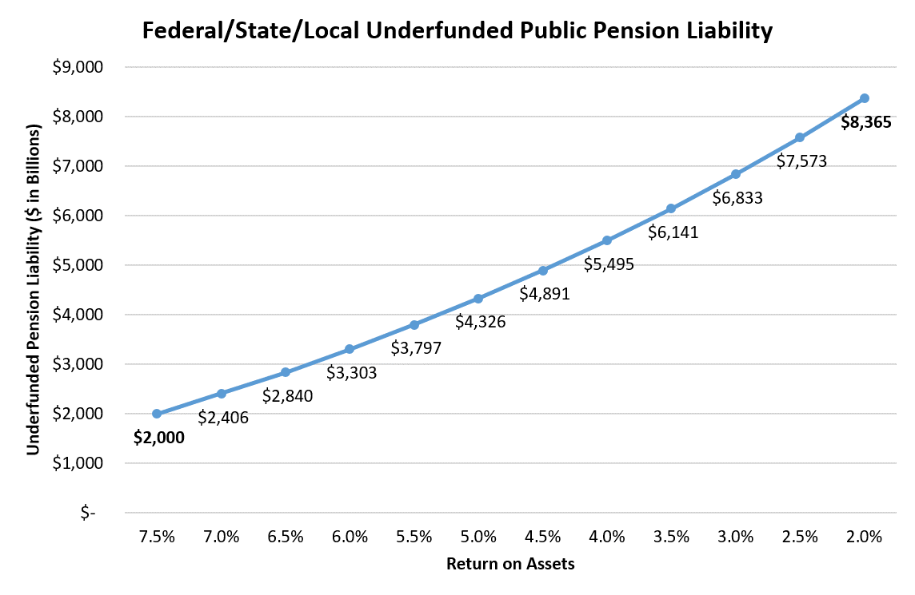
The Return on Assets and Funding

Slide 11
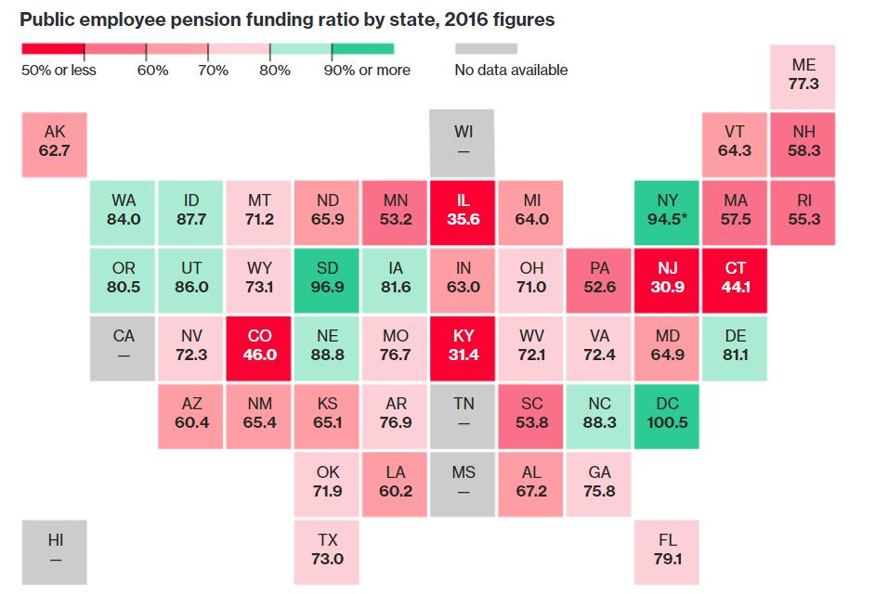
Public Pension Underfunding in the US

Slide 12
Actuarial Funding Levels
LGPS Authority | Assets at Market Value | Past Service Liabilities | Surplus (Deficit) on Actuarial Basis | Funding Level | Employer Contribution Rate (primary) | Employer Contribution Rate (secondary)
Greater Manchester | 17,325 | 18,696 | (1371) | 93% | 16.7% | 2.7%
Cornwall | 1,475 | 1,961 | (486) | 75% | 17.8%
Croydon (London) | 877 | 1,203 | (326) | 73% | 17.9%
Wiltshire | 1,831 | 2,246 | (415) | 82% | 19.4% | 11.5%
Surrey | 3,213 | 3,892 | (679) | 83% | 15.8% | £44million recoverable
Islington (London) | 1,084 | 1383 | (299) | 78% | 14.7% | 4.4%
Cardiff UA (Wales) | 1,653 | 1,952.9 | (299.9) | 85% | 16.6% | 6.4%
Merseyside | 6,850 | 8,061 | (1231) | 85% | 15.4% | £129 million

Slide 13
Investment Strategies key to making up shortfall
Overall Asset Allocation
  Main categories (Equity, Bonds, Property, Alternate)
  Sub-categories (Equity by location, Corporate vs Government Bonds vs Index-linked)
Timing of investment /disinvestment
  Riding the yield curve
Bringing to Scale (alternate investments)
  Direct
  Pooled Vehicles (Indirect)

Slide 14
Funding and Strategy Statements
Funding Strategy Statement (introduced 2007) to be periodically revised after Actuarial Valuation
  Funding objectives
  Policy on contributions
  Meeting deficits
  Admission and Termination of employers
Investment Strategy Statement (2017)
  Complimentary to FSS
  Statement of investment principles with regard to asset allocation and risk
  Compliance with 6 prudential principles in Investment and management Regulations 2016

Slide 15
Regulation 7 – Six Prudential Principles
Investment in wide variety of asset types
The suitability of types of investment (net return, liquidity, risk)
The approach to and management of risk
The approach to pooling assets including justification of those assets kept outside the pools
Social, ethical and corporate governance approaches towards investments
Exercise of voting rights

Slide 16
Strategic Asset Allocation

Slide 17
Hymans Robertson Report (2014)
Commissioned by Central Government to look at investment of LGPS Pension Funds
Two main conclusions
1st Conclusion – Passive management (beta)of equities yields almost identical yield over long term as active management (alpha), but is much less expensive
  Significant net increase by moving from active to passive management
  In contrast active management much more important in alternate investments
2nd conclusion - Investment in alternatives especially infrastructure is expensive
  Need to achieve scale to lower costs through direct investment or less expensive pooled vehicles

Slide 18
Hymans Robertson Report (2)
Looked at 3 options
  One fund
  Merger of existing funds into bigger funds
  Keep same separate funds but pool assets through collective investment vehicle
PWC provided report on possible structure for pooled vehicles
  Recommended Authorized Contractor Scheme as an approved qualified investor for 3 reasons
    Could invest in the widest type of assets
    Could create umbrella sub-fund structure to insulate different funds from meeting losses
    Favourable Tax Treatment

Slide 19
Conclusion on Pooled Funds
Will only start operating in April 2018
Will take 10 years to get decent performance information
  Cost information will be available earlier than return information
  Unwinding existin investments / management arrangements
State of economy will be critical to performance
  Uncertainties around Brexit
  State of World Economy
Not a Magic Bullet
  Remember the Channel Tunnel

Slide 20
Case Study: Greater Manchester Pension Fund
Oldest LGPS Fund in the Country – originally created in 1921
Re-organised in present form in 1987 after Greater Manchester County Council was abolished
Tameside MBC is the administrating authority – provides staff, office and support services
Main organization
  Management Panel - Trustees
  Advisory Panel – Each Local Authority has rep + 6 employee reps
  External Advisors
  Working Groups - Alternate investments, Business Development, Employer Funding, Ethics and Audit, Pension Administration, Property

Slide 21
Main Features of Investment Strategy (1)
Creation of small Designated Fund in 1994 separated from Main Fund to provide low risk returns for employers with high proportion of liabilities compared to assets
Designated Fund holds about 5% of assets
Designated Fund invested primarily in index-linked securities whereas Main Fund is invested across all main funds with much higher risk/return

Slide 22
Main Investment strategies (2)
Set through main Review in 2000-01
  Relatively unchanged through 15 years
  Changes in sub-asset class allocations (e.g. geographical spread of equities)
  New special opportunities fund created in 2009-10
Equity 65% : Non-equities 35%
Equity split between UK and Overseas Equity
Non-equities split between fixed interest bonds, index-linked securities, property, private equity, cash
  Private equity since 1981

Slide 23
Fund Performance

Slide 24
Stability of Allocations
Very stable allocations between Public Equity and Non-Equity
  2001 – 65: 35;
  2005 – 63: 37
  2008 – 65: 35
  2011 – 62: 38
  2016 – 61.5: 38.5
Very stable allocations to Property (10%) over entire period, Bonds (18% in 2001, 17.3% in 2015), and increase in cash (3.9% in 2001 rising to 6.2% in 2012, and 2015)

Slide 25
Incremental Changes
UK Equity falls as % of overall holdings
Small increases in alternative investments over period 4.5% in 2012, 5% in 2015
Within alternatives, small Increases in allocations to private equity
  3% in 2001
  5% in 2015
Increases in allocations to infrastructure (now target 4% of main fund) and local property venture capital
  Infrastructure fund – 2014-15 = £157 million; Return 6.5%
  - 2015-16 £245 million Return 8.6%

Slide 26
Distribution of Equities

Slide 27
In the top 20 stocks over 15 years

Slide 28
And some that fell by the wayside

Slide 29
Property
Main Features
Total Return Property Performance to 31 Dec 2015
Underperformance of benchmark
Decline in number of directly held properties from 93 in 2001 to 48 in 2015
Increase in investments through pooled vehicles
Internal managed until 2014-15
Duration / GMPF /IPD Median
1 year 10.5% 13.3%
3 years 11.4% 14.0%
5 years 8.2% 10.7%
10 years 4.2% 6.0%
20 years 8.4% 9.4%

Slide 30
Private Equity – Allocations, Commitments Drawdowns

Slide 31
Private Equity
Volatile over 15 year period with big declines in wake of Financial Crisis
  End of megadeals
  Lack of opportunities
  Illiquidity arising from inability to withdraw money
Nevertheless growing commitments from 222 million in 2001 to 1310 in 2015
Annualized Inception performance 16.6%; 1980s commitments yielded average of 12%; 1990s yielded average of 25%; 2000s yielded average of 10%

Slide 32
Why has GMPFs relative performance declined?
Probably too cautious, did not need to take big risks
  GMPF is best funded LGPS scheme – 105% funded in 2001, 100% in 2007 and 93% in 2016
Main asset and sub-asset allocations probably maintained for too long
  Did not take the opportunity to invest more heavily in riskier assets in upturn and then sell to lock in gains
The majority of equity funds with active managers
  But performance unlikely to have exceeded passive investing

Slide 33
‘Challenging’ Investment Landscape
Very difficult – Quantitative Easing (QE) has inverted the traditional time value profile of interest and reduced overall supply of bonds
  Negative interest rates on 17.2 trillion USD of debt worldwide
Cheap money has led to large buyback of shares for debt especially in US, artificially inflating equity markets further
  Amazon PE 190 X
Property and Private Equity extremely vulnerable to downturn; residential property also over-inflated and retail space vulnerable to growth of internet sellers
Specially targeted infrastructure attractive
  But remember the Channel Tunnel
Gold, Silver, Bitcoin ??
SME cloud funding type operations – but can you take to scale?

Slide 34
But can you Ignore the challenge?
High Risks
And the risks are getting higher (Equity markets vastly overpriced, QE has mopped up a lot of good quality corporate bonds)
But 5 or 6% better than 2 %
He who dares wins (SAS)

