Slide 1
EU Population Ageing and its effect on the sustainability and adequacy of pension, health and Long-Term Care systems
Marcello Morciano
Health Economics Group, University of East Anglia (UK)
Institute for Economic and Social Research, University of Essex (UK)
CAPP – Research Centre for the Analysis of Public Policies, University of Modena and Reggio Emilia (IT)
Paris, 13 September 2017

Slide 2
INDEX: A two-part lecture
Part I
  The socio-demographic transition process in the EU countries...
  Impact of Population Ageing on the Economy
Part II
  Impact of Population Ageing on the sustainability and adequacy of:
    Pension,
    Health and
    Long-Term Care systems

Slide 3
The demographic transition
E-mail: m.morciano@uea.ac.uk

Slide 4
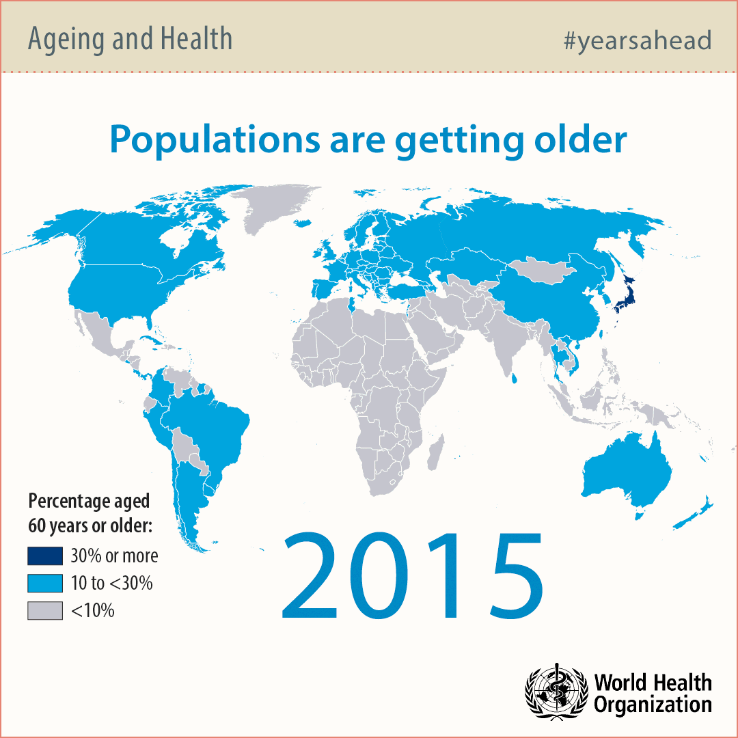
DEMOGRAPHIC PRESSURE:
a global ageing challenge
Notes:
Globally, Population Ageing in Europe is most advanced
From a regional perspective, Europe is and will continue to be the grayest region
But with some important differences between and within EU countries
Moreover, the UN expects the pace of aging to accelerate in the future

Slide 5



DEMOGRAPHIC PRESSURE:
the EU ageing challenge
The European society is ageing faster:
As a consequence, the EU would move from having four people of working-age to each person aged over 65 years to about two people of working-age
More older people will stress the pension, the health care system and the economy.
More will require assistance in everyday activities (Long-Term Care, LTC), and an increasingly number will spend time in nursing homes.
Who will pay for this and how?
How this will re-shape our societies?
1960 today 2060
Percentage of population above 65 years in the EU region
10%
18%
30%
Percentage of population above 80 years in the EU region
1%
5%
12%

Slide 6
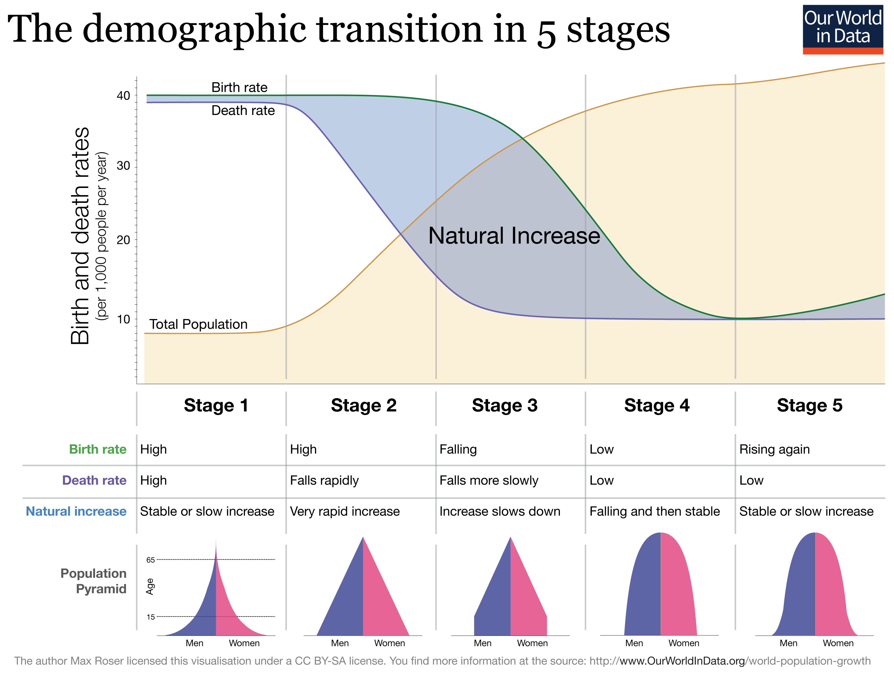
The demographic transition in Europe

Slide 7
Member states with the largest populations in 2013 and 2060
Source: Table 4, the ageing of EU p. 15

Slide 8
Total Fertility Rates, 1950 to 2050 in selected
EU countries
Source: UN population projection
Notes:
Leggi p. 10 AAE-The-ageing….

Slide 9
Period expectation of life at birth, 1950-2090
Men Women

Slide 10
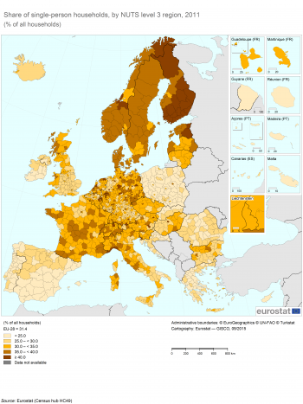
The progressive “individualisation” of European societies
Share of single-person households in 2011
(% of all households)
In cities, the emerging “4-2-1” family structure (4 grandparents to look after; 2 parents (caregivers), neither of whom has siblings; and 1 child) is emblematic of the demographic transition process
many older people live alone
Source: Eurostat (Census hub HC419)

Slide 11
Old-age dependency ratios in selected
EU countries 1970-2060

Slide 12
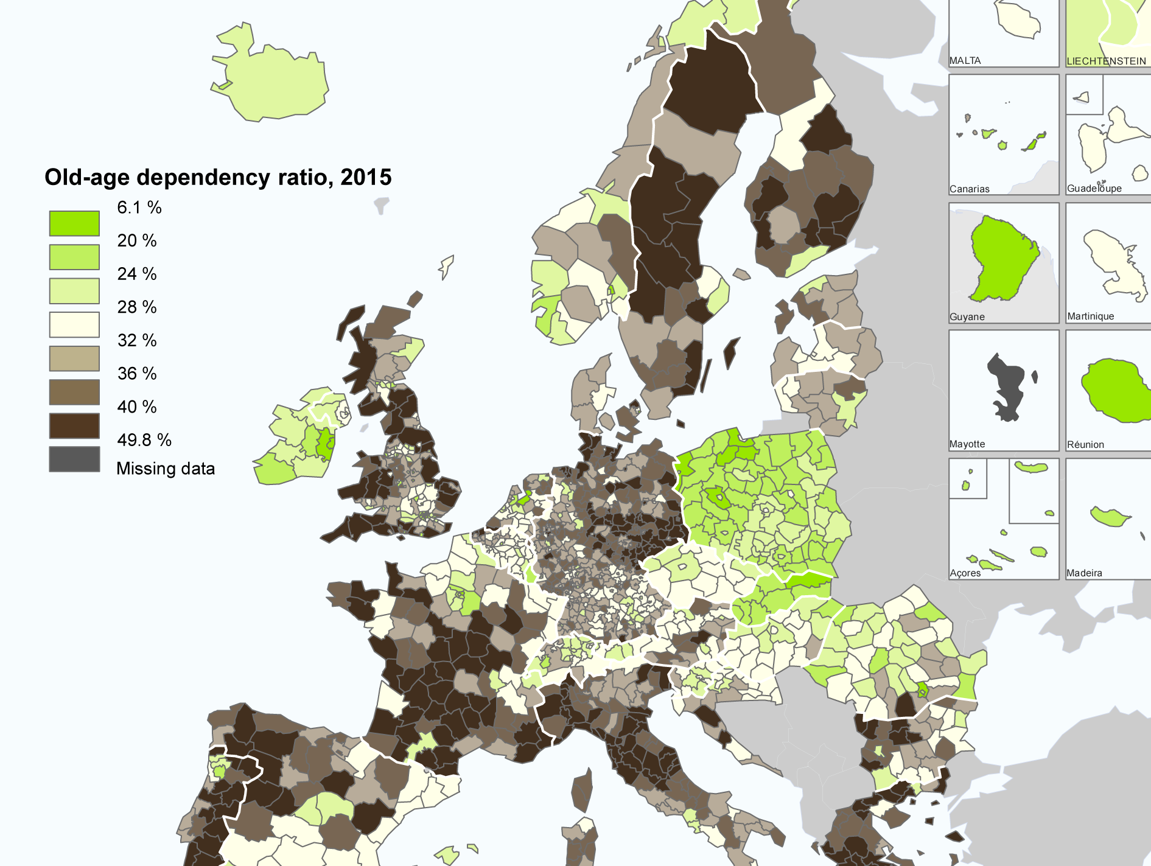
DEMOGRAPHIC PRESSURE: Old-age dependency ratio
important differences between and within EU countries
important differences within a given country (e.g. urban/rural area; rich/poor areas)
Source: ESPON

Slide 13
Projection of net migration flows,
2010 and 2020 to 2060
important differences between (and within)
EU countries
Internal migration from poor to rich EU area
Table 1 (AAE-the ageing report) p. 11

Slide 14
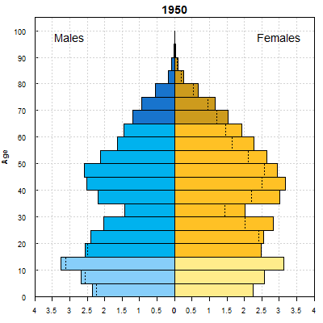
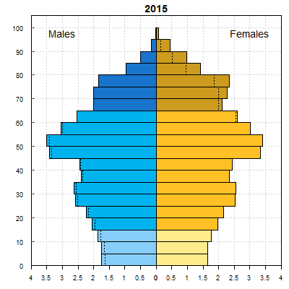
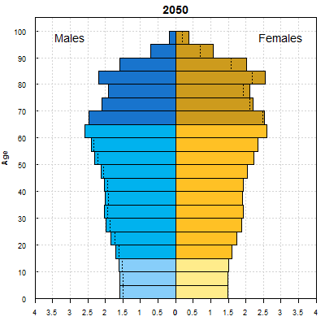
The population pyramids in selected EU countries
Age structure of Germany’s population
The dotted line indicates the excess male or female population in certain age groups. The data are in thousands or millions.
Source: United Nations, Department of Economic and Social Affairs, Population Division (2015). World Population Prospects: The 2015 Revision. <https://esa.un.org/unpd/wpp/Graphs/DemographicProfiles/>

Slide 15
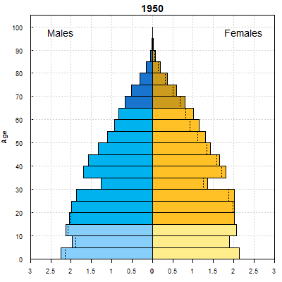
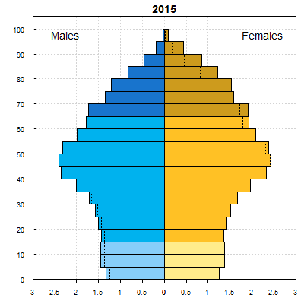
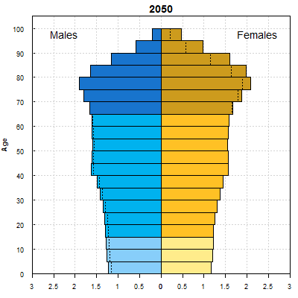
The population pyramids in selected EU countries
Age structure of Italy’s population
The dotted line indicates the excess male or female population in certain age groups. The data are in thousands or millions.
Source: United Nations, Department of Economic and Social Affairs, Population Division (2015). World Population Prospects: The 2015 Revision. <https://esa.un.org/unpd/wpp/Graphs/DemographicProfiles/>

Slide 16
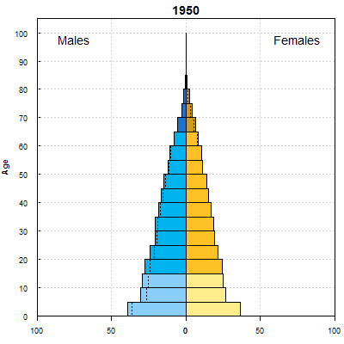
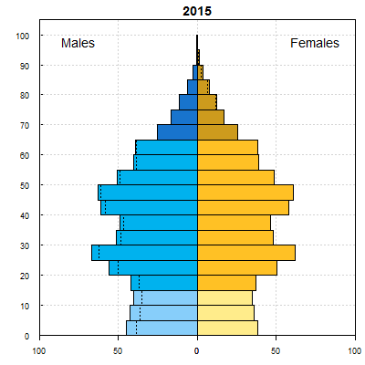
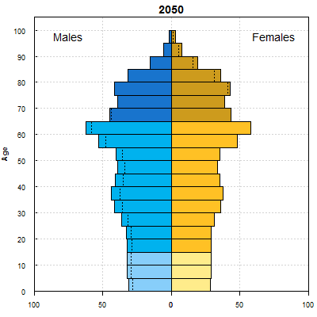
The population pyramids in China
Age structure of China’s population
The dotted line indicates the excess male or female population in certain age groups. The data are in thousands or millions.
Source: United Nations, Department of Economic and Social Affairs, Population Division (2015). World Population Prospects: The 2015 Revision. <https://esa.un.org/unpd/wpp/Graphs/DemographicProfiles/>

Slide 17
The Epidemiological pressure
Although the size of the older population influences the economy,
the health status is the major drivers of the need for (public/private) support and related costs
EU citizens aged 65 could expect less than half of their remaining years to be free from conditions affecting their ability to manage daily living activities but…
ageing of the big generations of baby-boomers increases the number of those potentially in needs
Trends in disability in EU are not always clear
51% 43% of remaining life in good health
Source: Own elaborations from Table 1 (p.11) in Social Protection
Committee-European Commission (2014). Year 2009.
Notes:
Are projected gains in longevity will be accompanied by an expansion or a contraction in disability-free life expectancy and then in the number of those that will demand care services?

Slide 18

Who provide informal support? Factor influencing the supply of care
Relatives and friends provide the first and more relevant form of support. Informal (unpaid) care is important in all EU countries,
but is more common in some than in others
Average amount of informal care vs. percentage of informal carers
Formal and informal care can be substitutes or complements, depending on the type of care and needs
Notes: informal care provided to someone outside the household in the population aged 50 and older.
Source: SHARE data elaborated by Rodrigues, R., Huber, M. & Lamura, G. (eds.) (2012). Facts and Figures on Healthy Ageing and Long-term Care.
European Centre for Social Welfare Policy and Research: Vienna.
Notes:
Likely to affect the decisions of relatives around retirement and labour market participation
The future sustainability of a model based on the provision of informal LTC support faces the question: will future cohort of people in needs of LTC be as likely to have a spouse or children that provide care for them?

Slide 19
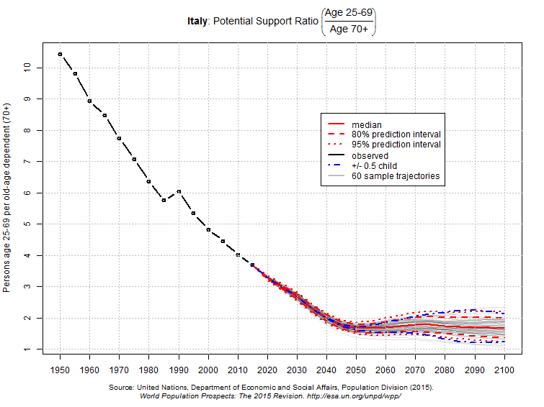
Who provide informal support? Factor influencing the supply of care
Relatives and friends provide the first and more relevant form of support. Informal (unpaid) care is important in all EU countries, but is more common in some than in others
Potential Support Ratio in Italy [(𝐴𝑔𝑒 25−69)/(𝐴𝑔𝑒 70+)]
Source: UN, Department of Economic and Social Affairs, Population Division (2015).
World Population Prospects: The 2015 Revision

Slide 20
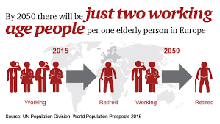
Who provide support at old-age?
The role of migrant workers
The future sustainability of a model based on the provision of informal LTC support faces the question: will future cohort of people in needs of LTC be as likely to have a spouse or children that provide care for them?
Main countries of origin and destination of migrant care workers in Europe
Share of foreign-born workers in community services vs. those privately employed by households in selected EU countries
Source: Rodrigues, R., Huber, M. & Lamura, G. (eds.) (2012). Facts and Figures on Healthy Ageing and Long-term Care. European Centre for Social Welfare Policy and Research: Vienna.
Notes:
The future sustainability of a model based on the provision of informal LTC support faces the question: will future cohort of people in needs of LTC be as likely to have a spouse or children that provide care for them?

Slide 21
The socio-economic gradient with health
Birth-cohort trends in older-age functional disability and their relationship with socio-economic status in the United Kingdom
Source: Morciano M., Hancock R. and Pudney S., (2016) ‘Birth-cohort trends in older-age functional disability and their relationship with
socio-economic status: Evidence from a pooling of repeated cross-sectional population-based studies for the UK’. Social Science & Medicine.

Slide 22
At-risk-of-poverty by age groups (compared to the total population)
Source: EU-SILC 2009 data elaborated by Rodrigues, R., Huber, M. & Lamura, G. (eds.) (2012). Facts and Figures on Healthy Ageing
and Long-term Care. European Centre for Social Welfare Policy and Research: Vienna.

Slide 23
Material deprivation rate and at-risk-of-poverty rate of 65+ pop
Source: EU-SILC 2009 data elaborated by Rodrigues, R., Huber, M. & Lamura, G. (eds.) (2012). Facts and Figures on Healthy Ageing and
Long-term Care. European Centre for Social Welfare Policy and Research: Vienna.
Notes:
The material deprivation rate measures the percentage
of the population that cannot afford at least three of the
following nine items:
1. to pay their rent, mortgage or utility bills;
2. to keep their home adequately warm;
3. to face unexpected expenses;
4. to eat meat or proteins regularly;
5. to go on holiday;
6. a television set;
7. a washing machine;
8. a car;
9. a telephone

Slide 24
Impact of Population Aging on the
Economy
E-mail: m.morciano@uea.ac.uk
Notes:
See http://www.nber.org/papers/w22452

Slide 25
Ageing will negatively affect economic growth
Population ageing is widely expected to have detrimental effects on aggregate economic growth
This potential arises from the fact that fundamental economic behaviours, such as labour supply and consumption, vary systematically over the lifecycle
People tend to consume less than they earn during the middle part of the lifecycle when they are at peak labour supply, but more than they earn during the older part of the lifecycle when they reduce labour supply and finance health-related consumption
IMF estimates indicate that ageing can reduce the EU aggregate annual growth rate by as much as:
  0.6pp during the period 2014-2019
  0.9pp during the period 2020-2025
  From the 1990-2005 average annual growth rate of 2.1%
source: UN

Slide 26
Working-Age population growth will fall dramatically
On average across the EU, working-age population growth will fall from 1.7% over 2000-2015 to -5.5% over 2015-2030
All EU countries will face either a slower-growing or declining working-age population, and corresponding pressure on labour supply
Growth in Working-Age population across the EU (%)
E-mail: m.morciano@uea.ac.uk
source: UN

Slide 27
Ageing Will Also Reduce the Economy’s Savings Rate
In addition to reducing labour supply, population aging will reduce the economy’ savings rate, and in turn, investment
The academic literature using the life-cycle model estimates declines in the average savings rate of 0.5-1.2 pp from a one pp rise in the old age dependency ratio
Old Age Dependency Ratio and Household Savings Rate (OECD countries)
source: UN, OECD

Slide 28
Many factors can mitigate the impact of ageing on the Economy … but fiscal challenges will remain
A number of developments can dampen the impact of ageing on the economy:
Policy reforms that improve labour force participation rates
Raised retirement age
Investment in ‘silver’ industries
Immigration flows
Financial inflows, which could fill a domestic savings-investment gap
Innovation and technological progress in the long run
Human capital development and increased productivity
However, the fiscal challenges are large and will require re-thinking of social programs, most of which were designed for a growing-population model
Further, the historical experience is one of under-estimation of the pace of population ageing: populations have aged more rapidly than forecasted

Slide 29
Thank you for your attention
E-mail: m.morciano@uea.ac.uk

Slide 30
Impact of Population Ageing on Public Finances
E-mail: m.morciano@uea.ac.uk

Slide 31
The estimated impact of population ageing on Public Finances in EU

Slide 32
Pension and Healthcare Expenditures are already high
9 out of the 28 EU countries already spend more than one-fifth of their GDP on pension and healthcare
pension spending is about twice spending on healthcare

Slide 33
Key indicators for fiscal sustainability challenges
28 ip037_vol1
Notes:
PUBLIC/PRIVATE DEBT
Fiscal sustainability assessment by Member State p. 27 ip037_vol1

Slide 34
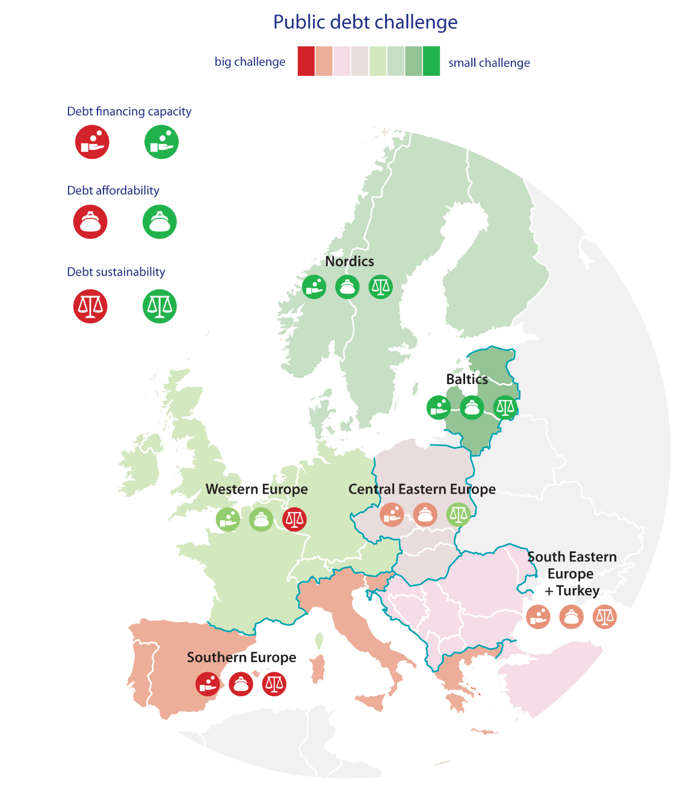
The demographic transition is occurring in the context of the global financial crisis and recession, which led to dramatic increase in debt levels for a number of countries
The average EU debt-to-GDP ratio rose from 43.4% in 2007 to 73.6% in 2014
The Financial Crisis led to a large increase in EU debt levels, further pressuring fiscal sustainability

Slide 35
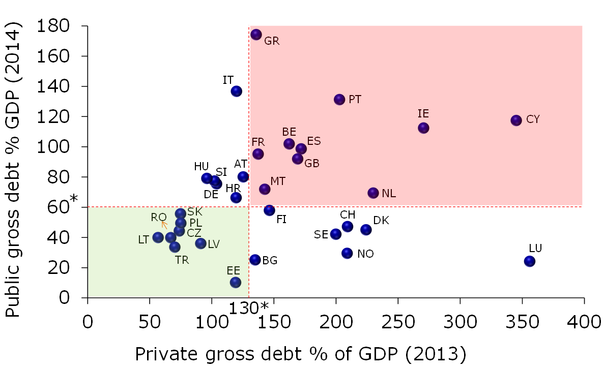
The Financial Crisis led to a large increase in EU debt levels, further pressuring fiscal sustainability
Private and public sector debt is high in EU countries
Public debt challenges seem to be the greatest in Southern European countries
Public debt challenges are lowest in the Baltics and Nordics (except Finland and Iceland)
Private debt challenges are highest in LU and CY
In Western European countries the risks related to public debt financing and affordability appear to be rather muted (only Ireland faces affordability challenges).

Slide 36
Impact of Population Aging on the
Pension systems
E-mail: m.morciano@uea.ac.uk

Slide 37
A taxonomy of EU pension systems
Detailed comparison of pension systems across EU countries is a difficult task and beyond this lesson
Pension systems were already covered in previous lessons
and more details will come in future lessons too
Just a remind: all the countries of the EU have set up schemes whereby workers are assured of a certain level of income upon their retirement

Slide 38
A taxonomy of EU pension systems
Schemes are: i) public; ii) mandatory; iii) PAYGO financed
However the degree of development of single national schemes is very different, as it is different the mechanism of determination of pension benefits and social security contributions, the degree of complementarity between public and private sector, the interaction between pension systems and other tier of the social protection system
It is possible to resort to a very broad distinction between two different type of pension system which finds an explanation into the hystorical evolution of pension systems in Europe.
    the Beveridgean system
    the Bismarkian system

Slide 39
The Beveridgean system
  social security benefits ensure for each citizen (resident) a basic income
  (public) pension benefits are flat (and normally means tested).
  individuals who want (and can) supplement this basic income during old age, turn to the market and join private pension schemes (either voluntarily or as part of their labour contract)
  typical countries: Denmark, Ireland, the Netherlands and the United Kingdom

Slide 40
The Bismarkian system
  people have a right to social security benefits during old age only insofar as they acquire that right by working when adult
  the pension benefits are earnings-related and profession-related, generally subject to maximum limits.
  often supplemented with a minimum pension guarantee for people who have had only weak attachment to the labour force
  limited role to voluntary pension arrangements
  typical countries Germany, Belgium, Sweden, France and the southern European countries

Slide 41
A taxonomy of EU pension systems
In the economic literature (see for example Conde Ruiz and Profeta 2007) it emerges that Beveridgean countries w.r.t Bismarkian countries are associated with:
  Lower public pension spending
  High-income inequality
  More intense presence of privately financed pension schemes
  Higher replacement rates for low income individuals

Slide 42
A broader/comprehensive classification of pension systems
A broader and more comprehensive classification is the World Bank/OECD taxonomy.
Pension systems can be classified into a three level scheme, where each level pursues a different objective
  First pillar: avoiding poverty in old age. Typically public and PAYGO, universal or flat rate benefit or minimum pension, contains strong redistributive elments
  Second pillar: ensuring adequacy, occupational schemes, can be public or private, DB or (N)DC, funded or PAYGO, may vary in the degree of redistribution, typically based on the labour market position of the insured
  Third pillar: giving flexibility, individual plans, typically voluntary, private and funded
Remember that this an over-simplified classification; each country experiences pension schemes with different level of interaction across pillars

Slide 43
The effect of ageing on the pension system
What is the expected effect on pension systems of the demographic transition?
  Fertility decrease
  Longevity increase
  Reduction in the economic growth
  Reduction in the rate of return of capital
  Increasing political weight of the old part of the population
Pension policy reforms should find solutions that redistribute optimally risks among individuals and generations
Broadly speaking two fundamentals different approaches to reform pension systems:
  Radical reforms: change the financing method
  Parametric reforms: change the computational rule and/or retirement age

Slide 44
The effect of ageing on the pension system
What is the expected effect on pension systems of the demographic transition?
  Fertility decrease
  Longevity increase
  Reduction in the economic growth
  Reduction in the rate of return of capital
  Increasing political weight of the old part of the population
2014 Pension Sustainability Index for western Europe and North America
Notes:
2014 Pension Sustainability Index for western Europe and North America fig. 7 p. 31

Slide 45
The reforming process of EU pension systems
What kind of policies can be implemented in order to face the expected ageing of the European population and the slowdown in economic growth?
  Modify pension portfolio
  Increase contributions
  Decrease pension benefits
  Increase retirement age
Each policy has associated risks & difficulties to be implemented
  Financial risks in an era of low interest rates; inter-generational distribution of burden
  Tax wedge and distortions
  Political costs and inter-generational distribution of the economic burden
  An older workforce, with implications on labour and total productivity

Slide 46
The reforming process of EU pension systems
What have European government done on their pension system in order to face these problems?
There are some common trends:
  Substantially increased retirement age
  Reduced valorization of past earnings in the pension formula
  Modified indexation mechanism of pension benefits
  Introduced different kind of automatic adjustment (NDC, linking ret age to lifetime expectations; sustainability adjustments)
Successful policies? Probably too early to give a definitive answer. Ex-ante evaluation possible through dynamic simulation

Slide 47
Impact of pension reforms on the average effective retirement age from the labour force
Average exit age from the labour force expected in 2060, men
Notes:
AAE p. 44

Slide 48
Impact of pension reforms on the average effective retirement age from the labour force
Average exit age from the labour force expected in 2060, women
Notes:
AAE p. 44

Slide 49
Changes in the replacement ratio in selected EU countries across for the period 2010-2060
Country | TYPE OF SYSTEM | Rep rate in 2010 | Rep rate in 2060 | Difference
Denmark | FLAT + DB | 69% | 67% | -2%
Netherlands | FLAT + DB | 105% | 101% | -4%
United Kingdom | FLAT + DB | 60.30% | 50.30% | -10%
France | PS + DB | 77.60% | 58.80% | -19%
Germany | PS | 59.10% | 63.40% | 4%
Greece | FLAT + DB + NDC | 121% | 83% | -38%
Italy | DB + NDC | 89.10% | 69.10% | -20%
Spain | DB | 94.50% | 86.50% | -8%
Poland | NDC | 75.50% | 53.30% | -22%
Sweden | NDC | 60.30% | 50.30% | -10%
Notes:
Zaidi, need to be updated

Slide 50
Summarising…
Sustainability: reforms enacted in EU countries seem to be able to realize the aim of maintain (or recover) financial sustainability in the long run.
Adequacy: in many countries, Replacement Ratio (RR) would remain similar to those of todays new pensioners. In others, will reduce considerably
This is realised mainly through a substantial increase in the average retirement age/ reduction RR and less by developing a more thight complementary private pension pillar
The open issues are:
the ability of an ageed workforce to deliver reasonable rate of growth in the future
risk of poverty among the poorest segment of the population

Slide 51
Impact of Population Ageing on the health systems
E-mail: m.morciano@uea.ac.uk

Slide 52
The burden of diseases…
In EU, most deaths today occurs because of non-communicable deseases (chronic/degenerative conditions such as high blood pressure, diabetes, cognitive conditions)
  In the nineties, about 47% (53%) of death were associated with chronic conditions (infectious diseases)
  In 2000, about 56%
  Forecast for 2020, puts the figure around 70%
The foundamental role of primary/acute care & prevention in EU.

Slide 53
Preoccupations of European health systems
1980s: Cost containment
1990s: Efficiency and markets
2000s: Quality
Today: (again) sustainability

Slide 54
Age-related spending for health care (spending per capita as % of GDP per capita), EU28
Older people are the main “consumers” of health care

Slide 55
Common features of European Health Systems
A broad package of health care services, embracing most mainstream health interventions
Universal coverage of all citizens, regardless of financial or health status
Low reliance on direct user charges
Financial contributions according to ability to pay, independent of health status (tax or social insurance)
High levels of regulation of providers
A unifying principle of ‘solidarity’ - the health risks of all citizens are pooled, with contributions to the risk pool unrelated to health status

Slide 56
Distribution of public health expenditure by areas in the EU, 2006-2013

Slide 57
How Cost containment is achieved?
Gatekeeping (the role of general practitioner (GP): a doctor who provides general medical treatment for people who live in a particular area)
    Traditional feature of public European systems (UK, Scandinavia, Italy)
    In some respects, directed at enhancing quality of care
    But main focus is on containing costs
    Some evidence of success
    Social insurance countries seeking to encourage gatekeeping through payment mechanism (France, Germany)
Co-payments
Community care

Slide 58
How Cost containment is achieved?
Gatekeeping (the role of general practitioner (GP): a doctor who provides general medical treatment for people who live in a particular area)
    PRINCIPLES:
    Limiting access to specialist care
    Persuading citizens to use preferred providers
    Potential lever to improve costs and quality
    Needs to be implemented alongside many other policies
    Very different effectiveness in different systems.
Co-payments
Reference pricing
Community care

Slide 59
How Cost containment is achieved?
Gatekeeping
Co-payments
    Traditionally low levels of co-payment in European systems (but increasing)
    Widespread voluntary insurance against co-payments in some systems, diluting incentive effect (France, Ireland)
    Differential co-payments according income (and wealth)
Reference pricing
Community care

Slide 60
How Cost containment is achieved?
Gatekeeping
Co-payments
Reference pricing
    Designed to encourage use of cheaper generic substitute drugs
    Involves setting a fixed ‘reference price’ for all drugs within a cluster
    Patients must pay difference between drug price and reference price
    Complex technical issues (choice of clusters, choice of reference price)
    Widespread use in Europe (Sweden, Germany, Spain, Italy), but Norway abandoned because ineffective.
Community care

Slide 61
How Cost containment is achieved?
Gatekeeping
Co-payments
Reference pricing
Community care
    Objective is to keep patients out of unnecessary hospital care, and to minimize length of stay
    Some crude attempts to limit very long lengths of stay (bed blocking) (Belgium, UK)
    Incentives for local government to arrange for community care (England)

Slide 62
Developing private markets and Improving efficiency
Provider markets
    Major efforts to make provider markets more competitive
    Clearly relevant to some aspects of acute care, but concerns at implications for chronic care
    Mixed evidence on the effect
Payment mechanisms
Purchaser markets
Information and markets
Health technology assessment

Slide 63
Developing private markets and Improving efficiency
Provider markets
Payment mechanisms
    Almost all systems reimburse providers according to some sort of (diagnosis-specific) payment
    Most payment are set passively, according to expected average costs
    some cost-sharing between the payer and the provider occurs once provider costs on a particular patient exceed some threshold (the Netherland).
Purchaser markets
Information and markets
Health technology assessment

Slide 64
Developing private markets and Improving efficiency
Provider markets
Payment mechanisms
Purchaser markets
    Payers for health care (e.g. local governments) have tended to reimburse passively
    concern with the risk adjustment process, needed to create a fair market and prevent cream skimming of rich, healthy patients
    Little evidence of benefits in terms of quality or efficiency
    Key issue: how to reconcile active purchasing with the patient’s traditional freedom to use any provider and fixed fee schedule.
Information and markets
Health technology assessment

Slide 65
Developing private markets and Improving efficiency
Provider markets
Payment mechanisms
Purchaser markets
Information and markets
    Information is a key resource in the functioning of health care markets
    Traditionally poor level of information on costs and quality
    The case of England: great opportunity to enhance information base for patients and collective purchasers but…
    Concern about distortions induced by public reporting.
Health technology assessment

Slide 66
The Performance ratings in England
no patients waiting more than 18 months for inpatient treatment
fewer patients waiting more than 15 months for inpatient treatment
no patients waiting more than 26 weeks for outpatient treatment
fewer patients waiting on trolleys (gurneys) for more than 12 hours
less than 1% of operations cancelled on the day
no patients with suspected cancer waiting more than two weeks to be seen in hospital
improvement to the working lives of staff
hospital cleanliness
a satisfactory financial position
Plus…
… a satisfactory quality inspection.

Slide 67
Developing private markets and Improving efficiency
Provider markets
Payment mechanisms
Purchaser markets
Information and markets
Health technology assessment
    Universal move towards defining an ‘essential’ package of care
    Principal criterion for inclusion in package is cost-effectiveness of interventions
    An enormous task, with numerous methodological and practical complexities
    Many countries setting up health technology assessment institutes (e.g. NICE in England, Finland, Germany, Sweden)

Slide 68
Health systems in the EU
In EU, there is no a single health system
Instead we have different health systems inherently linked with different cultural/social values, institutional setting and traditional welfare regimes in place
Very often, current health policies are the result of the stratification of unsystematic reforms aiming at facing emerging socio-economic pressures.

Slide 69
Four broad types of health system
Social insurance: unreformed
  France, Austria
Social insurance: competitive
  Netherlands, Germany
Public sector: devolved
  Sweden, Spain
Public sector: centralised
  United Kingdom, Italy
  … but the reality is far more complex
Notes:
Weaknesses of social insurance: The narrow finance base;
Sickness funds securing quality or cost control over providers;
Lack of control over expenditure growth;
Lack of accountability of providers to insurers and patients.

Slide 70
Pooling schemes and their financing

Slide 71
Country clustering based on system characteristics

Slide 72
Country-specific per capita expenditure levels

Slide 73
Expenditure on health care by financing source excluding long-term care, 2013 (or nearest year)

Slide 74
Share of public expenditure on health by level of government, 2013 or latest

Slide 75
Acute care beds per 100,000 inhabitants
2013 or latest year

Slide 76
Variation in the overall strength of primary care in Europe
Highly associated with the number of acute care beds available
Notes:
(p. 142)

Slide 77

Evolution of total (public and private) public expenditure on health as a share of GDP, 1960 – 2013
We already have observed a substantial increase of health spending over time
Ageing population, however, is leading policymakers to rethink their m
health services m
Notes:
Ip037_vol1 p. 29

Slide 78
Annual average growth rates in real current public health expenditure per capita, 2003-2008 and 2008-2013
The effect of the financial crisis and “austerity”

Slide 79
Demography will present a formidable challenge for Health care systems
Expenditure projections (under different scenarios) suggest that:
Keeping health program eligibility, cost and generosity unchanged, over 2016-20150 ageing alone will require governments to spend additional 1%-2% of GDP every year on health care
Much depend on the relationship between ageing and health. A high scenario, would see additional spending growing even faster (2-4%) of GDP annually

Slide 80
The reforming process
Many governments in the EU are reviewing their health care systems and the suitability of their existing approaches to financing, organizing and delivering health care services.
Yet health care reform is inherently a normative as well as an economic and organizational activity.
Pressures to achieve better expenditure control and/or greater productivity and efficiency need to be balanced against the moral imperatives to maintain universal access to necessary care, and to improve the equity with which services are distributed across different social classes.

Slide 81
Spending split between health care and long-term care in the EU, 2007-2013
Note that the expenditure on Long-Term Care is growing faster

Slide 82
Impact of Population Aging on the Long-Term Care (LTC) systems
E-mail: m.morciano@uea.ac.uk

Slide 83
Key concepts: What is long-term care (LTC)?
Long-term care (LTC) is a range of services required by persons with reduced degree of functional (physical or cognitive) capacity, and who need help to meet their basic personal needs
Most LTC is not medical care: it is care for chronic illness/disability instead of treatment of acute illness. Caring for chronic illness lasts as long as the recipient is alive
Most LTC is assistance with the basic personal tasks of everyday life: bathing, eating, taking medication, etc
Most LTC is provided informally (whereas acute care provided by professionals): Informal care may affect caregiver’s labour supply
LTC market dominated by for-profit facilities facing excess demand: no incentive to improve quality of care to remain competitive
Comprehensive acute care insurance but little private LTC policies
Demographic transitions will affect the LTC industry even more than acute care.

Slide 84
LTC regimes in EU
In EU, there is no a single LTC system
Instead we have different LTC systems inherently linked with different cultural/social values, institutional setting and traditional welfare regimes in place
Very often, current LTC policies are the result of the stratification of unsystematic reforms aiming at facing emerging socio-economic pressures.

Slide 85
LTC regimes in EU
EU-LTC models differ in many important dimensions:
  The financing mode
  The level of spending
  The definition of needs
  The public/private mix
  The mix between cash-benefits and services
  The freedom to choose the LTC providers
  The balance between public and private providers
  The quality assurance
  The level of integration and coordination of care among different LTC institutions.

Slide 86
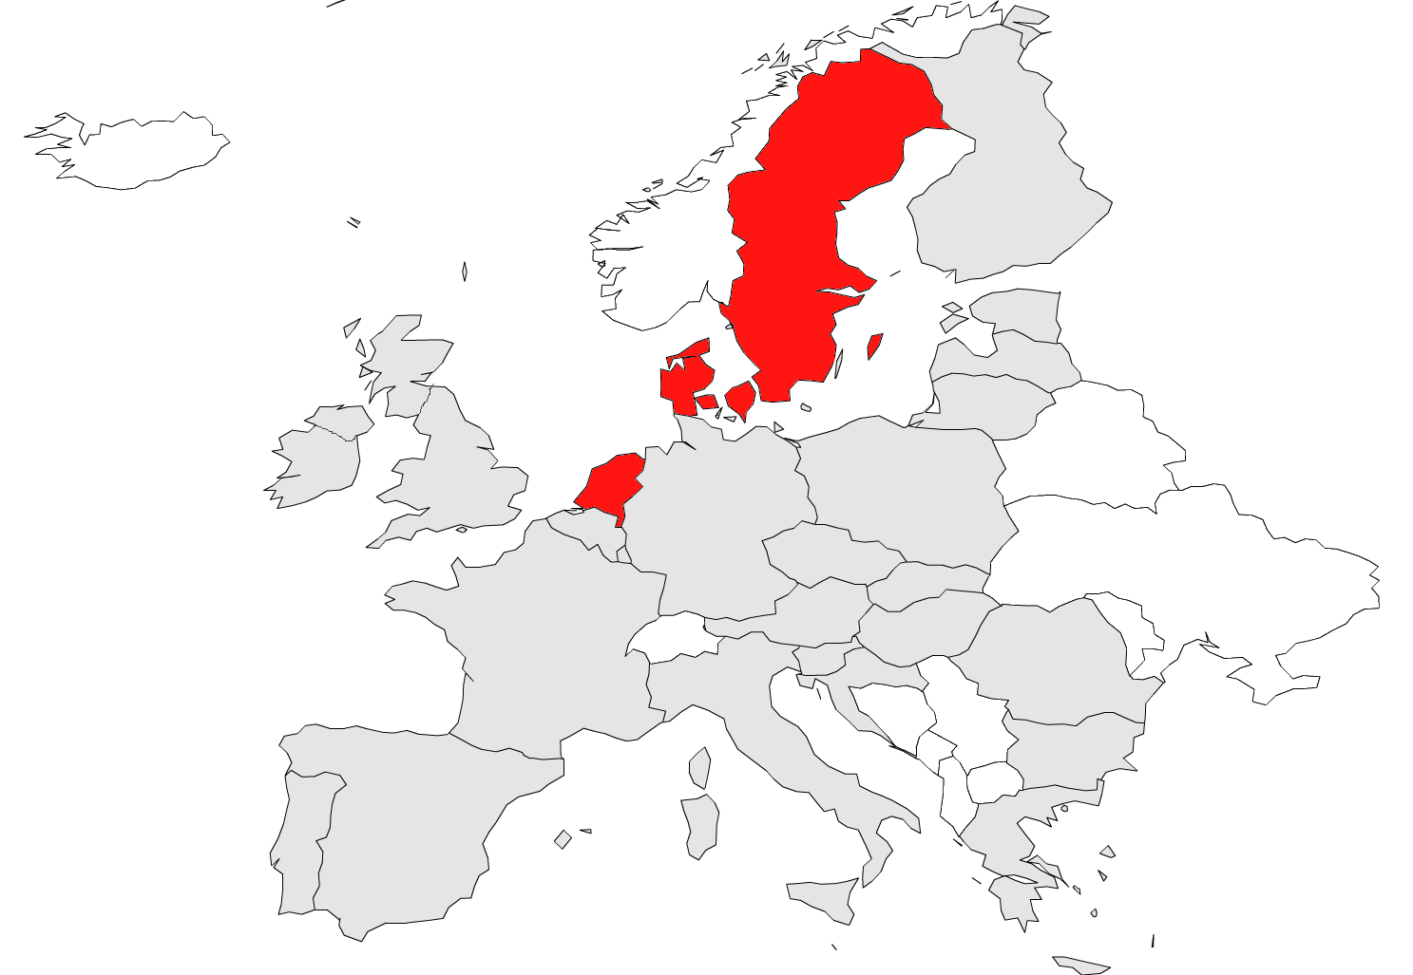
Typology of LTC systems in the EU28
Formal-care (FC) oriented provision;
generous, accessible and affordable
Financed from general revenue allocations to LA
High public and low private spending on FC
Low Informal care (IC) use, high IC support
Modest cash-benefits.
Source: European Commission, “Joint Report on Health Care and Long-Term Care Systems & Fiscal Sustainability”, October 2016.

Slide 87
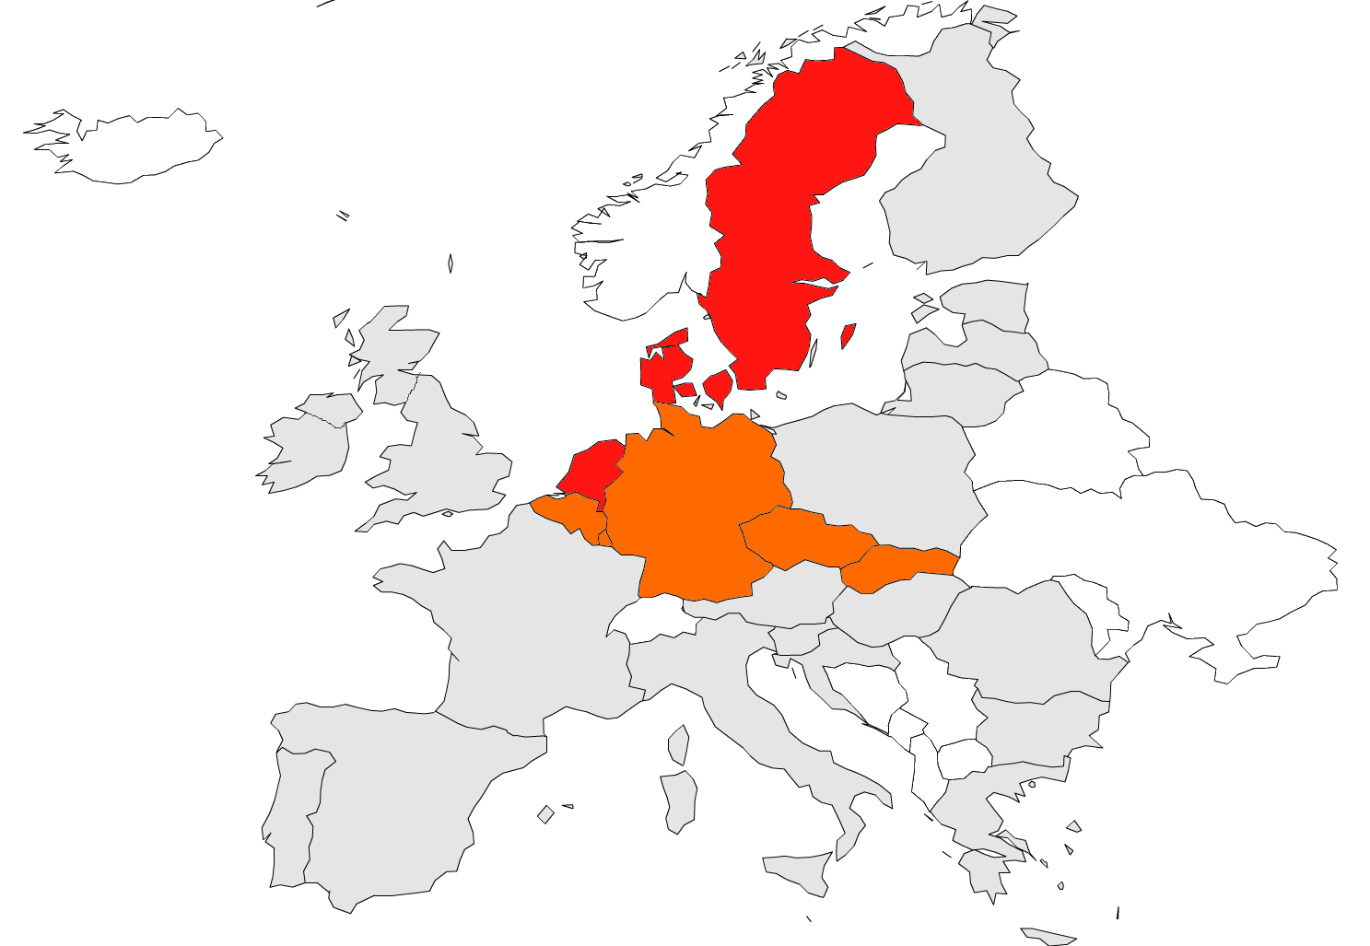
Typology of LTC systems in the EU28
Formal-care (FC) oriented provision;
generous, accessible and affordable
Financed from general revenue allocations to LA
High public and low private spending on FC
Low Informal care (IC) use, high IC support
Modest cash-benefits.
FC of medium accessibility;
some IC orientation in provision
Obligatory social insurance financed from contributions
Medium public and low private FC spending
High IC use, high IC support
Modest cash-benefits.
Source: European Commission, “Joint Report on Health Care and Long-Term Care Systems & Fiscal Sustainability”, October 2016.

Slide 88
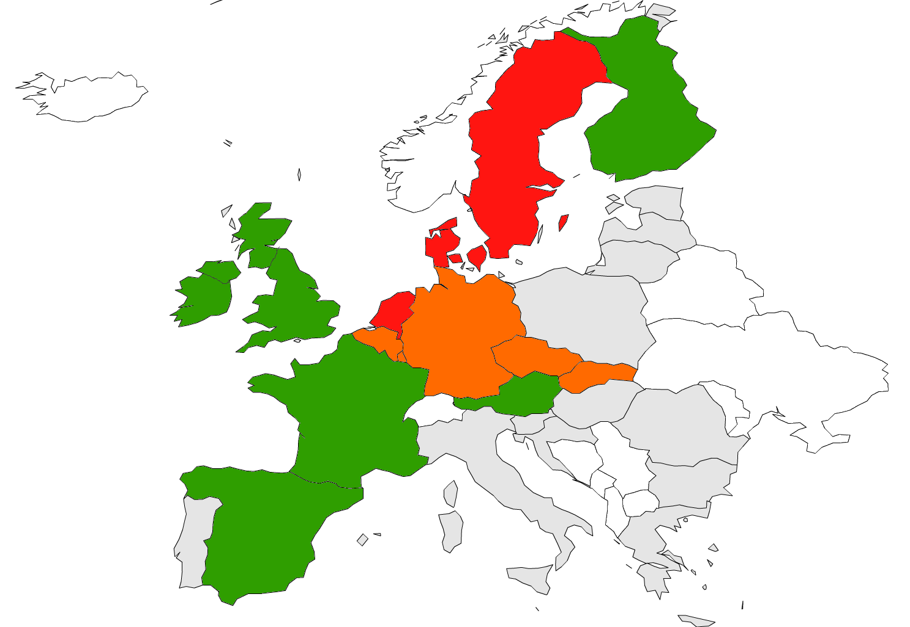
Typology of LTC systems in the EU28
Formal-care (FC) oriented provision;
generous, accessible and affordable
Financed from general revenue allocations to LA
High public and low private spending on FC
Low Informal care (IC) use, high IC support
Modest cash-benefits.
FC of medium accessibility;
some IC orientation in provision
Obligatory social insurance financed from contributions
Medium public and low private FC spending
High IC use, high IC support
Modest cash-benefits.
FC of medium accessibility;
medium IC orientation in provision
Medium coverage financed from contributions\general revenue
Medium public and private FC spending
High IC use, high IC support
High cash-benefits.
Source: European Commission, “Joint Report on Health Care and Long-Term Care Systems & Fiscal Sustainability”, October 2016.

Slide 89
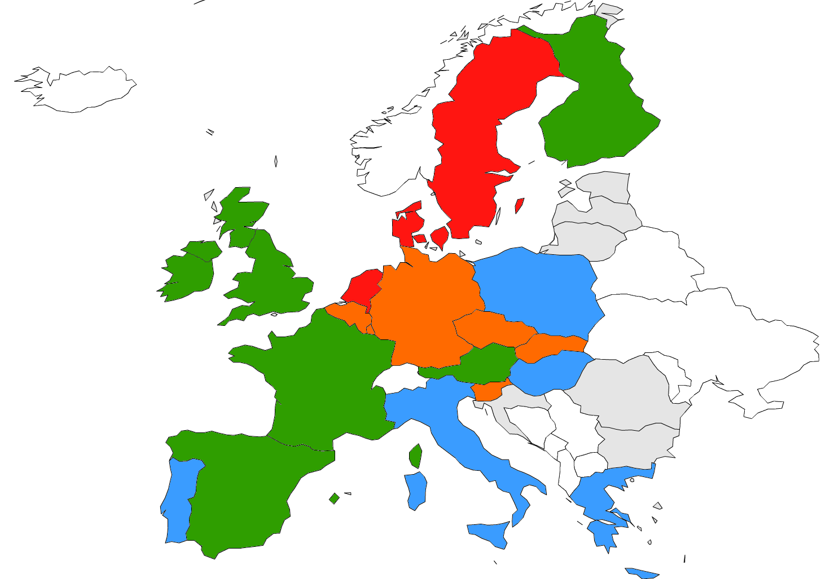
Typology of LTC systems in the EU28
Formal-care (FC) oriented provision;
generous, accessible and affordable
Financed from general revenue allocations to LA
High public and low private spending on FC
Low Informal care (IC) use, high IC support
Modest cash-benefits.
FC of medium accessibility;
some IC orientation in provision
Obligatory social insurance financed from contributions
Medium public and low private FC spending
High IC use, high IC support
Modest cash-benefits.
FC of medium accessibility;
medium IC orientation in provision
Medium coverage financed from contributions\general revenue
Medium public and private FC spending
High IC use, high IC support
High cash-benefits.
Low FC accessibility; strong IC orientation in provision
Modest social insurance against LTC risks
Low public and high private FC financing
High IC use, low IC support
High cash-benefits.
Source: European Commission, “Joint Report on Health Care and Long-Term Care Systems & Fiscal Sustainability”, October 2016.

Slide 90
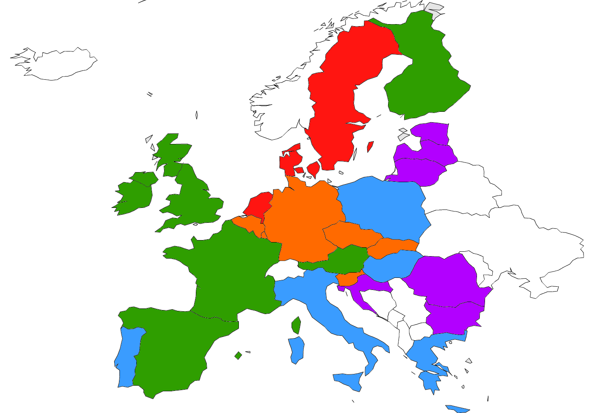
Typology of LTC systems in the EU28
Formal-care (FC) oriented provision;
generous, accessible and affordable
Financed from general revenue allocations to LA
High public and low private spending on FC
Low Informal care (IC) use, high IC support
Modest cash-benefits.
FC of medium accessibility;
some IC orientation in provision
Obligatory social insurance financed from contributions
Medium public and low private FC spending
High IC use, high IC support
Modest cash-benefits.
FC of medium accessibility;
medium IC orientation in provision
Medium coverage financed from contributions\general revenue
Medium public and private FC spending
High IC use, high IC support
High cash-benefits.
Very low FC accessibility;
(almost) exclusive IC orientation
Little social insurance against LTC risks
Very low public FC spending
Very high IC use, little to no IC support
Modest/low cash-benefits.
Low FC accessibility; strong IC orientation in provision
Modest social insurance against LTC risks
Low public and high private FC financing
High IC use, low IC support
High cash-benefits.
Source: European Commission, “Joint Report on Health Care and Long-Term Care Systems & Fiscal Sustainability”, October 2016.

Slide 91
What can we learn from the EU LTC systems?
Countries with universal coverage and high formal care provision have relatively high public LTC expenditure (burden for the long-term sustainability of public finances)
Countries with low public LTC expenditure relies heavily on:
  out-of-pocket payments (unaffordability, sub-optimal consumption, catastrophic costs)
  informal care (effects on labour market participation of the carer).

Slide 92
What can we learn from the EU LTC systems?
Means-tested programmes are targeted to disabled in financial needs (safety-net) but support is restricted to those below a certain income/asset threshold (high admin costs, cliff-edge effects, exhaustion personal-assets, sub-optimal saving, significant unmet needs)
Mixed models reduce the risk of non-take-up but requires coordination and co-operation among institutions
Countries with a strong emphasis on:
  Social insurance model: contributions levied on a narrower tax base than general revenue, tax distortions on employment
  Tax-based model: funds levied on a bigger tax base that is ageing

Slide 93
Projected increase in public long-term care spending in EU28, 2013 - 2060

Slide 94
Projected increase in public LTC spending in EU28 two scenarios

Slide 95
Summing-up
EU-countries have different LTC systems but share common socio-demographic and economic pressures.
Against a background of rising demand for LTC, the fiscal sustainability of LTC is a daunting policy challenge.
There is a window of opportunity for designing efficient, equitable and sustainable LTC system.

Slide 96
Some recommendations #1
An efficient LTC system:
  could reduce hospitalization and subsequent associated costs.
  should support delivering:
    LTC services at home rather than in institutional setting when appropriate;
    support care recipient to remain independent;
    support informal carer.

Slide 97
Some recommendations #2
Key choices in implementing LTC reforms:
  Building consensus on the role of individuals & State;
  Providing clear & accessible information on the LTC system;
  Promoting a transparent & comprehensible funding mechanism;
  Avoiding “unequal treatment of equals” & “equal treatment of unequals”;
  Improving governance by coordination & co-operation between different agents/authorities involved & between States with similar LTC systems; The regulatory framework should strenghen incentive mechanisms
  Monitoring, collecting & sharing data: There are «natural experiments» ongoing

Slide 98
Final Discussion
E-mail: m.morciano@uea.ac.uk

Slide 99
Many Factors Can Mitigate the Impact of Aging on the Economy But Fiscal Challenges Will Remain
A number of developments can dampen the impact of aging on the economy: Policy reforms that improve labour force participation rates
Raised retirement age
Investment in ‘silver’ industries
Immigration flows
Financial inflows, which could fill a domestic savings-investment gap
Innovation and technological progress in the long run
Human capital development and increased productivity
However, the fiscal challenges are large and will require re-thinking of social programs, most of which were designed for a growing-population model
Further, the historical experience is one of under-estimation of the pace of population aging: populations have aged more rapidly than forecasted

Slide 100
On the acceptability of reform process
Experience accumulated on pension systems reforms would recommend:
  Building consensus on the role of individuals & State
  Providing clear & accessible information
  Promoting transparent & comprehensible funding mechanism
  Avoiding horizontal and vertical inequities
  Improving governance by coordination
  Monitoring, collecting & sharing data
  Policy reforms should be assessed and evaluated ex-ante and ex-post in a systematic and formalised way based on evidence.
Notes:
EVALUATING REFORMS SYSTEMATICALLY (ip037_vol1_en_2) p 134

Slide 101
Thank you for your attention
E-mail: m.morciano@uea.ac.uk

