Slide 1


The information to pension fund members for defined contribution pension plans: main issues and practical solutions
Elisabetta Giacomel
Head of the Research Department and International Affairs
Component Two - 2018 Training Course “Financing the social security system in an ageing society: the role of public finance and private supplementary funds”
INPS, Rome, July 6, 2018

Slide 2

Information to pension fund members for defined contribution pension plans
Information play a crucial role in a DC private pension system where members are required to make several choices
A good information regulation is not enough for “appropriate” individual decisions. It is necessary a balanced use of policy instruments (e.g. education, product/plan standardisation, default options, prudential regulation that limits risk-taking, price/cost caps, advice)
Information should focus on keys information and have to be communicated in a simple way. A limited number of information documents should be mandatorily made available to members (others are at disposal on the web-site of the pension fund and on request);
The trade-off between complete and layered information could be better regulated if there is a proper “retirement culture”.
1

Slide 3
COVIP’ s information regulation approach
According to regulation, COVIP has to supervise on information to be provided to members (and on pension funds’ behaviour) to protect members and beneficiaries and to assure a sound functioning of the private pension system.
COVIP
sets rules to:
  standard information for all different kinds of pension funds (comparability and focus on keys information)
  informative documents to made available to members written in conformity with schemes provided by COVIP
  calculation and disclosure of costs applied to members (structure of costs and SCI)
  advertisement
  collection of new adhesions
publishes on its web site examples of information documents
publishes on its web site the SCIs of all funds
2

Slide 4
Information to potential members
Documents (of few pages) to be provided to members
Informazioni chiave per l’aderente - a key information document with the main characteristics of the pension fund (e.g. investment policy, contributions, costs, returns )
La mia pensione complementare, versione standardizzata - a document containing pension projections for an hypothetical member, according to COVIP rules
Questionnaire to assess members’ retirement needs and risk profile to “orientate” them in the choice of their investment options
3

Slide 5
Informazioni chiave per l’aderente
A document of 4 pages (a document with more information - Nota Informativa – is available on the pension fund’s web-site)
Investment options classified according to COVIP rules
Graphic representation of portfolio information for each investment option
All information related to costs are included in a new sheet “Scheda Costi” (to be published on the pension funds and COVIP web-site) https://www.covip.it/?cat=317
New approach to compare costs across different kinds of pension funds
4

Slide 6
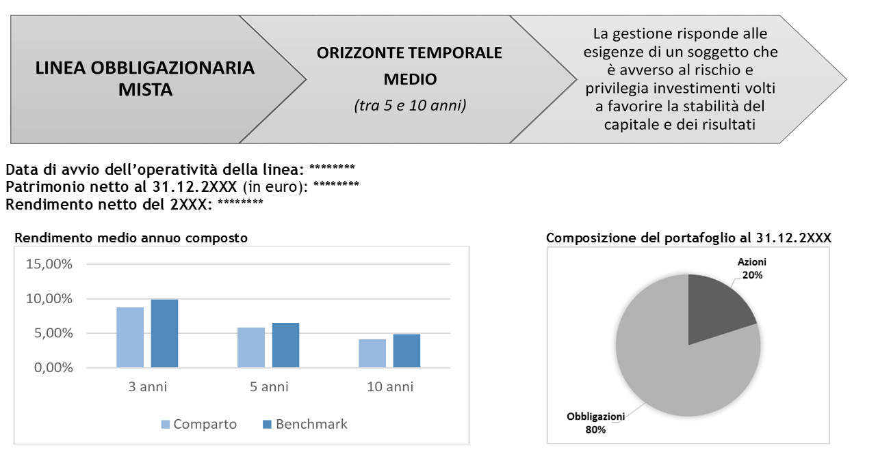
Informazioni chiave per l’aderente: investment options
5

Slide 7
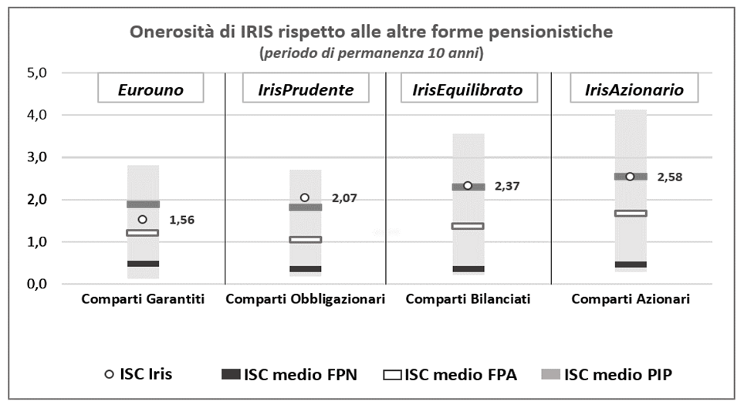
Informazioni chiave per l’aderente: costs
New approach to compare costs
6

Slide 8
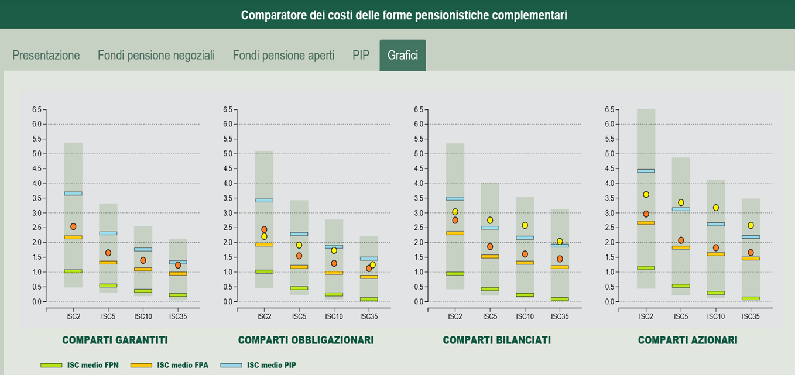
Tool to compare pension fund costs on COVIP web-site
http://www.covip.it/isc_dinamico/
7

Slide 9
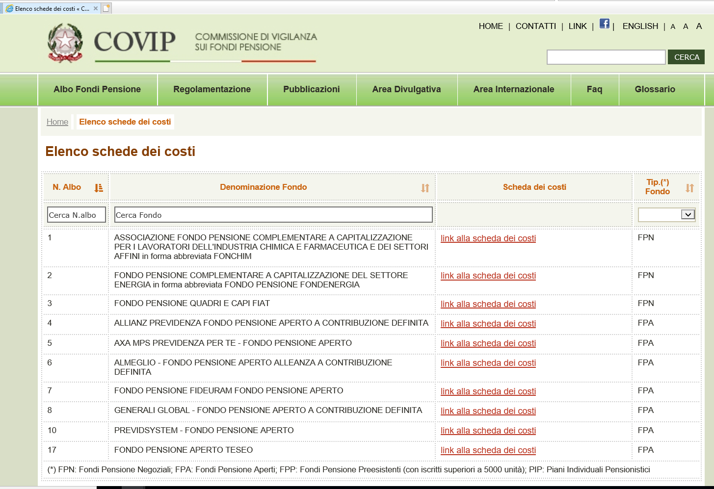
«Schede dei costi» on COVIP web-site
https://www.covip.it/?page_id=12513
8

Slide 10
Information to actual members
Comunicazione periodica – a document with the main information related to individual retirement position (e.g. contribution paid, investment returns)
La mia pensione complementare – a document containing the pension projections taking into account member’ information and according to COVIP rules
Other documents have to be made available on the web of the pension fund, or provided on request.
9

Slide 11
Comunicazione periodica

Slide 12
Comunicazione periodica

Slide 13
La mia pensione complementare (pension projections)
Regulation set by COVIP in 2008 (since then, any major change)
Pension projections are computed using a deterministic method
Common rules for DC IORPs and DC personal plans (DB IORPs are excluded)

Slide 14
Pension projections - objectives
awareness, making people more aware of how much they might reasonably expect at retirement (particularly useful in case such an estimate is also available from the 1st pillar)
information, making people able to better evaluate the impact of the different choices they are asked to make when they join a plan (i.e. the pension provider, the contribution rate, the investment option, the kind of pension benefits, etc.)
educate, making people better equipped to do the right choice for their private pension

Slide 15
Pension projections – standardized and personalized version
 | Standardized pension projections - ‘representative individual’ | Personalized pension projections
When? | At adhesion paper version | On annual basis Elettronic or paper version
Age | 30 years 40 years 50 years | Member age
Retirement age | 67 years | COVIP (66-70 years)
Annual contributions | 1.500 euro 2.500 euro 5.000 euro | Member contributions
Investment line | All investment lines of the IORP | Investment line(s) chosen

Slide 16
Pension projections – general rules
Parameters | COVIP | IORP | MEMBER
Gender | (standardized)
Age | (standardized)
Age of retirement
Costs
Contributions | (standardized)
Wage
Wage growth rate | (1%)
Investment line |  | (β ,α )
Rate of returns
Inflation rate | (2%)
Mortality table | (IPS 55 or IPS 55U)
Technical rate | (0%)
Annuity charge | (1.25%)

Slide 17
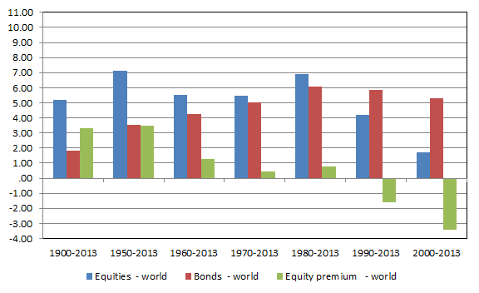
Pension projections – rate of returns
Different hypotesis by asset class:
  Bonds: 2% (real)
  Equities: 4% (real)
For each investment lines, returns are computed taking into account the strategic asset allocation:
R_{(IL)}= 2% * β + 4*α where α = weight of equities; β = weight of bonds
These rates were set in 2008 and have not been changed since then

Slide 18
Pension projections – uncertainty
The uncertainty surrounding PPs is communicated with a written caveat:
The higher the equity allocation, the higher the variability of returns
Pension funds can also provide members with personalized PPs via their websites
In this case, they are allowed to incorporate the uncertainty in PPs by setting symmetric scenarios wrt the COVIP central scenario (2-4% expected rates of return)

Slide 19
Pension projections – communication

Slide 20
Pension projections – communication

Slide 21
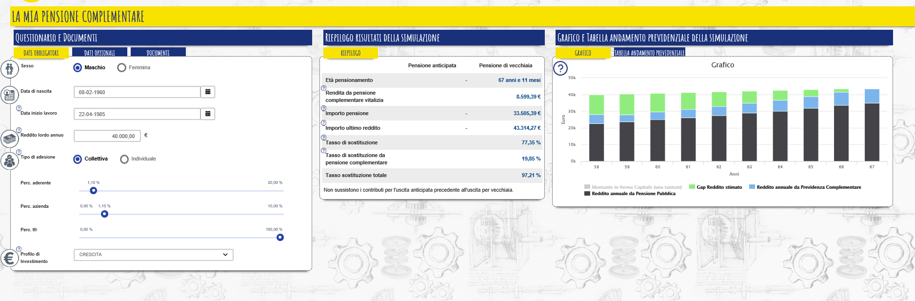
Pension projections by web-sites
  an example:

Slide 22
Future developments
Occupation pension funds - Directive 2016/2341/CE (IORP II):
  Pre-contractual information: minimum set of information (description of the characteristics of the pension funds, pay-out options, where further information are available); no standardised information
  On-going information - “Pension Benefit Statement” :
    Annual information
    Member information (accrued entitlements and accumulated capital);
    pension projections.
  Pre-retirement information and information during the pay-out phase (to be regulated)
  Personal pensions - PEPP regulation (still in process)
    standardized information to facilitate comparability
Italy has a regulatory framework which is substantially compliant with the new European regulation.
At European level, Italy is considered a reference experience for DC private pension systems.
21

Slide 23




Retirement education
        La “Guida introduttiva alla previdenza complementare”
        Il video ”10 cose da sapere sulla previdenza complementare”
        Il Questionario di autovalutazione “Conoscere per scegliere”
        Il collegamento al sito del “La mia pensione” dell’INPS
22

Slide 24
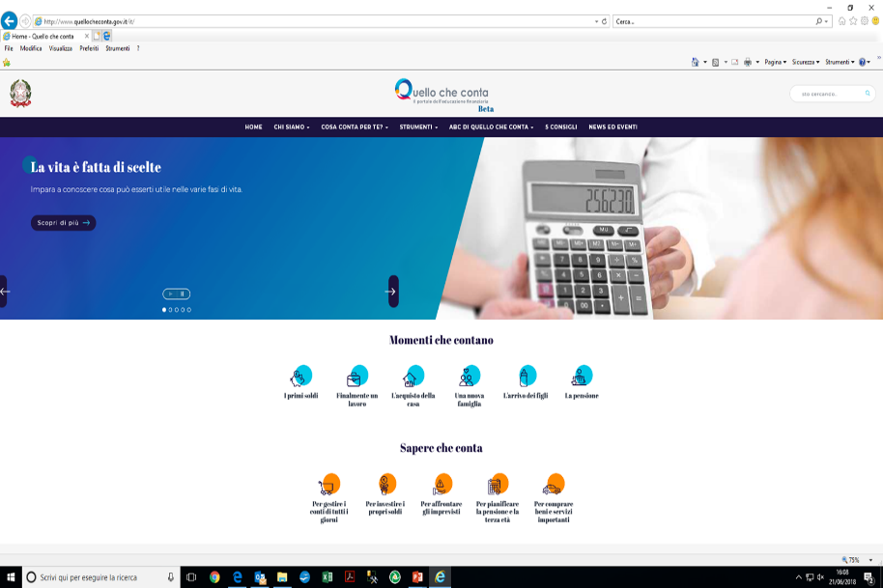
Retirement and financial education
  Comitato per la programmazione e il coordinamento delle attività di educazione finanziaria
  National strategy of financial, retirement and insurance education (in line with OECD countries)
  National portal: www.quellocheconta.gov.it
23

Slide 25
for questions and further information, please contact giacomel@covip.it

