Slide 1
long term care policy solutions for an ageing society and its Financial sustainability. the case of Italy
Rome, July 9th, 2018

Slide 2
Index
Part 1
Definition and measurement of LTC
Financing LTC and elderly care in Italy
Public expenditure for LTC in Italy
Regional differences in eligibility rules for LTC in Italy
Conclusions
Part 2
Forecasting LTC needs in Europe
Which system will be the best?
Conclusions

Slide 3
PART 1

Slide 4
Definition and measurement of LTC
LTC is defined as a wide range of services provided over a prolonged period of time, due to chronic conditions and/or disabilities (Scheil-Adlung, 2012).
Not all the resources for LTC are directed to the elderly, given that it covers also people who present a condition of dependency; to this extent, LTC costs related to severe disability are relatively independent of age and cannot be easily predicted.
Among all LTC recipients, around 60% are women because of their higher life expectancy, combined with a higher prevalence of disabilities and functional limitations in old age.

Slide 5
Definition and measurement of LTC
In spite of many studies carried out for Europe, that have been focusing on describing aggregate data related to the overall amount of resources spent to finance LTC, a clear distinction between LTC expenditure and elderly care expenditure has not been attempted so far.
Given the growing rates of population ageing in Europe, this issue becomes of great interest for policy considerations.
Based on the SHA classification, the Italian Ministry of Finance suggests that almost 2/3 of the whole LTC spending are destined to the elderly.

Slide 6
Financing LTC and elderly care in Italy
The Italian LTC financing is managed through three institutional levels: Central, Regional and Community based.
The Central Government, through Social Security, administers the so called “indemnities for caring”, cash benefits amounting to € 507 per capita provided to invalid people, 80% of whom are elderly. Checks are granted in relation to the health condition of the recipient and independently from his/her economic position.
Regions are responsible for delivering LTC services: they manage and allocate resources devoted to LTC. The source of funding is the Regional Health Fund, autonomously administered by each region.
Community services are managed by the municipalities, whose financing is mainly provided by communities’ direct taxation.

Slide 7
Public expenditure for LTC in Italy
Public spending on LTCs includes three different types of benefits:
i) health care for those who are not self-sufficient, i.e. those who, due to chronic illness, age, and mental limitations, need continued assistance,
ii) accompanying allowances
iii) the socio-assistance benefits provided by local authorities, in particular municipalities, for the benefit of the disabled, elderly people who are not self-sufficient and people dependent on alcohol and drugs.

Slide 8
Public expenditure for LTC in Italy
As far as healthcare services are concerned, they can simply be aggregated into three main categories, based on the type of recipient and their modes of delivery:
residential care for the elderly and disabled;
non-residential care (semi-residential and home care facilities) for the same category of subjects;
assistance, in whatever form, to dependents (alcoholics and drug addicts) or psychiatric disorders.
These benefits are all "in-kind" and are provided by NHS entities independently.

Slide 9
Public expenditure for LTC in Italy
Accompanying allowances are specific monetary benefits foreseen in the case of so-called “civil disability”, that is, invalidity which does not arise from causes of service, war or labor.
It is the benefit of civilian invalids (civilian blinds and deaf people), who can access them without any minimum payment of social security contributions and regardless of their income.
Indemnities are paid directly to the beneficiaries, irrespective of their actual use in the purchase of goods and services useful for improving their living conditions (the delivery is not subject to the certification of the purchase of the benefit).

Slide 10
Public expenditure for LTC in Italy
Social welfare benefits are granted to elderly individuals who are not self-sufficient, disabled, with psychic disorders and to persons with alcohol and drug-related problems.
These benefits differ from one another, are predominantly "in nature", means tested and provided by the local authorities, mainly by the municipalities.

Slide 11
Public expenditure for LTC in Italy

Slide 12
Public expenditure for LTC in Italy

Slide 13
Public expenditure for LTC in Italy

Slide 14
Public expenditure for LTC in Italy

Slide 15
Regional differences in eligibility rules for LTC in Italy
LTC regional programs can be put into practice using “in kind” services or money transfers such as “Buoni/voucher sociali" or “Assegni di cura".
In general, these programs, which integrate the Accompanying indemnity, the only existing national program, focus on:
activating or strengthening the taking over of the non self-sufficient person through personalized health and socio-assistance plans;
strengthening support for the non self-sufficient person and his/her family through the increase of home care, even in terms of hours of assistance and personal care;
supporting the person who is not self-sufficient in the purchase of home care and health care services;
to support the family (or another informal care giver) who directly provides care.

Slide 16
Regional differences in eligibility rules for LTC in Italy
The access to any of these forms of LTC requires a certain degree of interaction between the applicant and the provider institution.
A common approach describes this interaction in three ways:
the availability of the service
its accessibility
its use (i.e., access realized) by the applicant.

Slide 17
Regional differences in eligibility rules for LTC in Italy
The assessment of the availability concerns the existence of a LTC supply in the fragile elderly residential area;
accessibility refers to the circumstances (typically, health conditions and socio-economic status) that determine whether or not an individual can benefit from a nursing program;
finally, the use refers to the extent to which an individual can benefit from a program, as access has been granted.
In the report, we will look only at the first two perspectives.

Slide 18
Regional differences in eligibility rules for LTC in Italy
The access regulation generally includes at least two sequential and compulsory phases that have been implemented after the individual (or whoever is doing it) has inquired the institution responsible for the care program (health district, municipal social services, Single Access Points):
the elderly social-health profile is evaluated by a Multidisciplinary Assessment Unit (assessment of needs);
is assessed (following criteria defined at regional, municipal or healthcare level) as "at risk" and, therefore, he/she is eligible for assistance.
Therefore, the notion of eligibility incorporates two aspects:
the extensive margin discriminates between those who have access to the care system or not,
while the intensive margin determines the amount of benefits (or services) the individual has the right.

Slide 19
Regional differences in eligibility rules for LTC in Italy
Establishing when a vulnerability occurs is, of course, a medical and philosophical issue, linked to the concept of human dignity.
From an empirical point of view, although vulnerability is an undesirable condition, it is essentially a phenomenon that cannot be directly observed.
Hence it emerges the need to develop models and methods that are able to provide a thorough estimate of the severity of the phenomenon, with the aim of putting countermeasures that can slow them down, delay or prevent them from worsening.
Medical literature has produced a rich and extensive debate on the nature of fragility, but despite numerous single- and multi-dimensional indices being proposed in recent years, it cannot be asserted that today there is an evaluation methodology which is universally recognized.

Slide 20
Regional differences in eligibility rules for LTC in Italy
Against this background, it is quite evident that the absence of a standardized definition may result into a broad heterogeneity in the definitions (and consequently the assessment methods) of vulnerabilities adopted by regional lawmakers in care program regulations.
The resulting generation of "non-self-sufficiency" concepts, in turn, implies eligibility criteria and coverage rates that are potentially very different from program to program.

Slide 21
Regional differences in eligibility rules for LTC in Italy

Slide 22
Regional differences in eligibility rules for LTC in Italy

Slide 23
PART 2

Slide 24
Background and motivation
The impact of ageing population represents a serious concern around the world and, in particular, in Europe which will be turning “increasingly grey” in the upcoming decades.
As a result, the demographic old-age dependency ratios are projected to almost double from now until 2060, moving from 4 to 2 working-age people for every person aged 65 and above(EC, 2015).
From a macroeconomic perspective, this implies that the projected potential GDP growth will remain much lower than in previous decades.
Aging of the population, combined with the weak economic growth, result in increasingly stringent public finances with serious threats to the financial sustainability of the social security and healthcare systems

Slide 25
Background and motivation
Life expectancy (LE), along with fertility rates and migration flows are the key features of the current aging process in Europe and around the world (Cutler and Meara, 2013).
Medical technologies are among the main determinants for the increase in LE: they have turned many, once deadly diseases into chronic conditions. This phenomenon has been more sustained in Europe with respect to other parts of the world, placing the EU-28 among the worldwide leaders for LE.
A longer LE can be seen as a potentially “good" or “bad" news, depending on the quality of the “extra” life years lived. In particular, at aggregate level, an older and unhealthy population implies an extra burden in terms of both pensions and health care expenditure.

Slide 26
Background and motivation
According to GBD (2016), despite global health improvement and life expectancy increases, people spend more time with reduced functional health status, partly confirming that absolute expansion of morbidity has occurred.
These results are particularly true for high income countries during the 1990-2015 period, where trends in years of functional health loss have increased more than expected and similar trends are forecasted for the near future.

Slide 27
Background and motivation
Since 2000 many countries have witnessed a significant decline in healthy life expectancy at birth, inverting what had been a continuous growth process.
This decline has been particularly marked in Europe, with significant differences across geographical areas, and more importantly, across gender: women, tend to live longer, but spend more years in bad health with respect to men.

Slide 28
Background and motivation
Accurate forecasts of future trends in population health could thus offer important support to policy makers in order to design and implement effective and sustainable policies.
In spite of the existence of reliable long-term models predicting population structure by age and sex, long-term forecasts of population health exist only in the US (Goldman et al., 2013) and UK (Guzman-Castillo et al., 2017).

Slide 29
EU-FEM + other FEM like models
The FEM is unique among existing models that make health expenditure projections. It is the only model that:
projects health trends rather than health expenditures. It is also the only model that generates mortality out of assumptions on health trends rather than historical time series.
produce a multi-risk factor, multi-disease model capable of assessing policies to improve chronic care delivery and thus assessing the trade-offs between primary prevention, secondary prevention and treatment alternatives.

Slide 30
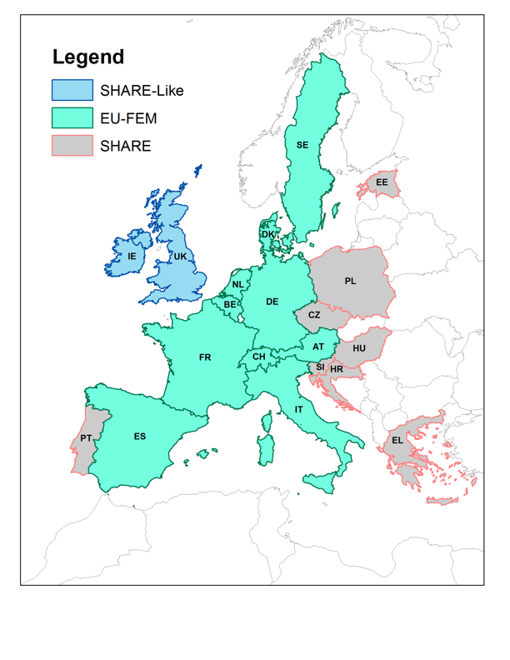
Countries included in the EU-FEM model

Slide 31
Variables modeled
Economic Outcomes | Health Outcomes | Other Outcomes
Employment status Earnings Demographics Medical Expenses Med. Expenses by type Wealth Health Insurance (TBA) Disability insurance (TBA) | Death Heart diseases Stroke Cancer Hypertension Diabetes Lung Diseases Pain Arthritis Osteoporosis (TBA) Parkinson (TBA) BMI Smoking status ADL status IADL Status Life Expectancy Disease free Life Expectancy QALYs | Income Tax Revenue (TBA) Soc. Security Revenue Social Security Outlays Retirement and pension Productivity (TBA)

Slide 32
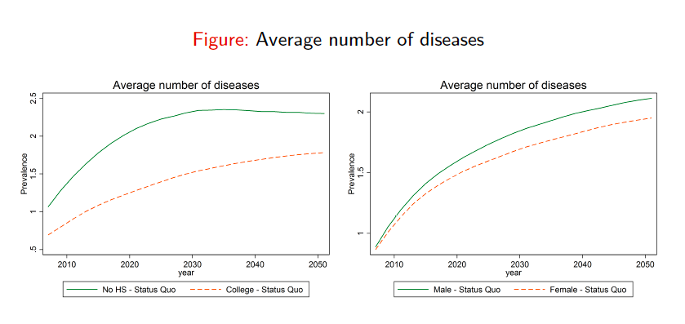
Results for EU-FEM

Slide 33
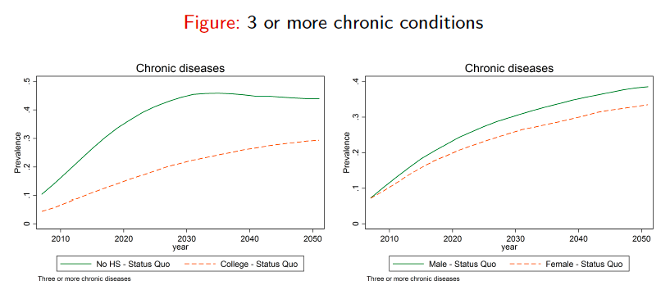
Results for EU-FEM

Slide 34
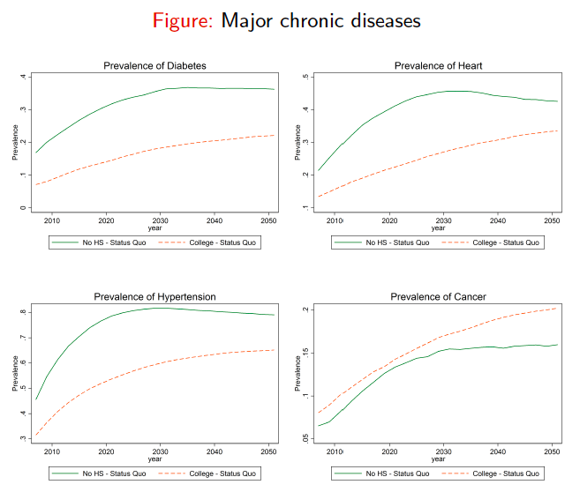
Results for EU-FEM

Slide 35
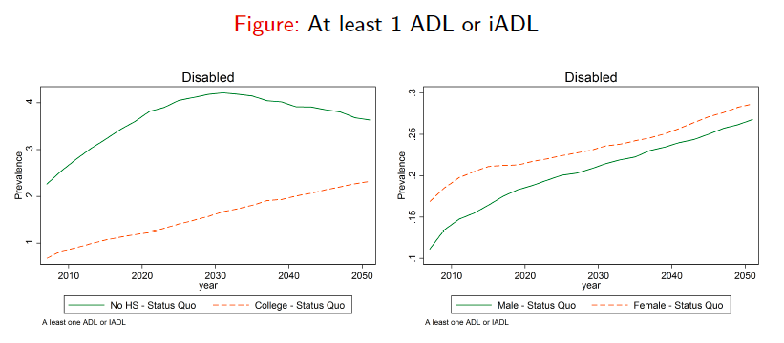
Results for EU-FEM

Slide 36
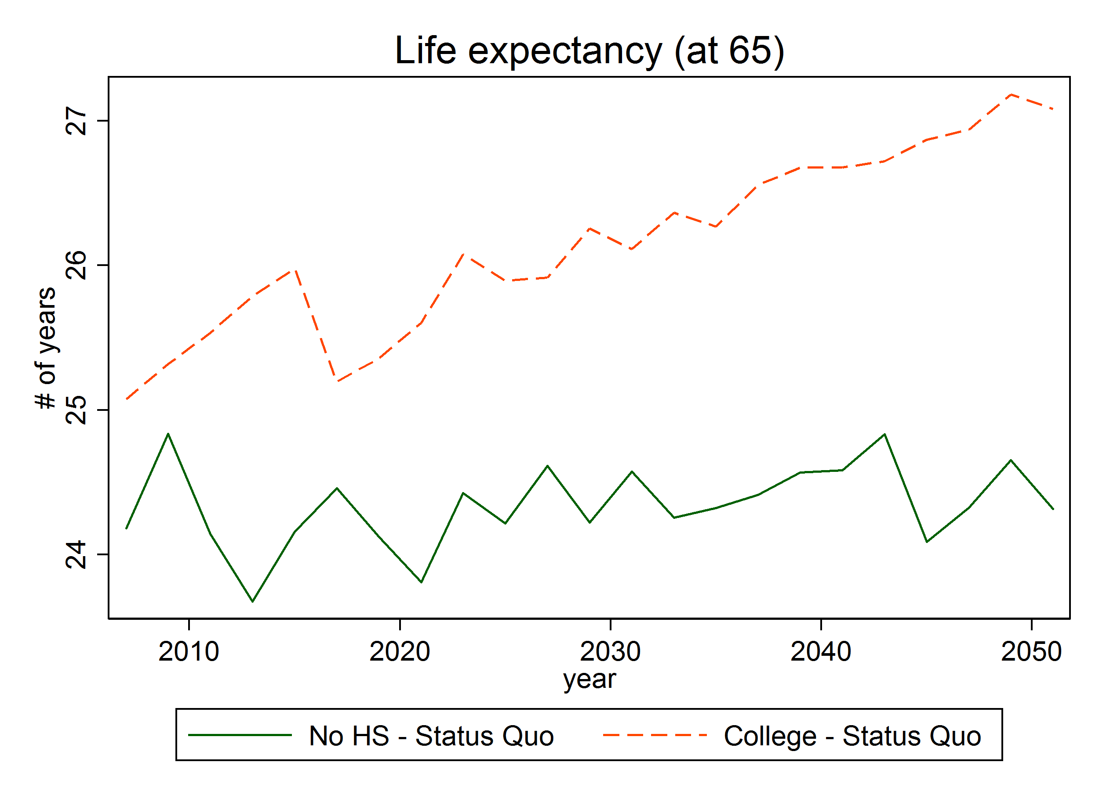
Results for EU-FEM

Slide 37
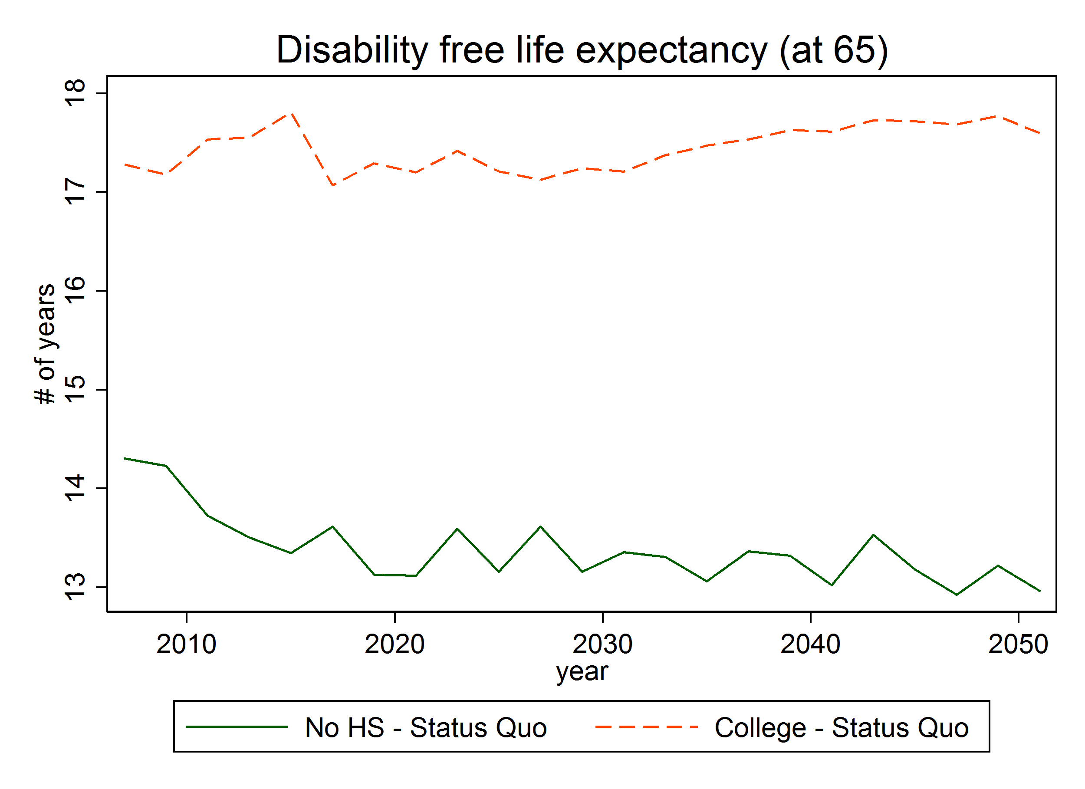
Results for EU-FEM

Slide 38
PART 3

Slide 39
Conclusions
LTC is growing, though it is still a small sector of the economy.
Although the LTC covers people of all ages, over 65 and especially over 80, are those with the highest chance of receiving LTC services. Among them, women are the main recipients of services.
The LTC is a highly labor-intensive sector, largely funded by public funds, with an average of 1.5% of GDP across the OECD and about 1.3% of the total OECD workforce is estimated to be engaged in this type of activity..
Most of the assistance is provided by informal care, especially women who work part-time in most countries.

Slide 40
Conclusions
Due to the variety of service recipients, governance, service delivery, and the workforce employed, LTC services are often fragmented and almost always the connection to the healthcare systems is poor.
There are big differences in size, benefits, target groups, use, supply, governance, and financing of LTC care across countries and, in countries, between regions.

