Slide 1
Pension Fund portfolio management: risk&risk premium, diversification, allocation and governance
Italy 1st – 15th July 2018

Slide 2
Index
  Financial Risk pag. 3
  Portfolio Management for Pension Funds pag. 11
    Pension Fund Risk
    Financial Risk and Actuarial Risk
  Portfolio Management: Governance pag. 16

Slide 3
  Financial Risk
Risk: ”The exposure to a future and uncertain event that can cause damage (danger)”;
“Risk is a concept associated with human expectations and their prediction / intervention capacity in unknown or uncertain situations.
Recent regulations define risk as "the effect of uncertainty on targets," pointing out that this effect can be both positive and negative. The word "risk" therefore appears more or less overlapping with the pair "risk / opportunity" or "danger / opportunity"
    - in finance - Risk: is the possibility of obtaining a return (result) in relation to the investment activity which is lower than expected, the loss (ie, yielding less than 0) is only one case.
      Financial risk of an investment is the distribution of possible deviations (realized returns) from the expected return or the target.
    - for a Pension Fund - Risk: is the chance to obtain a level of performance or a funding of the pension liabilities lower than expected/targeted;
Notes:
La nozione implica che una scelta influenzi il risultato. Le stesse perdite potenziali possono anche essere chiamate "rischi". Sebbene ogni comportamento umano sia rischioso alcuni hanno una percentuale di rischio maggiore.
Per "rischio" possiamo indicare anche la distribuzione dei possibili scostamenti dai risultati attesi per effetto di eventi di incerta manifestazione, interni o esterni ad un sistema.
The risk is identified by three elements: the damaging event, the intensity of the harmful event, and the likelihood that the malicious event will manifest itself.
Example damaging event: the loss due to the change in the exchange rate;
intensity of the harmful event: loss of 10% of the value of the investment;
probability of the event: 3%.

Slide 4
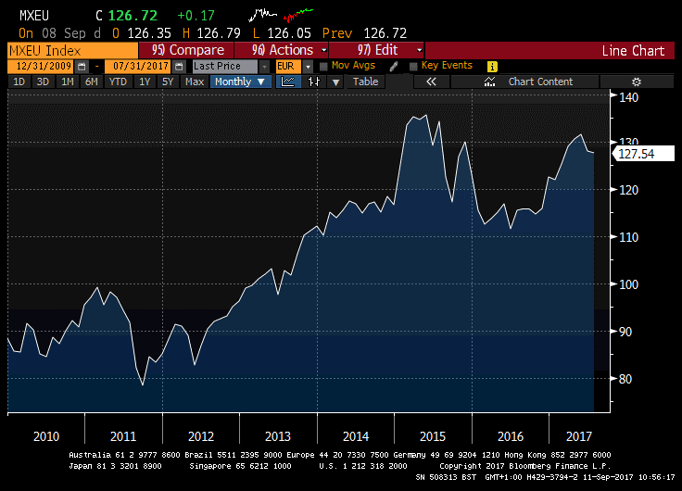
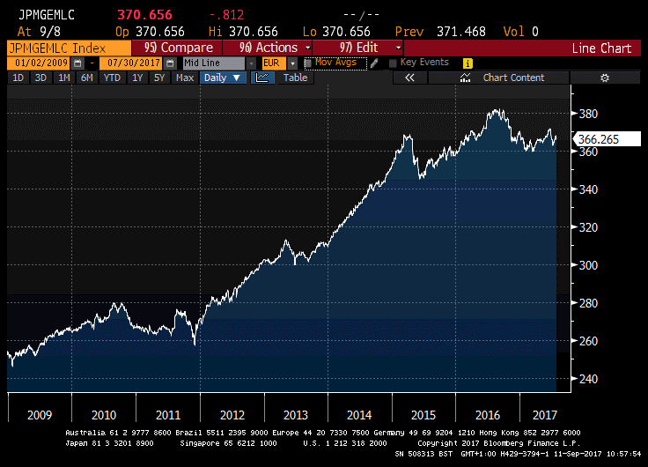
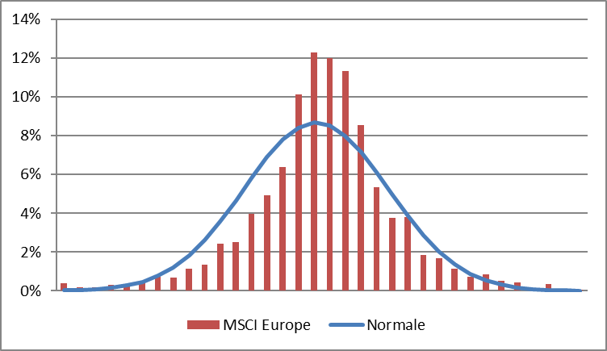
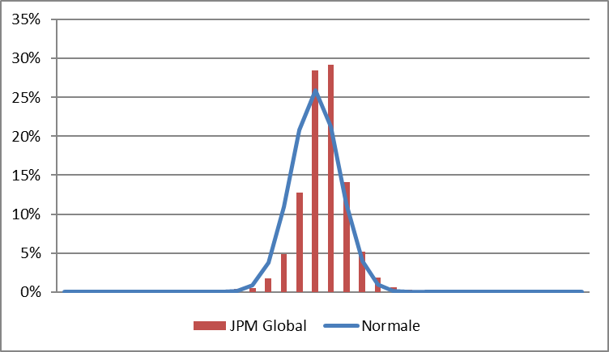
  Financial Risk
Expected Return
Expected Return
Freq. %
Return
Freq. %
Return

Slide 5
  Financial Risk
Risk
Systematic Risk
Specific Risk
Systematic Risk (or Market Risk) : It is the risk towards the market as a whole, it is linked to macro-economic factors (recession, economic growth, wars, monetary policy, etc ...) and market functioning (risk appetite).
not eliminable, only partially reduced for diversification
Specific risk (or Idiosyncratic Risk): peculiar and distinctive risk of the individual investment;
can be reduced by diversification
Notes:
As an example of systemic risk, the collapse of Lehman Brothers in 2008 caused major reverberations throughout the financial system and the economy. Lehman Brother's size and integration in the economy caused its collapse to result in a domino effect that caused a major risk to the financial system in the U.S.

Slide 6
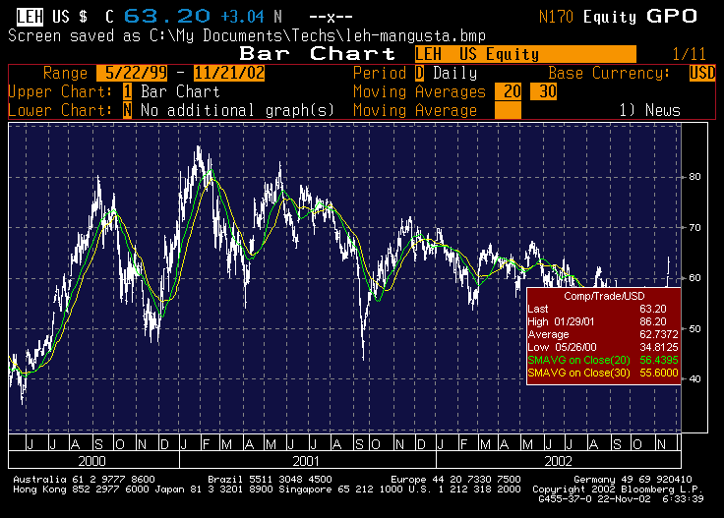
  Market Risk: an example

Slide 7
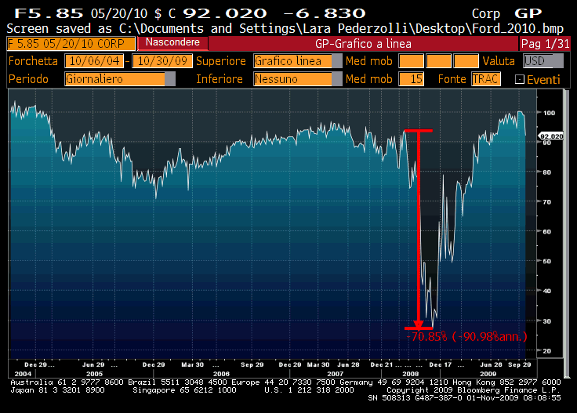
  Credit risk: an example
Corporate bond, fixed coupon 5.85%; maturity May 20, 2010
Notes:
Ford Rating S&P
Nov-03 BBB-
May-05 BB+
Jan-06 BB-
Jun-06 B+
Sep-06 B

Slide 8
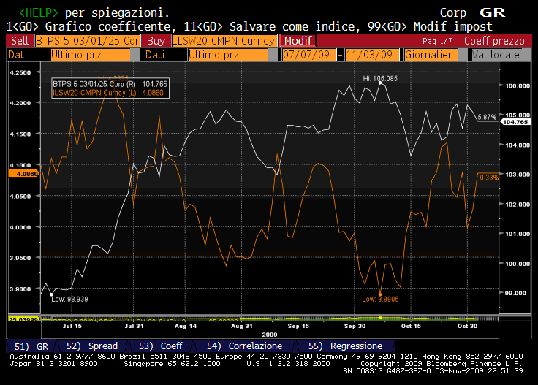
  Interest Rate risk: an example

Slide 9
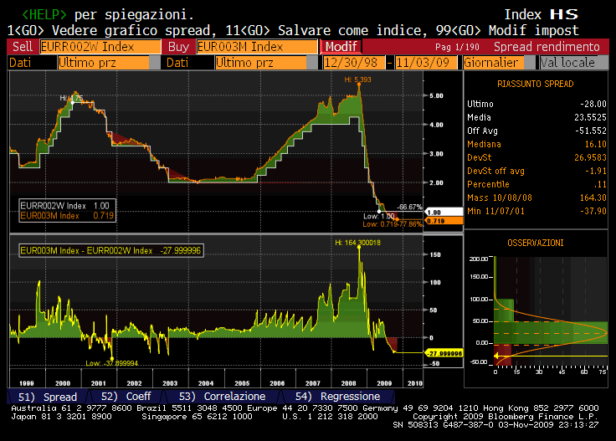
  Liquidity risk: an example
TED: Comparison between the official discount rate for Europe and the Euribor 3M
Notes:
Il money market è il mercato all’ingrosso della liquidità, mercato interbancario nel quale le banche si prestano o impiegano liquidità a varie scadenze. Euribor ed Eonia due indici molto usati nel money market

Slide 10
  Operational or counterparty risk: an example
The 10 events of greater operational loss in 2008

Slide 11
  Portfolio management: for Pension Fund
    - for a Pension Fund- Risk is: the chance to obtaining a level of benefit and / or financing of benefits lower than the targets set.
The target is
SUSTAINABILITY
(of PF)
SOLVENCY
(of benefits)
ADEQUANCY
(of benefits)
PF Defined Benefit
PF Defined Contribution
The risk is: do not pay the pensions
due to lack of financing/funding,
or financial resources shortage,
for inadequacy with respect to the function
The PF objective is the payment of adequate benefits that is sustainable over time.

Slide 12
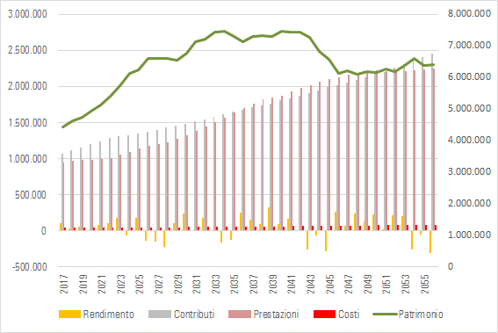
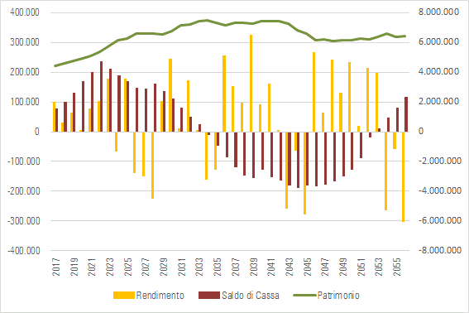
  Portfolio management: for Pension Fund
The riskiness of a pension fund depends on:
Decrease of contribution flows
increase in benefits, or
portfolio finance losses
can determine different levels of coverage (GAP) and therefore make necessary actions to maintain the adequate funding level.
    liabilities (the liabilities term structure)
    contributions (the contributory flows term structure)
    the available asset (amount and quality)

Slide 13
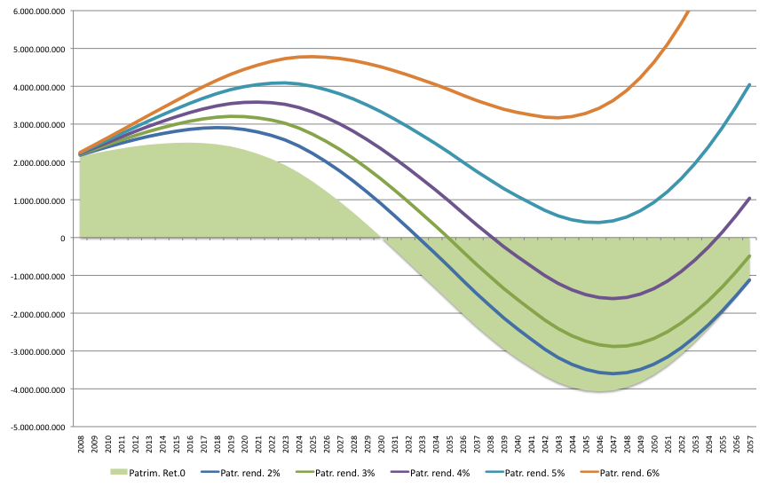
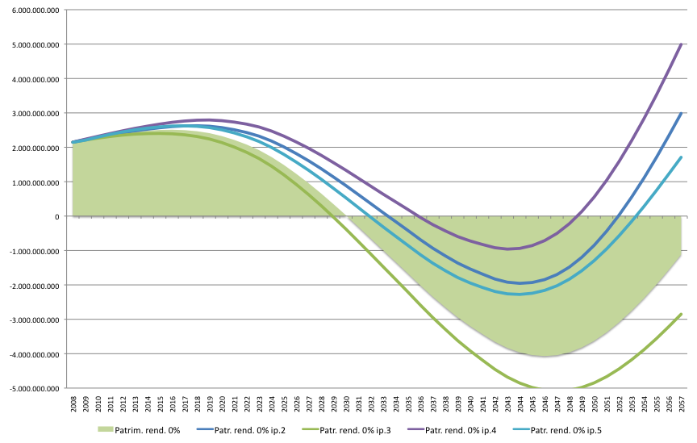
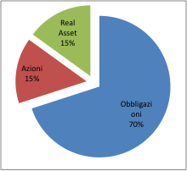
  Portfolio management: for Pension Fund
$$F\left(t+1\right)= F\left(t\right) + r\left(t+1\right) + C\left(t+1\right)−P\left(t+1\right)−O(t+1)$$
Asset (t+1) = Asset (t) + Return + Contributions – Benefits - Expenses
Financial Risk
Actuarial Risk
An inconsistent or inefficient investment policy cause an over-exposure to actuarial risk
A weak or unbalanced benefits/contribution rules or actuarial model leads to an over-exposure to financial risk
For both risk forms there are limits they can not overcome

Slide 14
  Portfolio management: for Pension Fund
The PF’ risk manifests itself as Asset Liabilities mismatching, due to:
an unexpected increase in the benefits’ amount or their anticipation;
an unexpected reduction in the contributions’ amount;
the setting of an insufficient or incoherent target return;
un asset’s inability to pay benefits (liquidity risk);
a financial loss or the failure to achieve the target return.
The fundamental safeguards to manage the riskiness of the pension fund are:
the combined management of assets and liabilities (ALM)
the assets and positions liquidity
the concentrations
the conflict of interests

Slide 15
  Portfolio management
Finance is the discipline that studies the processes by which individuals (institutions, people, businesses, etc.) manage money flows (allocations, uses, jobs, etc.) over time.
Finance "explores ways of allocating money between alternative uses, in order to maximize the investor's satisfaction. "
1.
The investor's satisfaction is the achievement of his goal, as a rule: to receive a certain yield (expected return) within a given time horizon compatible with his own level of risk appetite / aversion.
2.
Financial markets are the places where investors exchange risks against potential gains - returns - which are the remuneration that the investor receives for the risks he has exposed. Expected risks and returns are two related magnitudes and expressed by the prices of financial instruments.
3.
Portfolio management consists in spending “at best" the risk that is considered to be bearable and consistent with the objectives (the risk budget), by exposing itself to the financial risks obtained by investing capital, in order to maximize performance in relation to the its goal.
4.
5.
The institutional investor is a risk manager, yields are the effect of how he has "spent" his own risk budget between different risk premium due to market trends, pursuing its set of goals.

Slide 16
  Portfolio management: Governance
Financial management consists of spending at "best" risk budget on the basis of market conditions, by exposing the financial risks obtained by investing capital to maximize the risk premium in relation to its objectives.
To this end, the investor must continually:
  estimates and verifies benefits/contributions flows (realized and expected),
  measure the securities and PTFs risk premium,
  measure the securities and PTFs risk,
  assess risk based on his risk aversion,
  assess the adequacy of risk premium,
  evaluate profitability in relation to objectives,
  define constraints (risk budget) or maximize result.
risk
Risk
budget
Risk premium
(return)
Market returns
market
prices
uncertainty
Objective
(ALM)

Slide 17
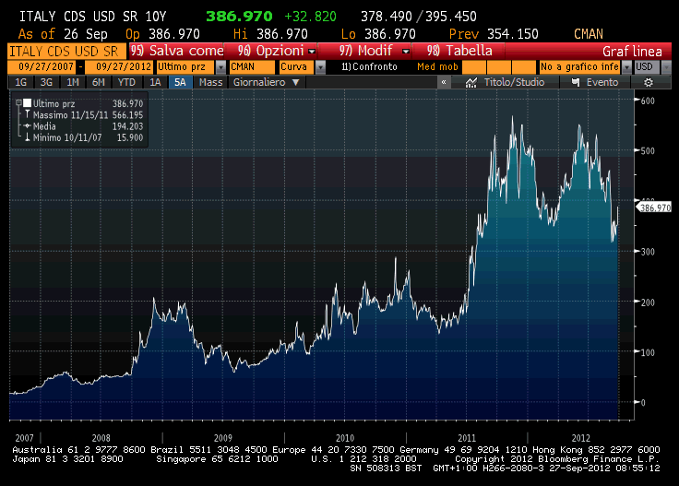
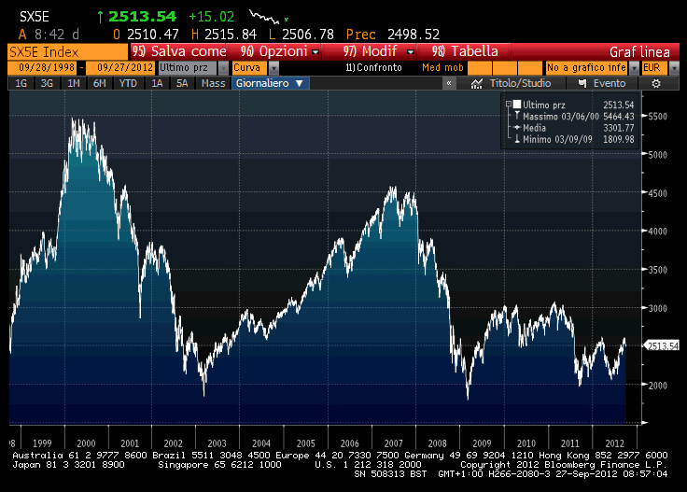
  Portfolio management: Governance
risk
risk
budget
risk premium
market returns
uncertainty
market
prices
Objectives
(ALM)
How can this complexity be managed?
There is just one single tool the “governance”, where by governance we mean the ability of an organization to function in a coherence and systematic manner with its goals

Slide 18
  Portfolio management: Governance
Governance consists of three main elements:
Institutional structure
Functions, statutes, regulations, agreements, rights, representation, bodies/organs, etc.
People
People, preparation, skills, responsibilities, powers, functions, experience, etc.
Processes
Procedures, Verifications, Tools, Frequency, Organization, Decisions, Information, Transparency, Processes, etc.
with two priority objectives:
Make timely and effective operational and management interventions that determine short-term performance without acting on the institutional structure;
2. Pursue long-term performance through the evolution and definition of the institutional structure.

Slide 19
  Portfolio management: Governance
  The governance (of an asset owner) is not a philosophical or generic theme of organization, but it is the central issue for long-term value creation.
  Governance can add or subtract returns, or rather increase or decrease risk-adjusted returns, depending on its quality.
  The quality of governance depends on:
    Full and constant exposure to risk (risk budget) for achieving the goals is the basis of every well-governed financial institution;
    The dedicated resources (invested) in its realization;
    The delegations and the operational spaces entrusted to it.
    “Governance budget” is the quality and quantity of investor's resources dedicated to governance, which results in the ability to create value through effective actions, processes, procedures and functions.
    Governance, in order to contribute in generating value over the long term, has to face and manage five fundamental aspects:

Slide 20
  Portfolio management: Governance
Pursue a clear goal, align with a common mission.
Pension Funds or more generally Institutional Investors represent and consist of a composite set of parties, stake holders and objectives. This element is made even more complex in organizations that often do not have an institutional and operational optimal organization, knowledge and experience.
Governance has to center the evolutionary and reforming capacity of the institution, change must be a natural and continuous process aimed at achieving common goals in an evolving and often transforming context.
Governance must be able to define alignment of objectives and interests among all involved parties (stake holders).

Slide 21
  Portfolio management: Governance
Beware of the time horizon.
Pension funds are characterized by a long term investment horizon, a key element of their risk / return profile. Management must include short-term interventions integrated with long-term choices, aware of the sequential nature of investment processes. Every effort must be made to maximize the benefits of the time horizon.
Governance must implement procedures and decisions that can benefit from short-term opportunities without penalizing long-term goals, eliminating impulsive choices and premature conclusions.

Slide 22
  Portfolio management: Governance
3. Focus on risk management
Pension funds operate in the financial markets, a difficult and hostile environment, characterized by continually evolving risks and situations of uncertainty. Risk management needs to implement qualitative and quantitative processes to analyze this constantly moving environment to allow the investor to continue using the risk budget to maximize profitability.
Governance must act and operate efficiently in a rapid evolving risks context, adapting effectively to market signals and conditions.

Slide 23
  Portfolio management: Governance
4. Innovation capabilities
Financial industry and markets are innovation generators, driven by huge profits from new market opportunities or their ability to transfer risks. An investor can benefit from this innovation if he is able to evaluate it, understand it, and manage it, aware of having to change his or her organization to do so.
Governance must be able to benefit from innovation through the ability to assess and understand new investment opportunities while applying new management and operational models; aware that today's risk management tools and procedures may be unsuitable for new financial products.

Slide 24
  Portfolio management: Governance
5. Efficient management of counterparties
Pension Fund activity is based on the extensive use of external entities, first of all the managers to whom the financial management is delegated. Selection, assignment and management of counterparties is a complex organizational theme that involves the Fund's competencies and procedures, but also sees a certain level of information asymmetry between the parties as well as potential sources of conflict of interest.
Governance must be able to handle this complex issue (agency issue) in order to provide the Pension Fund of the best Managers and other counterparties, capable to provide the best support to achieve the goals.

Slide 25
  Portfolio management: Governance
  Governance is the best investment to increase performance (and proper return on risk) and reduce the long-term risk of a Pension Fund.
  Financial markets are characterized by huge variations in risks and long periods of uncertainty that make risk management- which must be integrated into governance- the fundamental function of a Pension Fund.
  Expenses, time and resources dedicated to governance are not cost, they are an investment.
  The valuation of new investments / assets must always be compatible with the investor's governance. First the governance must evolve changes can occur in portfolios or asset allocation; the valuation of new investments / assets must be a stimulus to change / improvement.
  Enhanced and developed governance enables you to benefit from financial innovation and save on asset management.
  Governance "never sleeps", but it has to evolve continuously in its three fundamental components; its evolution is a priority of the Fund.

