Slide 1


the Italian Private, Supplementary Pension System:
Structure, Regulation, Supervision
Ambrogio Rinaldi
Central Director, COVIP
Component Two - 2018 Training Course “Financing the social security system in an ageing society:
the role of public finance and private supplementary funds”
INPS, Rome, July 6, 2018

Slide 2

Contents
Main structural features
Evolution since the set-up of the system in the 90’s
EU and Italian regulation
The organization of supervision
Main quantitative information (end-2017)
  members, contributions, assets
  asset allocation
  returns
  costs

Slide 3
the Italian Supplementary Pension System:
Main Structural Features
almost DC only since mid ‘90s (establishment of the current system)
different kinds of pension funds:
  «Contractual» Occupational Funds
    set-up at industry level for all sectors
    initiative by Trade Unions & Employers’ Associations
    non-profit
    some «regional» occupational funds
  Open Pension Funds
    established by financial and insurance groups
    open to individual & collective membership
  Insurance-based Personal Plans (PIPs)
  many «old» pension funds at company level
    on-going consolidation, transformation from DB to DC

Slide 4
the Italian Supplementary Pension System:
Evolution since the Set-up of the System in the 90’s
1993→: current system is introduced
  in the occasion of a major reform of 1° pillar pensions, to compensate pension cuts for future retirees
  significant tax advantages introduced
2005-2007 major reform
  system-wide auto-enrolment introduced
    based on severance pay «TFR» (7%of current wages) to be paid to pension funds
    limited success, comes on the top of contributions of 33% of current wages of to be paid for 1°pill. pensions
since 2015, introduction of «contractual enrolment» at industry level
  membership rises, but with low contributions

Slide 5
The Italian Supplementary Pension System:
EU and Italian Regulation
  Reference EU Directive: IORP I (2003), a «minimum harmonization» directive
    solvency requirements introduced, on the basis of «Solvency 1» EU regulation in place for insurance firms
    limited attention to DC plans
  National regulation more focused on DC plans. Main features:
    individual accounts
    mark-to-market valuation of assets
    comprehensive information to members
    comparability across all different kinds of plans
    members may transfer their accrued capital across different plans
  IORP II EU Directive approved in 2016 and to be applied by Jan2019
    attention to governance, key functions, internal controls
    increased attention to DC plans and info to members, but not beyond Italian regulation already in place
    transposition in the national legislation is in course
  Proposed EU Regulation on Pan-European Personal Pensions (PEPP)

Slide 6
The Italian Supplementary Pension System: the Organization of Supervision
  COVIP is competent for the supervision of all kinds of supplementary pension plans
    Independent Institution, Board appointed by Gvt for 7 years
    Comprehensive Regulatory and Supervisory Powers
      responsible for both prudential supervision and for information to members (consistently with a DC system where risks are held by members)
    Cooperates with other supervisory authorities of banking, financial and insurance sectors
    at EU level, participates in EIOPA work and decisions (supervisory convergence)
    Contributes to other international fora on pensions (OECD, IOPS, etc.) →IOPS meeting in Bejing next October !!

Slide 7
Supervisory Practices and Tools
  Structural/regulatory supervision
    Authorization – access to market
    Templates for by-laws, fund rules, information to members
  Controls
    desk-based checking of documents issued by pension plans
    regular reporting of all pension plans based on highly developed IT system
      data collected at the level of individual security and of individual member
    on-site inspections
  Letters of intervention
  Sanctions
  Last-resort Measures (winding-up, etc.)

Slide 8
Italian Supplementary Pension System:
Main Data (end-2017)
Assets 162 billion euro ( 9.5% GDP 3.7% Households’ assets)
Members 7.6 ml (28.9% work force)
Annual flow of contributions 14.5 bln euro (0.8%GDP)
  usually, 9-10% of current wages (7% TFR + 2-3% employer+employee contributions)
  about 2m members do not contribute

Slide 9
Pension funds‘ assets in % of GDP in OECD countries

Slide 10
Assets
Million of euros

Slide 11
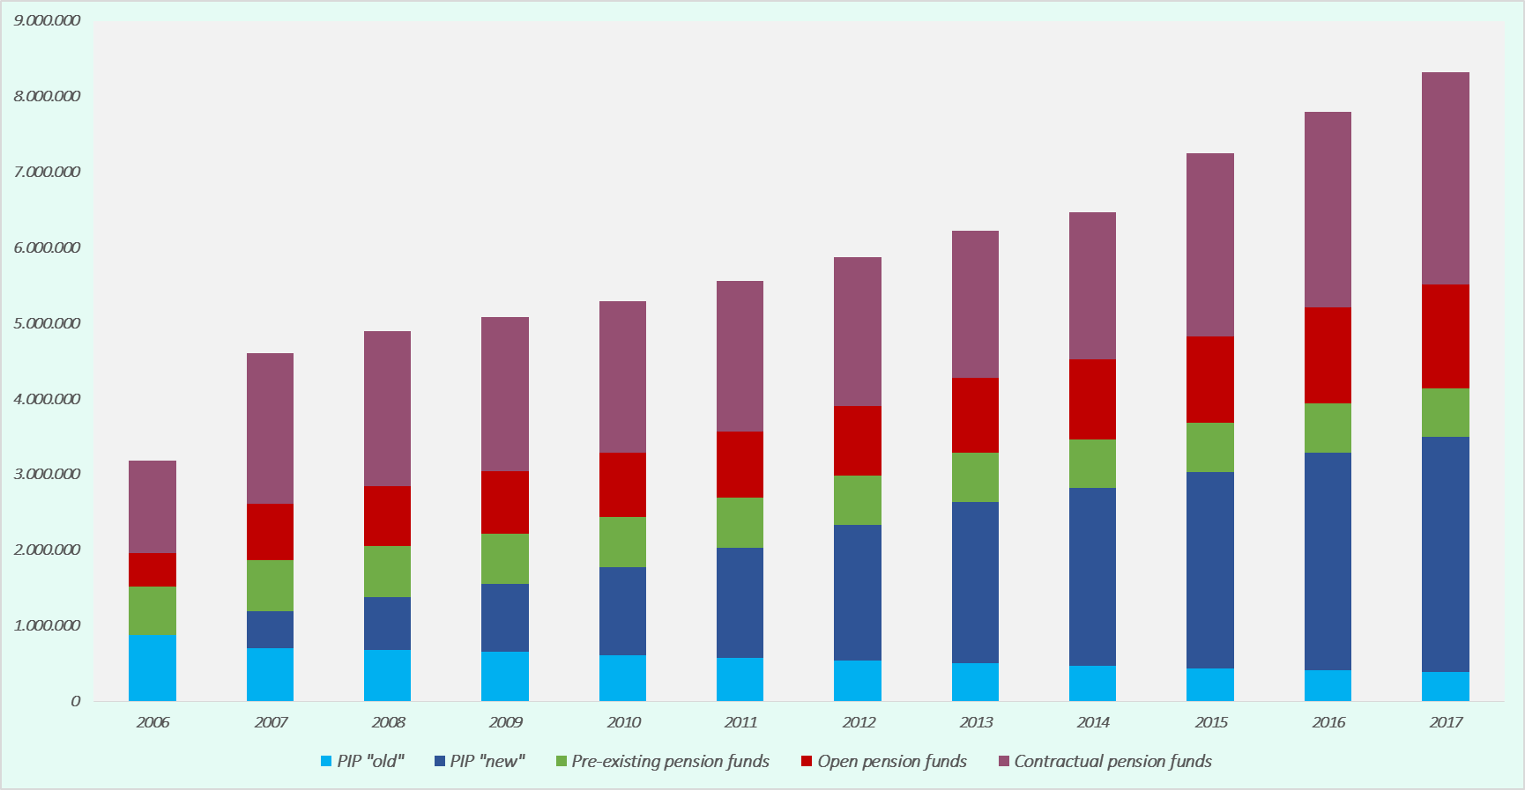
Members

Slide 12
Membership and Coverage Ratios by Age and Gender
Relazione Annuale 2017

Slide 13
Number of pension funds – Consolidation of the System

Slide 14
Investment Options
Most of pension plans offer to members a number of investment options: tipically, 4-5 investment options
Members choose the option they prefer
  in some cases, a default option applies
  in case of «silent/automatic» enrolment, an option has to be applied offering a return guarantee
    some concern about such guarantees in the current low-yield environment
Life-cycle investment options are possible, but still not very popular

Slide 15
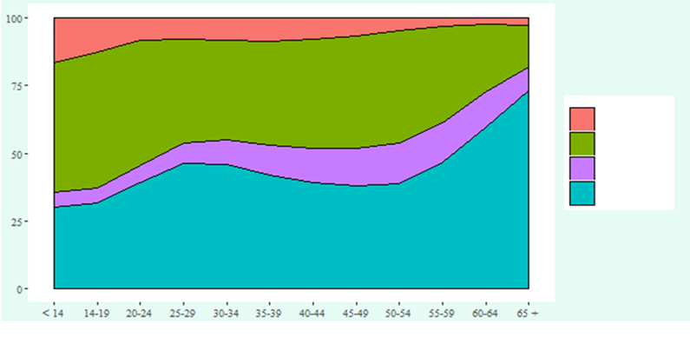
Investment options by age of members
Equity
Balanced
Bonds
Guaranteed

Slide 16
Asset Allocation

Slide 17
Asset Management, Returns and Costs
Contractual occupational funds have to appoint an external asset manager
Benchmark portfolios play a key role (Strategic Asset Allocation –SAA)
  actual asset allocation stays close to SAA (close-to-passive strategies)
Mark-to-market valuation is strictly required
  hesitance to invest in alternative assets
Conservative investment behaviour, little use of derivatives
  some concern for exposure to a persistent low-yield environment & to market risk, if rates go up and/or price of stocks go down
  anyway, returns have been quite OK so far, despite recurrent financial crises
Costs have been kept low for contractual pension funds, and contributed to their good net returns
For other kinds of plans, costs are higher and highly dispersed

Slide 18
Rates of Return

Slide 19
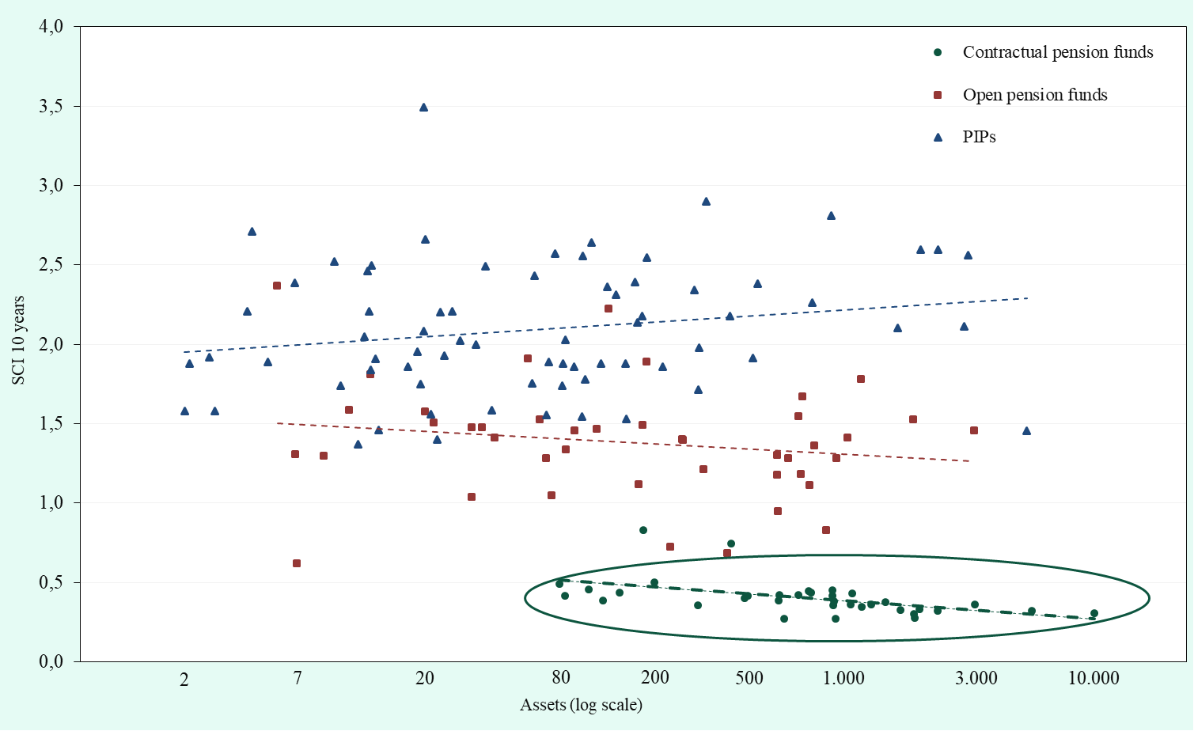
Costs by Type and Size of Funds – Level and Dispersion

Slide 20
Acronyms
DC Defined Contributions
DB Defined Benefits
EIOPA European Insurance and Occupational Pension Authority
IOPS International Associatio of Pension Supervisors
IORPs Institutions for Occupational Retirement Provision
OECD Organization for Economic Cooperation and Development

Slide 21
for questions and further information, please contact
rinaldi@covip.it

