Slide 1
Labour market and welfare policies in Italy
Prof. Stefano Sacchi
President, National Institute for Public Policy Analysis (INAPP)
Component Two- 2018 Training Course “Financing the social security system in an ageing society:
the role of public finance and private supplementary funds”
Italy, July 1st -15th, 2018

Slide 2
Index
Overview of the Italian labour market
Labour market and welfare policies
Recent employment protection legislation reforms
Recent unemployment benefit reforms
Recent short-time work reforms
Recent social assistance reforms

Slide 3
Growth and employment in and after the crisis
 | GDP annual % growth | Public debt | Government deficit | Unemployment as % of active population (15 - 74) | Youth unemployment as % of active population (15-25)
2007 | 1.5 | 99.79 | -1.52 | 6.1 | 20.4
2008 | -1.1 | 102.40 | -2.69 | 6.7 | 21.2
2009 | -5.5 | 112.54 | -5.26 | 7.7 | 25.3
2010 | 1.7 | 115.41 | -4.24 | 8.4 | 27.9
2011 | 0.6 | 116.52 | -3.71 | 8.4 | 29.2
2012 | -2.8 | 123.35 | -2.92 | 10.7 | 35.3
2013 | -1.7 | 129.01 | -2.94 | 12.1 | 40.0
2014 | 0.1 | 131.78 | -3.03 | 12.7 | 42.7
2015 | 1 | 131.54 | -2.58 | 11.9 | 40.3
2016 | 0.9 | 132.01 | -2.49 | 11.7 | 37.8
2017 | 1.5 | 132.14 | -2.12 | 11.2 | 34.7

Slide 4
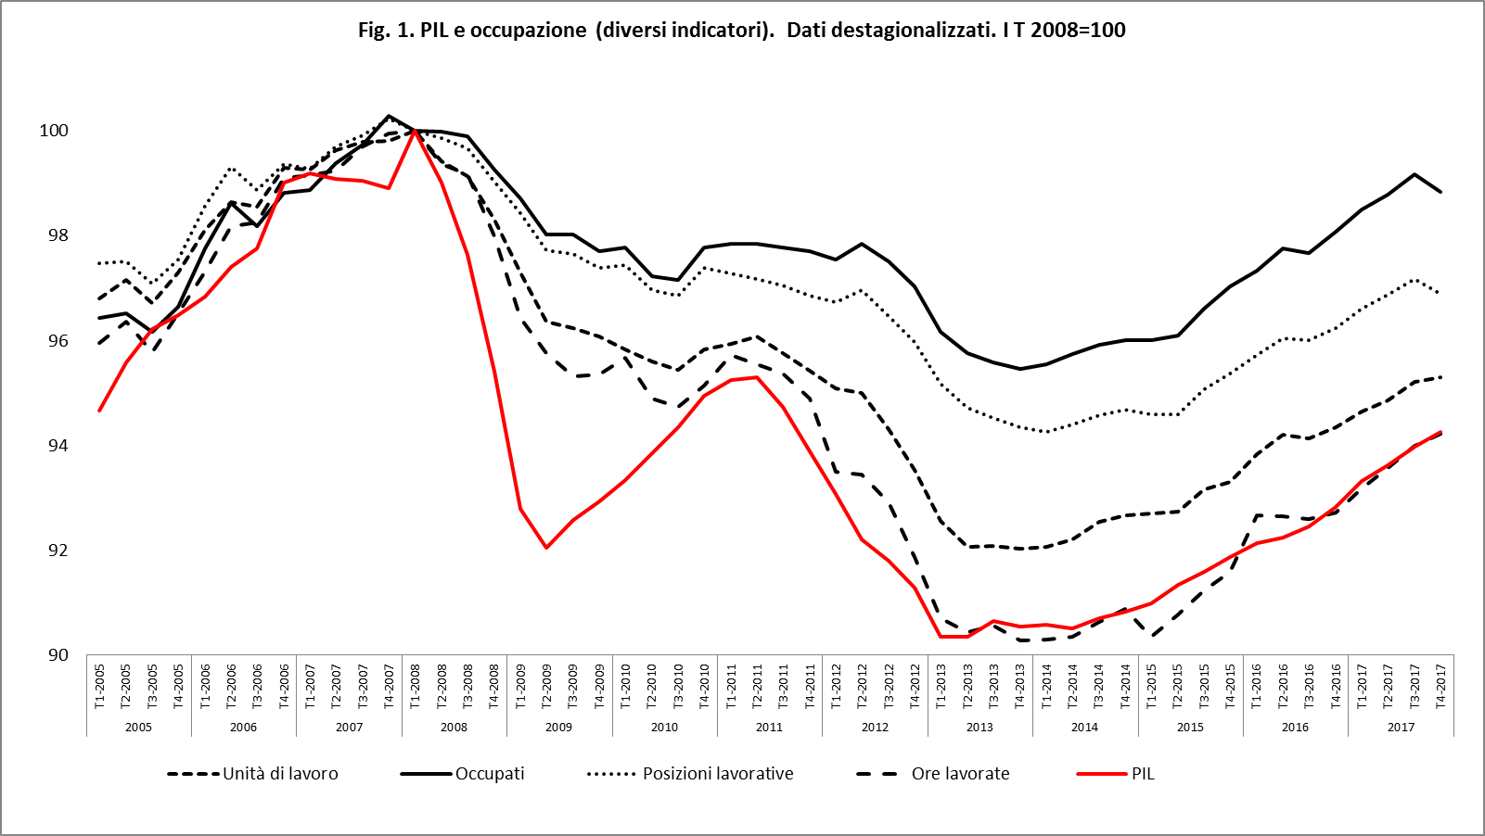
Growth and employment in and after the crisis
4

Slide 5
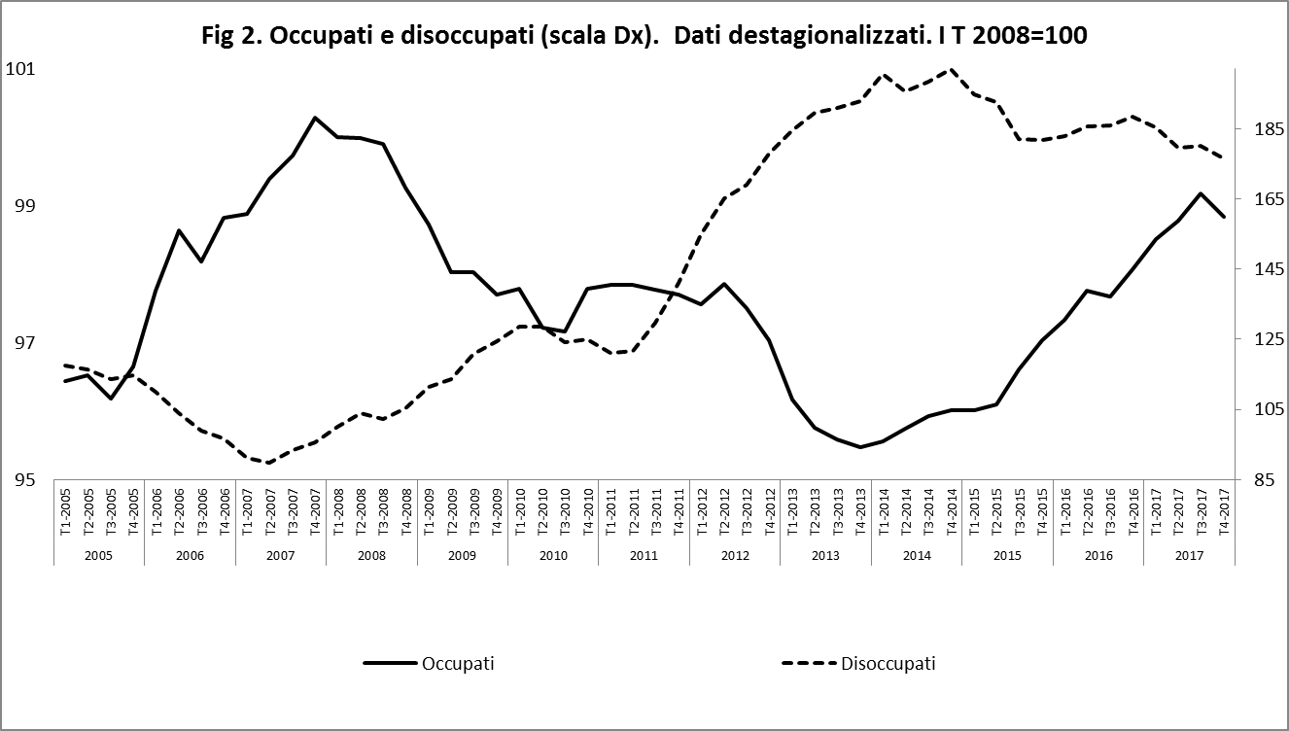
Growth and employment in and after the crisis
5

Slide 6
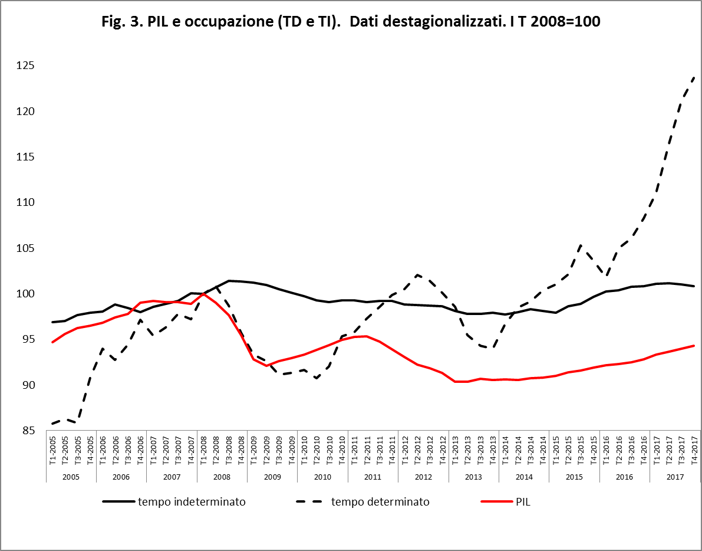
Growth and employment in and after the crisis
6

Slide 7
What we look at
Employment protection legislation
OECD LMP classification
8. Out-of-work income maintenance and support
8.1 Full unemployment benefits
8.1.1. Unemployment insurance
8.2 Partial unemployment benefits
Social assistance (minimum income scheme)

Slide 8
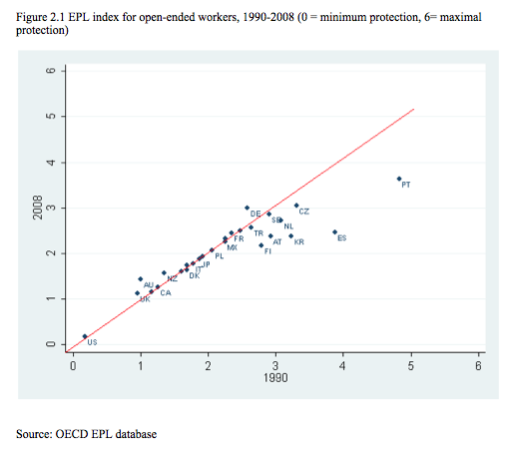
EPL open-ended 1990-2008

Slide 9
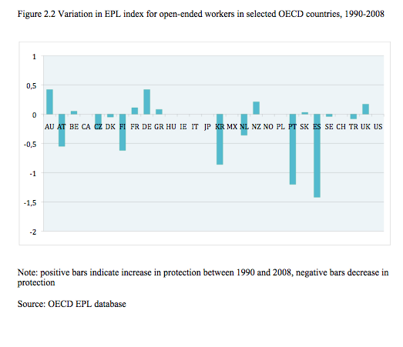
EPL open-ended 1990-2008

Slide 10
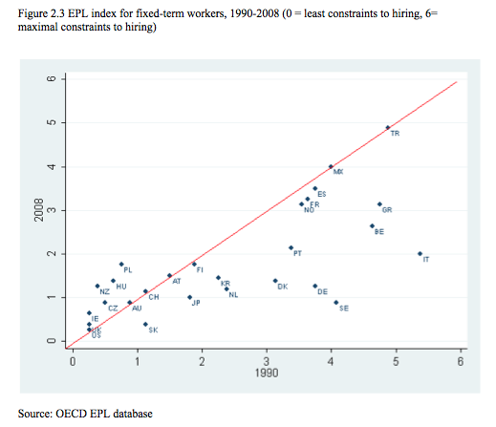
EPL fixed-term 1990-2008

Slide 11
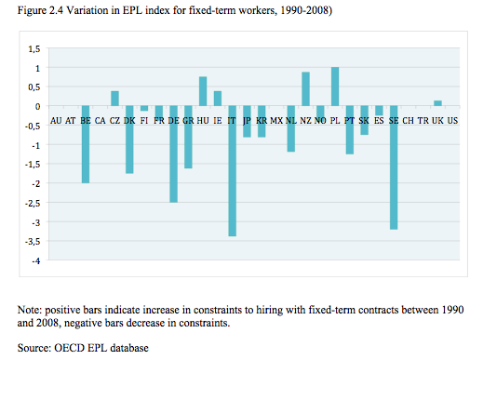
EPL fixed-term 1990-2008

Slide 12
Source: OECD
Share (%) of temporary in total dependent employment 1990-2012
 | 1990 | 2000 | 2012
UK | 5 | 7 | 6
Denmark | 11 | 10 | 9
France | 11 | 16 | 15
Germany | 11 | 13 | 14
Italy | 5 | 10 | 14
Spain | 30 | 32 | 24
EU-21 | 10 | 13 | 14
OECD | 10 | 11 | 12

Slide 13
Source: OECD
Share (%) of temporary in total dependent employment, 15-24 – 1990-2012
 | 1990 | 2000 | 2012
UK | 10 | 13 | 15
Denmark | 30 | 30 | 21
France | 38 | 55 | 55
Germany | 34 | 52 | 54
Italy | 11 | 26 | 53
Spain | 66 | 69 | 63
EU-21 | 26 | 36 | 39
OECD | 20 | 24 | 24

Slide 14
Policy response: Italy’s “Jobs Act”
A consistent project of both labour market institutions and social protection reform, inspired by flexicurity
Introduced in Parliament in April 2014, government entrusted by Parliament with the introduction of reform within set guidelines in December 2014
Whole reform (8 decrees) completed by September 2015 (10 months)

Slide 15
Jobs Act: the objectives
More and better jobs
More jobs in the medium run
Better jobs from now
Animal spirits and internal demand
More favourable conditions for firms
Jobs and rights for workers
Trade-off btw these aims: seeking a balance
Building confidence towards Italy
Attracting foreign investors
Building credibility through delivery

Slide 16
Jobs Act (EPL reform): motivation
Transitions
Port of entry: Transitions twd open-ended contracts always more likely for those empoyed – irrespective of contract type – than for not-employed
Persistence (entrapment): Individual characteristics being equal, irrespective of the type of contract currently held, the most likely future event is to hold the same type of contract currently held
Reduced human capital accumulation in fixed-term contracts is both cause and consequence of persistence

Slide 17
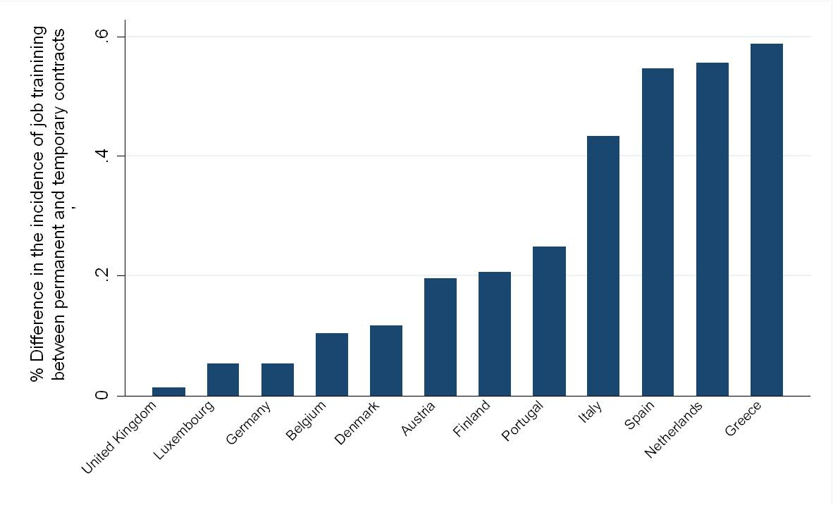
Jobs Act (EPL reform): motivation
On-the-Job Training Opportunities for Temporary Workers
(Boeri, 2010)

Slide 18
Jobs Act (EPL reform): motivation
Consequences
Segmentation btw standard/non-standard becomes a generational divide
Negative effects on human capital at the macrolevel through reduced investment in training at the individual level
Negative systemic effects: low productivity growth (wealth of evidence: Bank of Italy, Isfol)
Through social insurance, segmentation in social protection: flex-insecurity

Slide 19
Jobs Act: the new open-ended contract
Applies to new hirings
You pay, you fire. You know how much.
Firing costs increase with seniority within the firm
Employer can make an offer to the employee: 1 monthly wage per year of seniority – min 2 max 18 monthly wages
Offer is tax-free for the worker
If the worker accepts, contract is terminated
If worker does not accept, goes to court and wins the lawsuit for unfair dismissal, NO LONGER REINSTATED
Price for unfair dismissal: 2 monthly wages per year of seniority – min 4 max 24 monthly wages – taxed
Reinstatement only for discriminatory dismissals

Slide 20
Jobs Act: the new open-ended contract
Policy objectives
To reassure and invite investors: firing costs are certain and known in advance; very limited role of the courts
To make the (new) open-ended contract the “master contract” through the functioning of the labour market: tackling the human capital trap
New contract coupled with substantial tax incentive for employers (up to 8,000 € contribution exemption per year for 3 years )

Slide 21
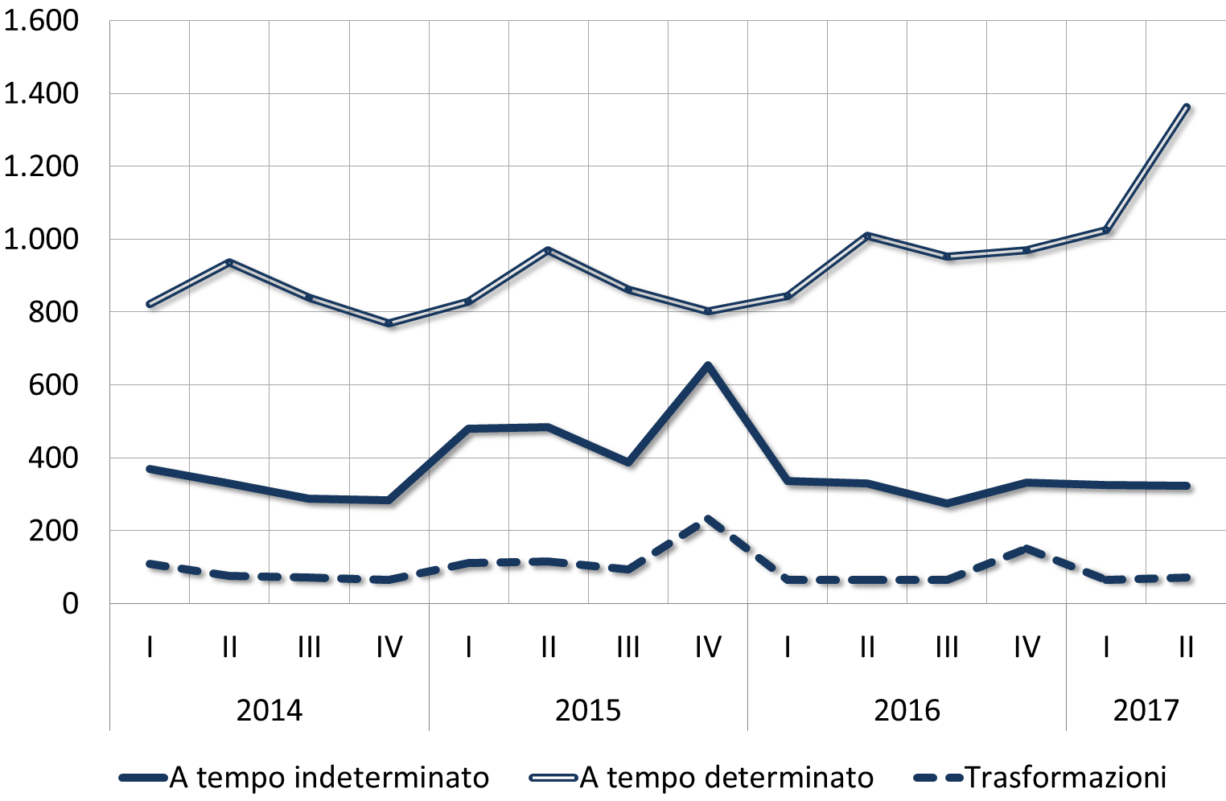
New hires and transformations, 2014-16
X 1,000
Source: INAPP elaborations on INPS data

Slide 22
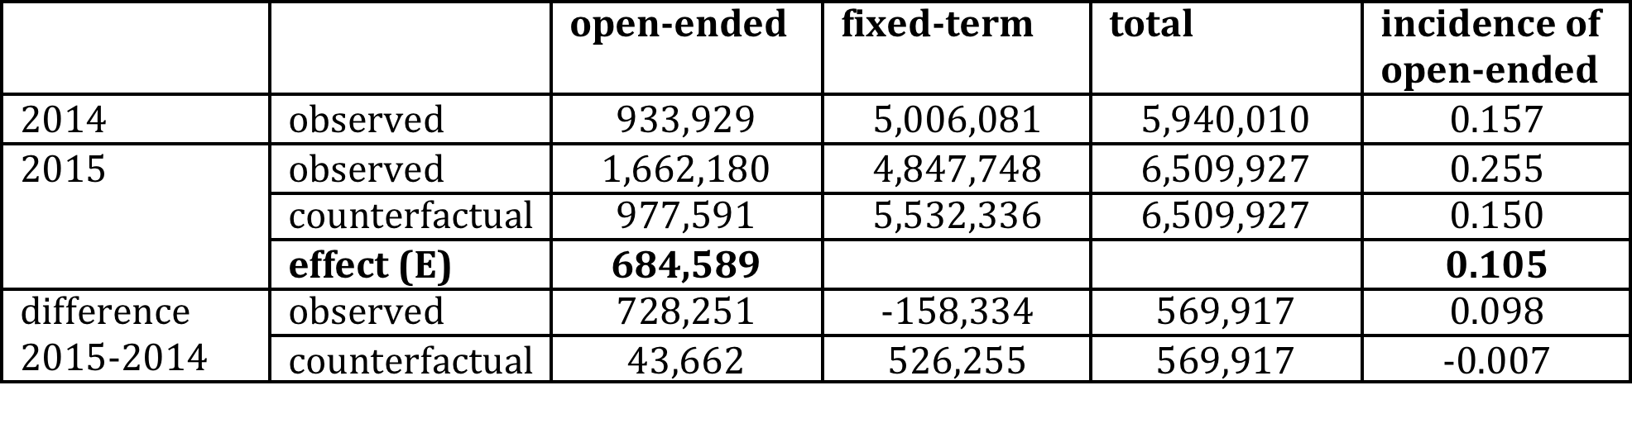
Counterfactual evaluation of the Jobs Act
Social security contribution reduction and employment protection, Year 2015
Newly established contracts of eligible workers*, both fixed-term and open-ended:
observed values and counterfactual scenario (i.e. in the absence of regulatory changes). Years 2014-2015
Treatment group: workers eligible for the social security contribution reduction and, since 7 March 2015, for the new open-ended contract type (contratto a tutele crescenti)
Source: INAPP elaborations on CICO, MLPS data

Slide 23
Temporary work still growing
23

Slide 24
Temporary work still growing
In 2014 the government made it easier to hire through fixed-term contracts. These provisions later written into one of Jobs Act implementing decrees
These provisions had some beneficial effects (reduction of court litigation), but at the same time went in a different direction than the new open-ended contract, reducing overall consistency of the reform
The new government just introduced a decree (to be ratified or amended by Parliament) that aims at correcting this, limiting the use of fixed-term contracts

Slide 25
Out-of-work income maintenance transfers Evolutionary background
Italy introduced UB in 1919, but did not develop them in the golden age or after the oil shocks
Italy relied on short-time work (cassa integrazione) introduced in the 1940s (war damages, post-war reconstruction) and expanded in all the post golden age crises
Interaction of STW with bankruptcy laws for large companies at the core of Italian state-assisted capitalism
Prominence of STW crowded out modern system of UB and ALMP
No minimum income schemes: no nation-wide safety net for the poor

Slide 26
Income maintenance transfers reform
Strengthening income protection for the workers
Recalibrate protection from the job to the worker
Support transitions between employment states
Strengthening unemployment benefits
  Broader coverage, inclusiveness and duration (linked to contribution record)
  New scheme after exhaustion of unemployment insurance benefit (later merged into new minimum income scheme)
Rationalize short-time work (STW)
  Original function of maintaining skills
  Enlarge protection

Slide 27
UB requirements
New Italy’s UB (NASPI): 3 months in the past 4 years
Germany: 12 months in the past 2 years
Spain: 12 months in the past 6 years
Denmark: 12 months in the past 3 years
France: 4 months in the past 28 months (3 years for over-50)
Also: DISCOLL for w&s independent contractors, PhDs, postdocs. Same rules as NASPI but reference period from 1 January of previous year to event; limited to 6 months

Slide 28
UB schemes compared
 | Italy | Germany |  | Spain | DK | France
Duration rule (weeks of duration:weeks of contribution) | 1:2 | 1:2 |  | 1:3 | - | 1:1
Maximum duration (months) | 24 | Depends upon age |  | 24 | 24 | Depends upon age
 |  | <50 | 12 |  |  | 24
 |  | 50-55 | 15 |  |  | 36
 |  | 55-58 | 18 |  |  | 36
 |  | >58 | 24 |  |  | 36
Replacement rate (first month) | 75% gross wage up to a ceiling (1195€), then 25% | 60% net wage |  | 70% gross wage | 90% gross wage | 40% of wage + €11,76 a day; or 57% of wage within 75% of wage

Slide 29
UB schemes compared
 | Italy | Germany | Spain | DK | France
Family benefits | Yes | Yes (increase to 67% of wage) | Yes (increase of ceiling to 1,170 euro/month) | No | No
Benefit ceiling | 1300€/month | Approx. 3600€/month in Western Lander | Approx 1060€/month | Approx 2200 €/month | No
Taxation | Yes | Yes | Yes | Yes | Yes

Slide 30
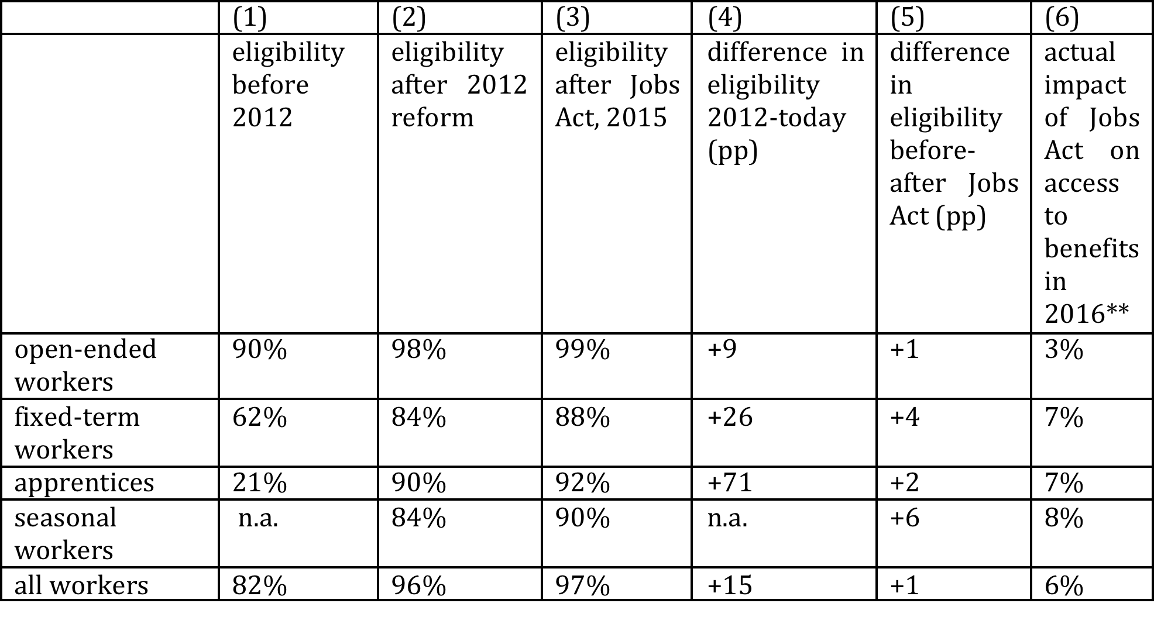
Eligibility to UB by type of contract, 2016

Slide 31
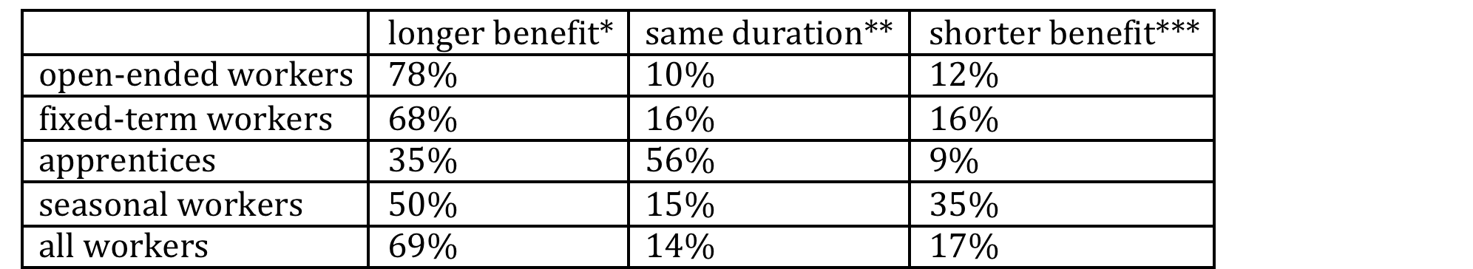
Impact of JA reform on UB duration,
by type of contract
* duration of benefit under 2015 rules is at least four weeks longer than under 2012 rules
** duration of benefit under 2015 rules is no more than four weeks longer or shorter than under 2012 rules
*** duration of benefit under 2015 rules is at least four weeks shorter than under 2012 rules
Source: Own calculations on INPS data

Slide 32
Short-time work reform
Aligning individual with social costs: decreasing contribution to the scheme, increasing company co-payment upon usage (also: co-payment progressive in benefit duration)
Limiting duration (2 or 3 years within a 5-year moving period)
Exclusion in case of company closure
Extension to hitherto excluded workers (+400,000)
Extension to hitherto excluded firms (+1.5 million)
Structural budget savings for approx. 1 bln € / year

Slide 33
The new social assistance scheme
Reddito di inclusione (inclusion income)
Anti-poverty measure aimed at all residents, targeted to the poor through a means-test (household income and wealth)
Two components:
Monthly cash transfer
Social and work activation/inclusion programme, involving the whole household

Slide 34
Funds for anti-poverty measures, 2012-2021 (millions of euro)

Slide 35
Eligibility criteria
ISEE (means testing) no higher than 6,000 euro
ISRE (income component of ISEE) no higher than 3,000 euro
Real estate wealth: Home wealth disregarded, other real estate no higher than 20,000 euro
Financial wealth: no higher than 6,000 euro (single); 8,000 euro (couple); 10,000 euro (households with at least 3 members)

Slide 36
Cash transfer
Difference btw threshold (3,000 euro) and ISRE
Covers up to 75% of threshold (those closer to threshold are excluded)
ISRE?
Household incomes adjusted for family size (equivalence scale)
All incomes taken into account (except disability benefits)
Disregard of rent up to a 7,000 euro/year + 500 euro per child (after the second)
Labour income disregard of 20%, up to 3,000 euro

Slide 37
Cash transfer
Number of household members | Eligibility threshold (incomes in €, net of rent and other disregards) | Gross incomes*
1 | 3,000 | 8,250
2 | 4,710 | 11,137
3 | 6,120 | 13,650
4 | 7,380 | 15,780
5 | 8,550 | 17,550
* hp: paid employment, rent 300 €/month, increased by 50€/month for each additional household member)

Slide 38
Cash transfer
Number of household members | Income threshold* | Eligibility threshold (75% of income threshold) | Maximum benefit amount (monthly)
1 | 3,000 | 2,250 | 187.5
2 | 4,710 | 3,532 | 294
3 | 6,120 | 4,590 | 382.5
4 | 7,380 | 5,535 | 461
5 | 8,550 | 6,412 | 534
6 or more | 8,637 | 6,478 | 540
* Net of rent and other disregards

Slide 39
Individualised insertion programme
Claimant and household catered to by municipalities (social services)
Multidimensional assessment of needs (want of work, medical conditions, substance abuse, mental diseases, etc)
Social services liaise with other specialists from other administrations (multidisciplinary équipes): PES, National Health System, Substance Abuse Units, etc.
Individualised insertion (and activation) programme signed
Contract between household and public authority, envisages sanctions if no compliance (conditionality)

Slide 40
REI: outlay, beneficiaries, duration
Approx. 3 billion/euro per year (0.17% GDP)
2 billion/euro alloted to cash transfer, the rest devoted to services
Covers half of population in “absolute poverty” (actually a reference budget)
700,000 households
2,5 million individuals (700,000 of which underage)
Maximum benefit duration 18 months, followed by a 6-month waiting period , then 12 more months are possible
40

Slide 41
Expenditure on STW, 2017 (millions of euro)

Slide 42
Expenditure on main UB, 2017 (millions of euro)

Slide 43
Expenditure on other UB, 2017 (millions of euro)

