Slide 1
The Italian Social Security Policy Response to Population Ageing
Michele Raitano (Sapienza University of Rome)
Component Two- 2018 Training Course “Financing the social security system in an ageing society:
the role of public finance and private supplementary funds”
”
Italy, July 1st-15th, 2018

Slide 2
Index
A preliminary issue: demographic risks in PAYG vs funded schemes => how to deal with the «disappearance» of the young?
Demographic projections in Italy and their effects on pension spending
Italian pension reforms to cope with an ageing population: automatic increase in retirement ages and exceptions for heavy workers
Are there heterogeneities in older workers employability?
Pension adequacy and increase in retirement age

Slide 3
Demographic risks in public pensions (a)
PAYG has an explicit intergenerational link. In financial equilibrium:
twL=pN ⇒ t=p/w*N/L
Are N and L purely exogenous variables? Role of pension, labour market and immigration policies (and demographic policies in the very long run)
Does the financial equilibrium only depend on the number of producers?

Slide 4
Demographic risks in public pensions (b)
Are funded scheme neutral with respect to population ageing?
What is the role of financial markets? What are the drivers of stocks and bonds prices?
Trade off between risks and diversification in international financial markets.
The crucial dimensions is always the total production (in a country or worldwide).

Slide 5
What would happen in a “world without young”?
A general issue related to demographic risks: What would happen in a world without young (i.e. the last generation abstraction)? Or without jobs? Or in a permanent stagnation context?
When these scenarios do not affect total product, but the number of producers only: distributive issue, unrelated with the impossibility of a pension scheme => Issues related to computation method rather than to financing methods
In permanent stagnation limits for both PAYG and funded schemes

Slide 6
Determinants of projected pension spending
Mechanical exercises (no general equilibrium models) on current pension rules based on several assumptions on:
  Demographic trends: fertility, mortality, migration rates and migrants’ composition
  Employment rates by age and gender
  Productivity growth
  => GDP growth
N.B. Projections not forecasts! The baseline scenario is the central scenario, not the most likely scenario.

Slide 7
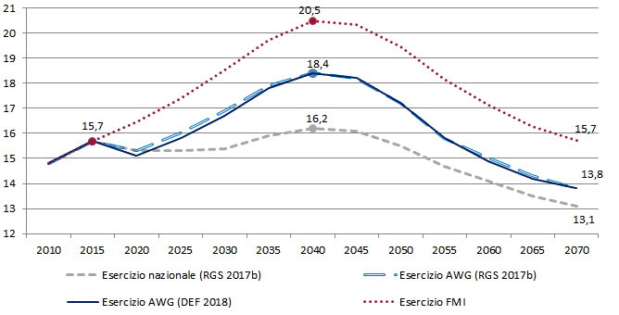
Projections of gross public pension spending in Italy

Slide 8
The uncertainty of demographic projections

Slide 9
Life expectancy at birth according to AWG 2018

Slide 10
Life expectancy at age 65 according to AWG 2018

Slide 11
The uncertainty of employment rate trends

Slide 12
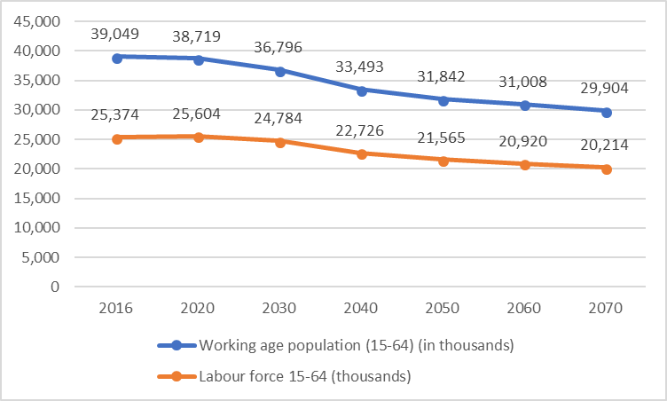
Labour force according to AWG 2018

Slide 13
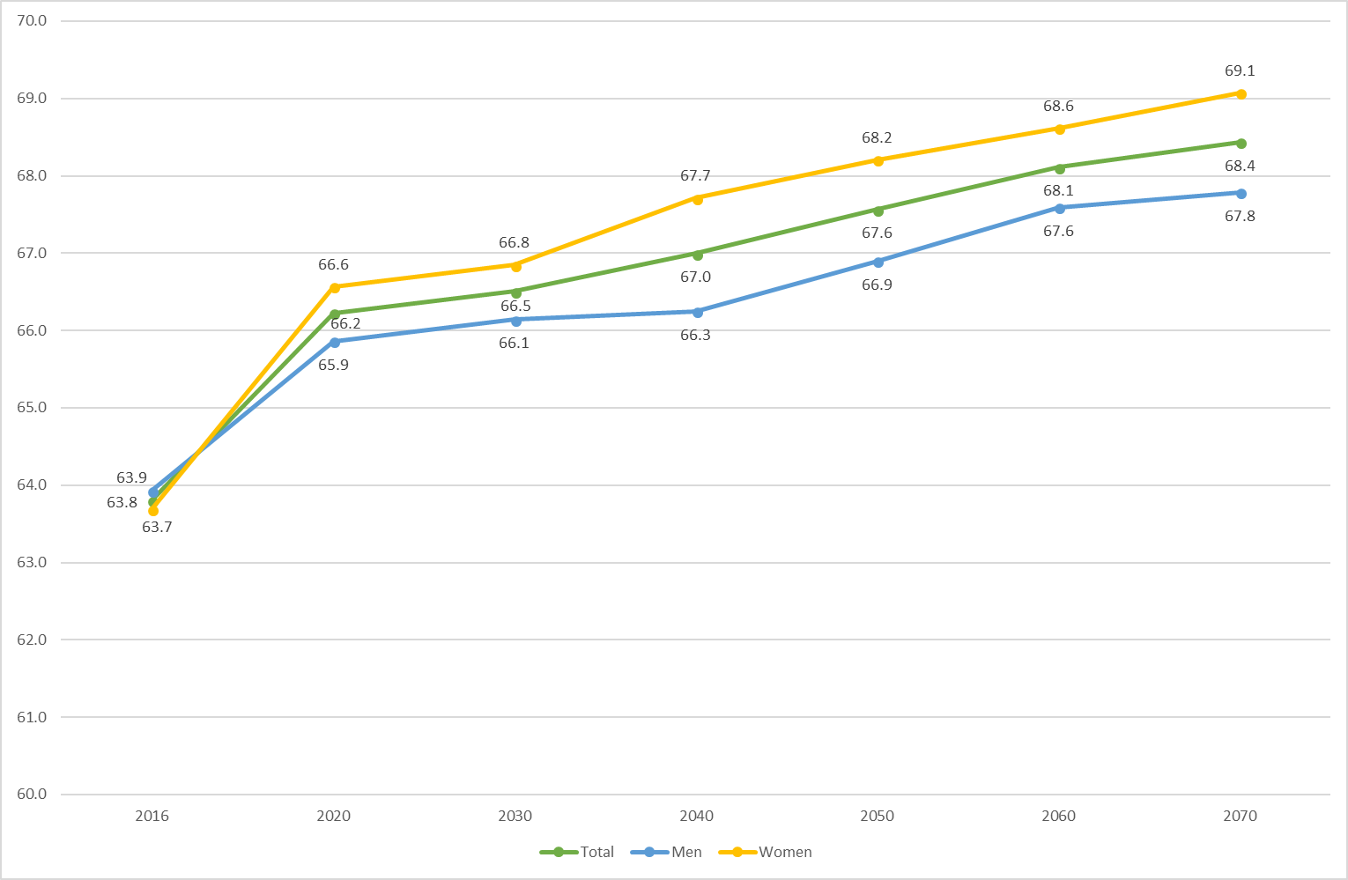
Effective retirement age according to AWG 2018

Slide 14
Projected dependency ratios according to AWG 2018

Slide 15
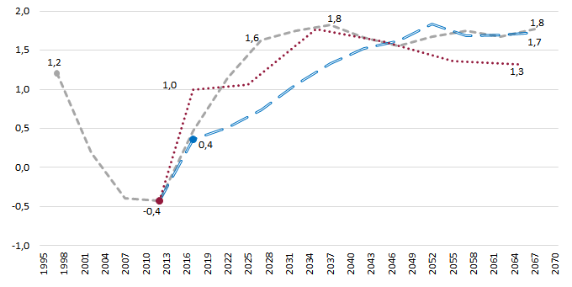
Assumptions on productivity growth

Slide 16
The uncertainty of GDP growth

Slide 17
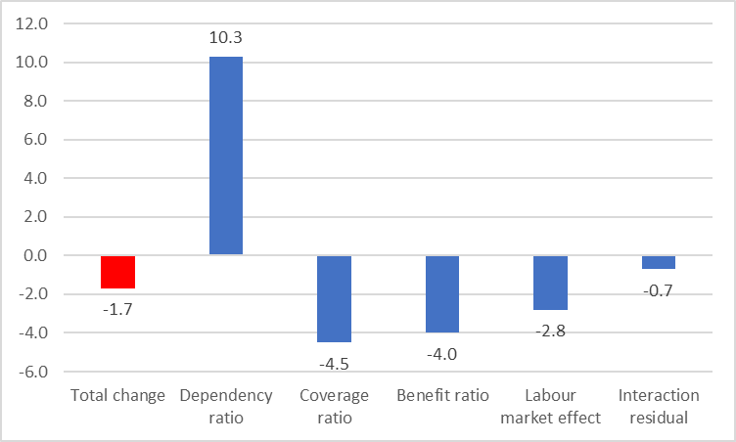
Determinants of pension spending change 2016-2070

Slide 18
Ageing and pension rules in Italy
2009-2011 reforms established the automatic link between changes in life expectancy at birth and eligibility requirements for pensions
Ratio 1:1 in retirement age increase WRT life expectancy increase
Automatic increase in both earnings related and NDC schemes
Limited flexibility in retirement age in the NDC inconsistent with the NDC logic:
  retirement allowed 3 years before the standard age for those with a pension amounting at least 2.8*social assistance benefit
  retirement allowed 4 years after the standard age for those with a pension lower than 1.5*social assistance benefit

Slide 19
Expected requirements for old-age pensions in 2011

Slide 20
Expected requirements for early retirement in 2011

Slide 21
Recent Italian reforms about retirement ages
Update in retirement ages in 2019: 67 years or 43 contribution years and 3 months (42+3 for females) for early retirement
Advanced pension with a bank loan “Voluntary APE” (trial until 2018) since age 63 (costly for workers) or “firm APE” (costs paid by the firm)
Social APE for some categories: disabled, long-term unemployed, and those with 6 out of 7 final years worked in 15 types of “heavy jobs” and 36 years of total contribution => how are these jobs defined?
Heterogeneity in workability and life expectancy according to the type of job => an expert Commission established by the Budget Law for 2018
Are life expectancy homogenous? Implications for the NDC

Slide 22
Heterogeneity in elderly employability: open questions
Is retirement postponement a free choice of the worker?
Are older workers homogenous?
Is the productive system able to provide labour supply for an ageing workforce?
Could the increase in retirement age determine a reduction of potential output trough a lower productivity?
Rapid increase of eligibility requirements puts stress on LMPs and welfare system.

Slide 23
Implicit assumptions behind the 2011 reform
Low employment rates of older workers in Italy were considered due only to loose eligibility requirements => belief in a sort of “Say law” of older workers supply.
Limited attention to the interplay of individual characteristics affecting both labour demand and supply, i.e. skills, health status, family needs.
However, clear evidence that retirement age and employment chances strongly depend on individual characteristics, mostly favouring the well-off workers => are older individuals’ employment rates by their characteristics (e.g. education)?
Clear merits of introducing tools as the APE
From risks to become a poor pensioner to the risk to become an old unemployed?

Slide 24
Elderly emp. rates: All educational groups

Slide 25
Elderly emp. rates: At most lower secondary graduates

Slide 26
Elderly emp. rates: upper secondary graduates

Slide 27
Elderly emp. rates: tertiary graduates

Slide 28
Elderly emp. rates: all educational groups - Males

Slide 29
Elderly emp. rates: tertiary graduates - Males

Slide 30
Population ageing and pension adequacy (a)
Earnings related benefits independent on retirement age, but on (mostly) final wages and years of contributions
P_{ER}=c*CY*W_{t-1}
NDC pensions – being actuarial based – strictly related to retirement age
P_{C}=M*CT
where M=f(W, t, g) over the whole career

Slide 31
Population ageing and pension adequacy (b)
Employability crucial to assess if the increase in retirement age enough to guarantee pension adequacy, especially in NDC
NDC formula acts as a sort of mirror of labour market outcomes => individuals disadvantaged in the labour market will be disadvantaged also during retirement.
An increase in retirement age – if coupled with an increase in employability – has two positive effects on NDC pensions: trough contributions and transformation coefficients.
From risks of being a poor pensioner to risks of being an old unemployed?

Slide 32
Expected pensions: continuous careers

Slide 33
Expected pensions: fragmented careers

Slide 34
Expected pensions: parasubordinate until 2017

Slide 35
Conclusions and open questions
GDP growth is the crucial variable to be assessed
Heterogeneity in life expectancy and in older-workers employability => towards forms of flexibility in retirement age
Does the increase in retirement age differently affect health of individuals performing different types of jobs?
Importance of the expert Commission to analyse jobs heaviness and life expectancy gaps between individuals
No risks of pension inadequacy for standard workers, risks related to fragility of the working career, at both young and old ages

