Slide 1
The aging process in China in an international perspective
Michele Bruni
EU-China SPRP
CAPP Center for Public Policies
University of Modena

Slide 2
Ageing and labor shortage
China, Europe, and numerous other developed and developping countries are affected by similar demographic trends, namely a progressive population ageing and an increasing labor shortage.
The cause of these trends that already affects around 70 countries and during this century will spread to all the others, is represented mainly by the so called demographic transition, with a relevat contribution coming from the improvement in life conditions and the progress of medicine

Slide 3
China and the consequences of the DT
In China the aging process is by now becoming a very hot topic of political and scholarly debate, while the discussion on labour shortage is for the moment substantially avoided
If data and forecasts are by now largely available, opinions on the consequences of the phenomenon largely differ

Slide 4
The demographic transition
The DT has been defined as process that brings a population from a traditional regime, characterized by high rates of fertility and mortality, to a modern regime, characterized by low fertility and low mortality.
The demographic transition started to affect some European countries at the end of the XVIII century and has then spread to other countries together with socioeconomic development.
The DT is connected to economic growth and social development, while religious, political and ideological factors play a relevant role in determining its pace and impact.

Slide 5
The phases of the demographic transition

Slide 6
The convergence of Europe and China: total fertility rate and life expectancy in selected periods

Slide 7
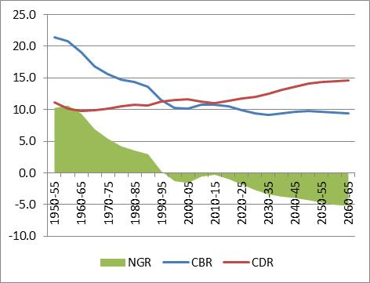
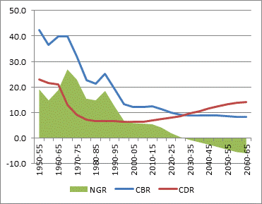
Europe and China – Crude birth rate, crude death rate and natural rate of growth; 1950-2070
Europe
China

Slide 8
China - Average yearly number of births, deaths and natural balance (thousand)

Slide 9
Europe and China; total population; absolute value, absolute change and percentage change in relevant periods; 1950-2100

Slide 10
China: Population by main age group (absolute values in million and percentage composition)
From 1950 to 2015 the number of people 65 and plus has increased five-fold and the percentage on total population from 4.4% to 9.7%. In the following 35 years the number of elderly will increase from 135 to 360 million and their percentage over total population will reach 26.1%. At the same time, those 80 and above will become almost one third of the elderly.
Source: UN DESA, 2017
Notes:
10

Slide 11
China: Population by main age group: yearly absolute change in million and yearly percentage change
Between 2015 and 2030 total population will increase (+ 3.3 million per year) as a balance between, on the one hand, a decline by 1.6 million young and 2.5 million people in working age and, on the on the other hand, an increase by 7.4 million of the elderly. In the following 20 years the increase of the elderly (4.5 million) will not be sufficient to offset the decline of the young (-1.2 million) and of working age population ( -6.1 million).
Source: UN DESA, 2017
Notes:
11

Slide 12
1.3 China: Ageing Process / 1
To better appreciate the speed of the Chinese ageing process, the following slide compares China with 14 other big countries as to the percentage of people 65 and older in 2015, 2030, 2060 and 2100. The countries are classified into three groups: those where the percentage of the elderly is below 15%, those where it is between 15% and 30%, and those where it is above 30%.
In 2015 in China the percentage of elderly was still below 10%, a situation shared not only by the 6 poorest countries in the sample, but also by Russia and the USA (both above 10%). The remaining 6 countries include Japan where more than 1/4 of the population was already above 64, and 5 EU countries.
With time the percentage of elderly tends to increase in all 15 countries, but the progression of China stands out for its rapidity.
By 2060 China will have broken the 30% mark together with Spain, Italy and the UK.
Notes:
12

Slide 13
Selected countries; percentage of people 65 and above; 2015, 2030, 2060, 2100

Slide 14
Demographic indicators of socioeconomic burden; 1950-2100
The indicators most commonly used are strictly demographic in nature.
The Old age dependency ratio (OADR) is computed dividing the number of elderly by the number of people in working age.
The ratio between the number of youth (normally 0-14) and the number of people in working age (the Young age dependency ratio, YADR) provides a measure of the socioeconomic burden represented by the children.
The sum of the two indicators gives the Total age dependency ratio (TADR), which is normally taken as a measure of the socioeconomic burden of a country

Slide 15
The limits of the demographic indicators of socioeconomic dependency (1)
Only one part of the people in working age , sometimes less than 60%, has a formal job;
The duration of the training phase of life has greatly increased, and in developed countries the average age of entry in the working phase of life is above 20, while in many developing countries numerous children start working before becoming 15;
In some countries the retirement age is below 64as (China is one of them)
Differences in the education system, economic and social development, productive specialization and technologies create different percentages of students, housewives and unemployed in different countries.
In conclusion at present the people in the 15-64 age group do not represent those that maintain, while those in the 0-14 and 15-64 age groups do not represent the sustained and therefore

Slide 16
The limits of the demographic indicators of socioeconomic dependency (2)
In conclusion the demographic indicators are not a good measure of socioeconomic dependency
Moreover:
The differences in the age of entries and exits make cross section analyses highly misleading;
While the increase in life duration and in the training phase of life will bring, in not too far a future, to raise retirement age, and to modify the definition of working age first to 20-70 and then to 25-74; this will make extremely difficult to make inter-temporal comparisons.

Slide 17
TEDI: an economic indicator of socioeconomic dependency (1)
The problems we have just outlined can be easily solved by substituting Employment to WAP.
Adopting this approach, the Total economic dependency indicator (TEDI) is computed by dividing the total number of dependents by the number of employed, in substance the number of those that do not work by those that have a job.
TEDI tells us how many people are sustained, in a given area or in a given country by, 1,000 workers.

Slide 18
TEDI: an economic indicator of socioeconomic dependency (2)
The economic indicators allows:
Estimating the structural burden by a larger number of typologies of dependents: students, non-labour force in working age, unemployed, retired, etc.;
Verify in which measure the changes in the structural burden are due, on the one hand, to demographic tendencies and, on the other, to the capacity (or lack of capacity) of the economic system to generate additional employment;
Estimate the growth of employment, and therefore of production, needed to obtain a given level of structural burden.

Slide 19
EU - Total and specific rates of economic dependecny
TEDI
Shares of specific rates

Slide 20
EU
From 1991 to 2015 the number of dependents for 1,000 workers has been, equal, on the average, to 1,334, but notable variations have been registered.
TEDI reached a maximum value of 1,450 in 1994, then progressively declined during the long expansionary phase that lasted till 2008 when registered a minimum of 1,216. During the financial crisis TEDI increased again reaching a new maximum in 2013 when a new phase of decline came in. In 2015 it was equal to 1,274.
TEDI presents a long term negative trend, that is the socioeconomic burden has been progressively declining in spite of the growth in total population;
It is characterized by short term oscillation which are explained by the economic cycle; it increases in period of crisis, declines in period of growth;
Is characterized by a progressive decline of the share of the young, a progressive growth of the share of elderly, while the share of the dependents in working age has been substantially constant and remains the most relevant group.

Slide 21
China - Total rates of economic dependency and its determinants
In the 1995-2015 period, TEDI registered an average value of 761, the single values being included in a very small interval: in 1995, 1,000 employed sustained 779 dependents that declined to 750 in 2004 to then climb back to 775.
• The RoG of TP and EMP have been declining;
• Between 1995 and 2004 AYrGE>AYrGP
• Βetween 2004 and 2015 AYrGE<AYrGP

Slide 22
China -Urban Areas; Total rates of economic dependency and its determinants
The values of urban TEDY are much higher than those of the country as a whole, the average over the 1995 to 2015 period being equal to 940. Moreover this indicator presents a wider range and opposite trends, increasing from an initial value of 847 to a maximum of 997 in 2003 to then decline to 908 in 2015.

Slide 23
Economic indicators; scenarios

