Slide 1
Paving the way to inclusive growth in the EU
Barbara Kauffmann
Director of Employment and Social Governance
European Commission,
DG Employment and Social Affairs
15 September, 2017
EU-China Policy Dialogue

Slide 2
Paving the way to inclusive growth
in the EU
Outline of the presentation
Recent developments and challenges for the future
Social security as part of the policy mix
Instruments and tools at European level

Slide 3
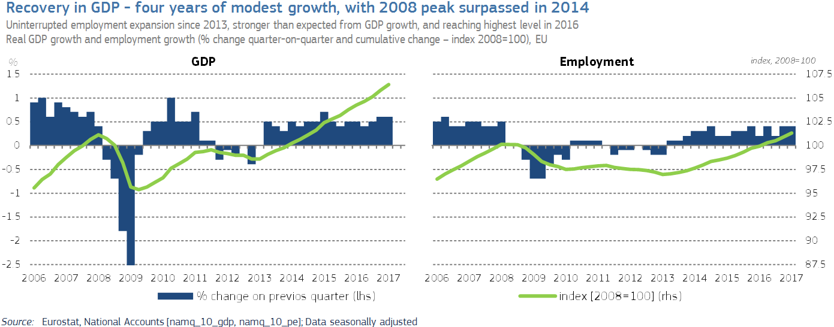
Economic and employment growth: recovery started in mid-2013
Recent developments Future challenges
Notes:
General context: Today, the European Union is finally, firmly on the path to recovery, both in terms of GDP and employment.
Note however that there remain large differences between countries, and promoting renewed convergence remains a challenge.
In 2016, the employment rate of the population aged 20 to 64 stood at 56,2%, whereas in Sweden this was 81,2% (note, 78,6% in Germany)

Slide 4
Employment rates are lower for specific categories
Recent developments Future challenges
Source: Eurostat, Labour Force Survey
Notes:
Moreover, in most Member States, certain groups of the population have lower employment rates.
Despite major increases over recent decades, the employment rates of women remains below those of men.
At EU28 level, the gap in 2016 remains at more than 10 percentage points (65,3% versus 76,8%).
Among the population aged 55 to 64, emplloyment rates have increased, partly due to increased participation of women.
Still, in light of the upcoming demographic challenges, more needs to be done here.
Among younger workers, labour force participation has to some extent decrased due to postponed entry on the labour market (higher educational attainment).
But the crisis also brought major increases in youth unemployment.
Whereas EU mobile workers tend to have high employment rates, even slightly higher than the native population, those born outside the EU tend to have lower employment rates.
Moreover, workers who have not obtained a degree of secondary education are finding it increasingly difficult on the labour market.
Employment as % of population
Unless specified otherwise:
Sex = total
Age = 20-64
Country of birth = Total
Educational attainment = Total

Slide 5
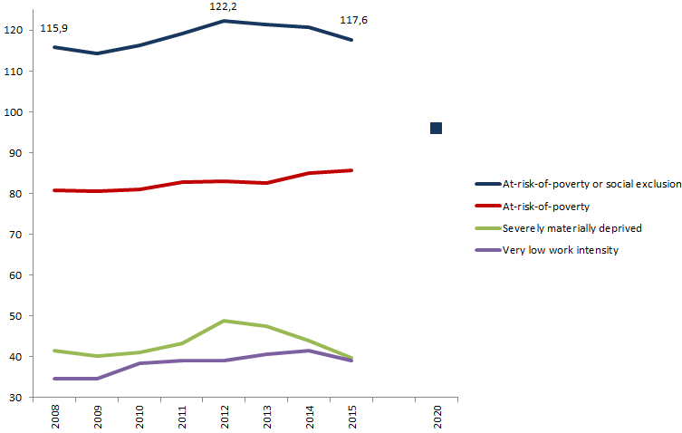
People at-risk-of-poverty or social exclusion (EU27, million)
Recent developments Future challenges
EU2020 target
Notes:
In terms of inclusion, we have seen a deterioration over the crisis period (away from the EU2020 target) of reducing AROPE by 20 million, by 2020
There has been an improvement in the economic recovery (which further underlines the link of growth and inclusion). Still, much work remains to be done.
There are large differences between countries (AROPE in 2015 at over 40% in BG and over 35% in RO; below 15% in CZ and 16% in SE)
Specific groups are at higher risk in most countries: children, migrants not born in the EU, Roma, those with low educational attainment.

Slide 6
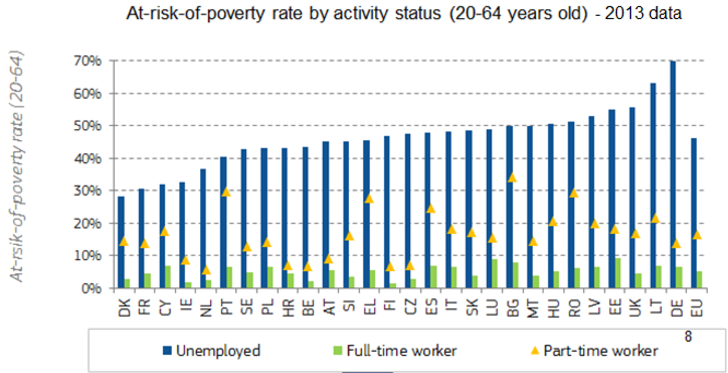
The unemployed are at higher risk of poverty than workers
Recent developments Future challenges
Notes:
The importance of a comprehensive approach can also be shown by income position of different groups in the labour market.
In all Member States, the unemployed face a substantial risk of poverty (despite them in many cases having access to income replacements benefits), whereas full-time work protects well.
Note that the poverty risk for part-time workers tend to be higher than for full-time (with some differences across the Member States).
Given the fact that part-time workers are still predominantly women, there is an important gender aspect to this finding.

Slide 7
Inequality (before and after taxes and transfers)
Recent developments Future challenges

Slide 8
Welfare policies can have a powerful impact on reducing inequalities if well targeted
Social security in the policy mix
Notes:
European countries spend a large part of their GDP on social benefits, even when we exclude pensions (as shown on this chart).
These benefits also have a major impact in reducing income inequalities.
Left axis = Reduction in income inequality (gini) due to social benefits (exlcuding pensions)
Right axis = Expenditure on social benefits (excl pensions) as % of GDP
From Reflection Paper on the Social Dimension of Europe (but corrected social spending for FR, which was 7,5% in the paper, instead of 17,5%)

Slide 9
Orientation of social protection expenditure
Social security in the policy mix
 | Orientation skewed
Towards… | Very positively (+) | Very negatively (-)
Pensions | MT, CY, NL | DE, IE
Health | IE, HR
Family | AT, BE, LU | IT, NL
Unemployment | AT, BG, DE, DK, EE, HU, LT, LU
Social exclusion and housing | CY, LT, NL, UK | AT, IT
Notes:
The orientation of social expenditure differs a lot – corrected for demographic and unemployment structures.
A number of MSs have a a strong positive orientation on some functions (right column)
Some (less often) have a negative orientation (they spend relatively less)
Question : more effective / better performance ?

Slide 10
EU rules on social security coordination
Social security in the policy mix
Regulation EC (No) 883/2004
Regulation EC (No) 987/2009
Coordination and not harmonisation – linking
statutory social security systems of 32 countries
Electronic Exchange of Social Security Information (EESSI)
An IT system that will help social security bodies across the EU exchange information more rapidly and securely.
A key innovation of the modernised rules on social security coordination (Regulations (EC) No 883/2004 and No 987/2009) applicable since 1st of May 2010.
Will cover all branches of social security, and it will connect all EU Member States, as well as Iceland, Lichtenstein, Norway and Switzerland.
Over 14 million EU citizens living in another Member State, all insured persons potential beneficiaries of social security coordination rules
Notes:
The EU provides common rules to protect social security rights of EU citizens and their family members when moving within Europe (EU 28 + Iceland, Liechtenstein, Norway and Switzerland).
The rules on social security coordination do not replace national systems with a single European one. All countries are free to decide who is to be insured under their legislation, which benefits are granted and under what conditions.
These rules apply to:
Nationals of the EU, Iceland, Liechtenstein, Norway or Switzerland who are or have been insured in one of these countries, and their family members.
Stateless persons and internationally recognised refugees residing in the EU, Iceland, Liechtenstein, Norway or Switzerland, who are or have been insured in one of these countries, and their family members.
Other Nationals of non-EU countries, by way of an extending Regulation (Reg. 1231/2010), if they are legally residing in the territory of the EU and have moved within the EU.

Slide 11
Instruments and tools
European Pillar of Social Rights
Social dialogue
Funding
Civil Society
European Semester
Notes:
Setting minimum standards and providing policy guidance: e.g. Directives on Working Time
Most of the tools to deliver on social Europe are in the hands of Member States and of social partners.
The EU sets a framework and supports
Minimum standards and policy guidance
Policy coordination: European Semester
Funding: European Social Fund; YEI; etc
Social dialogue
and Temporary Agency Work; Recommendations: on Youth Guarantee and Long-Term Unemployed

Slide 12
Instruments and tools
What is the European Pillar of Social Rights?
20 principles and rights
Equal opportunities and access to the labour market
Education, training and life-long learning
Gender equality
Equal opportunities
Active support to employment
Secure and adaptable employment
Fair working conditions
Wages
Information about employment conditions and protection in case of dismissals
Social dialogue and involvement of workers
Work-life balance
Healthy, safe and well-adapted work environment
Adequate and sustainable social protection
Childcare and support to children
Social Protection
Unemployment benefits
Old age income and pensions
Minimum income
Health care
Inclusion of people with disabilities
Long-term care
Housing and assistance for the homeless
Access to essential services
Notes:
The European Pillar of Social Rights is a compass toward renewed convergence

Slide 13
Instruments and tools
First initiatives
Proposal on Work-Life Balance:
Directive + policy measures (Paternity, parental and carer's leave, flexible working arrangements and dismissal protection/anti discrimination)
Initiative on Access to Social Protection:
Social partners' consultation (How to provide as many people as possible with social security coverage?)
Changes to Written Statement Directive:
Social partners' consultation on the Written Statement Directive (91/533/EEC) (Better information for workers; opportunity to poen a debate on minimum safeguards in very flexible and/or precarious jobs)
Communication on Working Time Directive:
Legal guidance on Directive 2003/88/EC (greater certainty and clarity; better apply the Directive's provisions; effective enforcement; better protection of workers' health and safety)
Notes:
Currently building support at the highest political level (interinstitutional declaration)
Role of social partners (ongoing social partner consultaton on access to social protection)

Slide 14
Instruments and tools
EU funds: supporting inclusive growth
European Social Fund : assisting every year more than 10 million people across the EU to upgrade their skills, facilitate labour market integration and combat social, focusing increasingly on systemic reforms, in a social investment approach.
Youth Employment Initiative: supporting more than 1.4 million young people in traineeships, apprenticeships or job placement.
European Globalisation Adjustment Fund
Employment and Social Innovation programme (EaSI)
Fund for European Aid to the Most Deprived (FEAD)
Erasmus: support to over 9 million young Europeans over past 30 years

Slide 15
Social Investment Principle: The earlier you invest in people, the higher the returns, while there are returns on investments throughout life-cycle
Source: Heckman (2008)
Notes:
The chart above is taken from a 2008 study by James Heckman assessing the return of a unit dollar invested at different ages of the lifecourse, assuming $1 is initially invested at each age. The chart shows that the earlier you begin to invest (starting with programmes targeted towards the earliest years) the greater the returns. That being said, investment later in the lifecourse, such as job and skill training, or in enabling people who have long-term care needs to participate through self-caring still brings significant rates of return, though somewhat lower.

Slide 16
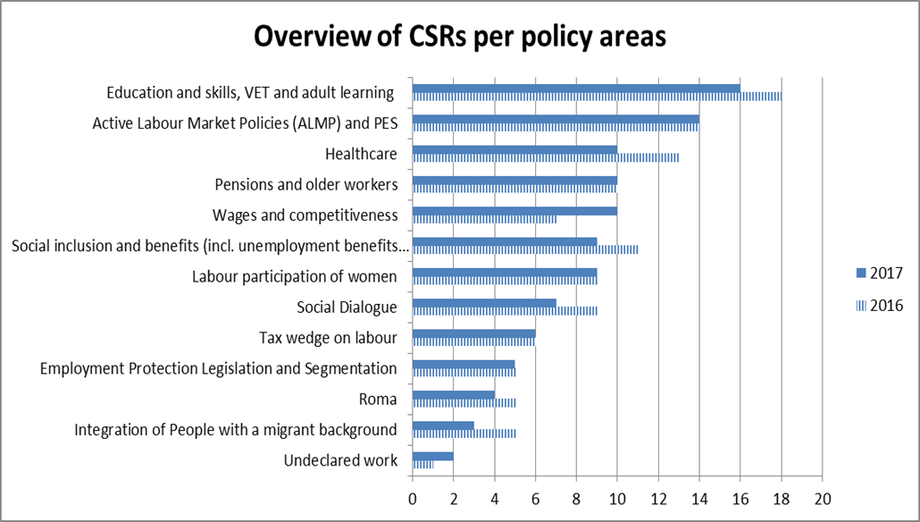
Instruments and tools
2017 Country Specific Recommendations

