Slide 1
Parametric Reforms in Germany
By
Prof. Dr. Heinz-Dietrich Steinmeyer
Beijing 29 August 2017
德国养老金参数改革
施坦梅尔·海因茨-迪特里希 教授
2017年8月29日

Slide 2
Introduction 简介
Long established pension system consisting of three tiers (or layers):
长期养老金制度共分为三层：
public insurance pension, 公共保险养老金，
supplementary pensions – usually provided by the employer,
补充养老金 - 通常由雇主提供，
personal savings。 个人存款。
Public system: 公共系统：
PAYG as of 1957 自1957年起的现收现付制
Replacement Rate aimed at about 60 % 替代率达到约60％
financed by contributions 通过缴费筹资
currently 18.7 % of income to be shared between
employer and employee by 50 % each
目前占收入的18.7 % ，雇主和雇员各负责50 %
plus state subsidies of about 75 Billion € per year.
加上国家每年补贴约75亿欧元。
Total expenditures 300 billion € per year (2017).
总支出每年3000亿欧元（2017年）。

Slide 3
Main Characteristics 主要特征
Covered by the system are 该制度包含：
all workers gainfully employed as well as
certain self-employed.
所有有偿雇佣工人，还包括一些个体经营（自雇）者。
Not covered by this system are public
officials who are covered by a special
retirement system.
政府官员不在此制度内，而在另一专门退休制度中。
The system provides benefits for 该制度提供福利给：
old age 老年人员
partial and full invalidity 残障人员
death. 亡故人员
rehabilitation measures 康复措施

Slide 4
Main Characteristics 主要特征
Retirement age currently (2017) 65 years and 6 months. 当前退休年龄（2017年）65岁6个月
Qualifying period of at least 5 years of contribution
至少5年的缴费期
Calculation of benefits is contribution-based
基于缴费基础的福利计算方式
Subject to contributions are only the first 6.350 € of monthly gross income (upper earnings threshold)
只有每月总收入的6350欧元部分，才作为缴费基础（此为收入门槛）
The benefit formula is aimed to provide a pension in relation to income from work during the working career
福利公式旨在为在整个工作生涯中的工作收入计算养老金
Actuarial factor in case of early retirement
提前退休情况中的精算因素
Benefits taxable as income and contributions tax-deductible
利润纳税收入和缴费免税

Slide 5
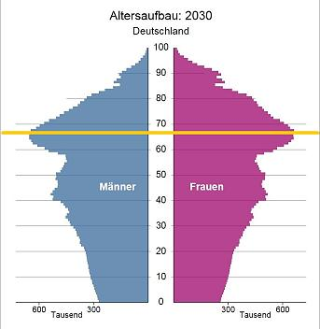
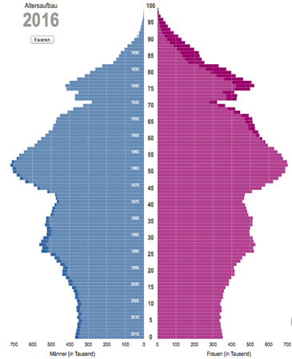
Reforms 改革

Slide 6
Reforms 改革
Main Issue – demographics and financing
主要问题 - 人口和筹资
Higher contributions or tax subsidies
– no choice
更高的缴费或税收补贴
- 没有选择
Major reform in 2001
2001 年重大改革
Need to cut benefits by amending the
benefit formula (indexing)
通过修改福利公式（索引）来削减福利
compensated by a voluntary private
system (Riester pension)
私人自愿补偿
制度（李斯特养老金）

Slide 7
Reforms 改革
Reform in 2005 as a kind of follow-up of the reform of 2001 2005年改革是2001年改革的后续
Act on Sustainability of Public Pension
Insurance introduced sustainability factor
which shares the demographic risk
between retirees and workers.
《公共养老保险可持续性法案》引入了可持续发展因素，分担了退休人员与员工之间的人口风险。
kind of cutting benefits
削减福利
Self-stabilizing effect 自稳定效应
works “automatically” “自动”
Non-controversial 无争议
Such a stabilizing measure was necessary.
这种稳定措施是必要的。
But: replacement rate decreased further.
但是，替代率进一步下降。

Slide 8
Reforms 改革
Reform in 2006 on Taxation Rules due to a decision of Federal Constitutional Court
根据德国联邦宪法法院的决定，2006年对税收制度进行了改革
Also harmonized the German taxation rules substantially with the taxation rules of most other countries which in general make expenses for pensions tax deductible and tax pensions after retirement as income
此外，还参照其他国家的税收制度对德国的税收制度进行调整，这些国家大多将养老金的免税额和退休后的养老金作为收入。

Slide 9
Reforms 改革
Reform in 2007
2007年的改革
Act on Adjustment of Retirement Age raised the normal retirement age from 65 to 67.
通过退休年龄调整法规将退休年龄由65岁提高至67岁。
With transition period – finally at 67 in 2030
过渡时期——到2030年达到67岁
Move has been highly controversial – not among the experts – who had discussed and proposed it already for a long time - but in the general public
这一举动引起了很大的争议——并不是在专家中——因为他们已经讨论并倡议了很长一段时间——而是在普通民众中
In the end means higher actuarial reduction when retiring early
这最终意味着提前退休的更高的精算减少了。

Slide 10
Reforms 改革
In 2014 a reform (?) with additional expenses – a step back?
2014年的改革（？）包含额外的开支——一种倒退？
Dealt with the so-called Mütterrente
处理所谓的Mütterrente
same number of pension credits for
children for births before 1992 as
already for births after that date
在1992年之前出生的孩子享受的养老金额度和1992年后出生的孩子持平
Controversial and problematic
争议和问题
Introduction of early retirement at age
63 without actuarial reductions
在63岁时提前退休，没有精算减免
Limited to certain age cohorts and
requires additional conditions to be met.
限于一定年龄的人群，需要满足更多的条件。

Slide 11
Reforms 改革
Reforms in 2016/17
2016-2017年的改革
Act on a more flexible transition to retirement and on prevention and rehabilitation
更灵活的退休政策法案以及预防和康复法案
also enables to work longer and part-
time parallel to receiving pension
也可以延长工作时间和兼职的方式来领取养老金
may also increase pension by working
longer
也可以通过延长工作时间增加养老金
A very recent reform will finally unify the rules for pensions between East Germany and West Germany
最近的这次改革将最终统一东德和西德之间的养老金规则

Slide 12
Conclusion 结论
Parameters 参数
Contributions and Tax Money 缴费和税金
Cutting benefits 削减福利
Retirement Age 退休年龄
no higher contributions or additional tax money
没有更高的缴费或额外的税金
But 但是
amendments to the benefit formula 对福利公式的修正
(sustainability factor)（可持续性的因素）
increasing retirement age （延长退休年龄）
compensating the losses by private provisions
用私人补贴补偿损失
Neveretheless –lower replacement rate and lower
income in old age
此外——低替代率和老年低收入

Slide 13
Conclusion 结论
Public pension insurance can no longer be the only source of income in old age
公共养老保险不再是老年人唯一的收入来源
Therefore Germany just recently considerably improved the system of supplementary – occupational – pensions and tries to improve coverage also among employees of small and medium-sized companies.
因此，德国最近在很大程度上改进了补充职业-养老金制度，并设法扩大中小企业雇员的保险范围。
In addition people are advised to save for retirement themselves.
此外，应对退休问题，建议人们自己也要储存积蓄。

