Slide 1
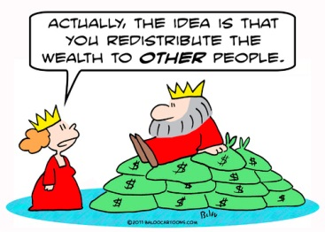
Social Security and Income Redistribution
Dr. Koen Vleminckx

Slide 2
Primary Objectives of Social Protection
Maintaining the acquired living standard in the event of the materialization of social risks
Combat poverty by guaranteering adequate minimum incomes
More recently: Active inclusion: prevention & reintegration
Reduction of inequality is not an explicit objective
Objectives can conflict

Slide 3
Social Protection and Inequality
Social Protection, throught the collection of contributions and spending on social insurance benefits, is arguably the most important tool that we have at our disposal for redistributing income.

Slide 4
Social Insurance and horizontal redistribution
Social insurance redistributes mainly horizontally:
From the young to the old
From the healthy to the sick and disabled
From those in employment to the unemployed
From families without children to those with children
…
Redistribution is from that perspective a side-effect

Slide 5
Redistribution as a side effect
Redistribution through social insurance depends to a large extent on the association between the insured risks and income (or a proxy such skill) :
Unemployement risk is higher for low-skilled people
Health risks are higher among low-skilled people
High-skilled people on average live longer
…

Slide 6
Social insurance and vertical redistribution
Many social insurance schemes have inbuild elements that promote vertical redistribution from high-income to low(er) income groups and individuals
Explicit: Minimum and maximum benefits (especially when no maximum contribution rate)
Implicit: corrections for household composition
Benefit targeting
Partial claw-back through taks system

Slide 7
Social insurance and vertical redistribution
Many social insurance schemes have inbuild elements that promote vertical redistribution from high-income to low(er) income groups and individuals
Explicit: Minimum and maximum benefits (especially when no maximum contribution rate)
Implicit: corrections for household composition
Benefit targeting
Partial claw-back through tax system
Safety net provisions (social assistance)

Slide 8
Experience from Europe
The level of social spending is important for the capacity of the social protecion system to achieve a stronger redistributive impact, both with regard to the prevention of poverty (AROP) as with regard to the reduction of income inequality (Gini)

Slide 9
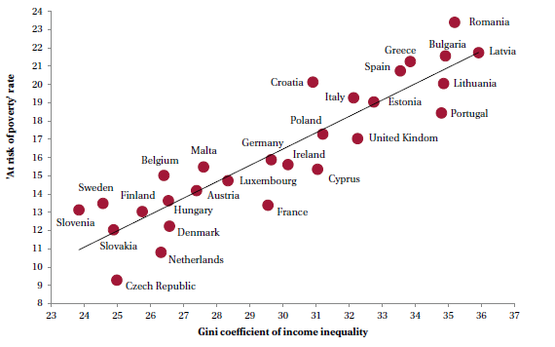

Slide 10
Experience from Europe
The level of social spending is important for the capacity of the social protecion system to achieve a stronger redistributive impact, both with regard to the prevention of poverty (AROP) as with regard to the reduction of income inequality (Gini)
But the design and structure of the social protection programmes is also important: some countries achieve stronger redistributive impact with similar levels of social spending

Slide 11
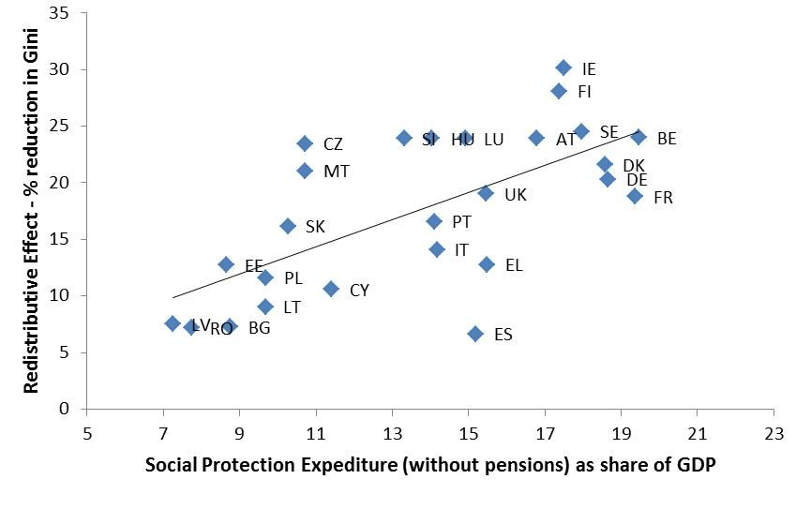

Slide 12
